Slide 1
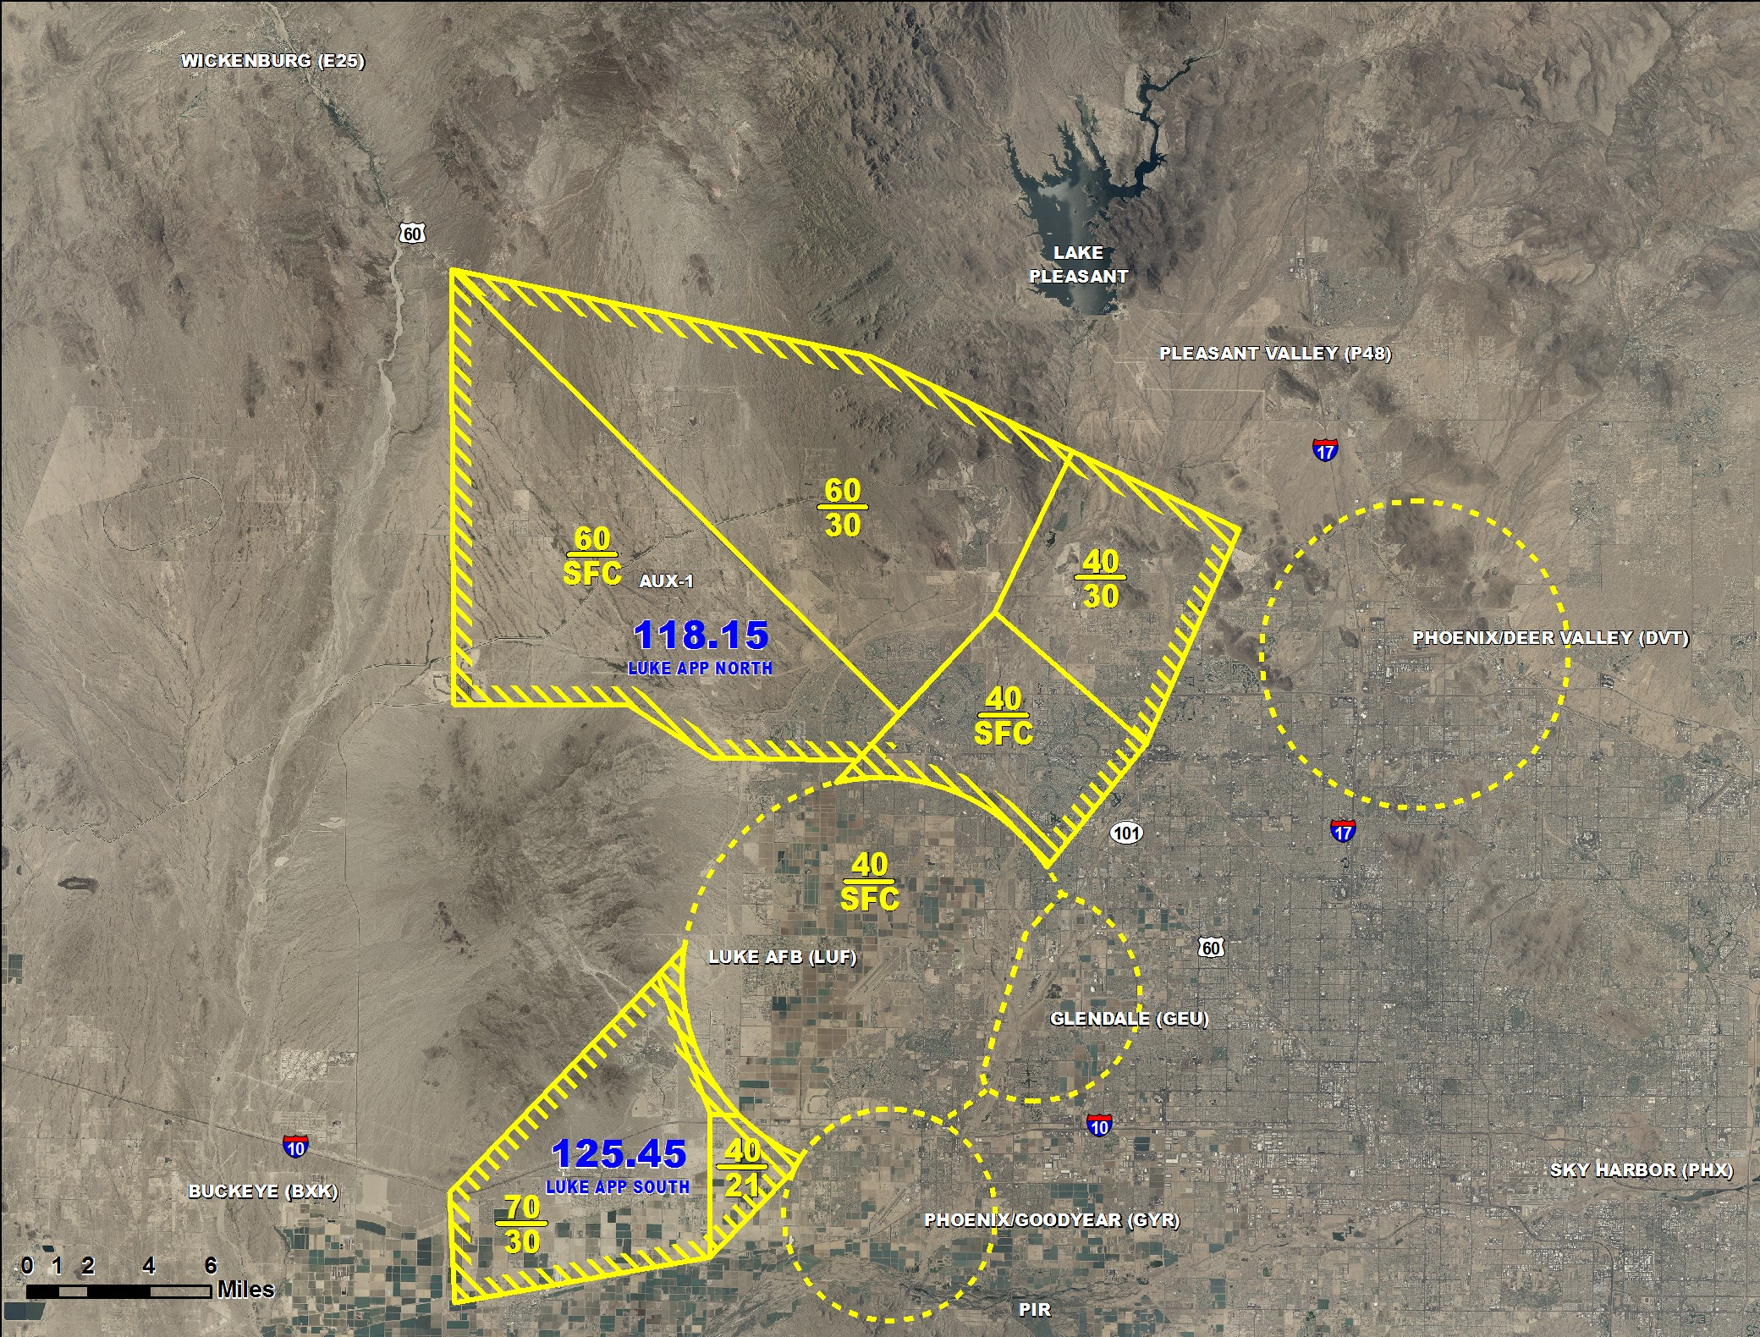
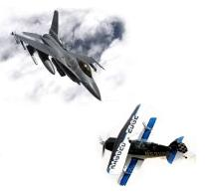
FAA Special Air Traffic Rule
Mandatory!!
2-Way Radio Communication
w/ Luke AFB Approach
Not for Navigation

Slide 2
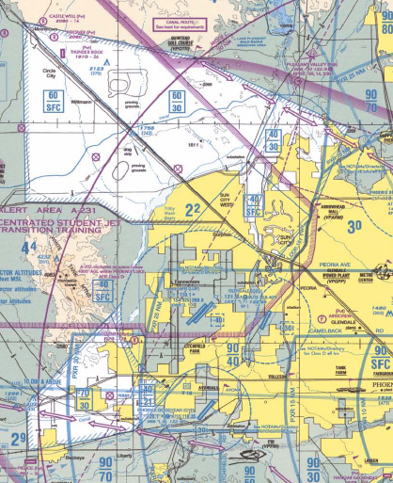
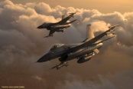
FAA Special Air Traffic Rule
Mandatory 2-Way Radio Comm with Luke Approach
Carefree Hwy
and
US 60
Quintero Golf Course
US 60
At
Del Web Hospital
E/W Canal
And
Agua Fria
Sun Valley Pkwy
And NW ridge of
White Tanks Mt
118.15
2269’ Peak
Power Plant
Substation
Sun Valley Pkwy
And NE Ridge
White Tanks Mt
Loop 101
West of
Arrow Head Mall
Sun Valley Pkwy
Bend and
Bell Road
2NM SW US 60
And
Loop 303
Jackrabbit Trail
And
I10
SE point of
White Tanks Mt
Sarival Ave
And
I10
I10
And
SR85
Jackrabbit trail
And
R/R Tracks
R/R Tracks
And
SR 85
125.45
Luke AFB Flight Safety
623 856 6942
www.luke.af.mil/library/midaircollisionavoidance.asp

