Slide 1
Topic of the Month July
Transition Training
<Audience>
<Presenter>
< >
Notes:
2016/02/22-083 (I) PP Original Author: Jay Mason (10/04/2015); POC Kevin Clover AFS-850 AFS-850 Operations Lead, Office 562-888-2020;
Presentation Note: This is the title slide for (Advanced Preflight After Maintenance)
Presentation notes (stage direction and presentation suggestions) will be preceded by a Bold header: the notes themselves will be in Italic fonts.
Program control instructions will be in bold fonts and look like this: (Click) for building information within a slide; or this: (Next Slide) for slide advance.
Some slides may contain background information that supports the concepts presented in the program.
Background information will always appear last and will be preceded by a bold Background: identification.
We have included a script of suggested dialog with each slide. Presenters may read the script or modify it to suit their own presentation style.
The production team hope you and your audience will enjoy the show. Break a leg!
(Next Slide)

Slide 3
Welcome
Exits
Restrooms
Emergency Evacuation
Breaks
Sponsor Acknowledgment
Other information
Notes:
Presentation Note: Here’s where you can discuss venue logistics, acknowledge sponsors, and deliver other information you want your audience to know in the beginning.
You can add slides after this one to fit your situation.
(Next Slide)

Slide 4
Overview
A Case Study
Publications that detail items unique to makes and models help determine areas for training
Use a published syllabus for transition training, or create your own
Use a CFI who has extensive experience in make and model
Another Case Study
Notes:
In this presentation we’ll first look at an unfortunately very common accident in Beechcraft single and multi-engine aircraft: retracting the landing gear after landing or, even worse, while rolling out on the runway. All Beechcraft models prior to 1984 have the position of their flap and landing gear switches reversed from almost all other complex aircraft types. Pilots sometimes inadvertently retract the landing gear when they have recently (or not so recently!) transitioned from other models when they think they are retracting the flaps.
We’ll also look at a great way to get good, thorough transition training: find a published syllabus specific to make and model. These are often available through type clubs, or online. Worst case, you can create your own with a knowledgeable CFI and a thorough study of the POH/AFM.
To that end, you MUST find a CFI who has experience in the specific airplane. As you may know, even a ‘simple’ airplane like a Cessna 172 has many variations over the years of its manufacture, which require knowledge and study.
And finally, we’ll look at another accident, this time a Cessna U206, in which knowledge of a fairly obscure system would have prevented the problem.
(Next Slide)

Slide 5
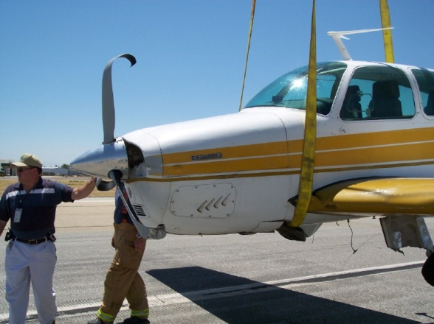
BEECH F33A N2306M 09/12/82
Reid-Hillview, CA (KRHV)
Turning off runway onto taxiway
Nose gear and right main gear collapsed.
NO mechanical malfunction
Investigation reveals that PIC is accustomed to flying other aircraft in which the flap and landing gear controls are the REVERSE of the F33A.
Prior to 1984 models, most Beechcraft models have the flap and landing gear switches REVERSED compared to other complex aircraft AND later Beech models.
Notes:
Here is a link to the AOPA Safety Report for this incident:
http://bonanza.org/documents/AOPA%20ASF%20Bonanza%20Debonair%20Safety%20Review%20(compressed).pdf
Scroll to page 2-23B
As stated previously, this is a common scenario in Beechcraft aircraft. In fact, Beechcraft piston aircraft manufactured AFTER 1983 (1984 models or newer) have THEIR flap and landing gear controls in the ‘NORMAL’ orientation. Pilots who fly BOTH older and new Beechcraft models (instructors, for example) need to have proper training on this and many other issues. While this is pretty much isolated to these Beech products, other aircraft types have issues with other systems, flying characteristics, and so on.
Topic for discussion: can you think of an issue that is specific to the make and model of aircraft that you are most comfortable in? How would you advise or instruct a pilot new to your type/model about this issue? Under what scenarios or flight regimes does this issue present a problem to flying that aircraft safely?
(Next Slide)

Slide 6
AOPA Safety Review Books are available for many models that should require Transition Training for ANY pilot.
The previous case study is cited in the Safety Review for Beech Bonanzas and Debonairs from AOPA.
This document alone mentions eight cases where pilots inadvertently retracted the landing gear on the ground.
This is a common issue, well known to flight instructors and insurance adjusters familiar with this type.
These kinds of recurring mistakes are required areas to cover for transition training in all makes and models. Another common example: pilots often forget to account for the Cessna 182’s forward CG when only the front seats are occupied-resulting in damage to firewalls in this model.
Notes:
Now, let’s switch the focus to Cessna transition training issues. The Cessna 182, and several other Cessna models, tend to have a forward CG when loaded with a pilot and front-seat passenger. The CG can possibly be beyond the forward limit. This results in publications like the Aviation Consumer Pilot Guide suggesting that buyers looking at C182’s should check for engine firewall damage from landing hard on the nose gear. This is an issue that should be covered when transitioning to this model.
Further, some Cessna models were built without the ‘BOTH’ position on the fuel selector, and then later versions of the same model were built WITH that position.
Question for discussion: how well do you know the weight and balance characteristics of the type and model you fly? What happens as fuel is burned off during a cross country flight to the handling of your airplane? Where can you get that information if you don’t know?
(Next Slide)

Slide 7
Type Clubs, Type Forums, and Pilot Reports are additional sources for study.
Type Clubs often have websites, monthly publications, and downloads with items to be covered when new to an aircraft.
There are forums and blogs for many types
Owners, mechanics, and
CFI’s experienced with these aircraft contribute to these resources
Contact info for CFI’s familiar with your new type is usually available through these resources and will make for a more thorough AND usually quicker transition.
Notes:
For most manufacturers, and some types, a quick search of the internet will lead you to a type club, and/or forums for them. Three are shown above, but a search turned up type clubs for the following, less common aircraft:
Aerostar Owners Association
American Navion Society
Cardinal Flyers Online
Ercoupe Owner’s Club
Lake Amphibian Flyer’s Club
Short Wing Piper Club
Twin Commander Flight Group
To name just a few (!!!). Further searching reveals that all of these clubs except the Navion Society list forums online. Several also have formal lists of CFI’s who are members who have extensive experience in the type. Even if you are just going to rent an aircraft of the type, it will be to you and your passenger’s benefit to become familiar with more than just a basic checkout-learn about the maintenance issues for the type too.
For group discussion: what are some common things that are critical and unique to your aircraft type preflight? Why?
(Next Slide)

Slide 8
Try to find a transition training syllabus for your aircraft!
Some Type Clubs publish these syllabi for their members to use. Couple these with a CFI familiar with the type.
The General Aviation Manufacturer’s Assn. (GAMA) offers a Master Transition Training Syllabus online.
Advisory Circular 90-109, Airmen Transition to Experimental or Unfamiliar Airplanes http://1.usa.gov/1czQN5E •
Airplane Flying Handbook (FAA-H-8083-3A), chapters 11 to 15 http://1.usa.gov/18orxyp •
FAA Safety Briefing, March/April 2014 issue http://1.usa.gov/FAA_ASB
Notes:
Think about the airplane(s) you most often fly. Can you easily determine that the safety wire used to secure the oil filter is in place? If so, did you check it? This is not on most preflight checklists, unless the PIC adds it. After the oil filter has been changed, you MUST check this, to cite one of many examples. If you fly long enough, you’ll see one that wasn’t installed, or worse, installed improperly (this IS a permitted task for an owner to perform , per FAR 43) and has now broken or come loose.
What are some other items that would require special checking after, for example, an annual inspection? Here are a few ideas beyond flight controls, trim tabs, and oil:
-Propellers
-Spinners, especially hardware
-Inspection covers
-Tire inflation, especially if new tire(s) installed
-Fuel caps in place
To name a few. What are some others??
(Next Slide)

Slide 9
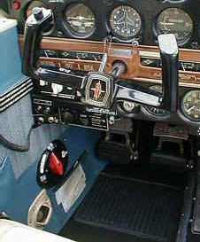
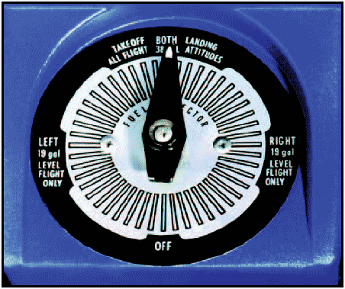
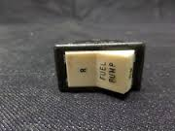
Even ‘simple’ aircraft have Differences…
Many pilots have transitioned from Cessna fixed-gear singles to Piper fixed-gear singles. Ask yourself what differences should be covered in transition training for these types?
Example: Piper singles have an electric standby fuel pump, most fixed-gear Cessnas do not.
Example: Cessna pilots need to understand that Piper aircraft do not have a ‘BOTH’ position on their fuel selectors.
Notes:
As previously mentioned, you should talk to your mechanic after maintenance has been performed and the aircraft approved for return to service. However, a check of the logbooks should give you a detailed, item-by-item list of work that was performed, along with parts replaced and so on. This can provide guidance as to how to proceed with your enhanced preflight inspection!!
(Next Slide)

Slide 10
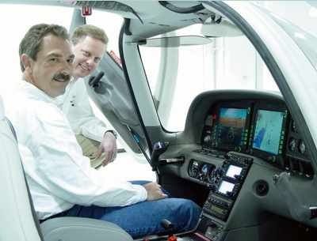
Do your transition training with an Instructor who KNOWS the type.
Again, type clubs and online forums are great sources for CFI’s who are recognized experts on the aircraft you are transitioning into. Another source: aircraft mechanics!!
Such training should include not only operational differences, ‘knobology’ and so on, but also knowing what things to look for during preflight and postflight, even if you’re renting. An ideal instructor has time both in the type you’ve been flying, and the new type, so they can help you efficiently learn the differences.
Notes:
It’s helpful not only to thoroughly learn your new aircraft type during transition training, but also how it differs from previous types you’ve been comfortable with. An example: all aircraft fuel tanks require some form of venting. The location and type of vents are quite different between, say, a Cessna 182 RG and a Beechcraft V35A. In fact, the fuel cap types and how they are secured are quite different between those two.
Aftermarket modifications can also cause confusion, even for CFI’s who are checking you out in a model they are quite familiar with. Things like tip tanks, engine modifications, propeller modifications, and so on all must be understood thoroughly to not only operate your aircraft safely, but also to operate it efficiently. And it goes without saying that anything unfamiliar must be discussed and trained with until its understood how that item is handled in the event of an emergency.
(Next Slide)

Slide 11
Not all V Tails, 182’s, and M20’s are the same!
Even if you have experience in ‘make and model’, year-to-year there are many differences between things like fuel systems, handling characteristics, starting procedures, etc.
One example: Cessna 182’s prior to 1986 have carburetors; 182’s manufactured after 1997 are fuel-injected, with engines from a different manufacturer.
If you fly multiple types of aircraft, what is your strategy for dealing with these differences?
Notes:
Stock Cessna 182’s manufactured prior to 1986 come with a Continental, carbureted engine. Those manufactured from 1997 onward come with a Lycoming, fuel-injected engine, and the engine instruments are located in quite different places as well. A pilot who is comfortable in an older 182 will need some training to understand how to start a newer 182, especially if that pilot has never operated a fuel-injected engine before. Speaking of emergencies, the newer models have a completely different fuel shutoff setup than the older ones, and this must be understood.
A pilot who has flown a Cessna 182RG and is transitioning to a Beech product will need to understand that 182RG wasn’t fuel injected, and that the Beechcraft airplane has a fuel-return feature that may, or may not, return some fuel to the tank that is in use. Many twins of the same ‘designation’ (Cessna 310’s, for example) have vastly different fuel systems from year to year, OR dependent upon optional extra tanks and such. In both examples, lack of proper training and understanding can result in fuel being pumped overboard and lost, or fuel interruption due to the engine(s).
Discussion: what does a pilot need to understand when transitioning from an aircraft with an automatic wastegate controller, vs. one with a fixed wastegate? For those unfamiliar with turbocharged airplanes, discuss what a pilot needs to understand for a transition between a Cessna 172 and a Piper Warrior or Archer.
(Next Slide)

Slide 12
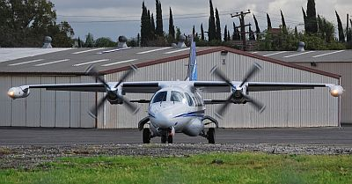
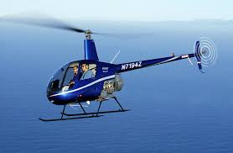
Why do aircraft renters and insurance Co’s require transition training?
Accident reports and studies continue to show that pilots are at greatest risk during their first 100 hours of flying a new type. Note that the FAA does not require transition training except for a new category or class, with the exception of two aircraft, the Mitsubishi MU 2 and the Robinson R22 helicopter. Rental facilities and insurance companies have picked up where the FAR’s leave off since these studies also show that good transition training significantly reduces the risk with pilots new to type.
Notes:
Here is a link to several articles concerning the MU 2 SFAR:
http://bonanza.org/documents/AOPA%20ASF%20Bonanza%20Debonair%20Safety%20Review%20(compressed).pdf
And one regarding the Robinson R22 and R44:
http://bonanza.org/documents/AOPA%20ASF%20Bonanza%20Debonair%20Safety%20Review%20(compressed).pdf
Many rental facilities require pilots to have prerequisite experience, and then a certain number of hours in make and model in order to rent and fly an aircraft. Additionally, they usually require a checkout and testing even if a pilot meets those requirements already. New owners, on the other hand, have no such requirement from the FAA for training unless they do not hold the necessary category and class on their pilot certificate. They may, or may not, be required by their insurance carrier to get transition training. If you have never flown this specific make and model (for example, you’ve been flying a Cessna 172 P and are now wanting to fly a 172M) at least sit down with a CFI familiar with both and learn the differences. In this case, they have different max gross weights, for example.
(Next Slide)

Slide 13
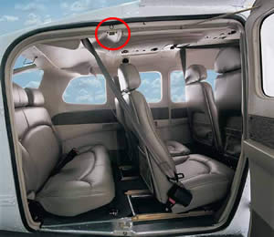
Case Study: Cessna 206
Some airplanes have elusive systems issues that require thorough knowledge and study !! Later Cessna U206’s have a microswitch on the fwd cargo door that prevents flap deployment.
Pilot couldn’t apply flaps, botched an attempted no flap landing. Aircraft damaged when it drifted off the runway.
Cause: pax leaning on cargo door, microswitch prevented flaps from moving!!
Notes:
Here’s an article regarding this accident from Gene Benson’s online source, ‘Gene’s Top Ten List of Pilot Killers:
https://genebenson.com/accident_prevention/top_ten/top_ten.htm
“All pilots know the basics of the simple single-engine or light multiengine airplanes that they fly. For example, if the alternator quits the engine won't immediately follow but the electrical load must be reduced to provide the longest amount of battery time to power radios and other essential equipment. Or, at least basic information like this should be understood. But some airplanes have systems that are a little more elusive and require a thorough study of the POH.
Four people escaped injury in California when the pilot botched a no-flap landing. The airplane drifted off the runway and collided with an airport sign and runway lights.
Why the no-flap landing? It seems that the flaps would not extend when the airplane was in the traffic pattern. The airplane is equipped with a door/flap limit switch which prevents the flaps from being lowered when the rear door is open. This is necessary since the door opens directly into the area of the flap travel. On this flight, a rear seat passenger was leaning against the door with sufficient force to open the switch and prevent the flaps from operating. Had the pilot been aware of this system he could have asked the passenger to refrain from leaning against the door and the flaps would have operated normally. I'll leave the issue of proficiency in no-flap landings for another time.”
(Next Slide)

Slide 14
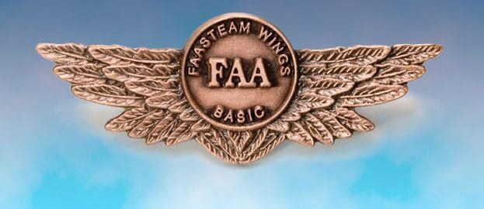
Proficiency & Peace of Mind
Notes:
Consider learning more about maintenance, preflight inspections, and many other topics related to flying safely after maintenance, by signing up for the WINGS Proficiency Program, and taking the online courses there. During any WINGS flight activity, your CFI can show you hands-on how these, and many other, ideas for preflight can enhance the safety of YOUR flying!!
(Next Slide)

Slide 15
About Your Author:
Jay Mason CFI-AIM
-Earned PPL in 1988; Initial CFI in 1993. Commercial Pilot, ASEL, AMEL Instrument. Flight Instructor for ASEL, AMEL, Instrument Airplane, and Advanced Ground Instructor
-2nd Generation GA Pilot: Dad Earned PPL in 1964, IFR in 2000 (Jay was His CFII).
-3800+ Hours TT, 2700+ Hours Dual Given. Gold Seal CFI American Bonanza Society Flight Instructor Academy Graduate
-Affiliations: AOPA; American Bonanza Society; SoCal Pilot’s Assn;
California Pilot’s Assn; Society of Aviation and Flight Educators (SAFE);
Cardinal Flyers (CFO); International Comanche Society
-FAASTeam Representative in the Long Beach FSDO
-Has earned Basic and Advanced FAA WINGS

Slide 16
Questions?
Notes:
Presentation Note: You may wish to provide your contact information and main FSDO phone number here. Modify with
Your information or leave blank.
(Next Slide)

Slide 17
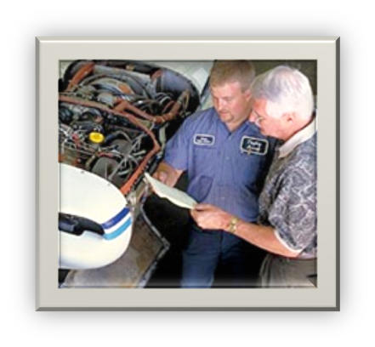
Topic of the Month July
Transition Training
<Audience>
<Presenter>
< >
Notes:
(End)

