Slide 1
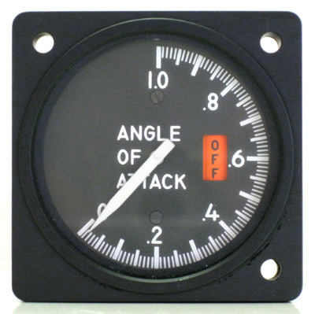
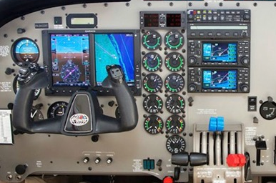
Topic of the Month May
Vmc Training & Angle of Attack
<Audience>
<Presenter>
< >
Notes:
2015/6/30-073 (I) PP Original Author, FAASTeam , John Steuernagle ; POC Kevin Clover, AFS-850 Operations Lead, Office 562-888-2020; revision 1 by John Steuernagle 07/28/2016.
Presentation Note: This is the title slide for Vmc Training & Angle of Attack
Presentation notes (stage direction and presentation suggestions) will be preceded by a Bold header: the notes themselves will be in Italic fonts.
Program control instructions will be in bold fonts and look like this: (Click) for building information within a slide; or this: (Next Slide) for slide advance.
Some slides contain background information that supports the concepts presented in the program.
Background information will always appear last and will be preceded by a bold Background: identification.
We have included a script of suggested dialog with each slide. Presenters may read the script or modify it to suit their own presentation style.
The production team hope you and your audience will enjoy the show. Break a leg!
(Next Slide)

Slide 2
Welcome
Exits
Restrooms
Emergency Evacuation
Breaks
Sponsor Acknowledgment
Other information
Notes:
Presentation Note: Here’s where you can discuss venue logistics, acknowledge sponsors, and deliver other information you want your audience to know in the beginning.
You can add slides after this one to fit your situation.
(Next Slide)

Slide 3
Overview
GAJSC * Recommendations
Vmc Training
Minimum Control Speed with Critical Engine Inoperative.
Angle of Attack (AOA) Indicators
* General Aviation Joint Steering Committee
Notes:
In this presentation we’ll address recommendations from the General Aviation Joint Steering Committee – a government /industry group that analyzes GA accidents and incidents. The Committee feels that improved and more frequent single-engine training in multi-engine airplanes will reduce the number of multi-engine loss of control events.
They specifically recommend Vmc Training to improve pilot response to power loss. Vmc – familiar to multi-engine pilots refers to the minimum speed required to maintain control when the critical engine fails. We’ll refine the definition in the next slide.
The GAJSC also heartily endorses Angle of Attack Indicators as an affordable technology to reduce stall/spin accidents. We’ll talk about AOA indicators after we address the Vmc issues.
Presentation Note: If you’ll be discussing additional items, add them to this list
(Next Slide)

Slide 4
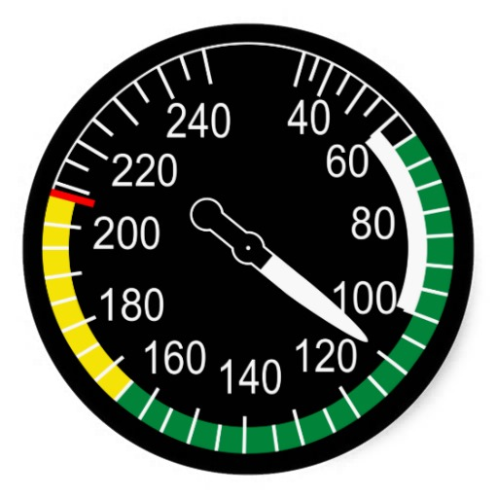
Vmc
Single-engine
Multi-engine
Notes:
Here’s a couple of airspeed indicators. Note that the multi-engine indicator has two red lines and a blue line. The lower red line is the speed below which aircraft control cannot be maintained if the critical engine fails under the worst possible conditions. Multi-engine pilots refer to it as Vee em cee.
The blue line that’s found on many but not all multi-engine airspeed indicators is the Best Single-engine Rate of Climb Speed. It’s good to be at or above this speed whenever possible to give you some climb performance if an engine should fail.
(Next Slide)
Background: Vmc – Minimum control speed with the critical engine inoperative. Marked with a red radial line on most airspeed indicators. The minimum speed
at which directional control can be maintained under a very specific set of circumstances outlined in 14 CFR part 23, Airworthiness Standards.
Under the small airplane certification regulations currently in effect, the flight test pilot must be able to (1) stop the turn that results when the critical
engine is suddenly made inoperative within 20° of the original heading, using maximum rudder deflection and a maximum of 5° bank, and (2)
thereafter, maintain straight flight with not more than a 5° bank. There is no requirement in this determination that the airplane be capable
of climbing at this airspeed. Vmc only addresses directional control.

Slide 5
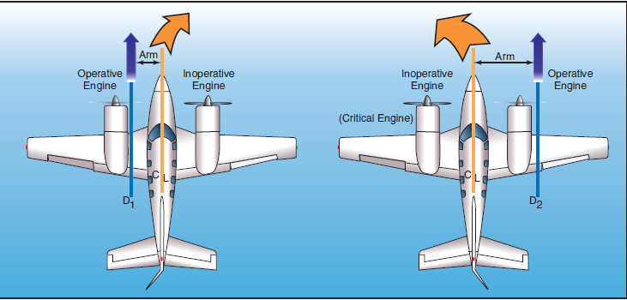
The Critical Engine
Notes:
We spoke of the critical engine in the previous slide so we’d better talk about what the term means.
The critical engine is the engine that will have the most adverse effect on directional control if that engine fails. Any engine failure on a multi-engine airplane will result in a yaw toward the inoperative engine but if the critical engine fails; the yaw forces will be greater due to P-factor.
All propeller-powered aircraft are subject to P-factor. Engines that rotate clockwise from the pilot’s perspective will produce greater thrust on descending propeller blades when the aircraft is flown at a positive angle of attack. Because there is a longer moment arm associated with the right engine in this illustration – the yaw will be harder to manage if the left engine fails.
Some manufacturers install counter rotating engines on their multi-engine aircraft. Thus yaw response is the same no matter which engine fails. Most US airplane engines rotate clockwise though so critical engine failure is something most multi-engine pilots have to train for.
(Next Slide)

Slide 6
But wait – there’s more ….
High power on operative engine
Forward CG
Windmilling prop on inoperative engine
Holding wings level
Landing gear retracted
Notes:
There are few bad situations that can’t be made worse. Which of these conditions will improve aircraft control when an engine fails?
Presentation Note: Ask the audience to consider these statements with respect to improved aircraft control. When they have answered; click to reveal the correct answer.
(Click)
That’s right. A forward center of gravity increases the moment arm to the rudder giving the pilot more rudder authority to counteract the yaw. All of the other conditions will make the situation worse.
(Next Slide)
Background: Multiengine airplanes are subject to P-factor just as single-engine airplanes are. The descending propeller blade of each engine will produce greater thrust than
the ascending blade when the airplane is operated under power and at positive angles of attack. The descending propeller blade of the right engine is also a greater distance
from the center of gravity, and therefore has a longer moment arm than the descending propeller blade of the left engine. As a result, failure of the left engine will result in the most
asymmetrical thrust (adverse yaw) as the right engine will be providing the remaining thrust. Many twins are designed with a counter-rotating right engine. With this design, the degree of asymmetrical thrust is the same with either engine inoperative. No engine is more critical than the other, and a Vmc demonstration may be performed with either engine windmilling.
In aircraft certification, dynamic Vmc is determined under the following conditions.
• Maximum available takeoff power. Vmc increases as power is increased on the operating engine. With normally aspirated engines, Vmc is highest at takeoff power and sea level, and
decreases with altitude. With turbocharged engines, takeoff power, and therefore Vmc, remains constant with increases in altitude up to the engine’s critical altitude (the altitude where
the engine can no longer maintain 100 percent power). Above the critical altitude, Vmc decreases just as it would with a normally aspirated engine, whose critical altitude is sea level.
Vmc tests are conducted at a variety of altitudes. The results of those tests are then extrapolated to a single, sea level value.
• Windmilling propeller. Vmc increases with increased drag on the inoperative engine. Vmc is highest, therefore, when the critical engine propeller is windmilling at the low pitch, high
r.p.m. blade angle. Vmc is determined with the critical engine propeller windmilling in the takeoff position, unless the engine is equipped with an autofeather system.
• Most unfavorable weight and center-of-gravity position. Vmc increases as the center of gravity is moved aft. The moment arm of the rudder is reduced, and therefore its effectivity is reduced, as the center of gravity is moved aft. At the same time, the moment arm of the propeller blade is increased, aggravating asymmetrical thrust. Invariably, the aft-most CG limit is the most
unfavorable CG position. Currently, 14 CFR part 23 calls for Vmc to be determined at the most unfavorable weight. For twins certificated under CAR 3 or early 14 CFR part 23,
the weight at which Vmc was determined was not specified. Vmc increases as weight is reduced.
• Landing gear retracted. Vmc increases when the landing gear is retracted. Extended landing gear aids directional stability, which tends to decrease Vmc.
• Holding wings level. Vmc is reduced significantly with increases in bank angle. Conversely, Vmc increases significantly with decreases in bank angle. Tests have shown that Vmc
may increase more than 3 knots for each degree of bank angle less than 5°. Loss of directional control may be experienced at speeds almost 20 knots above published Vmc when the wings are held level.
Vmc is highly sensitive to bank angle. To prevent claims of an unrealistically low Vmc speed in aircraft certification, the manufacturer is permitted to use a maximum of a 5° bank angle toward the
operative engine. The horizontal component of lift generated by the bank assists the rudder in counteracting the asymmetrical thrust of the operative engine. The bank angle works in the
manufacturer’s favor in lowering Vmc. Vmc is reduced significantly with increases in bank angle. Conversely, Vmc increases significantly with decreases in bank angle. Tests have shown that Vmc
may increase more than 3 knots for each degree of bank angle less than 5°. Loss of directional control may be experienced at speeds almost 20 knots above published Vmc when the wings are held level.

Slide 7
So much for theory
Notes:
Well enough of theory – it’s time for practice. Obviously there’s a lot going on when a critical engine fails. These are times when pilots absolutely must be on top of their game and you can’t maintain the edge if you don’t practice.
Too many pilots demonstrate Vmc during the check ride and the next time they have to cope with Vmc it’s the real deal and lives depend on perfect execution. So get with your flight instructor & do a Vmc demonstration or two and document it in the WINGS proficiency program. It’s time and money well spent for safety.
(Next Slide)

Slide 8
Stalls:
Can occur in any phase of flight
Are a factor in many fatal accidents
Usually involve low time pilots
Can occur at any airspeed
All of the above.
Notes:
On to Angle of Attack – Which of these statements are true with respect to stalls?
Presentation Note: Ask the audience to consider these statements with respect to stalls. When they have answered; click to reveal the correct answer.
(Click)
That’s right. Stalls can occur at any airspeed in any phase of flight. They are a factor in many fatal accidents and often – but not always – involve low time pilots.
(Next Slide)

Slide 9
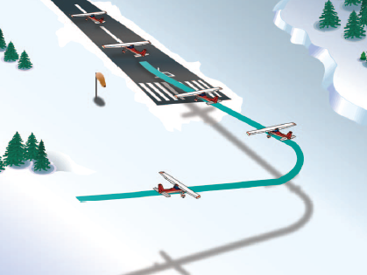
Stall/Spin Accidents
In the traffic pattern
Takeoff 28 %
Approach 18 %
Go Around 6 %
Crosswind
Maneuvering 41%
1 Fatal Accident/3 days
Notes:
Here’s the lowdown on Stall/Spin Accidents. They are deadly. More than half occur in the traffic pattern and most of the rest involve maneuvering – usually too close to the ground for recovery.
That all works out to one fatal accident every three days for the past ten years.
(Next Slide)

Slide 10
The Airspeed Problem
Notes:
We often discuss stalls with respect to airspeed and that can be a problem.
Wings stall when their critical angle of attack is exceeded. Airspeed is a secondary indication of how close we are to the critical angle of attack.
(Next Slide)

Slide 11
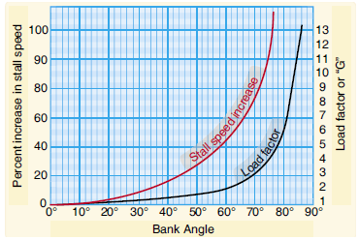
The Airspeed Problem
Aircraft configuration
Vs Cruise configuration
Vso Landing configuration
Load
Notes:
There are problems with using airspeed indications for stall avoidance. (Click)
One being that Stall speed changes with aircraft configuration. (Click)
Another has to do with aircraft load. As load or weight increase stall speed will also increase.
So if a wing can stall at any airspeed in any configuration pilots must manage angle of attack and that argues for an AOA display and/warning system in the aircraft.
(Next Slide)

Slide 12
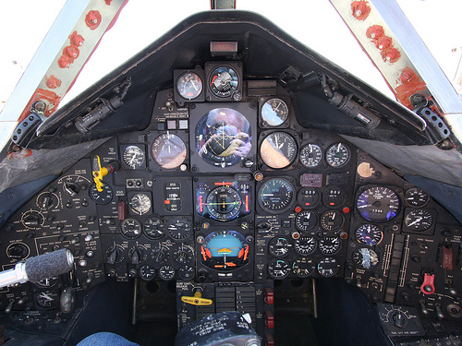
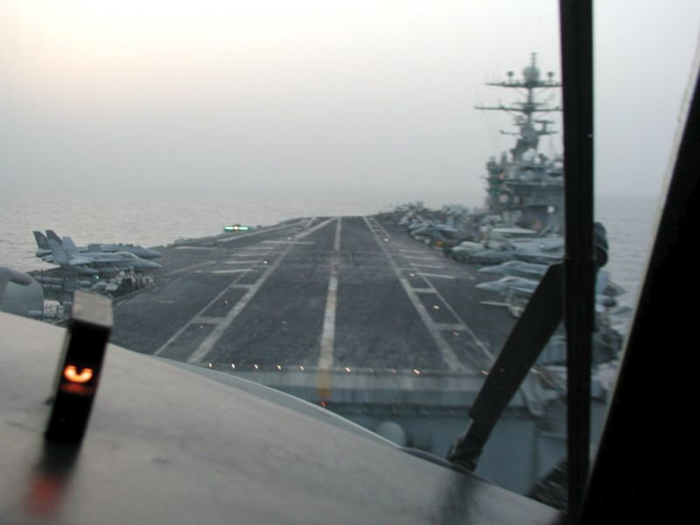
Angle of Attack Indicators
Notes:
Military aircraft have had AOA indicators for years. They’re essential to getting optimum performance in challenging situations but also very useful in routine flying as well. Only recently have they become more available and affordable for GA aircraft.
(Next Slide)

Slide 13
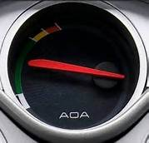
AOA For GA
Notes:
AOA indicators are showing up on many new aircraft and there are also a number of affordable options for retrofit as well. Angle of attack sensing & display that go a long way toward reducing the number of stall/spin accidents.
(Next Slide)

Slide 14
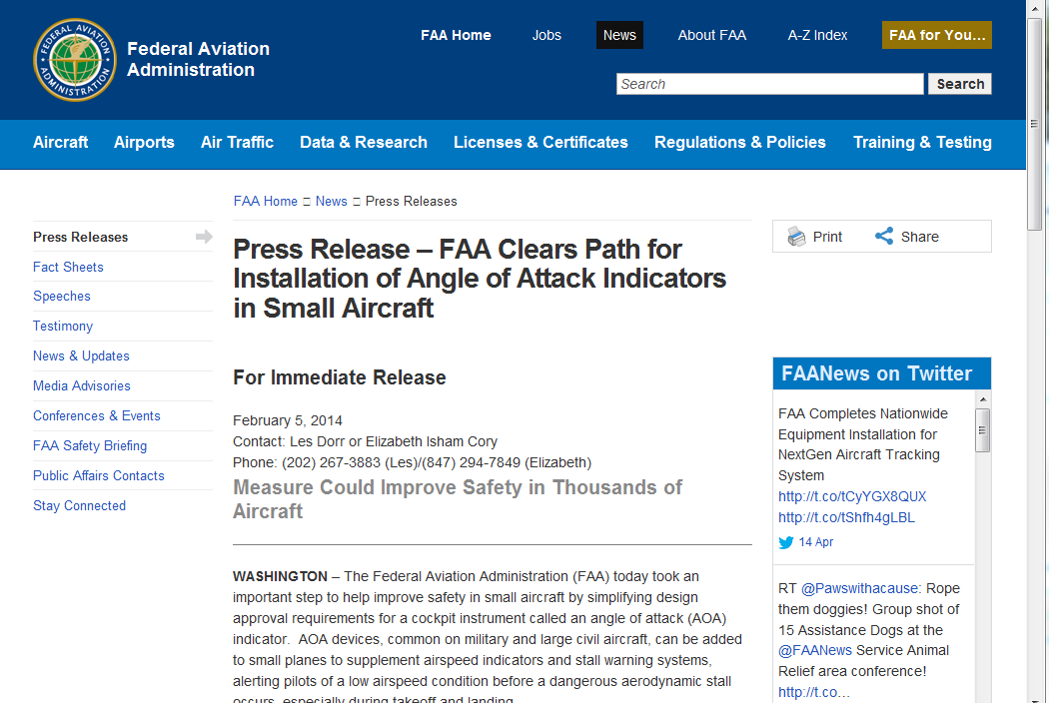
Streamlined Process
Notes:
FAA’s Small Airplane Directorate has streamlined the process for production and retrofit approval of AOA devices.
Presentation Note: If you have an internet connection you can access the Press Release by clicking on the information button on the lower right of the screen
(Next Slide)

Slide 15
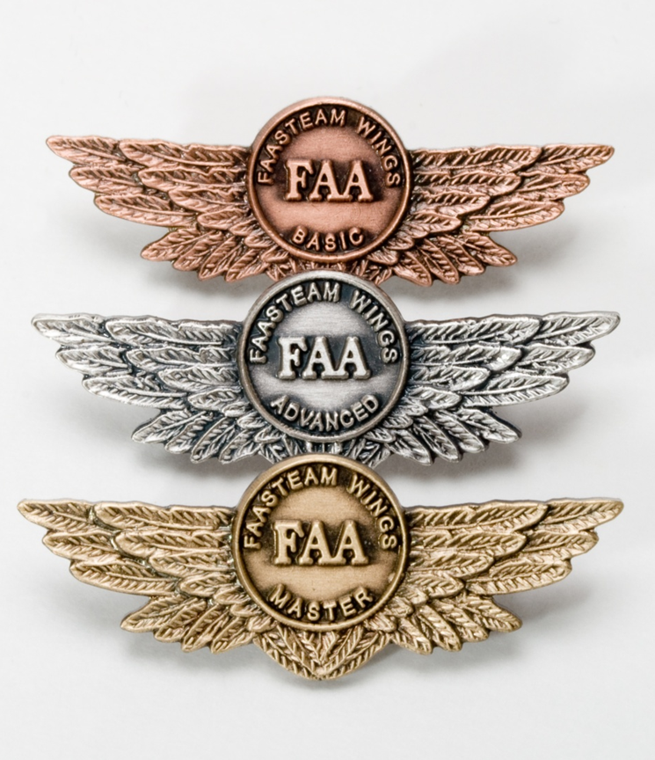
Safety Tip
Investigate AOA Systems
Practice
Stalls & slow flight
Pattern & Instrument
Fly with a CFI
Notes:
Angle of Attack systems promise so much benefit that we urge you to look into them for the aircraft you own or fly (Click)
And be sure to keep your skills sharp through practice of stalls & slow flight as well as pattern and instrument work. (Click)
Fly regularly with a CFI and be sure to document your achievement in the Wings Proficiency Program. It’s a great way to stay on top of your game.
(Next Slide)

Slide 16
Resources
FAA Small Airplane Directorate
http://www.faa.gov/about/office_org/headquarters_offices/avs/offices/air/directorates_field/small_airplanes/
AOA Press Release
http://www.faa.gov/news/press_releases/news_story.cfm?newsid=15714
FAA Safety Briefing Magazine
http://www.faa.gov/news/safety_briefing/
Notes:
Presentation Note: If you have an internet connection you can access the resources by clicking on text. If there’s no internet access the audience can copy the URLs below each item.
Here are some places you can go for more information.
(Next Slide)

Slide 17
Resources
Airplane Flying Handbook
http://www.faa.gov/regulations_policies/handbooks_manuals/aircraft/airplane_handbook/
Notes:
Presentation Note: If you have an internet connection you can access the resources by clicking on text. If there’s no internet access the audience can copy the URLs below each item.
Here are some places you can go for more information.
(Next Slide)

Slide 18
Questions?
Notes:
Presentation Note: You may wish to provide your contact information and main FSDO phone number here. Modify with
Your information or leave blank.
(Next Slide)

Slide 19
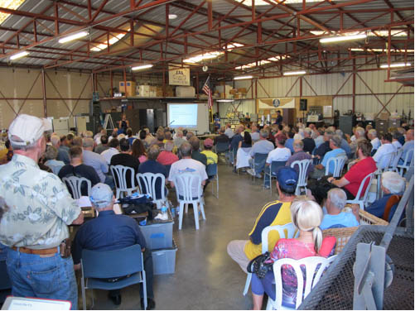
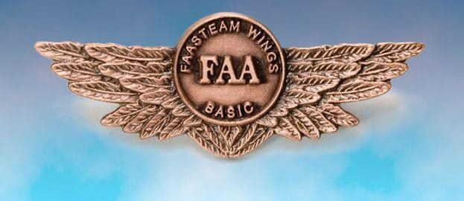
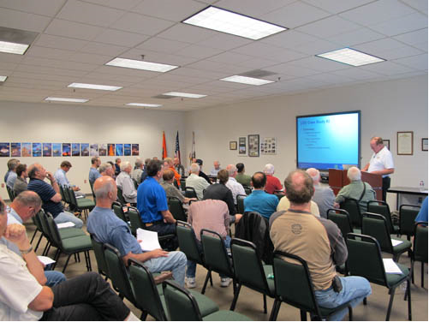
Thank you for attending
You are vital members of our GA safety community
Notes:
Your presence here shows that you are vital members of our General Aviation Safety Community. The high standards you keep and the examples you set are a great credit to you and to GA.
Thank you for attending.
(Next Slide)

Slide 20
Topic of the Month May
Vmc Training & Angle of Attack
<Audience>
<Presenter>
< >
Notes:
(The end)

