Slide 1
Topic of the Month June
The Human Startle Response and Managing Unexpected Events
<Audience>
<Presenter>
< >
Notes:
20 15/03/06-018 (E) PP Rev 1 Original Author: Jay Mason, POC Kevin Clover, AFS-850 Operations Lead, Office 562-888-2020; revised by (John Steuernagle) (08/31/2016)
Presentation Note: This is the title slide for The Human Startle Response and Managing Unexpected Events
Presentation notes (stage direction and presentation suggestions) will be preceded by a Bold header: the notes themselves will be in Italic fonts.
Program control instructions will be in bold fonts and look like this: (Click) for building information within a slide; or this: (Next Slide) for slide advance.
Some slides may contain background information that supports the concepts presented in the program.
Background information will always appear last and will be preceded by a bold Background: identification.
We have included a script of suggested dialog with each slide. Presenters may read the script or modify it to suit their own presentation style.
The production team hope you and your audience will enjoy the show. Break a leg!
(Next Slide)

Slide 2
Welcome
Exits
Restrooms
Emergency Evacuation
Breaks
Sponsor Acknowledgment
Other information
Notes:
Presentation Note: Here’s where you can discuss venue logistics, acknowledge sponsors, and deliver other information you want your audience to know in the beginning.
You can add slides after this one to fit your situation.
(Next Slide)

Slide 3
Overview
The Human Startle Response
A Case Study
Critical things that occur when least expected
The five stages of grief
(Kubler-Ross Model)
What are You going to do?

Slide 4
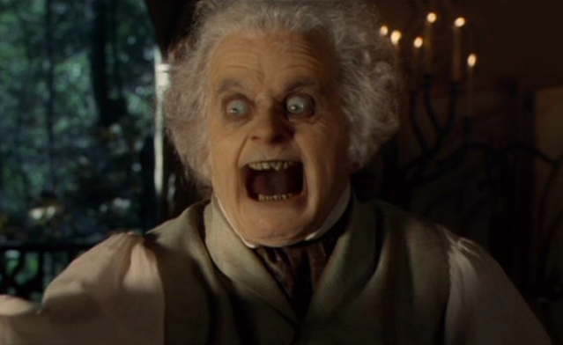
The Human Startle Response
Deep seated reflexive reaction
Prepares us for Fight or Flight
Not very useful in an aviation emergency
Notes:
The human startle response is a deep seated reflexive action initiated by the limbic system – the most ancient part of our brain. For eons it’s been a recipe for evolutionary success; instantly preparing us to fight for, or run for our lives.
Running or fighting may not be helpful when coping with a rapidly developing aviation emergency. Success or failure will depend on how well we are prepared to deal with the emergency and all too often – how close we are to the ground when it happens.
Let’s look at a case study of an accident that may have involved a startle response.
(Next Slide)

Slide 5
CIRRUS N146CK August 4, 2010
Phoenix-Deer Valley (KDVT)
Day VFR
Cross-country from KDVT to Tennessee
Cabin door opened on takeoff
PIC Requests return to airport to close door
Loss of Control on turn to final
One Fatality – the PIC
No other injuries
Building damage
Notes:
Here is a link to the NTSB report for this accident: http://www.ntsb.gov/_layouts/ntsb.aviation/brief2.aspx?ev_id=20100804X02630&ntsbno=WPR10FA383&akey=1
This is a classic example of an abnormal situation that was NOT managed well. Either because of distraction from the door being open, noise, trying to close the door, or some combination of those, the PIC lost control of the aircraft while maneuvering to land and solve the problem. This ‘unexpected event’ became an ‘unexpected emergency’ when it didn’t have to.
(Next Slide)

Slide 6
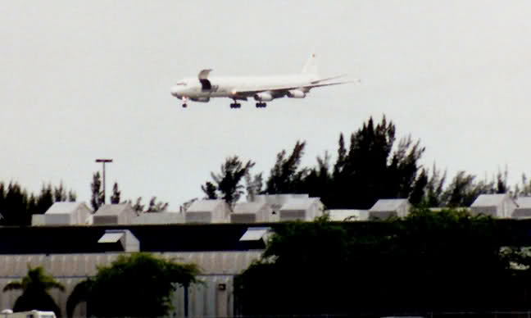
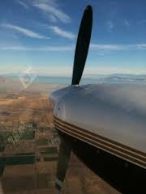
Critical Things That Occur When Least Expected
Partial or full loss of power on takeoff
Landing gear fails to extend after takeoff or before landing
Bird strikes
Control problems of failures
Notes:
You can add more examples if you wish. These four situations often catch pilots by surprise, and in many cases pilots don’t revisit and practice how they will handle these and many other abnormal and emergency situations, except during biennial flight reviews or other recurrent training, IF THEN!
(Next Slide)

Slide 7
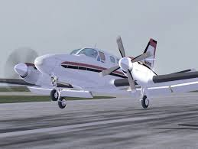
Characteristics Common To Unexpected Emergencies
They often occur close to the ground, OR during a transition from one configuration/phase of flight to another
There’s no time to think “What the….!”
Almost always there is no time to use a checklist
Chances of success are improved if your response to the abnormal event or emergency is thought about ahead of time!!
Notes:
Another example you might use: Helicopter engine failures that require autorotation. These must be practiced so that the response from the pilot is quick and assertive. Multi-engine pilots need to be current and proficient with engine-out procedures on takeoff. With both single and multi-engine aircraft an engine out situation close to the ground requires a pre-planned course of action. ME pilots practice this throughout their training, but many single pilots don’t have any pre-planned idea of what they will do or where they will go in such a case. You can think of other emergencies where this kind of pre-planning will make for a better outcome.
(Next Slide)

Slide 8
Kubler-Ross Model AKA The Five Stages of Grief
Grief Stage | Aviation Equivalent
Denial | This can’t be happening.
Anger | I can’t believe this is happening!
Bargaining | If you’ll just get me out of this …..
Depression | What’s the use? We’re doomed.
Acceptance | This is happening. I’ll take action!
Notes:
Here are the Five Stages in Detail, as theorized by Elisabeth Kubler-Ross:
The stages, popularly known by the acronym DABDA, include:^{[2]}
Denial — One of the first reactions is Denial, wherein the survivor imagines a false, preferable reality.
Anger — When the individual recognizes that denial cannot continue, it becomes frustrated, especially at proximate individuals. Certain psychological responses of a person undergoing this phase would be: "Why me? It's not fair!"; "How can this happen to me?"; '"Who is to blame?"; "Why would God let this happen?".
Bargaining — The third stage involves the hope that the individual can avoid a cause of grief. Usually, the negotiation for an extended life is made with a higher power in exchange for a reformed lifestyle. Other times, they will use anything valuable against another human agency to extend or prolong the life. People facing less serious trauma can bargain or seek compromise.
Depression — "I'm so sad, why bother with anything?"; "I'm going to die soon so what's the point?"; "I miss my loved one, why go on?" During the fourth stage, the individual becomes saddened by the certainty of death. In this state, the individual may become silent, refuse visitors and spend much of the time mournful and sullen.
Acceptance — "It's going to be okay."; "I can't fight it, I may as well prepare for it." In this last stage, individuals embrace mortality or inevitable future, or that of a loved one, or other tragic event. People dying may precede the survivors in this state, which typically comes with a calm, retrospective view for the individual, and a stable condition of emotions.
(Next Slide)

Slide 9
ABOUT THOSE FIRST FOUR…..
In the case of many unexpected situations in aircraft, if the pilot allows the first four of the five ‘stages of grief’ to occur, precious altitude, miles and time are compromised!!
You MUST go DIRECTLY to Stage #5: ACCEPT that the UNEXPECTED has occurred, and take action.
Which Brings Us To…
Notes:
When dealing with the unexpected, particularly if at low altitude on takeoff or landing, there is the element of surprise. Talk to any pilot who has experienced and engine failure on takeoff who DID NOT brief what they would do below leveling off at the cruise altitude, and they will tell you about the ‘Denial’ phase. It’s often wise when planning to surprise a student with a simulated engine failure, landing gear system problem, etc to allow at least 5 seconds (often longer) before expecting them to react. Practice and preparation will likely reduce this reaction time. You can think of and explain similar reactions from pilots that involve stages 2-4.
(Next Slide)

Slide 10
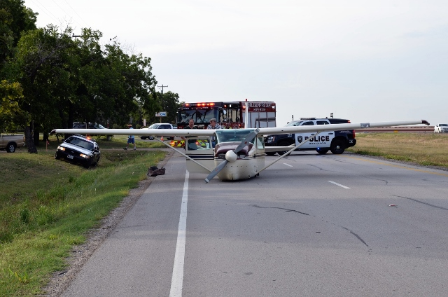
What ARE You Gonna Do?
Imagine the Unexpected Situation or Emergency. Then work in accordance with the following precepts:
1 – Get out of the emergency alive.
2 – The aircraft now belongs to your insurance company.
Notes:
Our theme throughout this presentation: think about the unexpected ahead of time!!! In the comfort of your home or office, it is much easier to think through your responses to such an event in light of these two (and there are others!) objectives.
(Next Slide)

Slide 11
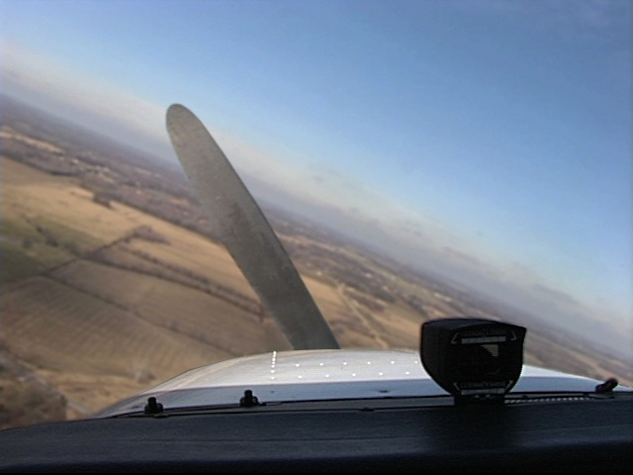
PRACTICE makes PERFECT
IF the door on your aircraft came open during or just after takeoff, how would you prevent the ‘emergency’ (described in our Case Study) from becoming an accident?
Think through the steps you would take.
Then, memorize, visualize and practice that procedure.
This is EXTREMELY important in cases where there will be LITTLE or NO TIME to come up with a plan!!!
Notes:
You might consider discussing the case study accident in more detail, and ask the audience where things went wrong. Then have them come up with a procedure that would have prevented this tragedy.
Once that is created, it is important to regularly review and commit to memory this kind of procedure. We’re not dealing with the kind of emergency where there is time to pull out the AFM or a printed checklist to make sure we did all the steps. In these situations there’s not time for that, things are happening too quick!! It is also extremely helpful to either sit in your aircraft and do the steps, touching the controls you’ll use, or visualize yourself doing elsewhere. It’s a really good idea to be able to visualize your aircraft’s cockpit well enough that you can do this, regardless.
(Next Slide)

Slide 12
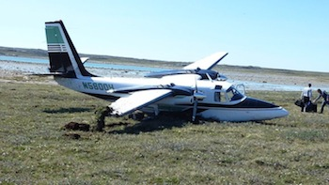
PRACTICE makes PERFECT
In cases like an unexpected engine failure, thinking through what you will do ahead of time, and then practicing your plan, will often make all the difference in the final outcome of YOUR unexpected emergency!!!
Notes:
No additional notes for this slide.
(Next Slide)

Slide 13
CHAIR FLY!!!!!!!
Regularly practice emergencies, in the comfort of your favorite chair, and you’ll be ready when, hopefully never, the time comes when you have to Manage the Unexpected!
Notes:
Like our pilot buddy here, practicing your emergency procedures regularly, and imagining what you will do, will expose areas where you need more knowledge or your thinking is unclear. NOW you have a chance to sort it out and come up with a plan of action that works better and/or makes more sense.
(Next Slide)

Slide 14
Proficiency and Peace of Mind
Fly regularly with your CFI
Perfect Practice
Document in WINGS
Notes:
There’s nothing like the feeling you get when you know you’re playing your A game and in order to do that you need a good coach (Click)
So fly regularly with a CFI who will challenge you to review what you know, explore new horizons, and to always do your best. Of course you’ll have to dedicate time and money to your proficiency program but it’s well worth it for the peace of mind that comes with confidence. (Click)
Vince Lombardi, the famous football coach said, “Practice does not make perfect. Only perfect practice makes perfect.” For pilots that means flying with precision. On course, on altitude, on speed all the time. (Click)
And be sure to document your achievement in the Wings Proficiency Program. It’s a great way to stay on top of your game and keep you flight review current.
(Next Slide)

Slide 15
Thanks to:
Jay Mason – Author
FAASTeam Rep in Long Beach California
Contact: saxflyr@cox.net
Notes:
Add any sponsors or folks you’d like to thank to this slide.
(Next Slide)

Slide 16
Questions?
Notes:
Presentation Note: You may wish to provide your contact information and main FSDO phone number here. Modify with
your information or leave blank.
(Next Slide)

Slide 17
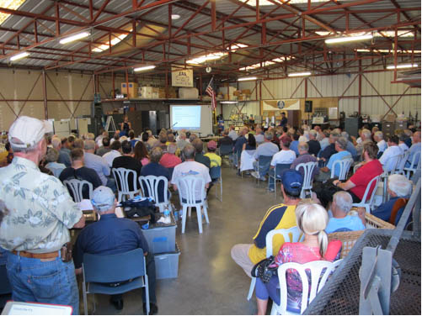
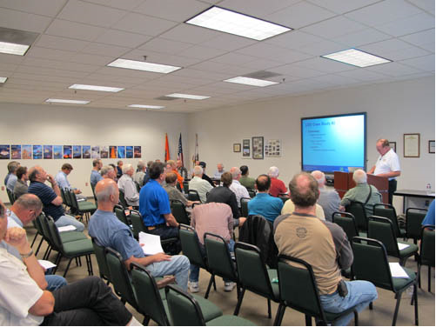
Thank you for attending
You are vital members of our GA safety community
Notes:
Your presence here shows that you are vital members of our General Aviation Safety Community. The high standards you keep and the examples you set are a great credit to you and to GA.
Thank you for attending.
(Next Slide)

Slide 18
Topic of the Month June
The Human Startle Response and Managing Unexpected Events
<Audience>
<Presenter>
< >
Notes:
(The End)

