Slide 1
Topic of the Month January
Enhanced Vision Systems
<Audience>
<Presenter>
< >
Notes:
2015/7/30-074 (I) PP Original Author, FAASTeam (JWS); POC Kevin Clover, AFS-850 Operations Lead, Office 562-888-2020; reviewed by John Steuernagle 7/17/2015/ revised by John Steuernagle 5/11/2017
Presentation Note: This is the title slide for Enhanced Vision Systems
Presentation notes (stage direction and presentation suggestions) will be preceded by a Bold header: the notes themselves will be in Italic fonts.
Program control instructions will be in bold fonts and look like this: (Click) for building information within a slide; or this: (Next Slide) for slide advance.
Some slides contain background information that supports the concepts presented in the program.
Background information will always appear last and will be preceded by a bold Background: identification.
We have included a script of suggested dialog with each slide. Presenters may read the script or modify it to suit their own presentation style.
The production team hope you and your audience will enjoy the show. Break a leg!
(Next Slide)

Slide 2
Welcome
Exits
Restrooms
Emergency Evacuation
Breaks
Sponsor Acknowledgment
Set phones & pagers to silent mode or off
Other information
Notes:
Presentation Note: Here’s where you can discuss venue logistics, acknowledge sponsors, and deliver other information you want your audience to know in the beginning.
You can add slides after this one to fit your situation.
(Next Slide)

Slide 3
Overview
GAJSC * Recommendations
Enhanced Vision Systems (EVS)
Available Technologies
General Aviation Options
* General Aviation Joint Steering Committee
Notes:
In this presentation we’ll address recommendations from the General Aviation Joint Steering Committee – a government / industry group that analyzes GA accidents and incidents. The Committee feels Enhanced and Synthetic vision technology can significantly improve general aviation utility and reduce the chance of accidents during night, and IMC operations. We’ll take a look at available technologies and GA options.
Presentation Note: If you’ll be discussing additional items, add them to this list
(Next Slide)

Slide 4
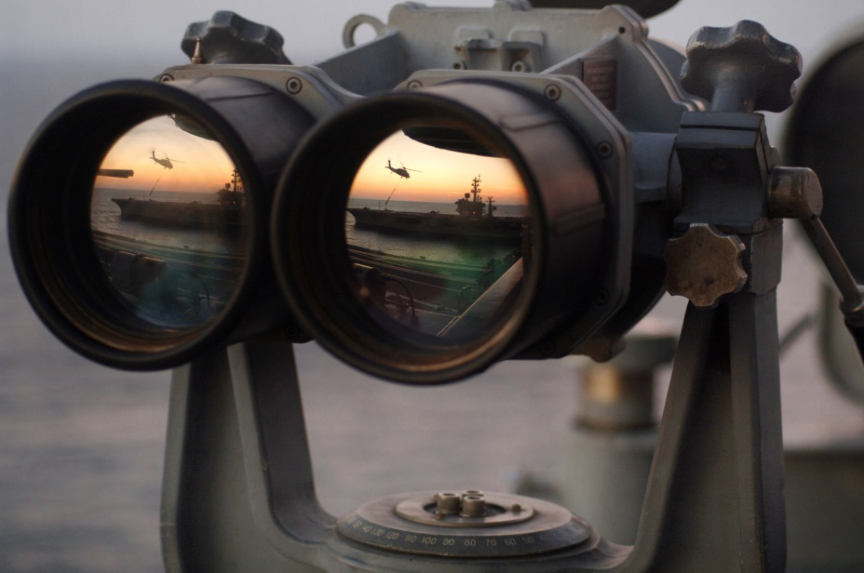
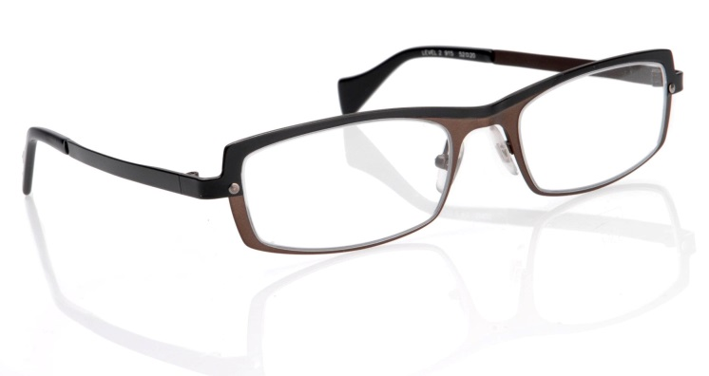
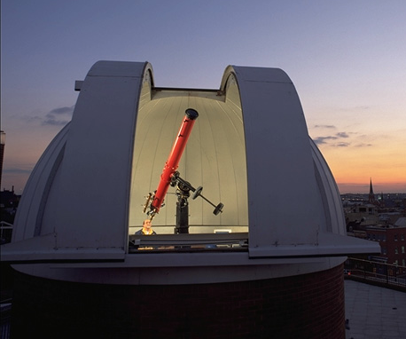
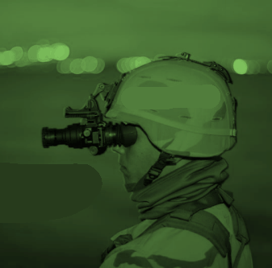
Enhanced Vision
Notes:
We’ve been looking for ways to improve our vision for a long time. Up until recently we were dealing with improvements to optical systems. Night vision scopes and goggles initially used infrared illumination but today, they’re passive systems that amplify what little light there is on even the darkest of nights.
(Next Slide)

Slide 5
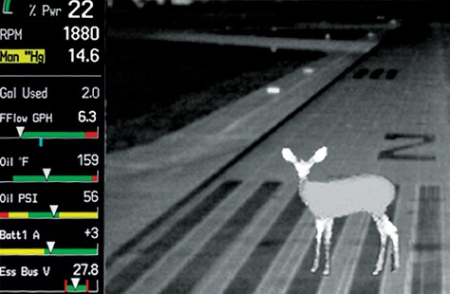
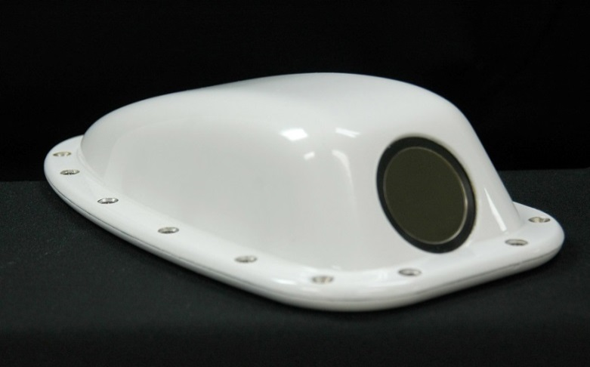
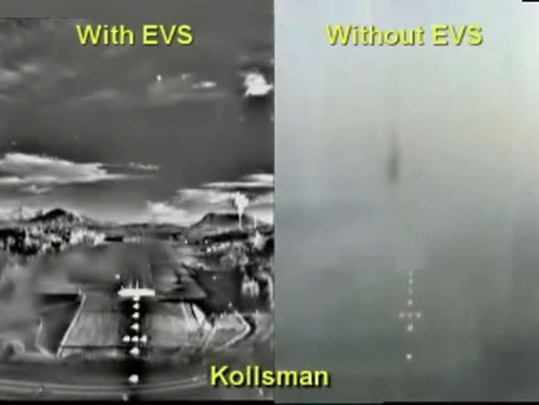
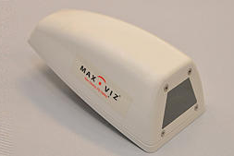
Enhanced Vision
Notes:
Infrared cameras are available for installation on GA airplanes and their output can be displayed on multi function displays. Of course it’s nice to be able to see wildlife and other obstructions on the runway but they’re also quite useful in depicting terrain in weather or on a dark night.
A word of caution though. Enhanced vision technology takes some getting used to. You’ll have to make the transition to visual reference at some point and that can be a challenge.
(Next Slide)

Slide 6
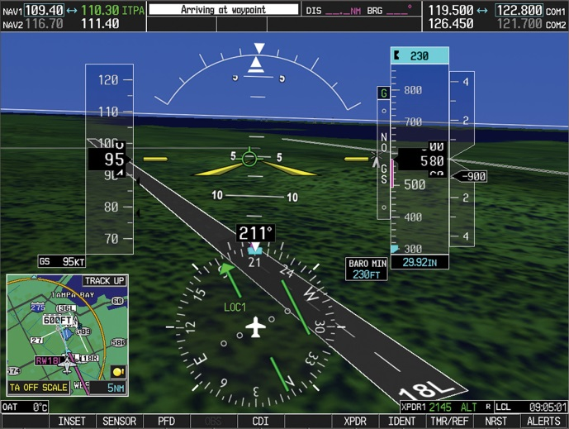
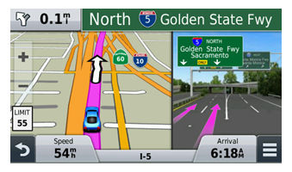
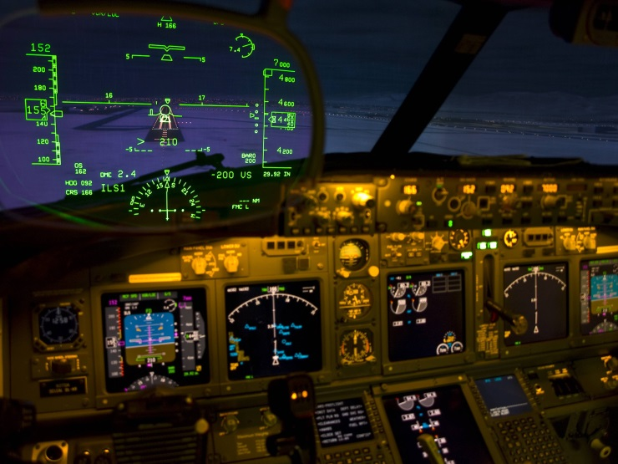
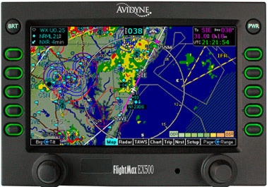
Synthetic Vision
Notes:
For some time now, we’ve been able to combine imagery from sensors and navigation systems, with our view out the window to see the world as never before. We call this Synthetic Vision (Click)
Using information from navigation databases we can create a picture of the flight environment and overlay that picture with aircraft instrumentation, and weather information to create a single image that contains all of the information necessary for safe flight operations. (Click)
Developed for tactical military flying, the HUD or Head Up Display presents information from aircraft instrument displays directly in pilots’ fields of view as they look through their wind screens. HUD technology is already installed in many airline cockpits and it’s making its’ way to General Aviation as well.
(Next Slide)

Slide 7
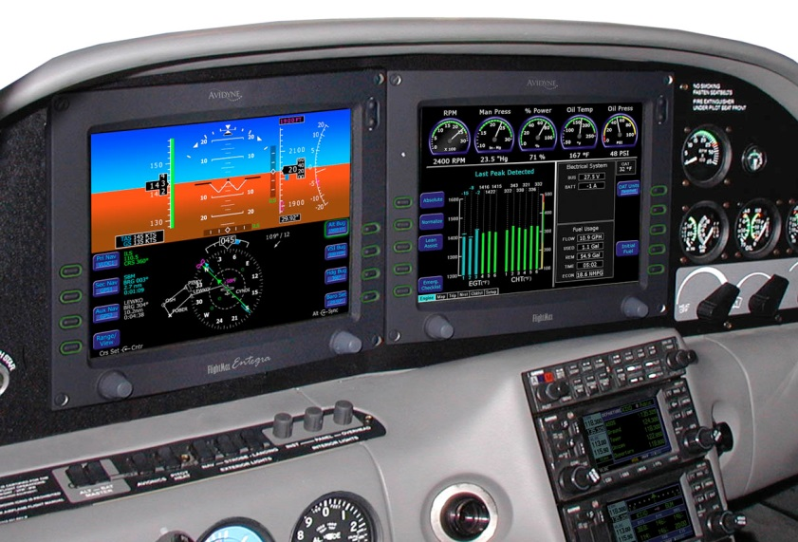
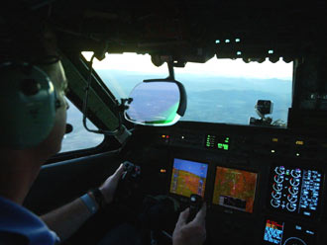
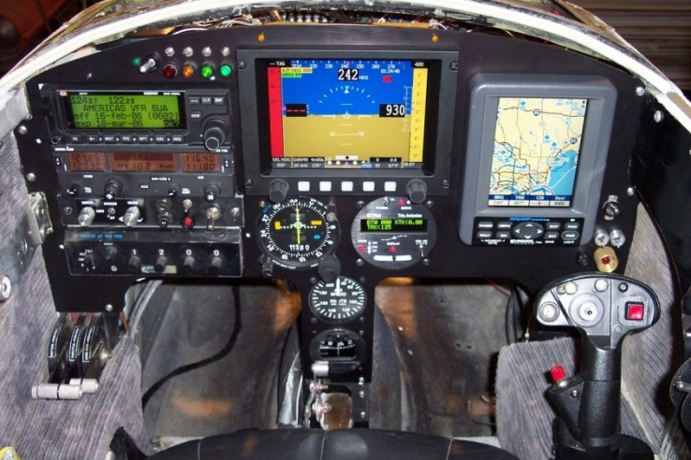
Display Choices
Notes:
Enhanced and Synthetic vision systems interface with a wide variety of general aviation multi function displays.
Presentation Note: Poll audience as to what sort of instrumentation they’re flying. If there are glass cockpit aviators in the audience ask them to talk about their transition experience and how long it took to be comfortable with the new technology.
Expect transitions to take longer if the aircraft you’re training in has unfamiliar glass cockpit instrumentation.
You can reduce training time and make time in the aircraft more productive if you log some time on an avionics simulator
Most manufacturers have personal computer-based simulations for their products
Many avionics packages can be operated in simulator mode.
(Next Slide)

Slide 8
Caution
Enhanced Vision can be used tactically
But not to lower instrument approach minimums
Use synthetic vision strategically
Especially in convective weather
Keep software and databases up to date
Understand your EVS & SVS systems
Maintain Proficiency
Notes:
Finally some cautions: (Click)
Enhanced vision, created from real time on board data sources can be used tactically. You know you have the latest information to act on because it’s generated from sensors on your airplane. Enhanced vision won’t allow you to descend below the DH or MDA though. You’ll still have to see the runway before landing. (Click)
Synthetic vision – especially when depicting weather events will be driven by data that is at best, 5 minutes old and it could be much older. That’s usually good enough to get the big picture but inadequate if you want to pick your way between thunderstorms. So if you’re not radar or storm scope equipped you’re better off to give convective weathera very wide berth. (Click)
Obviously you’ll need to keep your software and databases up to date. (Click)
Understand how your enhanced and synthetic systems work, what graphical indications mean, and what failure modes look like. (Click)
And maintain proficiency in all flight evolutions, equipment use, and programming. Periodic proficiency training with a CFI who’s proficient on the equipment in your airplane will give you the confidence to use all of your equipment effectively.
(Next Slide)

Slide 9
Questions?
Notes:
Presentation Note: You may wish to provide your contact information and main FSDO phone number here. Modify with
Your information or leave blank.
(Next Slide)

Slide 10
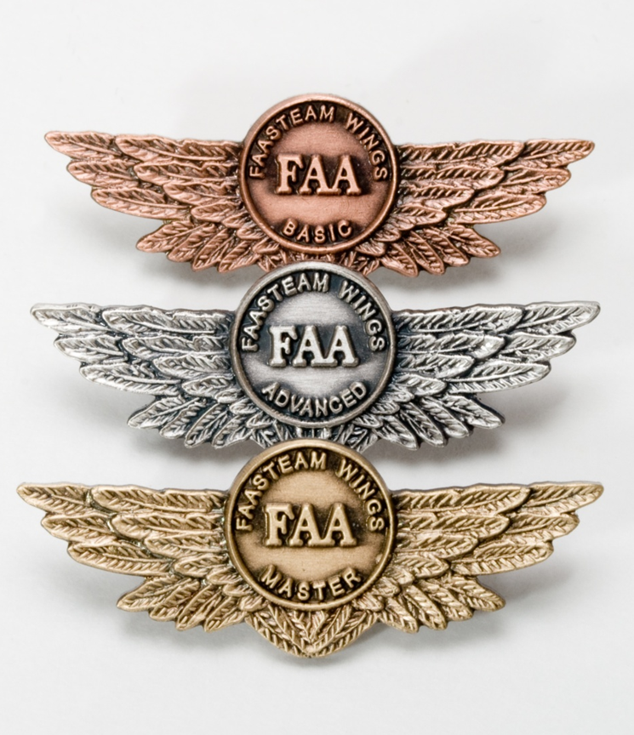
Proficiency and Peace of Mind
Fly regularly with your CFI
Perfect Practice
Document in WINGS
Notes:
There’s nothing like the feeling you get when you know you’re playing your A game and in order to do that you need a good coach (Click)
So fly regularly with a CFI who will challenge you to review what you know, explore new horizons, and to always do your best. Of course you’ll have to dedicate time and money to your proficiency program but it’s well worth it for the peace of mind that comes with confidence. (Click)
Vince Lombardi, the famous football coach said, “Practice does not make perfect. Only perfect practice makes perfect.” For pilots that means flying with precision. On course, on altitude, on speed all the time. (Click)
And be sure to document your achievement in the Wings Proficiency Program. It’s a great way to stay on top of your game and keep you flight review current.
(Next Slide)

Slide 11
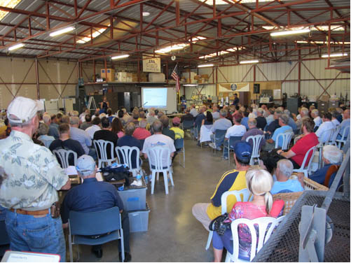
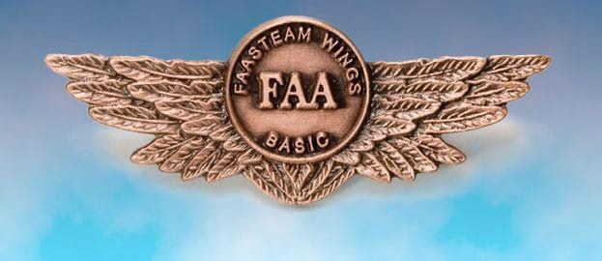
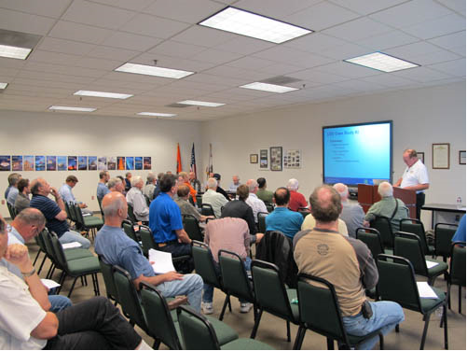
Thank you for attending
You are vital members of our GA safety community
Notes:
Your presence here shows that you are vital members of our General Aviation Safety Community. The high standards you keep and the examples you set are a great credit to you and to GA.
Thank you for attending.
(Next Slide)

Slide 12
Topic of the Month January
Enhanced Vision Systems
<Audience>
<Presenter>
< >
Notes:
(End)

