Slide 1
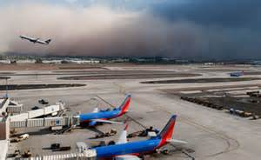
Forecasting Monsoon Thunderstorms and their Aviation Impacts
Larry Hopper (larry.hopper@noaa.gov)
Aviation Focal Point | National Weather Service Phoenix, AZ
Arizona Flight Training Workgroup Meeting
July 10, 2019 | Scottsdale, AZ FSDO

Slide 2
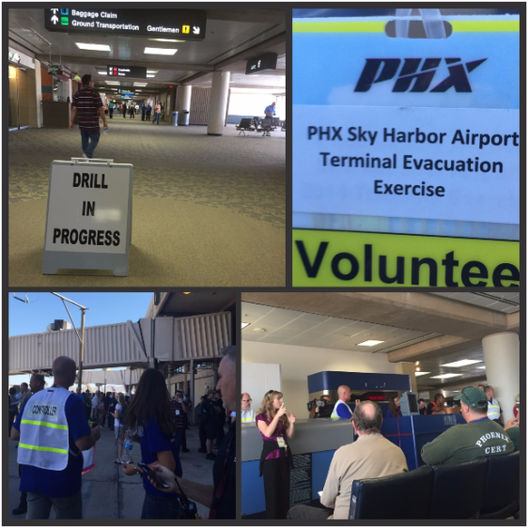
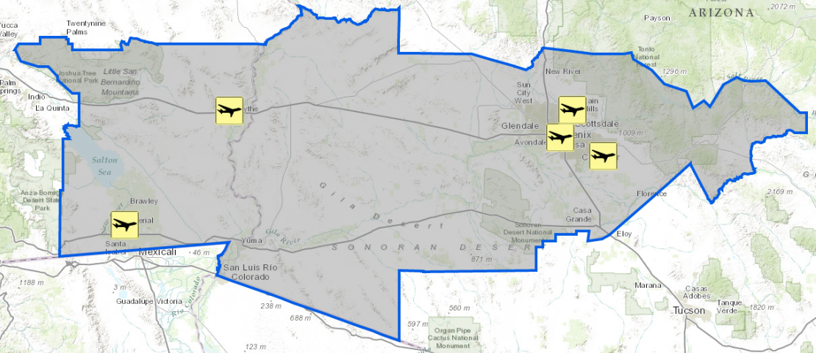
NWS Phoenix (PSR) Aviation Program
Forecasts and Watch/Warning/Advisories
Terminal Aerodrome Forecasts (TAFs)
Airport Weather Warnings (AWWs)
Started new TAF and AWW at DVT in March!
Specialized Decision Support (e.g., Super Bowl)
Local Research and Outreach (monthly exercises)
4 of 36 busiest airports in U.S. (by FY17 Ops):
12. PHX (455k; 1246 p/day)
19. DVT (384k; 1052 p/day)
34. IWA (291k; 796 p/day)
36. FFZ (289k; 792 p/day)
6 current TAFs:
Phoenix metro (PHX, IWA, SDL)
SE California (IPL, BLH)
Started TAF at DVT on March 6th
Notes:
FAAST = FAA Safety Team

Slide 3
Terminal Aerodrome Forecasts (TAFs)
We strive to write “practically perfect TAFs” in 6 lines or less by:
Writing to flight categories first and establishing trends
Adding specific details for the first 12 hours (especially first 3-6 hrs)
Highlighting specific events past 12 hours for planning
Notes:
Wind Direction, Speed, and, Gusts:
Mean wind direction differs by 30 degrees or more, with an accompanying mean wind speed of > 12 knots
Mean wind speed differs from forecast group mean wind speed by > 10 knots (and mean wind speed > 12 knots)
Wind gust is > 10 knots above forecast peak gust (or above the observed mean wind speed if no gust is forecast)

Slide 4
Terminal Aerodrome Forecasts (TAFs)
We strive to write “practically perfect TAFs” in 6 lines or less by:
Writing to flight categories first and establishing trends
Adding specific details for the first 12 hours (especially first 3-6 hrs)
Highlighting specific events past 12 hours for planning
Amendments issued if conditions causing categorical changes have occurred (or will) and persist for > 30 min (any time for thunderstorms)
VCTS = High confidence of prevailing t-storms in the 5-10 SM “vicinity”
TEMPO TS = High confidence of “temporary” t-storms within 5 SM
Notes:
Wind Direction, Speed, and, Gusts:
Mean wind direction differs by 30 degrees or more, with an accompanying mean wind speed of > 12 knots
Mean wind speed differs from forecast group mean wind speed by > 10 knots (and mean wind speed > 12 knots)
Wind gust is > 10 knots above forecast peak gust (or above the observed mean wind speed if no gust is forecast)

Slide 5
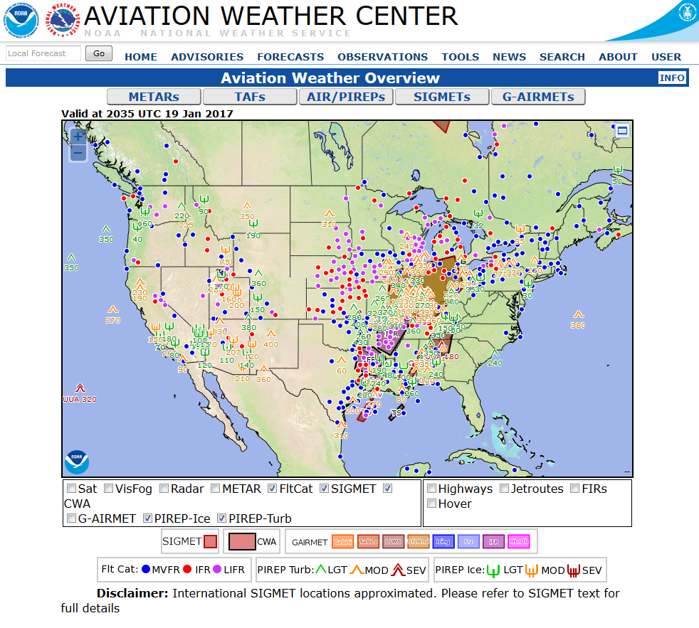
Interactive AWC Website
https://www.aviationweather.gov/
Easier to interpret TAFs and see weather impacts across the NAS

Slide 6
Aviation Forecast Discussions (AFDs)
We give details, confidence, and uncertainty in AFDs:
WFO Phoenix now issuing regularly by 00/06/12/18Z

Slide 7
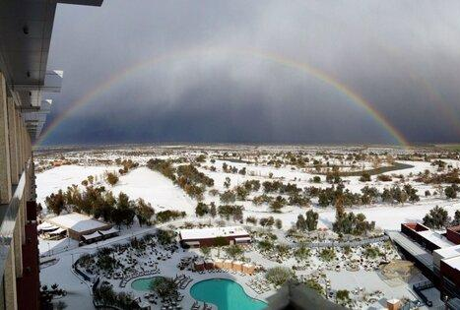
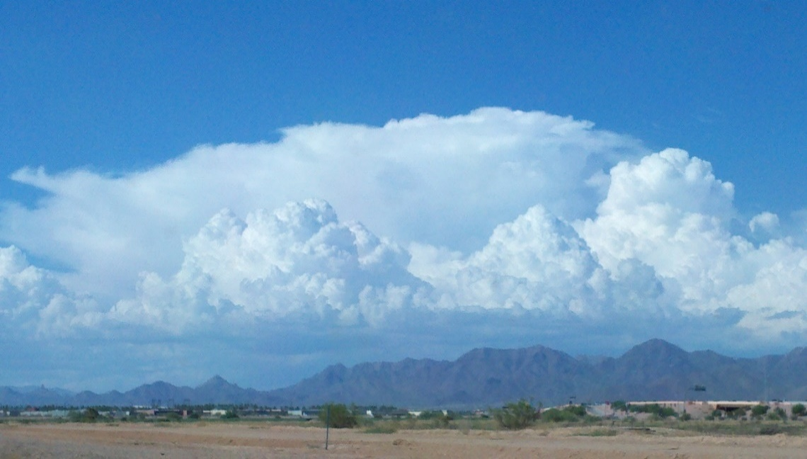
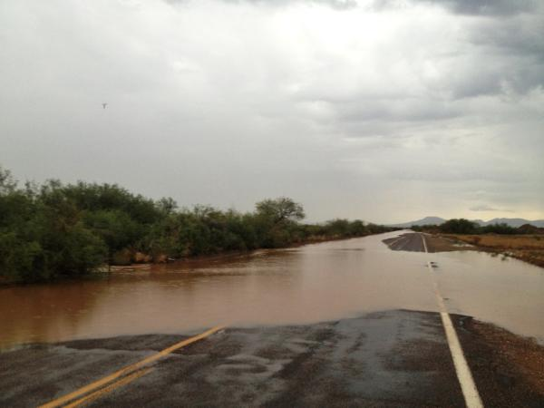
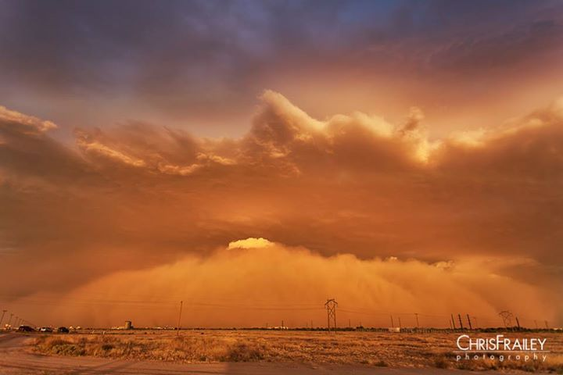
Seasonal Weather Hazards
Cool Season
Warm/Monsoon Season
Widespread rain leading to flash flooding and fog
Prolonged strong winds
Rare: Hail and tornadoes
Excessive Heat (#1 killer)
Strong to severe t-storms
Downbursts/microbursts
Dust storms
Frequent lightning
Flash floods
Woodbury Fire (2019)
Fires most common April-July (or later) due to dry fuels and lightning)

Slide 8
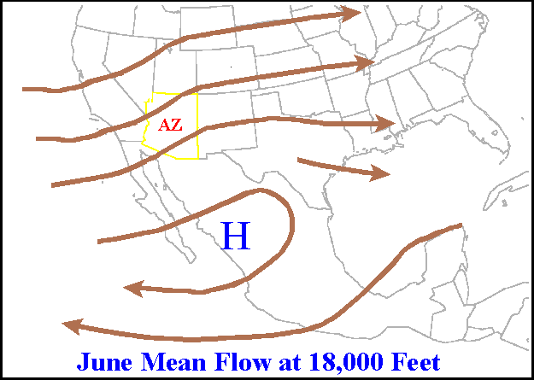
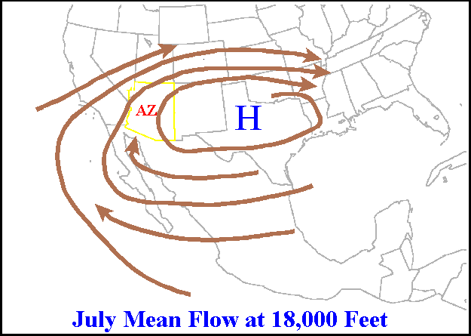
What causes our Monsoon Season?
Seasonal reversal in the prevailing wind flow patterns
Summer-Early Fall
Maddox Type I (SE flow)
Fall-Winter-Spring-Early Summer
Officially June 15 to Sept 30 (varies in reality)
Typical surface moisture surge lasting 2-4 days helps trigger t-storms

Slide 9
What causes our Monsoon Season?
Seasonal reversal in the prevailing wind flow patterns
Summer-Early Fall
Maddox Type I (SE flow)
Fall-Winter-Spring-Early Summer
(NE flow)
SE and NE flow aloft most common
Occasional westerly events; hybrids with SE flow (last Sunday?)
Objective monsoon climatology (ASU grant)
(W flow possible)

Slide 10
Monsoon Outlooks: Delayed Rainfall and Hot!
Odds tilted towards delayed start to monsoon and above normal temperatures
July Rainfall
July Temps
Jul-Sep Rainfall
Jul-Sep Temps
Notes:
https://www.wrh.noaa.gov/images/sto/GIS_NEW/

Slide 11
6-10 and 8-14 Day Outlooks: Monsoon Ramping Up
Above normal temperatures should be replaced by increasing rain chances!
6-10 Day Rainfall
6-10 Day Temps
8-14 Day Rainfall
8-14 Day Temps
Notes:
https://www.wrh.noaa.gov/images/sto/GIS_NEW/

Slide 12
Diurnal Cycle of Lightning
Southern Arizona lightning greatest from 2-5 p.m. MST (21-00 UTC) during 2003-2013
Lightning greatest in late July and August (lull early August)
Carlaw et al. (2017)

Slide 13
Spatial Distribution of Lightning (2-5 p.m.)
Lightning initially over higher terrain of southern and eastern Arizona
Carlaw et al. (2017)

Slide 14
Spatial Distribution of Lightning (5-8 p.m.)
Lightning greater over lower deserts and Phoenix later in the day
Carlaw et al. (2017)

Slide 15
Diurnal and Seasonal Cycle of Severe Weather
Severe weather reports peak later in the day from 4-7 p.m. MST (23-02 UTC)
Likely due to greater reporting of impacts in Phoenix metro area
Carlaw et al. (2017)
Severe reports also greatest in late July and August
Also has a noticeable lull in early August (below early July)

Slide 16
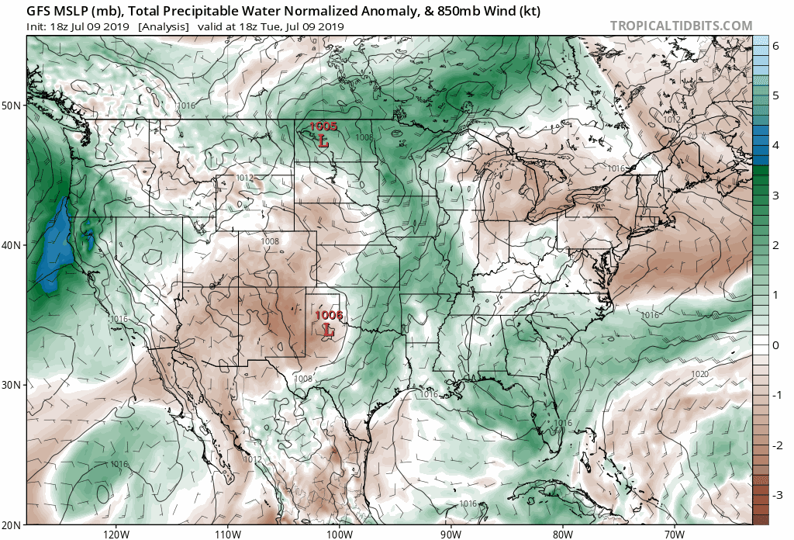
Thunderstorm Ingredients: Moisture
Water vapor cools and condenses to form clouds/storms when lifted
Gulf of California surges from tropical easterly waves and nearby storm complexes main moisture source for monsoon storms
Precipitable water most correlated w/Phoenix lightning (Rogers et al. 2018)
Moisture
Instability
Lift
Wind Shear
Notes:
https://www.tropicaltidbits.com/analysis/models/?model=gfs&region=us&pkg=mslp_pwata&runtime=2019070918&fh=150

Slide 17
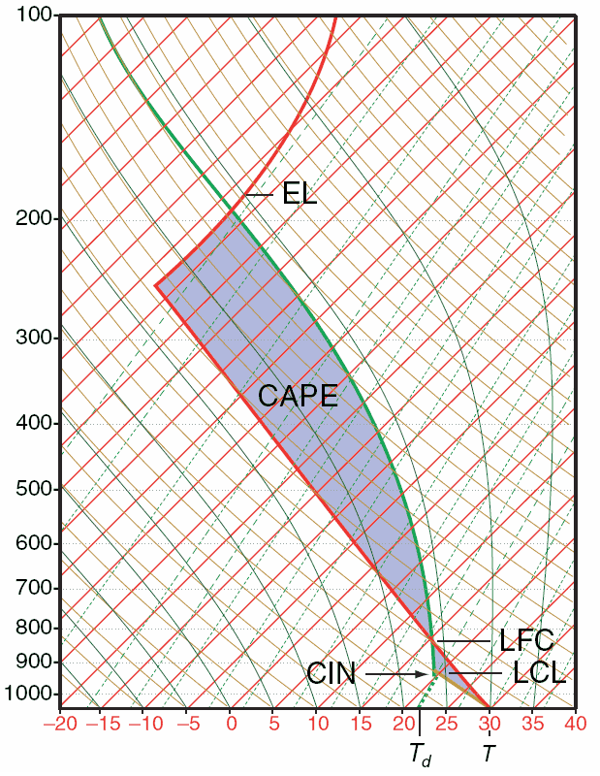
Thunderstorm Ingredients: Instability
Instability: air rises freely due to its own buoyancy
A bubble of air will rise as long as it is warmer than the air around it!
Instability parameters critical for
predicting thunderstorm development
Moisture
Instability
Lift
Wind Shear

Slide 18
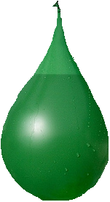
Potential Energy
Which water balloon has the
best chance to burst when it hits
the ground?
Or more scientifically, which balloon
has the higher potential energy?
Ground

Slide 19
CAPE: Convective Available Potential Energy
For storms, more potential energy means more CAPE
More CAPE = stronger and faster developing storms.
CAPE in the atmosphere can be calculated and visualized using a Skew-T diagram

Slide 20
Explanation of a Skew-T Diagram
Air Pressure:
Decreases as you go up in the atmosphere
Horizontal lines on the diagram (pressure is on a LOG scale)
Pressure (horizontal lines)

Slide 21
Explanation of a Skew-T Diagram
Air Temperature:
Lines SKEWED right (“Skew-T”)
0ºC line is shown (melting/freezing)
Temperature (lines “skewed” right)
0º C

Slide 22
Explanation of a Skew-T Diagram
Dry air bubbles follow these lines as they rise through the atmosphere
(cool at 9.8ºC/km)
Heat is conserved (no gain or loss) in an adiabatic process. Temperature changes are only due to expansion or compression of air.
Dry adiabat lines (dry air bubbles)

Slide 23
Explanation of a Skew-T Diagram
Saturated air bubbles follow these lines as they rise (cool at a slower rate with height)
Moist adiabat lines (saturated air bubbles)
There is little moisture at upper levels, so moist and dry adiabats are similar there.

Slide 24
Explanation of a Skew-T Diagram
The actual temperature of the air, as measured by the weather balloon:
Warmer than the air temperature
The actual dew point of the air, as measured by the weather balloon:
Colder than the air temperature

Slide 25
CAPE on a Skew-T
CAPE

Slide 26
CAPE on a Skew-T
More surface heat = More CAPE.
CAPE

Slide 27
CAPE on a Skew-T
CAPE also increases if atmosphere cools aloft
Dry air or “upper level disturbance” moves over
CAPE

Slide 28
Instability for Different Monsoon Storm Types
SE flow events have greatest moisture and instability (CAPE and “LI”)
NE flow events have the driest surface layer (DCAPE)
Type I: SE Flow
Type II: NE Flow
Type III: West/Hybrid
Notes:
Lifted Index is the Actual Environmental temperature at 500 mb – Parcel Temperature at 500 mb for surface-based parcel

Slide 29
Stability Profiles Common in Arizona
In our atmosphere, the air typically gets colder as you go up.
Cold
However, a CAP due to a layer of warmer air often prevents upward motions
Warm Temperatures
Cool
Requires lift to overcome
Warm/Moist

Slide 30
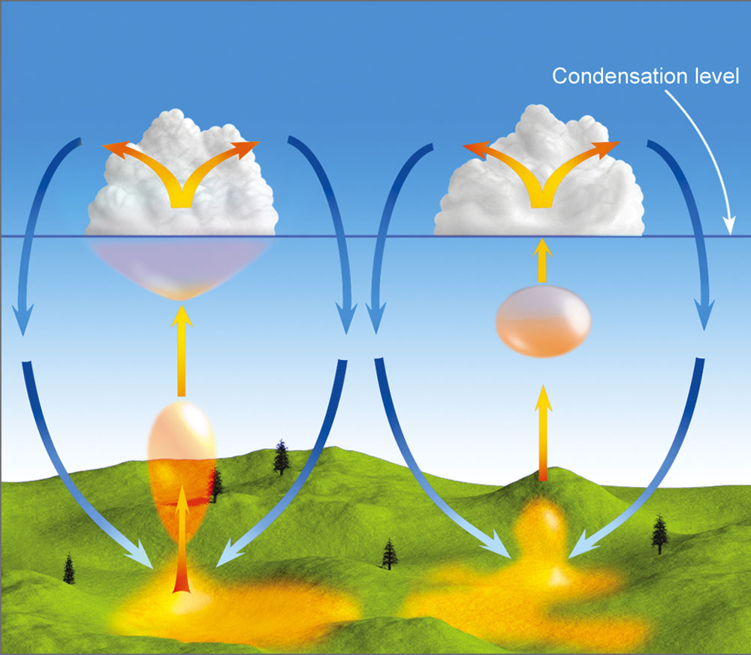
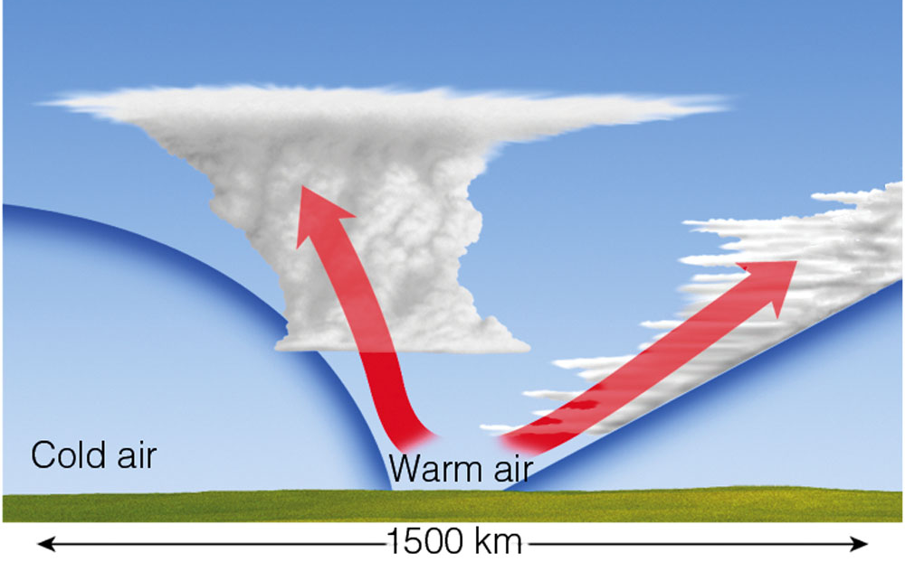
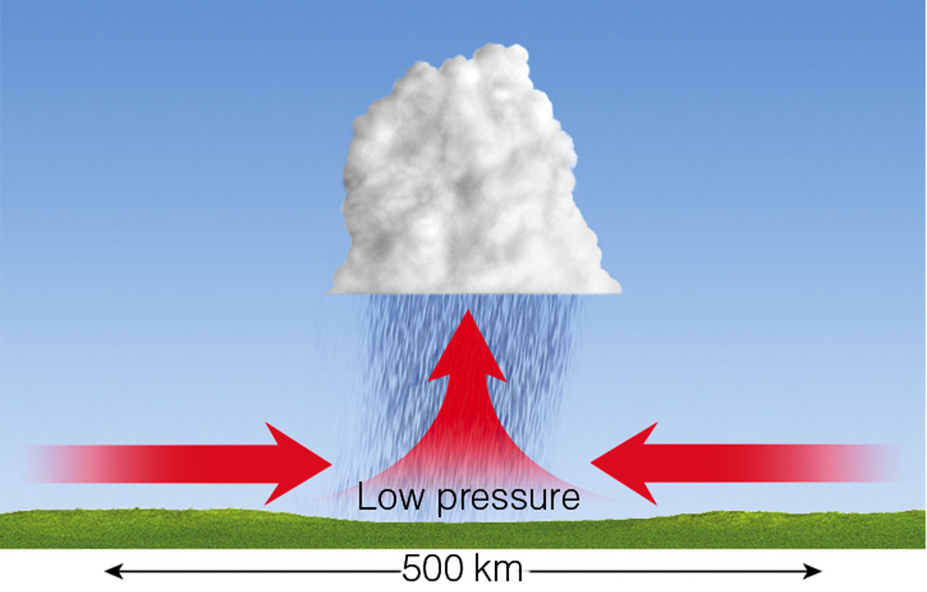
Thunderstorm Ingredients: Lift
Terrain and convergence due to low pressure systems most common
Do we ever have “fronts” in the monsoon?
Local Convection
(due to instability)
Frontal Lifting
Warm, less dense
Cold, dense
Moisture
Instability
Lift
Wind Shear
Cold, dense
Convergence
(Low Pressure Systems)
Terrain

Slide 31
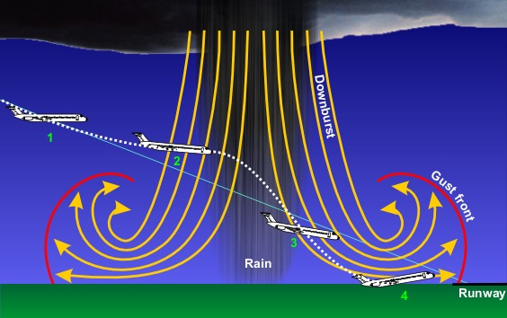
Microbursts
Very small-scale ”fronts” that pose hazards to planes
Dry air from cloud base to surface causes strong microbursts (best predictor DCAPE)
Notes:
Near Abilene TX. You can see the microburst come down on the left side of the screen and even see dust kick up after the strong winds hit the ground.

Slide 32
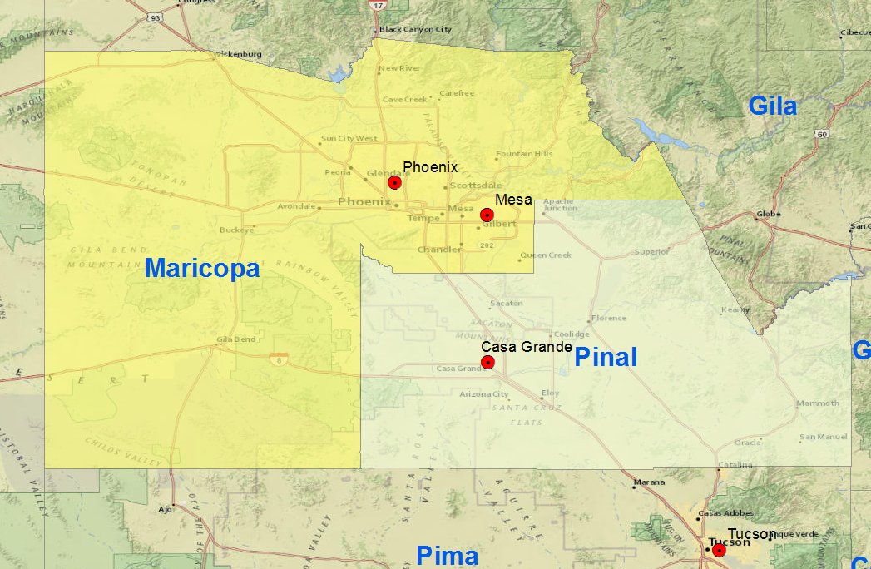
Second Year of Polygon Dust Storm Warnings!
More organized gust fronts and outflows behave like cold fronts, triggering dust storms and new thunderstorms
Shear best predictor for more organized (and severe) thunderstorms
Estimated phones alerted: 100,000 instead of 4.3 million!
97.5% Reduction in phones alerted!
New Polygon Warning: Only in effect for the area outlined in black. WEA uses the polygon rather than county boundaries to determine who is alerted.

Slide 33
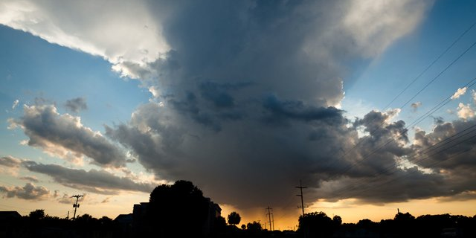
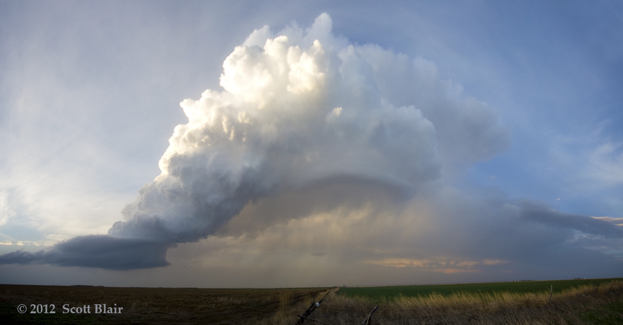
Thunderstorm Ingredients: Wind Shear
Shear (change in wind speed with height) is NOT needed to get storms, but allows organized storms to last longer!
Moisture
Instability
Lift
Wind Shear
Weak shear = Outflow-driven storms lasting ~1 hour
Strong shear = Storms last longer (updraft/downdraft separated)

Slide 34
Storm Prediction Center Convective Outlooks
Day 2 Outlook
(1630Z)
Day 1 Outlook
(2230Z)
SPC issues daily (12-12Z) convective outlooks to Day 3
“Marginal” Risk common (5% severe threat within 25 mi)
”Slight” Risk (15%) 1-3x p/yr; → Proxy for possible WATCH
Day 1 Outlook
(1230Z)
Severe Wind
(50+ knots)
Severe Hail
(1”+)
Tornado
Convective Outlook
Less than 2%
Slight risk most likely on days with 25-30+ kt shear (usually from NE)!
Notes:
Hazard Probs within 25 miles of a point

Slide 35
Severe Thunderstorm Watches
Watches issued for a high confidence of severe storms (in effect for 4-8 hours)
Only Severe T-Storm Watch issued for Phoenix last monsoon season (but not our only severe storms!)
If convection develops in 25-30+ kt shear, organized, severe storms likely!
Notes:
Hazard Probs within 25 miles of a point

Slide 36
Convective Warning Products
Watch: 3:40 p.m. (rare issuance)
Warning: 5:56 p.m.
AWW: 5:59 p.m.
Impact: 6:19 p.m.
(58 mph winds)
Notes:
Hazard Probs within 25 miles of a point

Slide 37
Convective Warning Products
Watch: 3:40 p.m. (rare issuance)
Warning: 5:56 p.m.
AWW: 5:59 p.m.
DUST STORM Warning: 6:03 p.m.
Impact: 6:19 p.m.
(58 mph winds)
Notes:
Hazard Probs within 25 miles of a point

Slide 38
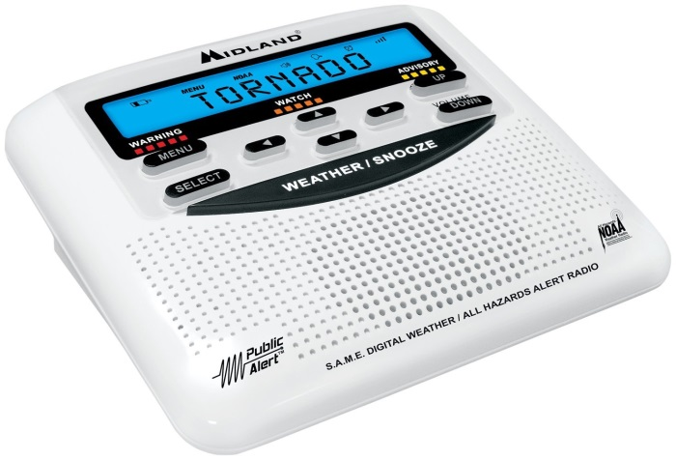
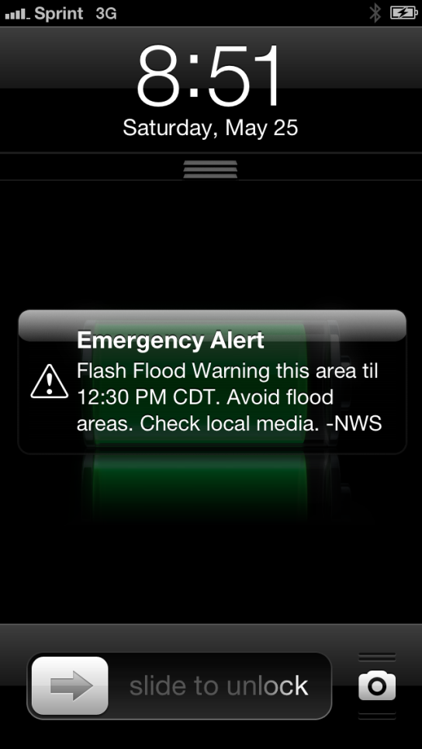
Keep Up to Date by Having 3 Ways to Receive Weather Warnings
Weather Apps
Weather Radio
Commercial Radio
Television
Mass Notification
Social Media
Only alerts for Tornado and Flash Flood Warnings
Most frequent posts on Twitter during weather events
Notes:
Remind people to watch Local TV stations during bad weather….most times the National stations like Weather Channel will not be talking about our severe weather especially if bad weather is going on over the west or east coasts. We are typically not the main story of the day. Weather radio, your own personal tornado siren…get one with S.A.M.E technology so you limit the number of warnings that activate the phone.

Slide 39
Questions?
Email Information:
larry.hopper@noaa.gov
weather.gov/Phoenix

