Slide 1
The National FAA Safety Team Presents
Introduction to Safety Risk Management (SRM)
<Audience>
<Presenter>
< >
Notes:
2022/03-15-246(I)PP Original Author: John Steuernagle 03/15/2022; POC (Kevin Clover), National FAASTeam Operations Program Manager, Office 562-888-2020; revised by (Name) (MM/DD/YYYY)
Presentation Note: This is the title slide for Introduction to Safety Risk Management (SRM)
Script - We have included a script of suggested dialog with most slides. The script will always appear in a non-italic font. Presenters may read the script or modify it to suit their own presentation style. See template slides 5 and 6 for examples of a slides with script.
Presentation Instructions - (stage direction and presentation suggestions) will be preceded by a Bold header: the instructions themselves will be in Italic fonts. See slides 2, for an example of slides with Presentation Instructions only.
Program control instructions - will be in bold fonts and look like this: (Click) for building information within a slide; or this: (Next Slide) for slide advance.
Background information - Some slides may contain background information that supports the concepts presented in the program. Background information will always appear last and will be preceded by a bold Background: identification.
The production team hope you and your audience will enjoy the show. Break a leg!
(Next Slide)

Slide 2
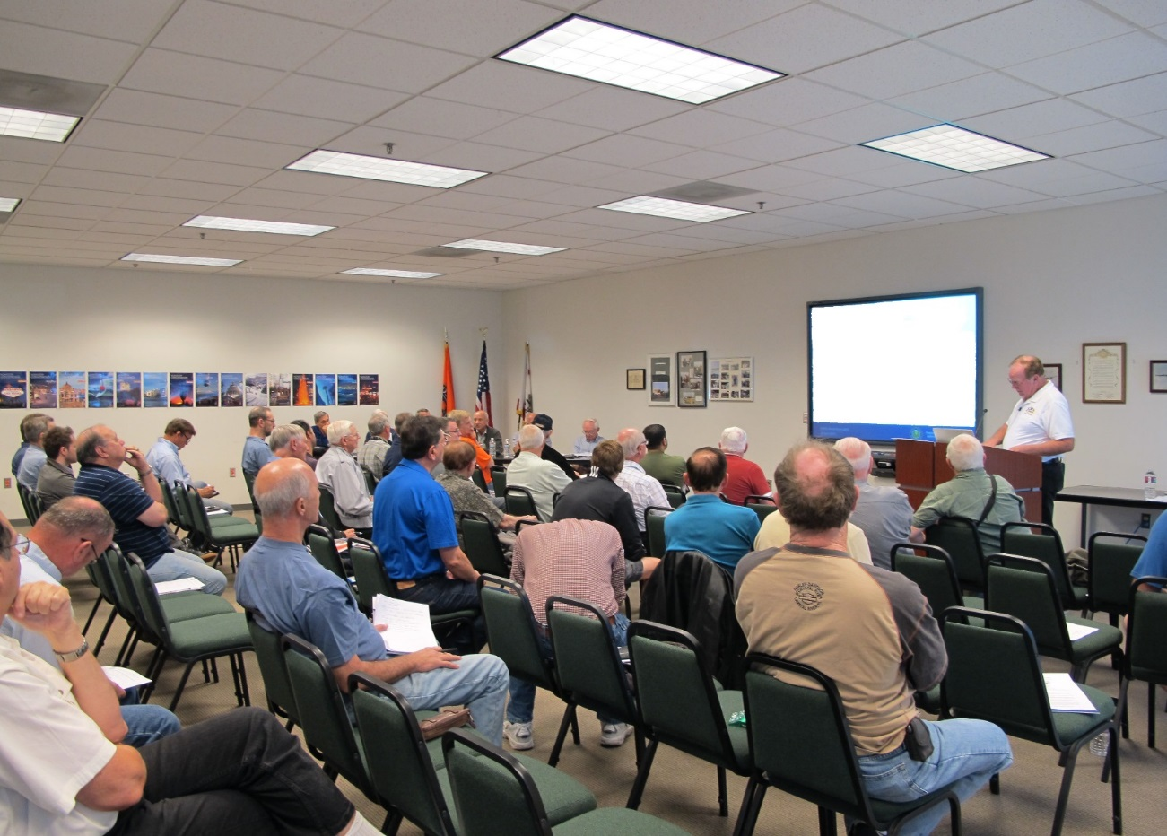
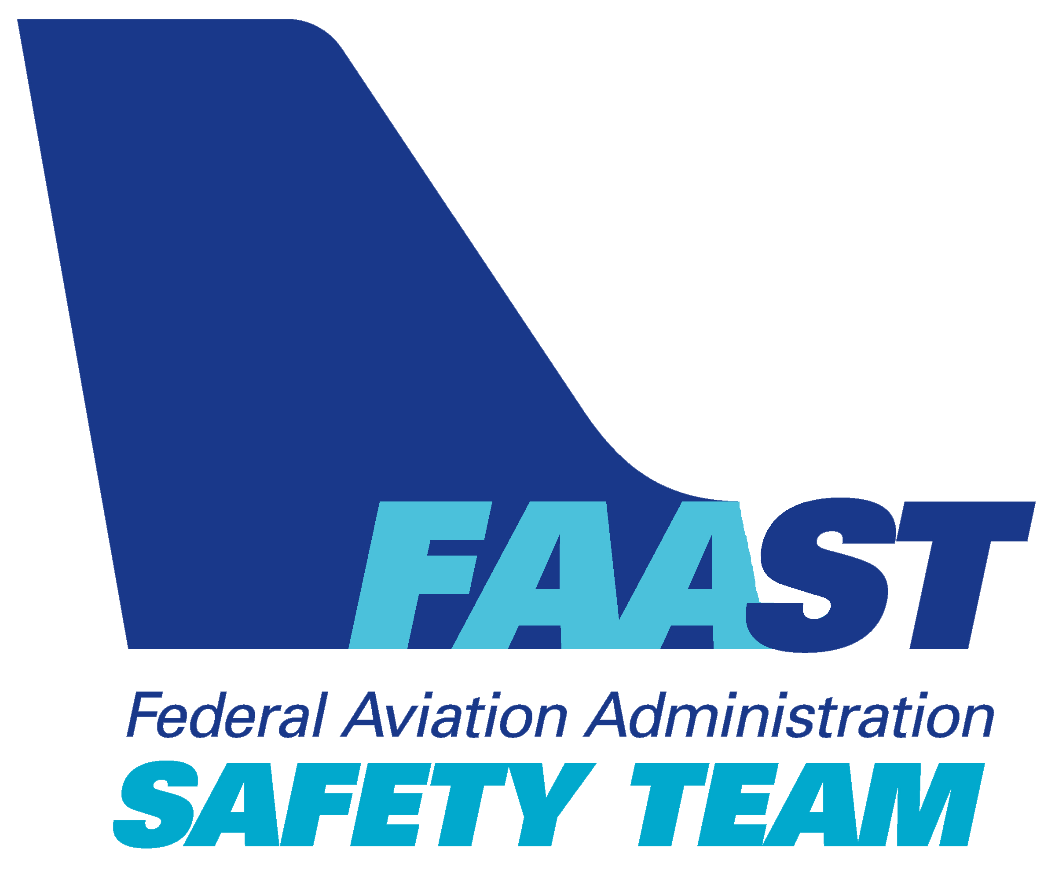
Welcome
Exits
Restrooms
Emergency Evacuation
Breaks
Set phones & pagers to silent or off
Sponsor Acknowledgment
Other information
Notes:
Presentation Note: Here’s where you can discuss venue logistics, acknowledge sponsors, and deliver other information you want your audience to know in the beginning.
You can add slides after this one to fit your situation.
(Next Slide)

Slide 3
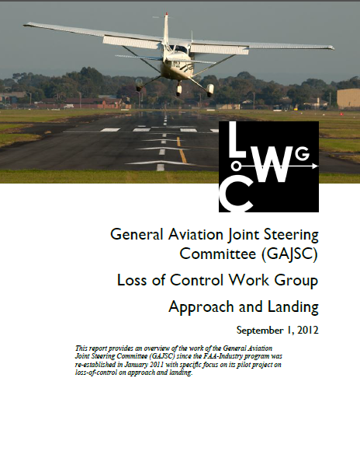
Overview
What is Safety Risk Management
How do pilots use SRM
SRM aids and technologies
* General Aviation Joint Steering Committee
Notes:
In this presentation we’ll talk a little bit about recommendations from the General Aviation Joint Steering Committee: a work group that studies General Aviation mishaps. We’ll define and discuss safety risk management and how pilots use SRM to not only fly safer but more efficiently. Finally we’ll show you some SRM aids and technologies.
But first – let’s look at what SRM is
Presentation Note: If you’ll be discussing additional items, add them to this list.
(Next Slide)

Slide 4
Foundational Elements of Safety
Safety Risk Management
Hazard identification, risk assessment, and risk mitigation
Pilot Proficiency
The skills to do the job
Technology
Supporting safe decision making and aircraft operations
Notes:
Our collective and individual safety programs are based on three foundational elements: (Click)
Safety Risk Management – hazard identification, risk assessment, and risk mitigation, (Click)
Pilot Proficiency – the skills to do the job, (Click)
and technology that supports safe decision making and aircraft operations.
Technology has made great progress in reducing aircraft accidents and it will continue but we still have to maintain proficiency and we have to know what we’re getting into and manage the flight risks to ensure that we have the resources and ability to meet the challenges we accept.
(Next Slide)

Slide 5
A matter of balance
Flight Challenges
Knowledge, Skill, & Technology
Safety Risk Management
Notes:
It’s a matter of balance. Our knowledge, skills, and technologies must be equal to the challenges we face in flight. But how do we know in advance that we’ll be equal to the task? (Click)
That’s where safety risk management comes in. We use the SRM process to understand flight challenges before we accept them. But before we see how that works, let’s define some terms.
(Next Slide)

Slide 6
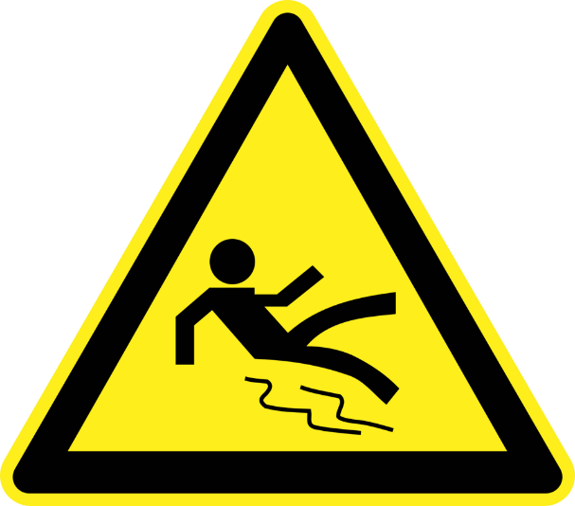
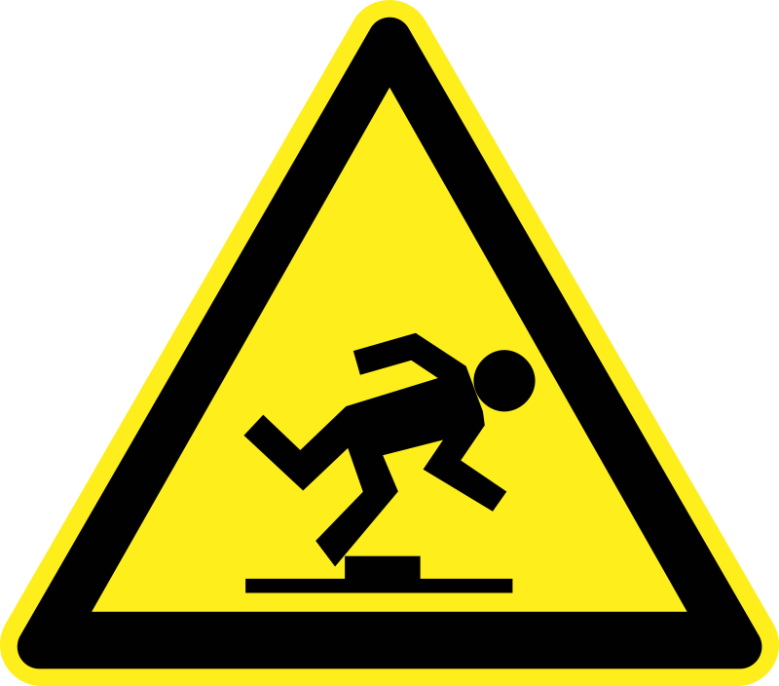
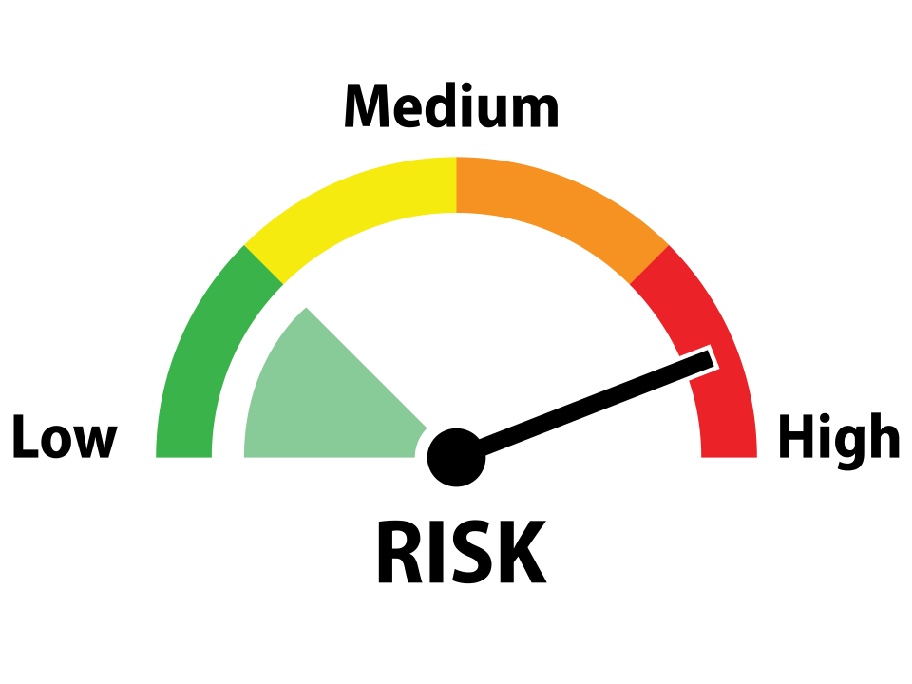
Hazards and Risks
Hazard
A condition, event, object or circumstance that could cause or contribute to an unwanted event
Risk
The future influence of hazards on safe operations
Notes:
A hazard is a condition, event, object or circumstance that could cause or contribute to an unwanted event. If we walk on an icy driveway on our way to the mailbox we might slip and fall.
Risk is the future influence of hazards on safe operations. In other words risk is an educated estimate of the chances that a given hazard might negatively affect our operations.
(Next Slide)

Slide 7
Accept
Eliminate
Mitigate
Notes:
Using our previous example – let’s say we’ve identified a hazard and we’re pretty sure it will cause us some trouble. We now have three choices: (Click)
We can accept the risk – rarely a good idea but you never know until you try. You might just make it. (Click)
We can eliminate the risk – that way we don’t have to deal with it at all. (Click)
Or we can mitigate the risk to an acceptable level. Make it less likely that we’ll have a negative experience. There’s just one more thing we need to consider.
(Next Slide)

Slide 8
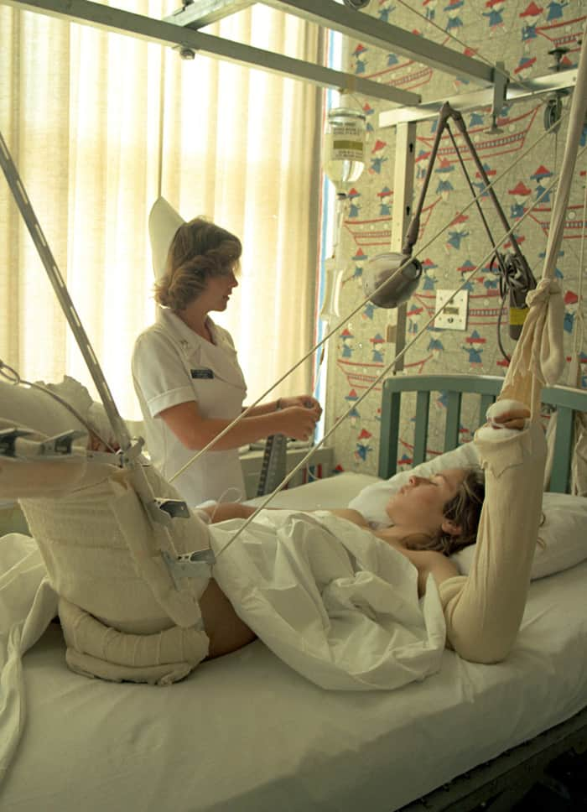
Severity of consequences
Marginal
Catastrophic
Notes:
The severity of consequences can run from minor inconvenience (Click)
to catastrophe. More about this and an aviation definition of consequences in a minute but first; let’s take a look at Safety Risk Management in action.
(Next Slide)

Slide 9
The SRM Process
Perceive –
Identify the hazard
Process –
Assess the likelihood of occurrence
Assess the severity of consequences
Develop plan to eliminate or mitigate risk
Perform
Implement risk elimination or mitigation plan
Perceive –
Assess plan effectiveness
Process –
Develop adjustments to the plan
Perform
Implement plan adjustments
Notes:
Here’s an easy to remember process for hazard identification, risk assessment, and risk mitigation. (Click)
Perceive – Identify the hazard. (Click)
Process – Assess the chances of the hazard impacting your flight operation. Assess the severity of consequences if it does and develop a plan to either eliminate the risk or reduce it to an acceptable level. (Click)
Perform by executing your risk elimination plan. Simple? Yes it is. But are we done here? Not quite. (Click)
Now it’s time to perceive the effectiveness of your risk mitigation plan. Are you getting the results you expected or do you need to make adjustments? Process and perform the plan adjustments and – you guessed it – Perceive the results.
So you see that the SRM process is far from a one and done job but rather a continuous management of safety risks.
That’s enough of theory – let’s see how it works in practice.
(Next Slide)

Slide 10
Safety Risk Management
Hazard Identification
Risk Assessment
Risk Mitigation
Monitoring
Notes:
As we saw in the video, SRM is a 3-step process beginning with (Click)
Hazard identification – What conditions or circumstances could negatively affect your flight. (Click)
Risk Assessment – How likely are the identified hazards to cause a problem and how severe will be the consequences if they do? (Click)
Risk Mitigation – What can I do to reduce the risks to acceptable levels? (Click)
Finally, we need to constantly monitor the hazards and risks associated with our flight to make sure that the identified risks remain at an acceptable level.
(Next Slide)

Slide 11
Hazard Identification
Hot oven & pizza pan
Notes:
So – back to the video – what are the hazards here?
Presentation note: Ask the audience to identify the hazards, then: (Click)
Right the hot oven, pizza, and the pizza pan are hazards.
(Next Slide)

Slide 12
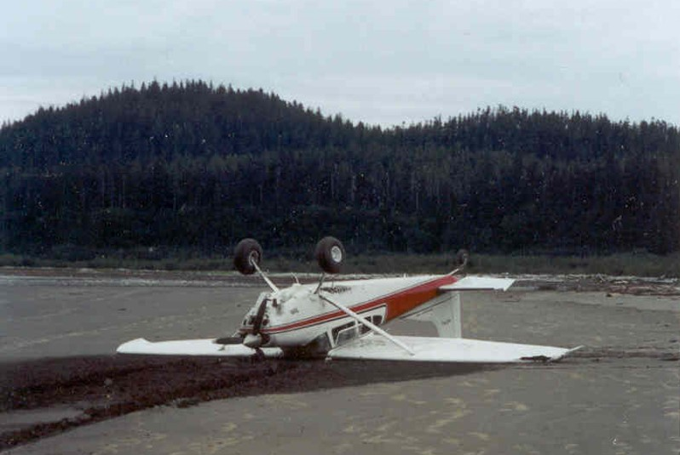
Risk Assessment
How bad is the wreck going to look?
Notes:
A famous Alaskan bush pilot was asked how he assessed the risks of landing at unfamiliar back country strips. His answer: “well the first thing you want to ask yourself is, how bad is the wreck going to look?” (Click)
Here’s a picture of a well executed short field landing at an annual Alaskan contest in Valdez. No airplanes were harmed in the filming of this event and the landing was success. No wreck. (Click)
But here’s a photo of another Alaskan landing on a beach. The combination of aircraft, pilot, and environment didn’t work out optimally in this case and, if the pilot had assessed this result as likely, he might not have attempted the landing.
(Next Slide)

Slide 13
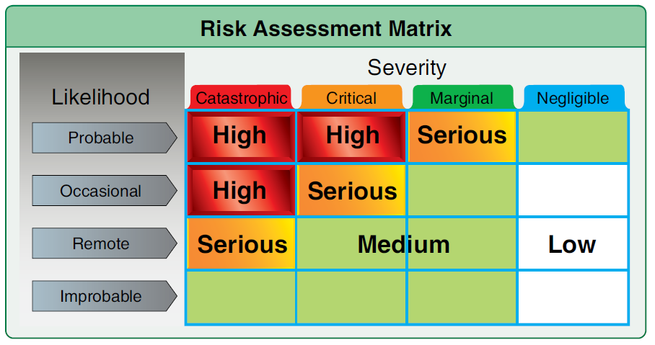
Risk Assessment
Hot oven, pizza pan, & pizza pie
Likelihood
Probable
Occasional
Remote
Improbable
Severity
Catastrophic
Critical
Marginal
Negligible
Notes:
But we were talking pizza – not planes. We have a hot oven, pan, and pie. How bad is this wreck going to look if we just reach in there and grab it. Think in terms of likelihood and severity. (Click)
Likelihood first – If we reach in with our bare hands and grab the pan, how likely is it that we’ll be burned?
Presentation note: Ask the audience for answers then:
Right you are it is highly probable that we’ll be burned. We’re going to be hurt. The question is, how bad is it going to look. Here are your severity choices: (Click)
Ask audience for input, then:
Well this burn won’t kill us but it’s not going to be marginal or Negligible either so we’re left with critical. Not in a life or death context but critical in that it’ll be a while before our hands are fully functional again and that could compromise the jobs we have to do. (Click)
Here’s a risk matrix from FAA’s Risk Management Handbook. (Click)
You can see that the combination of Probable and Critical equals High risk and we must do something to reduce that risk to an acceptable level.
(Next Slide)

Slide 14
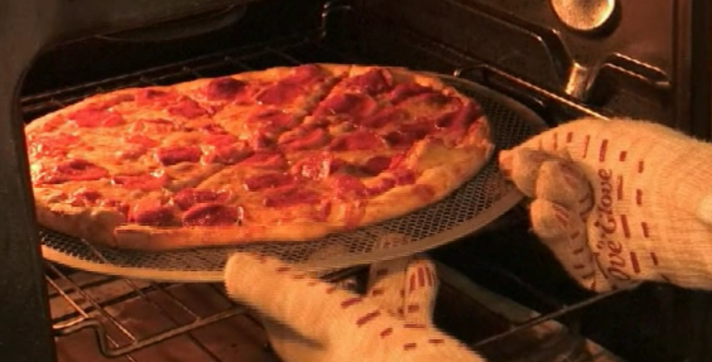
Risk Mitigation
The risk of injury is not eliminated – just reduced.
Notes:
We saw that the risk of injury from the hot oven & pie was mitigated to an acceptable level by using hot pads or gloves to get the pie on the table. Note that the risk of injury is less when the whole hand is protected; a little more likely if hot pads are used. Also note that the risk is not eliminated – just reduced. We could still burn an unprotected area or our gloves might be defective but, overall, the risk has been mitigated to an acceptable level.
The pizza example is simplistic. We all know that flying involves an extensive set of variables and a simple flight on one day can be impossible on another. Let’s take a look at a GA flight.
(Next Slide)

Slide 15
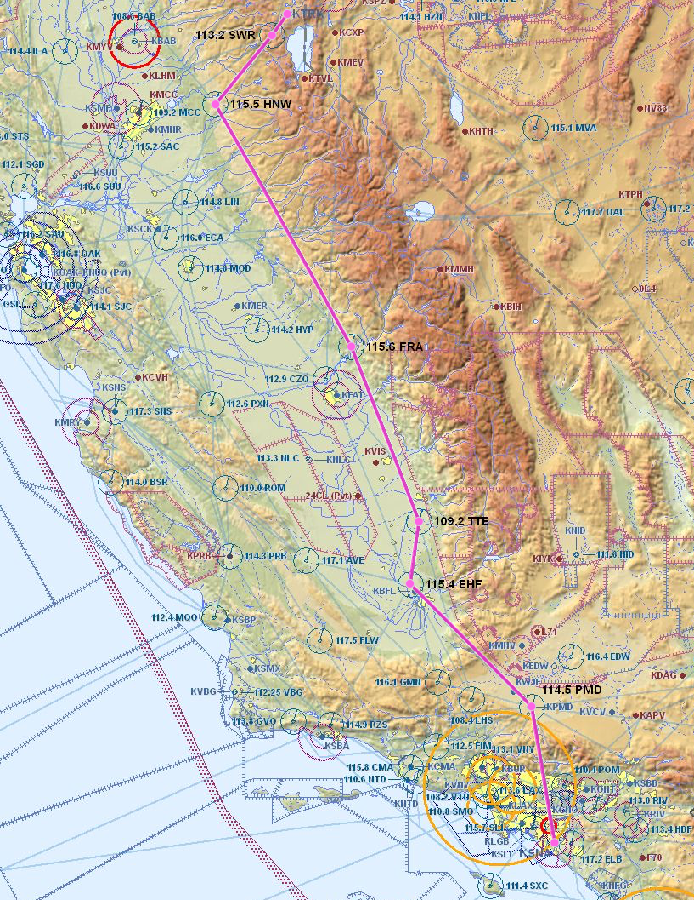
Hazard Identification
Mission – KSNA – KTRK
391 nm 3Hrs. 22 Min
Depart at 1800 Local Time
Pilot – Private, VFR
850 hrs. TT, 30 in last 6 months
Current medical, flight review, day/night currency
Aircraft – C-172-P
43 Gal Fuel, Day/Night VFR
Environment – DAY/Night/VFR
Mountains.
External Pressure (s) – Family Reunion
Notes:
In this example an 850 hour Private Pilot will be flying his family from Santa Ana, California to a reunion event in Lake Tahoe. The weather is forecast to be good along the route. The pilot will go straight to the airport after work and meet his family there. If all goes as planned, the flight will depart at or a little before six pm.
So what hazards should be considered for this trip? Would you say the risks are acceptable? If not, what could the pilot do to mitigate them?
Presentation note: Guide the audience in a discussion of hazards, risks, and mitigations. Some hazards include, VFR at night in mountainous terrain, possible fatigue due to departure after a full day at work, pressure to complete the flight in order to be present for the reunion, etc. Mitigations might include leaving work early in order to reduce fatigue and arrive in daylight or planning to leave early in the morning the following day. Make the point that going to this destination at night would be a particularly bad idea if the pilot were unfamiliar with the field.
(Next Slide)

Slide 16
Want an easier way to do it?
Introducing the FAASTeam Flight Risk Assessment Tool
Easy to use
Basic flight risk assessment
For General Aviation Pilots
FAAST FRAT
Notes:
Do you want and easier way to do it?
Introducing the FAAST FRAT; (Click)
an easy to use, basic Fight Risk Assessment Tool for general aviation pilots.
(Next Slide)

Slide 17
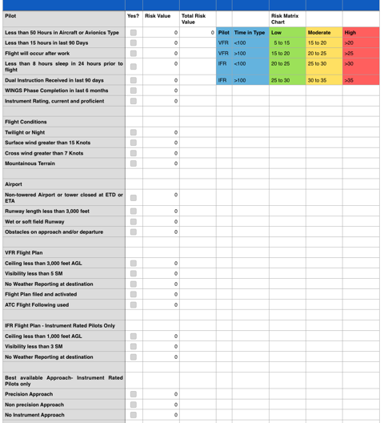
20 Statements - VFR
22 Statements - IFR
FAAST FRAT
Notes:
The FAAST FRAT is a simple automated spread sheet that contains 20 condition statements for VFR pilots; 22 for IFR pilots.
The statements describe common general aviation flight liabilities and assets. Pilots simply click the “yes” box next to each statement that applies to their flight.
Each yes statement generates a risk value and those values are totaled on the sheet.
The total risk value is related to the risk matrix chart to determine whether the flight risk is likely to be low, moderate, or high.
(Next Slide)

Slide 18
FAAST FRAT
Notes:
In this example, the pilot has fewer than 15 hours in the last 90 days but a WINGS Phase was completed in the last 6 months. The risk of low recent experience is cancelled by the WINGS Phase completion.
Surface winds will be greater than 15 knots resulting in a risk value of plus 4. The flight will be to a non-towered airport, ceiling will be less than 3,000 feet and there is no weather reporting at the destination. (Click)
This results in a total risk value of 15.
(Next Slide)

Slide 19
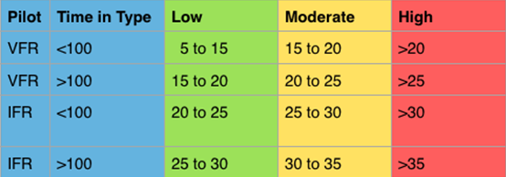
FAAST FRAT
Notes:
Looking at the Risk Matrix Chart we see that a Total Risk Value of 15 is between Low and Moderate for a VFR Pilot with fewer than 100 hours time in type, (Click)
but well within the low range for an IFR pilot with more than 100 hours time in type.
(Next Slide)

Slide 20
FAAST FRAT
Can’t cover all possible flight hazards
Does address common GA accident causal factors
Safety Risk Management - 101
Notes:
No FRAT can cover all possible flight hazards but this one – though simple – does address some factors that are common to GA accidents. We hope it’s use will prompt pilots to learn more about Safety Risk Management.
Now to get your copy here’s what you do……….
(Next Slide)

Slide 21
FAAST FRAT
Log on to FAASafety.gov
Click on Resources then click on Library
Notes:
Navigate to FAASafety.gov
Click on Resources, then click on Library.
(Next Slide)

Slide 22
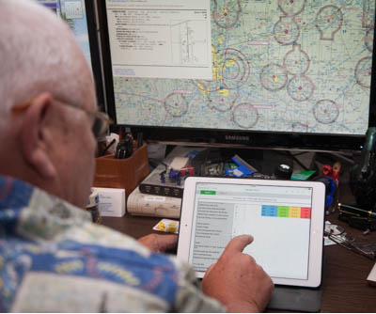
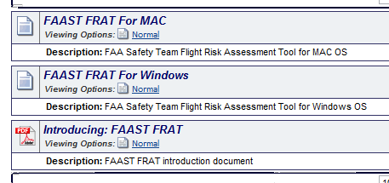
FAAST FRAT
Click on Flight Risk Assessment Tool
Download appropriate FRAT for your computer.
Notes:
Click on Flight Risk Assessment Tool (FRAT)
Download the appropriate FRAT for your computer
Note: FAAST FRAT for Windows will not run with Excel for MAC. If you want to run the FRAT on your Apple computer, you’ll need the Numbers application.
We’ve looked at safety risk management for individuals
(Next Slide)

Slide 23
Safety Risk Management
Safety Management Systems (SMS)
Notes:
We’ve taken a look at Safety Risk Management for individuals, (Click)
but SRM is also a foundational pillar of larger safety management systems that’s being adopted by large and small organizations world wide. So before we go, let’s take a quick look at SMS.
(Next Slide)

Slide 24
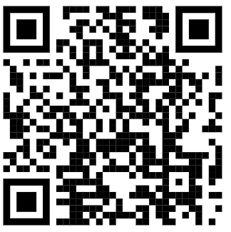
Safety Management Systems (SMS) Coming to General Aviation
https://www.faa.gov/about/initiatives/gasafetyoutreach
Notes:
Safety Management Systems are a set of policies and processes that can increase the safety and efficiency of any flight operation. And FAA is bringing SMS to General Aviation. You may have heard of SMS but thought it was only for large organizations but actually SMS can be scaled to fit any operation large or small.
There are 4 major components to a Safety Management System (Click)
Safety Policy – a documented commitment to safety that runs from the head of an organization to its newest member. (Click)
Safety Risk Management – a process that identifies hazards within an operation, determines to what extent an identified hazard may impact flight safety, and controls the risk of occurrence to an acceptable level. (Click)
Safety Assurance – By collecting and analyzing information derived from safety performance data Safety Assurance ensures the performance and effectiveness of Safety Risk Controls. (Click)
Safety Promotion communicates safety information and commitment throughout the organization. (Click)
You can find more information about Safety Management Systems at the URL on the Screen.
(Next Slide)

Slide 25
Questions?
Notes:
Presentation Note: You may wish to provide your contact information and main FSDO phone number here. Modify with
Your information or leave blank.
(Next Slide)

Slide 26
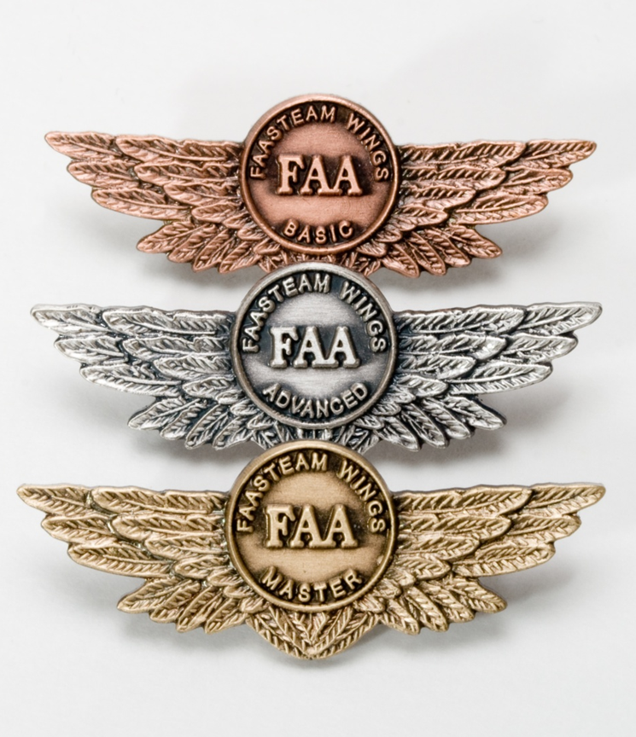
Proficiency and Peace of Mind
Fly regularly with your CFI
Perfect Practice
Document in WINGS
Notes:
There’s nothing like the feeling you get when you know you’re playing your A game and in order to do that you need a good coach (Click)
So fly regularly with a CFI who will challenge you to review what you know, explore new horizons, and to always do your best. Of course you’ll have to dedicate time and money to your proficiency program but it’s well worth it for the peace of mind that comes with confidence. (Click)
Vince Lombardi, the famous football coach said, “Practice does not make perfect. Only perfect practice makes perfect.” For pilots that means flying with precision. On course, on altitude, on speed all the time. (Click)
And be sure to document your achievement in the Wings Proficiency Program. It’s a great way to stay on top of your game and keep you flight review current.
(Next Slide)

Slide 27
Why WINGS?
Proficient Pilots are:
Confident
Capable
Safe
WINGS will keep you on top of your game
Notes:
So why WINGS? Well proficiency is key to success in almost every thing worth doing – especially flying. Proficient pilots are confident, capable, and safe.
WINGS is a proficiency training system specifically designed for general aviation pilots and regular participation will keep you on top of your flying game.
(Next Slide)

Slide 28
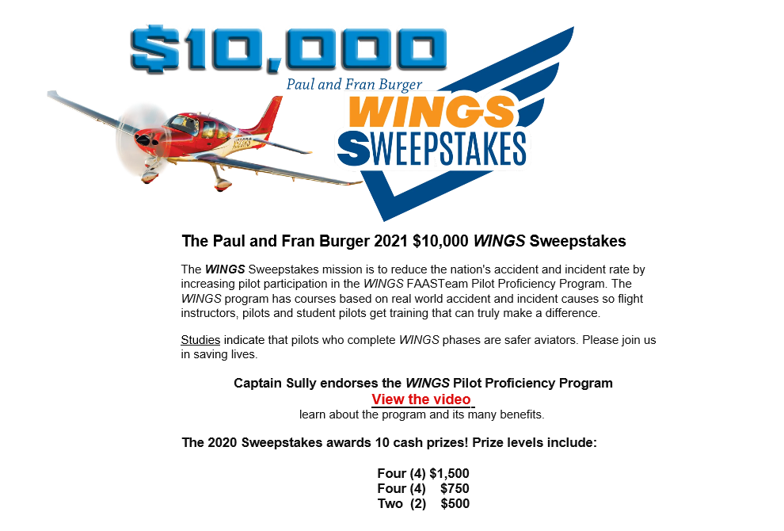
http://www.mywingsinitiative.org/
Notes:
Now there are even more reasons to participate in WINGS. Every time you complete a WINGS Phase you’re eligible to win cash the WINGS Sweepstakes.
The sweepstakes is generously funded by Paul Burger, a long time advocate for general aviation safety and a retired aviator who believes participation in this program saves lives. VISIT WWW.MYWINGSINITATIVE.ORG to learn more and enter the sweepstakes.
(Next Slide)

Slide 29
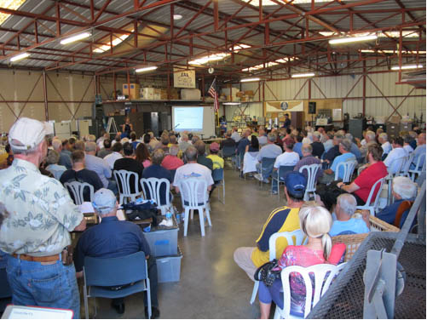
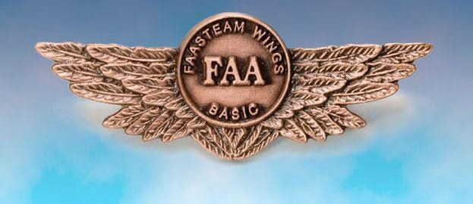
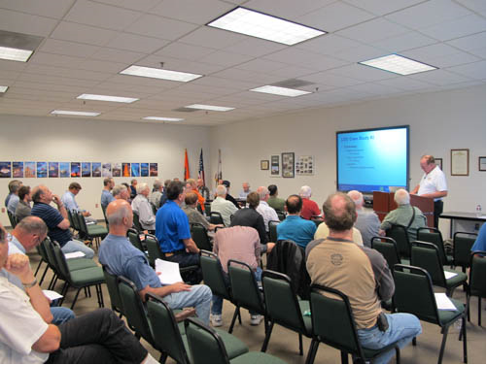
Thank you for attending
You are vital members of our GA safety community
Notes:
Your presence here shows that you are vital members of our General Aviation Safety Community. The high standards you keep and the examples you set are a great credit to you and to GA.
Thank you for attending.
(Next Slide)

Slide 30
The National FAA Safety Team Presents
Introduction to Safety Risk Management (SRM)
<Audience>
<Presenter>
< >
Notes:
(The End)

