Slide 1
The National FAA Safety Team Presents
Topic of the Month - June
Regulatory Roadblock Reduction
<Audience>
<Presenter>
< >
Notes:
2022/03-17-251(I)PP - Original Author: James Lamb 03/14/2018 SLT; POC Kevin Clover - National FAASTeam Program Mgr. (Operations), Office 562-888-2020; Revised by J Steuernagle (05/25/2022)
Presentation Note: This is the title slide for Regulatory Roadblock Reduction
Script - We have included a script of suggested dialog with most slides. The script will always appear in a non-italic font. Presenters may read the script or modify it to suit their own presentation style. See template slides 5 and 6 for examples of a slides with script.
Presentation Instructions - (stage direction and presentation suggestions) will be preceded by a Bold header: the instructions themselves will be in Italic fonts. See slides 2, 3, and 4 for examples of slides with Presentation Instructions only.
Program control instructions - will be in bold fonts and look like this: (Click) for building information within a slide; or this: (Next Slide) for slide advance.
Background information - Some slides may contain background information that supports the concepts presented in the program. Background information will always appear last and will be preceded by a bold Background: identification.
The production team hope you and your audience will enjoy the show. Break a leg!
(Next Slide)

Slide 2
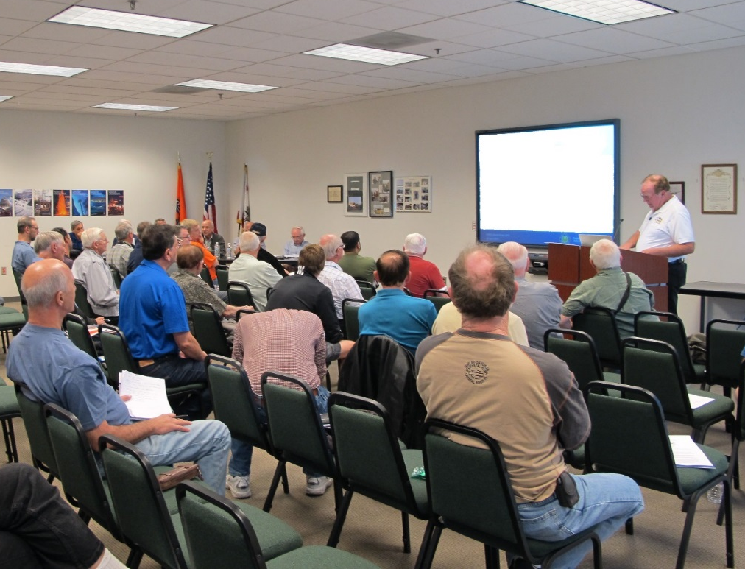
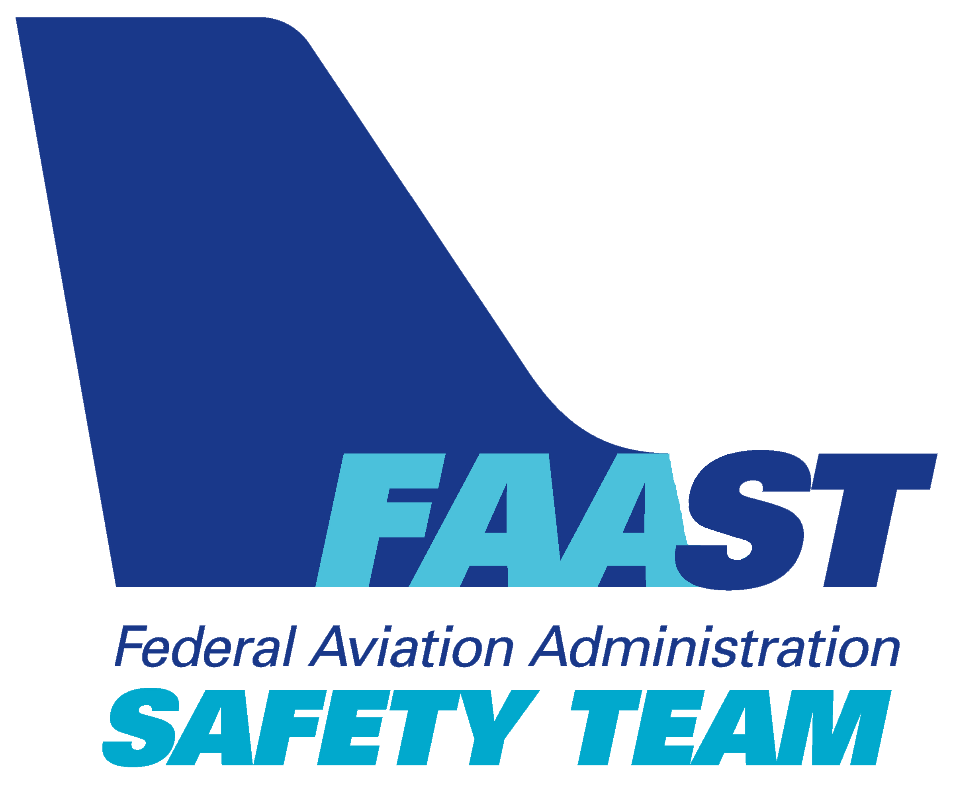
Welcome
Exits
Restrooms
Emergency Evacuation
Breaks
Set phones & pagers to silent or off
Sponsor Acknowledgment
Other information
Notes:
Presentation Note: Here’s where you can discuss venue logistics, acknowledge sponsors, and deliver other information you want your audience to know in the beginning.
You can add slides after this one to fit your situation.
(Next Slide)

Slide 3
Overview
Understanding Regulatory Roadblocks
Changes to certification of Part 23 aircraft
Technology to address LOC accidents
* General Aviation Joint Steering Committee
Notes:
In this presentation we’ll talk a little bit about recommendations from a work group known as the General Aviation Joint Steering Committee (GAJSC) that studies General Aviation mishaps and provided mitigation strategies. For this month’s topic, we review their study results and recommendations for “Loss of Control on Approach and Landing and En Route.
Presentation Note: If you’ll be discussing additional items, add them to this list
(Next Slide)

Slide 4
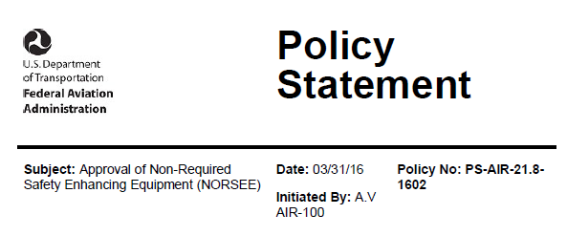
Approval of non-required safety equipment
Notes:
In 2016 the FAA took a major step toward easing the approval requirements for installation of non-required safety enhancing equipment. The policy statement acknowledges the benefits of equipping with safety gear and makes it easier for aircraft owners and manufacturers to do so.
(Next Slide)

Slide 5
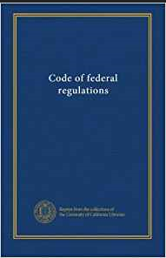
Reducing Regulatory Roadblocks
The FAA has accepted ASTM International standards as a means of certification for Part 23 aircraft.
This is aimed to streamline certification standards to reduce the regulatory burden on the industry and reduce the cost of aircraft certification.
Notes:
Recommendations from the GAJSC included reducing regulatory roadblocks that affect initial certification and installation of additional avionics technology. The committee believes that extensive certification requirements for installation of additional risk mitigating avionics in small GA aircraft results in an expense that is too large a fraction of the airplane’s value to justify the expense.
Part 23 regulations will continue to be used as a means of certification, but the administrator has deemed the ASTM standards to provide "at least the same level of safety as the corresponding requirements in part 23, amendment 23-64." For the past few years, the FAA has allowed ASTM consensus standards as a means of certification for Light Sport Aircraft. The agency has also made provisions within part 23 to streamline the certification of safety components such as angle-of-attack indicators. The catalyst for these changes was the Small Airplane Revitalization Act of 2013.
(Next Slide)

Slide 6
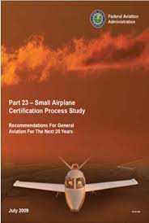
Changes to Certification of Part 23 Aircraft
The final rule overhauling airworthiness standards for general aviation airplanes, published in December of 2016, is now in effect.
Notes:
The Federal Aviation Administration (FAA) expects this rule will enable faster installation of innovative, safety-enhancing technologies into small airplanes, while reducing costs for the aviation industry.
With these performance-based standards, the FAA delivers on its promise to implement forward-looking, flexible rules that encourage innovation. Specifically, the new part 23 revolutionizes standards for airplanes weighing 19,000 pounds or less and with 19 or fewer passenger seats by replacing prescriptive requirements with performance-based standards coupled with consensus-based compliance methods for specific designs and technologies.
This regulatory change is a leading example of how the FAA is transforming its Aircraft Certification Service into an agile organization that can support aviation industry innovation in the coming years.
(Next Slide)

Slide 7
Changes to Certification of Part 23 Aircraft
ASTM F3264 - 18
Standard Specification for Normal Category Aeroplanes Certification
ASTM Consensus Standards F3264 - 17
Standard Specification for Normal Category Aeroplanes Certification
The introduction of new aircraft might have just become a lot easier. The FAA has accepted ASTM International standards as a means of certification for Part 23 aircraft.
Notes:
ASTM Consensus Standards F3264 - 17 identifies the industry standards which have been determined by consensus to demonstrate compliance to the requirements (“the Rules”) for Level 1, 2, 3, 4 Normal Category Aeroplanes
The FAA announced its acceptance of 30 published ASTM International consensus standards for certification of normal category Part 23 airplanes. The new Means of Compliance (MOC) are, according to the FAA, “an acceptable means, but not the only means, of showing compliance to the applicable regulations in Part 23 [and] provide at least the same level of safety as the corresponding requirements.”
(Next Slide)

Slide 8
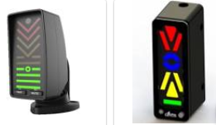
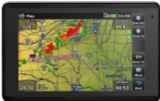
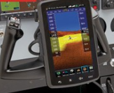
Aviation Technology
Technology that addresses LOC in GA aircraft could either be installed or portable devices such as:
Auto Pilot
GPS Navigation
AOA Indicator
Notes:
The GAJSC suggests that there is an opportunity to affect the value verses cost ratio for new equipment such that a large percentage of the general aviation aircraft owners will elect to purchase and install safety enhancing equipment.
i. Make publicly available a “baseline” approved Digital Terrain Elevation and Obstacles Database provided by the Federal government at a very low cost or free. It would be important to aerial application and rotorcraft communities and therefore the obstacle database must include obstacles down to 10 feet.
ii. Augment programs that will speed up the development of low cost graphical displays that reduce pilot workload and improve situational awareness.
(Next Slide)

Slide 9
GAJSC Report Finds IMC Accidents Frequently Started During Approach.
The GAJSC believes that providing pilots with GPS moving maps, real time weather, and terrain awareness has made a significant reduction in pilot workload during non-precision approaches.
Notes:
Reducing the regulatory barriers to encourage the development and installation of smart technology to integrate the piloting, navigation and control systems would improve envelope protection and reduce pilot workload.
(Next Slide)

Slide 10
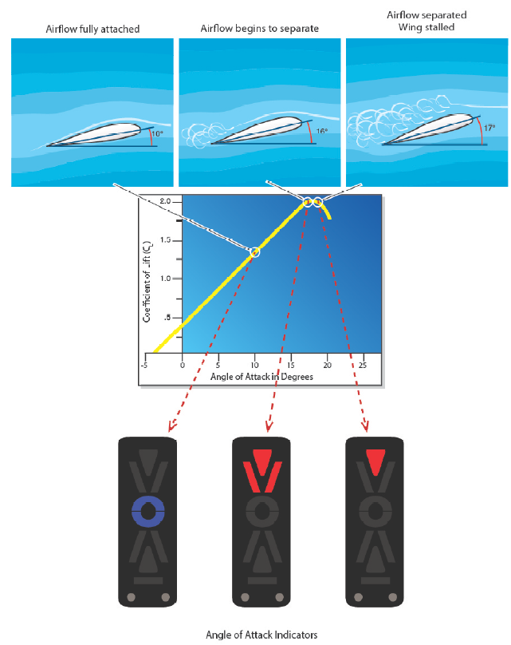
Risk Mitigation
Angle of Attack Indicators – AOA
The purpose of an AOA indicator is to give the pilot better situational awareness pertaining to the aerodynamic health of the airfoil. This can also be referred as stall margin awareness. More simply explained, it is the margin that exists between the current AOA that the airfoil will stall
(critical AOA).
Notes:
The FAA along with the General Aviation Joint Steering Committee (GAJSC) is promoting Angle of Attack (AOA) indicators as one of the many safety initiatives aimed at reducing the General Aviation accident rate. AOA indicators will specifically target Loss of Control (LOC) accidents. Loss of control is the number one root cause of fatalities in both General Aviation (GA) and Commercial Aviation. More than 25% of General Aviation fatal accidents occur during the maneuvering phase of flight. Of those accidents-half involve stall/spin scenarios. Technology such as AOA indicators can have a tremendous impact on reversing this trend and are increasingly affordable for GA airplanes. (Reference: Instrument Flying Handbook “FAA-H-8083-15B”)
The AOA indicator provides pilots with an awareness (visual and audio) of their margin above stall. The system accounts for all conditions such as weight and acceleration by design, whereas using stall speed does not. AOA system installations should be easy because they are not required equipment and do not interface with any existing equipment. The GAJSC suggest that AOA system installations should be easy because they are not required equipment and do not interface with any existing equipment.
(Next Slide)

Slide 11
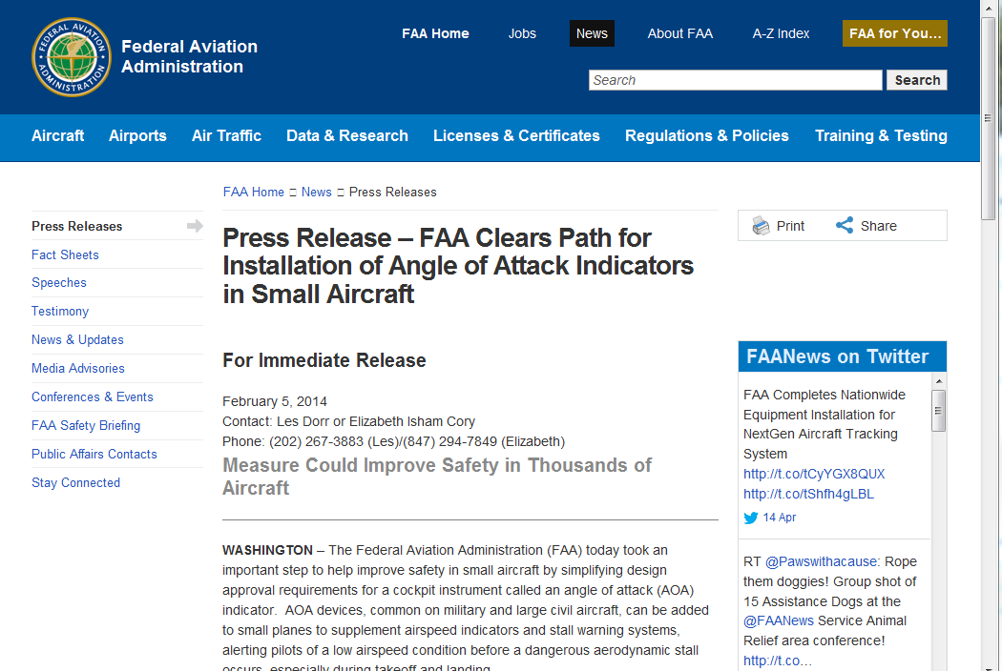
Streamlined Certification Process
http://Bit.ly/3NGriYD
Notes:
FAA’s Small Airplane Directorate has streamlined the process for production and retrofit approval of AOA devices.
Presentation Note: If you have an internet connection you can access the Press Release by clicking on the information button on the lower right of the screen.
(Next Slide)

Slide 12
Risk Mitigation
Autopilot
An AOPA Air Safety Institute report points out that an installed autopilot could reduce IMC and Night flight accidents by 50%.
Notes:
An autopilot can be capable of many very time intensive tasks, helping the pilot focus on the overall status of the aircraft and flight. Good use of an autopilot helps automate the process of guiding and controlling the aircraft. Autopilots can automate tasks, such as maintaining an altitude, climbing or descending to an assigned altitude, turning to and maintaining an assigned heading, intercepting a course, guiding the aircraft between waypoints that make up a route programmed into an FMS, and flying a precision or nonprecision approach.
(Reference: “Advanced Avionics Handbook”, FAA-H-8083-6 / Chapter 4 – Automated Flight Control
An AOPA Air Safety Institute report points out that LOC accidents at night and in IMC would drop by 50 percent simply by installing autopilots in the more than 100,000 IFR capable GA airplanes.
(Next Slide)

Slide 13
Risk Mitigation
Autopilot
Is not required equipment except in a few high end part 23 aircraft.
Notes:
The GAJSC’s report suggests that the FAA should find ways to help reduce the cost to about half of what it costs today to install safety enhancing technology. Given that an installation may have minimal risk but offer substantial safety benefit, the FAA should apply a risk management approach to address the current situation in which the FAA is actually an obstacle to getting safety enhancing technology into the GA fleet.
The report states homebuilders can install an autopilot for as little as $2,500. However, for most light airplanes that cost would be between $10,000 and $15,000 with the airplane value around $20,000 to $100,000. That is simply too large a fraction of the airplane’s value to justify the expense.
(Next Slide)

Slide 14
Summary – Removing Regulatory Roadblocks
With ASTM International consensus standards, certification of part 23 aircraft could become easier.
GA is going through a technical revolution and is accelerating today.
The FAA is working on ways to simplify certification & installation
Notes:
GA is going through a technical revolution that started in the mid 1990’s and is accelerating today.
Taking advantage of the rapidly expanding technical revolution is an important component of reducing GA accidents.
The technology to address LOC accidents can, in some cases, be designed as a portable device; but more typically, technologies that can address LOC accidents must be installed on the airplane. This is the main reason that cost keeps this technology out of small airplanes.
The FAA has the responsibility to ensure that devices meet the safety aspect prior to approving them.
Clearly the FAA is on the right track, but must find ways to help reduce the cost to about half of what it costs today to install safety enhancing technology.
If done properly the GA fleet can reap the potential benefit of reward with a balanced risk approach.
(Next Slide)

Slide 15
One more example
Garmin Emergency Autoland (EAL) system
Piper M600, TBM 940, Cirrus Vision Jet
When activated - squawks 7700 & broadcast on pilot selected and 121.5 Mhz.
Navigates to suitable emergency airport and lands
Listen for broadcasts and remain clear of emergency aircraft
Photo courtesy of Cirrus Aircraft
Notes:
Before we go, here’s one more example of how streamlined certification is increasing safety. As of today, 3 aircraft have been certified with Garmin’s Emergency Autoland (EAL) system.
The system can be activated by pilots, passengers, or the aircraft itself. Once activated, the system will squawk 7700 and broadcast on the last pilot-selected frequency and on the emergency guard (121.5 Mhz) frequency.
The aircraft will then navigate to a suitable emergency airport and land. When within 12 miles of the landing airport, the aircraft will broadcast advisories on the appropriate ATC or common traffic advisory (CTAF) frequency and on guard.
Pilots should listen for these broadcasts and ensure they remain clear of the emergency aircraft.
(Next Slide)

Slide 16
Questions?
Notes:
Presentation Note: You may wish to provide your contact information and main FSDO phone number here. Modify with
Your information or leave blank.
(Next Slide)

Slide 17
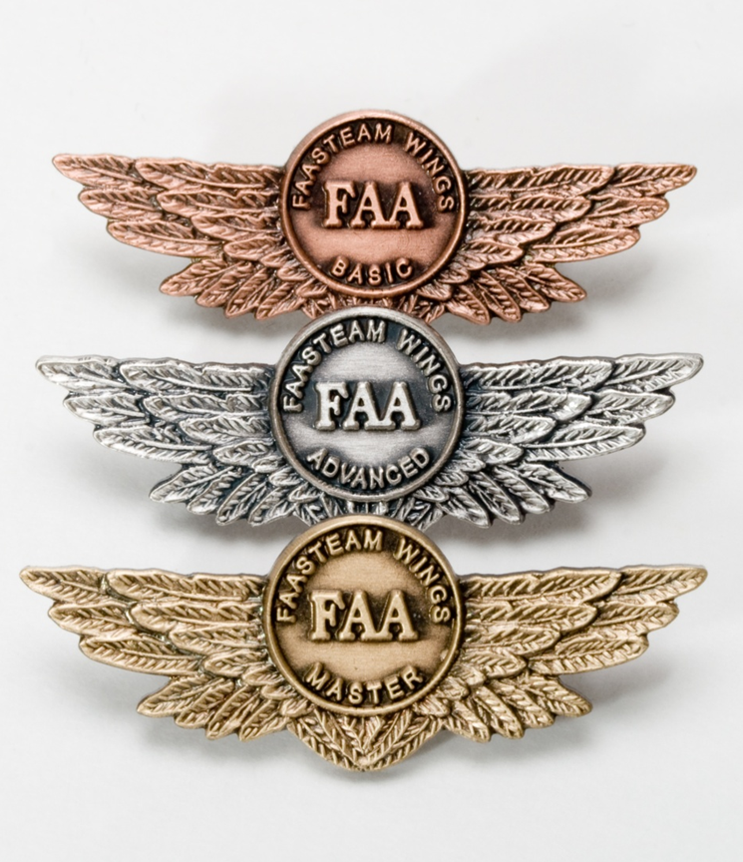
Proficiency and Peace of Mind
Fly regularly with your CFI
Perfect Practice
Document in WINGS
Notes:
There’s nothing like the feeling you get when you know you’re playing your A game and in order to do that you need a good coach (Click)
So fly regularly with a CFI who will challenge you to review what you know, explore new horizons, and to always do your best. Of course you’ll have to dedicate time and money to your proficiency program but it’s well worth it for the peace of mind that comes with confidence. (Click)
Vince Lombardi, the famous football coach said, “Practice does not make perfect. Only perfect practice makes perfect.” For pilots that means flying with precision. On course, on altitude, on speed all the time. (Click)
And be sure to document your achievement in the Wings Proficiency Program. It’s a great way to stay on top of your game and keep you flight review current.
(Next Slide)

Slide 18
http://www.mywingsinitiative.org/
Notes:
Every time you complete a WINGS Phase you’re eligible to win cash in the WINGS Sweepstakes.
The sweepstakes is generously funded by Paul Burger, a long time advocate for general aviation safety and a retired aviator who believes participation in this program saves lives. VISIT WWW.MYWINGSINITATIVE.ORG to learn more and enter the sweepstakes.
Just navigate to http://www.mywingsinitiative.org or scan the QR code for details. By the way, Instructors can also enter the sweepstakes. But there are even better reasons to participate in WINGS.
(Next Slide)

Slide 19
Safety Management Systems (SMS) Coming to General Aviation
https://www.faa.gov/about/initiatives/gasafetyoutreach
Notes:
Safety Management Systems are a set of policies and processes that can increase the safety and efficiency of any flight operation. And FAA is bringing SMS to General Aviation. You may have heard of SMS but thought it was only for large organizations but actually SMS can be scaled to fit any operation large or small.
There are 4 major components to a Safety Management System (Click)
Safety Policy – a documented commitment to safety that runs from the head of an organization to its newest member. (Click)
Safety Risk Management – a process that identifies hazards within an operation, determines to what extent an identified hazard may impact flight safety, and controls the risk of occurrence to an acceptable level. (Click)
Safety Assurance – By collecting and analyzing information derived from safety performance data Safety Assurance ensures the performance and effectiveness of Safety Risk Controls. (Click)
Safety Promotion communicates safety information and commitment throughout the organization. (Click)
You can find more information about Safety Management Systems at the URL on the Screen.
(Next Slide)

Slide 20
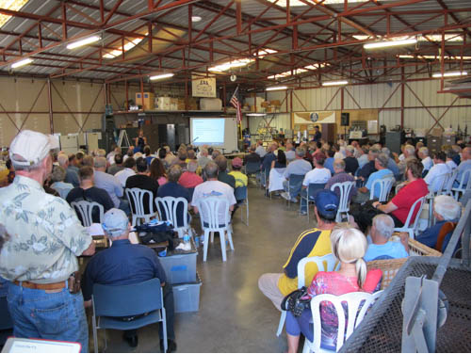
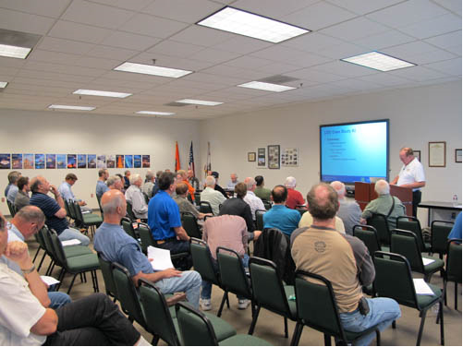
Thank you for attending
You are vital members of our GA safety community
Notes:
Your presence here shows that you are vital members of our General Aviation Safety Community. The high standards you keep and the examples you set are a great credit to you and to GA.
Thank you for attending.
(Next Slide)

Slide 21
The National FAA Safety Team Presents
Topic of the Month - June
Regulatory Roadblock Reduction
<Audience>
<Presenter>
< >
Notes:
(The End)

