Slide 1
The National FAA Safety Team Presents
Topic of the Month- February
Community Outreach
Preflight-in-a-Box
1st Responders Training
<Audience>
<Presenter>
< >
Notes:
2022/12-07-271(I)PP Original Author: J. Flowers September 2023 POC: K. Clover National FAASTeam Program Manager (Operations) Office 562-888-2020
Presentation Note: This is the title slide for Community Outreach – Preflight-in-a-Box
Script - We have included a script of suggested dialog with most slides. The script will always appear in a non-italic font. Presenters may read the script or modify it to suit their own presentation style. See template slides 5 and 6 for examples of a slides with script.
Presentation Instructions - (stage direction and presentation suggestions) will be preceded by a Bold header: the instructions themselves will be in Italic fonts. See slides 2, 3, and 4 for examples of slides with Presentation Instructions only.
Program control instructions - will be in bold fonts and look like this: (Click) for building information within a slide; or this: (Next Slide) for slide advance.
Background information - Some slides may contain background information that supports the concepts presented in the program.
Background information will always appear last and will be preceded by a bold Background: identification.
The production team hope you and your audience will enjoy the show. Break a leg!
(Next Slide)

Slide 2
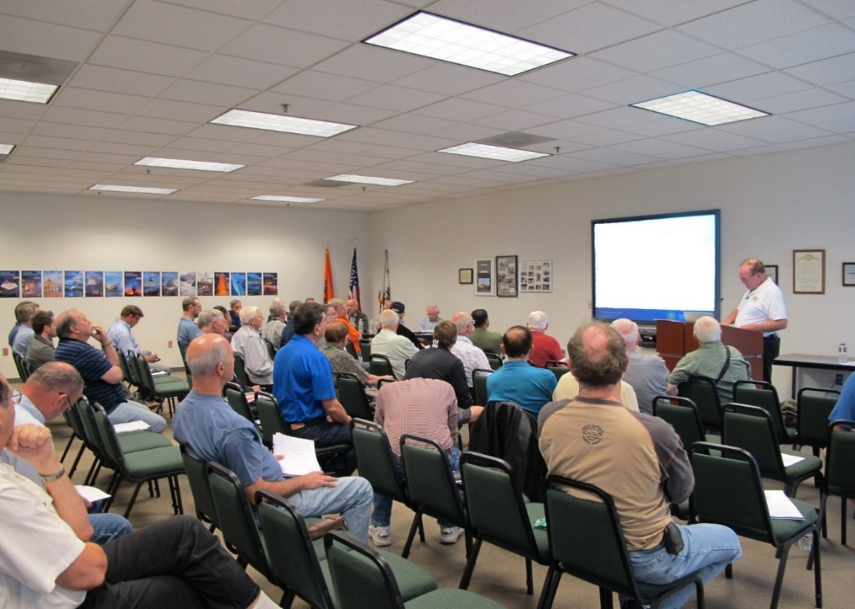

Welcome
Exits
Restrooms
Emergency Evacuation
Breaks
Set cell phones and pagers to silent or off
Sponsor Acknowledgment
Other information
Notes:
Presentation Note: Here’s where you can discuss venue logistics, acknowledge sponsors, and deliver other information you want your audience to know in the beginning.
You can add slides after this one to fit your situation.
(Next Slide)

Slide 3
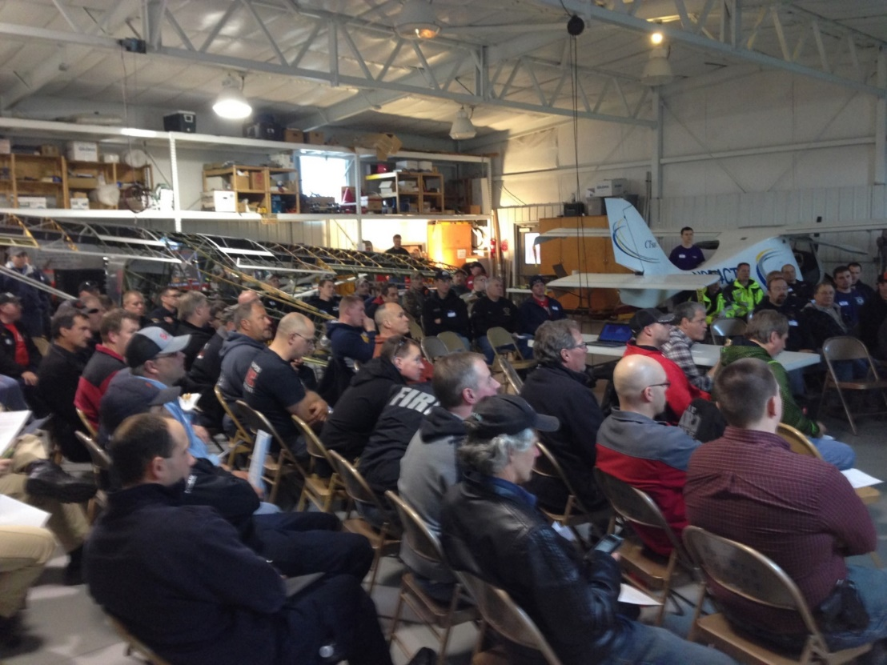
Overview
Community Outreach
Philosophy
Community Events
Notes:
In this presentation we’ll talk a little bit about the community outreach we have to offer. All of the events were designed to promote safety as it concerns local communities and includes more than just pilots or mechanics.
Presentation Note: If you’ll be discussing additional items, add them to this list
(Next Slide)

Slide 4
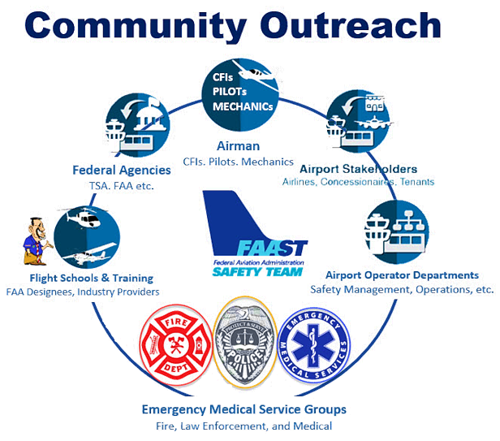
Large event outreach...
An opportunity to get the aviation community working together to focus on some aspect of aviation safety.
Notes:
Community Outreach events are produced on a larger scale than the usual seminars and webinars. They are an opportunity to bring the aviation community together to focus on some aspect of aviation safety. These events are held at an airport in conjunction with airport management and local aviation businesses. The events involve a classroom learning session followed by access to aircraft to gain practical knowledge.
(Next Slide)

Slide 5
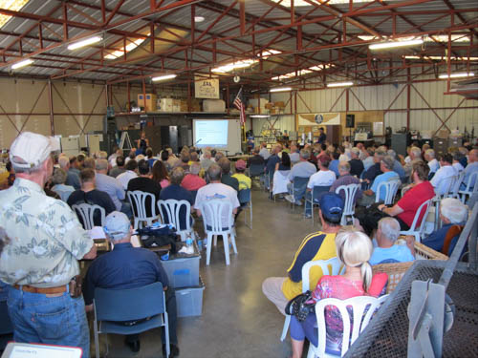

Community Events
Improve Safety
Improve Airport/Community
relations
Support local airports
  Flight schools & flying clubs
  Maintenance schools & facilities
  Flight Instructors & mechanics
  Community safety professionals
  Emergency Services
  Airport tenants and neighbors
Notes:
Community Events
Improve Safety through hands-on education and learning (Click)
They also Improve Airport/Community relations by bringing the community together in support of a common safety concern. (Click)
Community outreach also supports these local entities.
Presentation note: Pause for a few seconds for attendees to read the list then:
There are presently two FAASTeam-supported community outreach programs available. Let’s take a look at them
(Next Slide)

Slide 6
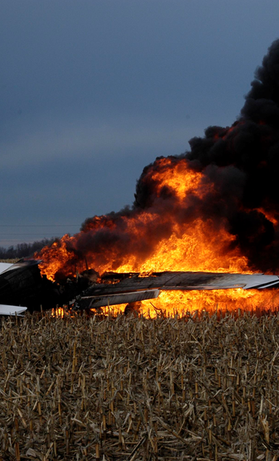
Federal Aviation
Administration
Option A:
Aircraft Accidents
for First Responders
Presented to:
By:
Date:
Produced by: AFS 850
The FAA Safety Team (FAASTeam)
Notes:
Take a few moments and consider who within your local area would respond to an aircraft accident.
When you think about it, the list of possible responders becomes much longer than just fire fighters or law enforcement.
Pilots, airport managers and personnel, and EMS volunteers are just a few responder types you may find on your list and all of them should benefit from this in-depth instructional opportunity.
Fire Fighters, Ambulance Crews, and Law Enforcement types work auto accidents daily. However, the elevated amounts of Hazardous materials such as fuel, the size of the accident scene, ballistic parachutes, and numbers of possible victims make aircraft accidents unique.
This event was designed to give those first to respond a look at the accident scene, ensure their safety, and give them what they need to know to assist the NTSB and the FAA in working aircraft accidents.
(Next Slide)

Slide 7

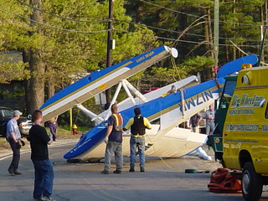
First Responders Training
This Photo by Unknown Author is licensed under CC BY-NC
Notes:
Community Emergency Response Professionals are required to participate in continuing education. This outreach satisfies part of that requirement by giving them an inside look at what to expect when responding to aircraft accidents.
(Next Slide)

Slide 8
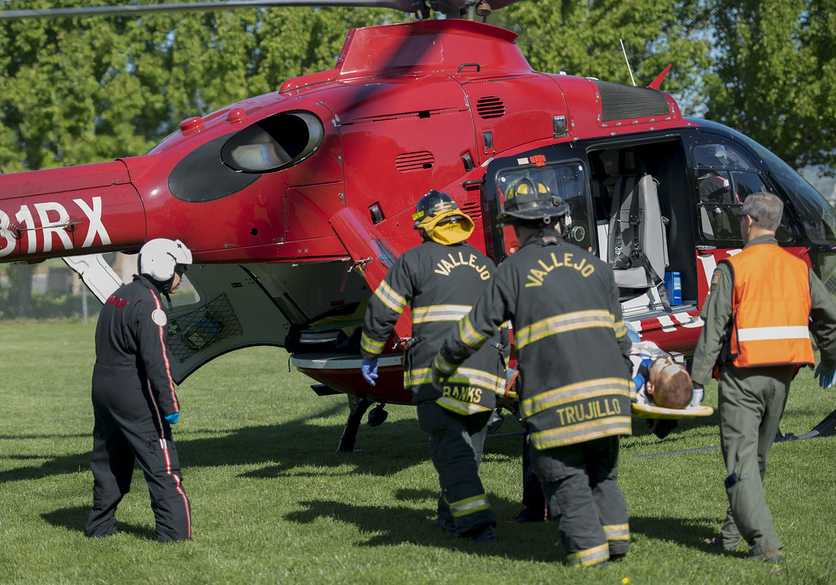
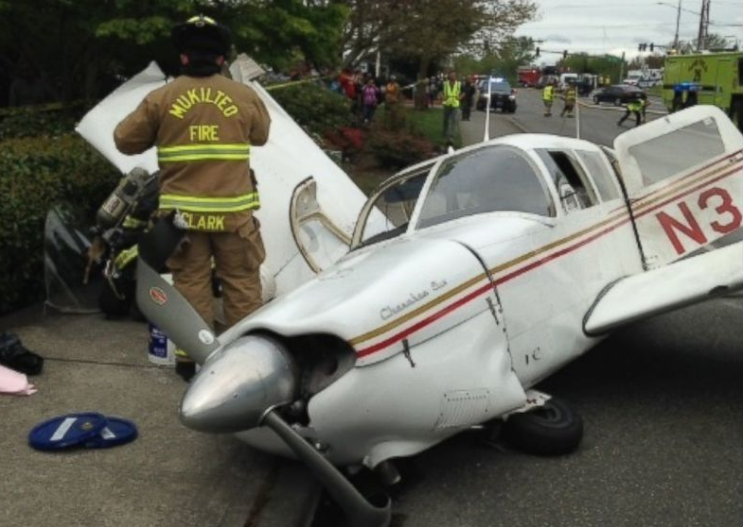
Training Saves
Lives!
This Photo by Unknown Author is licensed under CC BY-NC
Notes:
Contact your local FAASTeam Program Manager or FAA Safety Representative for an opportunity to learn more about this specialized response training.
(Next Slide)

Slide 9

Interaction between local Pilots & CFIs
When is the last time you discussed how to preflight an aircraft with a CFI?
When was the last time you took more than 15 minutes to preflight an aircraft?
Notes:
When is the last time you discussed preflighting an aircraft with a CFI? For many pilots the last preflight training they received was while getting a new certificate or an additional rating. Our second Community Outreach option may be just the thing to show you what you’ve been missing. One more question: (Click)
When was the last time you took more than 15 minutes to preflight an aircraft? A good preflight involves much more than checking off the boxes on a checklist. Preflight in a box not only reviews the knowledge required to perform a great preflight, but also gives attendees the opportunity to practice with the knowledge they’ve acquired. All in a controlled environment, overseen by professional CFIs and Mechanics from your local area.
(Next Slide)

Slide 10
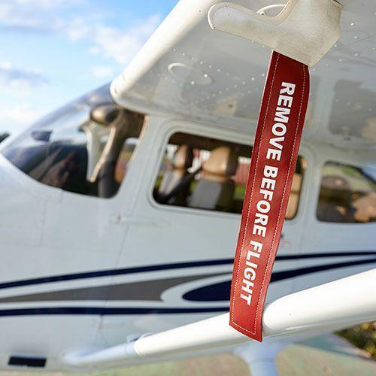
Option B:
Preflight-in-a-Box
Notes:
Preflight in a Box was designed to:
Reinforce how a CFIs should be teaching preflight to their students
Cover common errors and best practices
Allow the attendees to perform a preflight with CFI guidance.
Requires attendees to report their findings
Supports interaction with local Maintainers, CFIs and Students
(Next Slide)

Slide 11
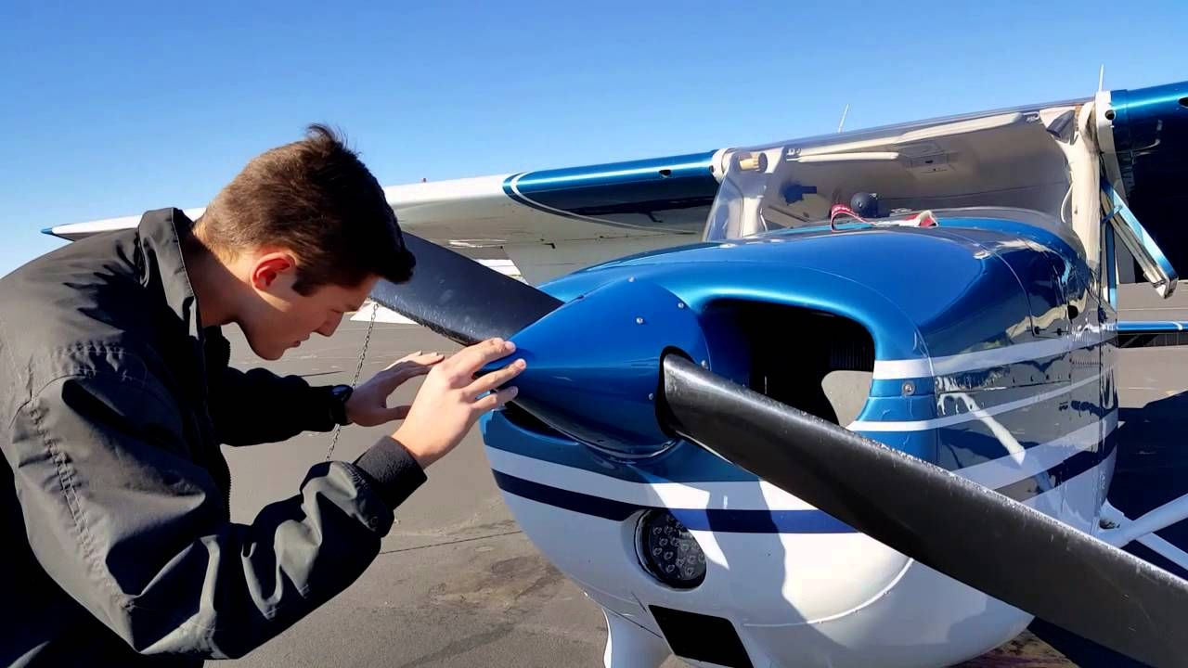
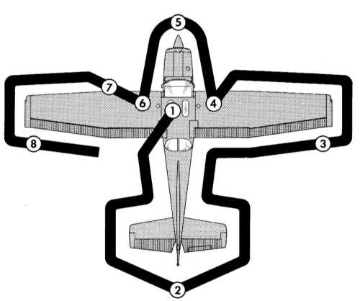
Preflight-in-a-Box
Hands-on Exercise
  Held at the Airport
Requires use of a “REAL”
Aircraft
Pre-flight “solo” or with a friend.
Notes:
The Program, held on an airport, includes group instruction and an “in person, hands on, pre-flight exercise” (Click)
It provides access to actual aircraft (Click)
The experience usually takes 2:00 to 2:30 Hours to complete.
And participants can pre-flight “solo” or with a fellow pilot.
(Next Slide)

Slide 12



Interested? Contact your local FAASTeam Today!
XXX FSDO
  John Smith, ASI, Operations
    (000) 000-0000 Office
    (000) 000-0000 Cell
  Jane Doe, ASI, Airworthiness
    (000) 000-0000 Office
    (000) 000-0000 Cell
Notes:
Presentation note: Putting a face to a name. use this slide to introduce a contact or group that can set up the community outreach events.
You may have a Representative that is very active in local aviation that can assist you in this outreach.
If you’re already scheduled a Preflight or 1st Responder event, hide this slide and use one of the two hidden slides that follow, to invite your audience to the program.
(Next Slide)

Slide 13

Join us for a Preflight seminar and practical exercise!!
Date: ________ Time: ________
Event:___________________________
Location:________________________
Notes:
Presentation note: We have chosen to hide this from your viewers. In the event you are already planning a Community Preflight event, enter the information here and unhide the slide.
(Next Slide)

Slide 14

Join us in support of local EMS Responders and Volunteers!!
Date: ________ Time: ________
Event:___________________________
Location:________________________
Notes:
Presentation note: We have chosen to hide this from your viewers. In the event you are already planning a Community 1st responder outreach event, enter the information here and unhide the slide.
(Next Slide)

Slide 15

Notes:
Presentation Note: You may wish to provide your contact information and main FSDO phone number here. Modify with
Your information or leave blank.
(Next Slide)

Slide 16

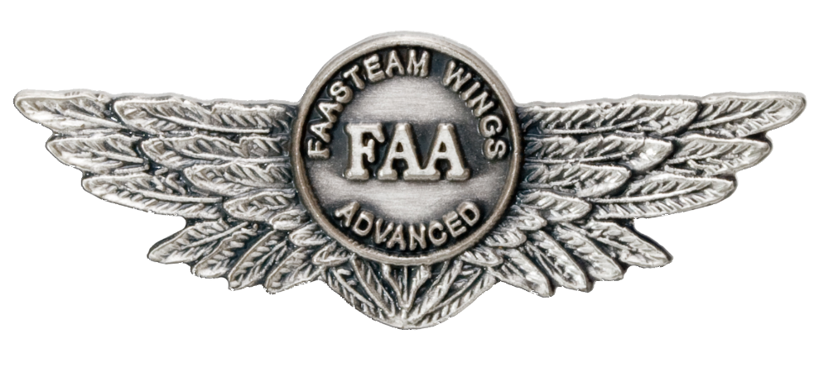
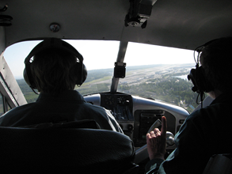
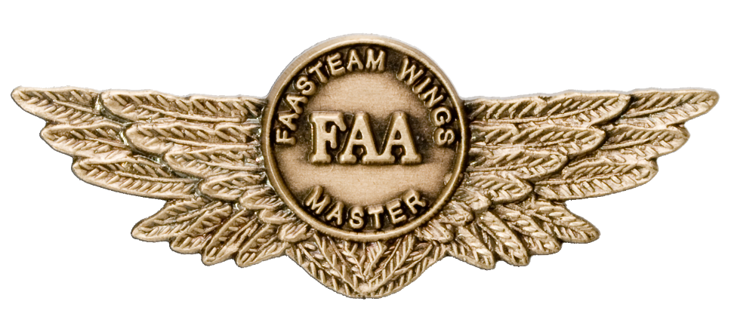
Proficiency and Peace of Mind
Fly regularly with your CFI
Perfect Practice
Document in WINGS
Notes:
There’s nothing like the feeling you get when you know you’re playing your A game and in order to do that you need a good coach (Click)
So fly regularly with a CFI who will challenge you to review what you know, explore new horizons, and to always do your best. Of course you’ll
have to dedicate time and money to your proficiency program but it’s well worth it for the peace of mind that comes with confidence. (Click)
Vince Lombardi, the famous football coach said, “Practice does not make perfect. Only perfect practice makes perfect.” For pilots that means
flying with precision. On course, on altitude, on speed all the time. (Click)
And be sure to document your achievement in the Wings Proficiency Program. It’s a great way to stay on top of your game and keep you flight review current.
(Next Slide)

Slide 17
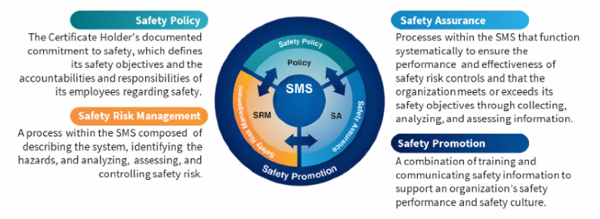

Safety Management Systems (SMS)
Coming to General Aviation
https://www.faa.gov/about/initiatives/gasafetyoutreach
Notes:
Safety Management Systems are a set of policies and processes that can increase the safety and efficiency of any flight operation. And FAA is bringing SMS to General Aviation. You may have heard of SMS but thought it was only for large organizations but actually SMS can be scaled to fit any operation large or small.
There are 4 major components to a Safety Management System (Click)
Safety Policy – a documented commitment to safety that runs from the head of an organization to its newest member. (Click)
Safety Risk Management – a process that identifies hazards within an operation, determines to what extent an identified hazard may impact flight safety, and controls the risk of occurrence to an acceptable level. (Click)
Safety Assurance – By collecting and analyzing information derived from safety performance data Safety Assurance ensures the performance and effectiveness of Safety Risk Controls. (Click)
Safety Promotion communicates safety information and commitment throughout the organization. (Click)
You can find more information about Safety Management Systems at the URL on the Screen.
(Next Slide)

Slide 18
Thank you for attending
You are vital members of our GA safety community
Notes:
Your presence here shows that you are vital members of our General Aviation Safety Community. The high standards you keep and the examples you set are a great credit to you and to GA.
Thank you for attending.
(Next Slide)

Slide 19
The National FAA Safety Team Presents
Topic of the Month- February
Community Outreach
Preflight-in-a-Box
1st Responders Training
<Audience>
<Presenter>
< >
Notes:
(The End)

