Slide 1
Topic of the Month April
Aircraft Performance and Limitations
<Audience>
<Presenter>
< >
Notes:
(2015/12/11-079 (I) PP Original Author: AFS-850 JWS 11/23/2015; POC (Kevin Clover), AFS-850 Operations Lead, Office 562-888-2020; revised by (Name) (MM/DD/YYYY)
Presentation Note: This is the title slide for Aircraft Performance and Limitations
Presentation notes (stage direction and presentation suggestions) will be preceded by a Bold header: the notes themselves will be in Italic fonts.
Program control instructions will be in bold fonts and look like this: (Click) for building information within a slide; or this: (Next Slide) for slide advance.
Some slides may contain background information that supports the concepts presented in the program.
Background information will always appear last and will be preceded by a bold Background: identification.
We have included a script of suggested dialog with each slide. Presenters may read the script or modify it to suit their own presentation style.
The production team hope you and your audience will enjoy the show. Break a leg!
(Next Slide)

Slide 2
Welcome
Exits
Restrooms
Emergency Evacuation
Breaks
Sponsor Acknowledgment
Other information
Notes:
Presentation Note: Here’s where you can discuss venue logistics, acknowledge sponsors, and deliver other information you want your audience to know in the beginning.
You can add slides after this one to fit your situation.
(Next Slide)

Slide 3
Overview
Loss of Control Work Group Recommendations
Aircraft Performance Parameters
Aircraft Limitations
Tips and Tricks
Notes:
In this presentation we’ll talk a little bit about Loss of Control Accidents and recommendations from a work group that studies loss of control. We’ll talk about aircraft performance parameters and calculations. We’ll also offer suggestions that will help you with aircraft performance prediction. Aircraft limitations will be discussed and finally, we’ll give you some tips and tricks that will help you to avoid performance-based accidents in any aircraft.
Presentation Note: If you’ll be discussing additional items, add them to this list
(Next Slide)

Slide 4
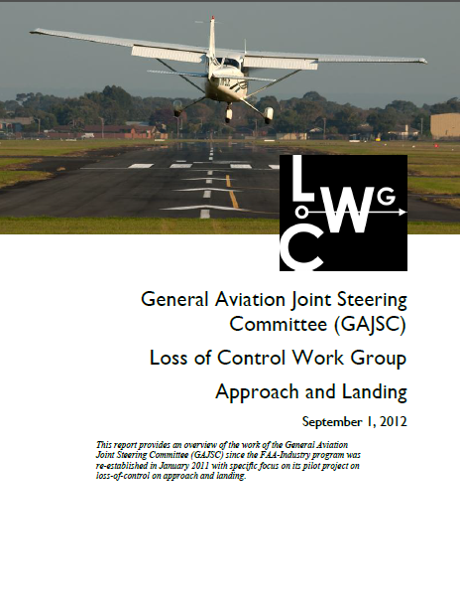
LOC Workgroup Findings
Lack of Aeronautical Decision Making Skills
Lack of single – pilot CRM skills
Incorrect calculation or perception of aircraft performance
Operations at edges of Weight & Balance Envelope are especially dangerous!
Notes:
Here are some findings of a recent study of Loss of Control accidents. Most fatal GA Loss of Control accident investigations cite inadequacies in Aeronautical Decision Making and - a subset of ADM - Single-pilot Cockpit Resource Management skills. Occasionally investigations have discovered causal factors resulting from unreasonable expectations of aircraft performance – especially when operating at the edges of the aircraft weight and balance envelope. That’s why the Loss of Control Work Group suggests improvement in pilots’ understanding and calculation of aircraft performance.
(Next Slide)

Slide 5
3 Questions
How much can I haul?
How far can I go?
How long will it take me?
How fast can I fly?
Notes:
When we speak of aircraft performance we’re usually answering 3 basic questions:
How much can I haul?
How far can I go?
How long will it take me?
It sounds simple but an exquisite set of interdependent variables must be considered in order to answer each of these questions. Most of these variables have to do with aircraft performance but the most important variable does not.
(Next Slide)

Slide 6
Aircraft Performance
Aircraft Weight & Balance
Pilot & Passengers
Cargo
Fuel
Notes:
A good way to plan a flight is to decide how much weight you want to haul to what destination. Start with crew and passengers. Then add cargo. If these items alone exceed your aircraft’s capability you’ll either have to make multiple trips or get a bigger aircraft.
Once you know how much you want to haul you can figure out how much fuel you can take and that – together with your weather information will tell you how far you can go. If you have enough to get to the destination plus alternate plus reserve you’re golden. If not – you’ll have to plan an en route fuel stop.
(Next Slide)

Slide 7
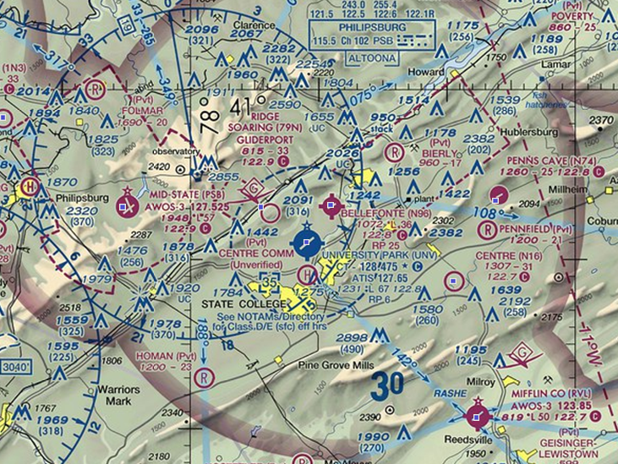
Aircraft Performance
Aircraft Weight & Balance
Pilot & Passengers
Cargo
Fuel
Route of flight
Departure, En route, Destination & Alternate Wx
Departure & Arrival Airports
Runway lengths & obstructions
Density altitudes
Add 50% for safety
Notes:
But wait – there’s more. You’ll also have to consider your departure & arrival airports runway lengths, obstructions & expected density altitude. If the field is short and/or obstructed you may not be able to safely fly with a full load. One more thing – Just because the book says the aircraft can do it doesn’t mean you can do it. Pilot skill and experience count for a lot when you’re trying to duplicate POH performance figures. So be conservative when you calculate your performance and consider adding a safety factor. Some pilots add 50% to their takeoff and landing calculations for safety.
Now we can figure all of this out by consulting the POH right? Maybe not. There’s one more huge variable to consider and I bet you know what it is.
(Next Slide)

Slide 8
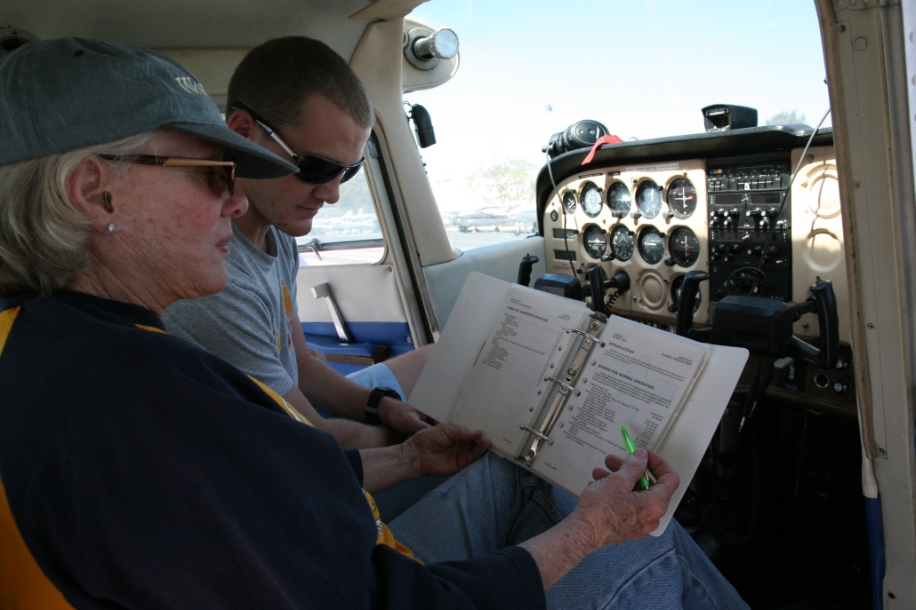
What’s the greatest variable?
The Pilot
Documented Performance
Mission weight and density altitude
Fly with a CFI
Notes:
So what’s the greatest variable in all this?
That’s right – the pilot. Let’s face it. The POH figures and all of our calculations don’t mean much if we can’t duplicate them in our flying. That’s why it’s important to document your performance capability at least yearly with a CFI. Fly at a typical mission weight and try to duplicate or simulate mission density altitudes. That way you’ll know what you and your aircraft can do.
(Next Slide)

Slide 9
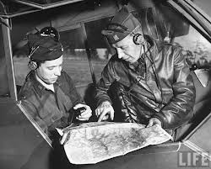
What’s my baseline?
Pilot & Aircraft Performance Reference
Environmental Circumstances
Pilot Performance
Decreased Performance
Increased Performance
Notes:
In order to know what performance you and your flying machine are capable of you’ll need to establish a baseline. Think of your baseline as an omnibus reference that relates pilot and aircraft performance under a given set of environmental circumstances on a given day.
Human factors such as fatigue and environmental factors such as higher density altitudes will result in performance below the baseline while proficiency training and lighter loading will likely result in above baseline performance.
The key point to remember is that for any given flight you need to determine how you and your aircraft will perform. Your baseline is the foundation of that determination.
(Next Slide)

Slide 10
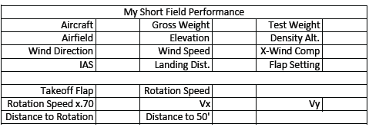
What’s my baseline?
http://faa.gov/go/flyalaska
Notes:
Here’s a sample baseline calculation sheet extracted from the Alaskan Off-Airport Operations Guide available at the URL below.
To establish your baseline we suggest you load your aircraft with a typical mix of fuel, cargo, and passengers. (We recommend that one of those passengers be your CFI.) Calculate your test weight and note runway condition, elevation, density altitude, wind direction and speed. (Click)
Also note what rotation and climb speeds you intend to use and calculate 70% of the rotation speed. We’ll explain why that’s important in the next slide.
Next you’ll fly several takeoffs and landings noting your performance on each trial. When you’re done you can average your performance figures and complete your baseline chart.
(Next Slide)

Slide 11
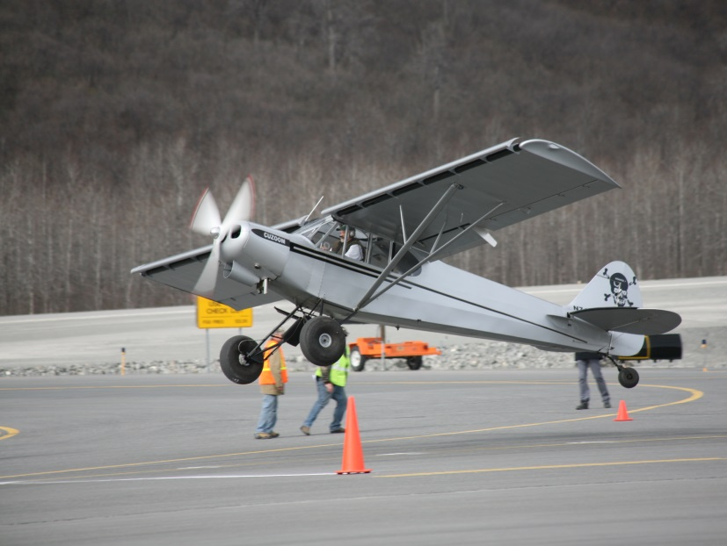
Takeoff calculations
Density altitude
Fixed pitch add 15% per 1000 feet DA to 8000 ft.
Constant speed add 12% per 1000 feet DA to 6000 ft.
50/70 Rule – no obstruction
60 x .7 = 42
30/70 Rule - obstruction
Notes:
Here are some rules of thumb when making takeoff calculations. (Click)
If you have a fixed pitch prop, add 15% to your calculated takeoff distance for each 1000 foot increase in density altitude up to 8000 feet. (Click)
For constant speed props add 12% per 1000 feet of density altitude up to 6000 feet. (Click)
When planning takeoff from short unobstructed runways establish a landmark at 50% of your calculated takeoff distance. (Click)
When on the take off roll you should have 70% of your rotation speed at that point. If you don’t – the safest thing is to abort the takeoff and reduce weight or wait for more favorable wind and temperature conditions. In this example we’re assuming a rotation speed of 60 knots or MPH. 70% of 60 is 42. The number you’ll want to see at the halfway point (Click)
If you must clear obstructions on takeoff you’ll need to have 70% of your rotation speed by the time you’ve travelled 30% of your available takeoff distance.
(Next Slide)

Slide 12
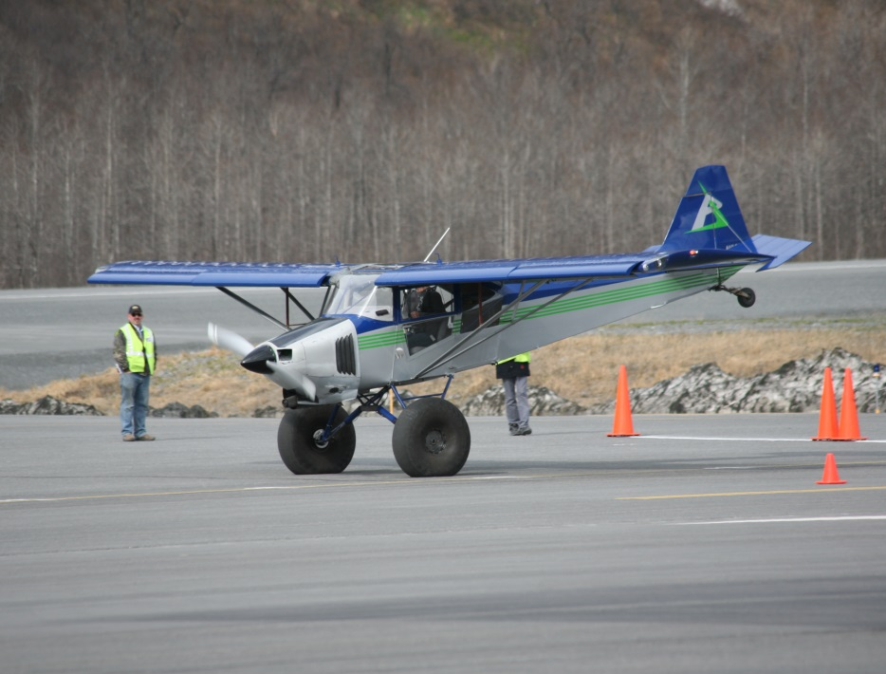
Approach & Landing
Stabilized short field final approach
Full flaps
1.3vso
Don’t cut final short
Go around if not stable
Notes:
You’ll want to be stabilized on final approach with full flaps at 1.3 times the stalling speed in landing configuration.
Don’t cut your final short. Make it long enough to be stabile and go around if you’re unstable.
By the way – the photos on this and the previous slide are of an annual takeoff and landing competition held in Valdez, Alaska. We strongly suggest you don’t try this at home without some quality instruction.
(Next Slide)

Slide 13
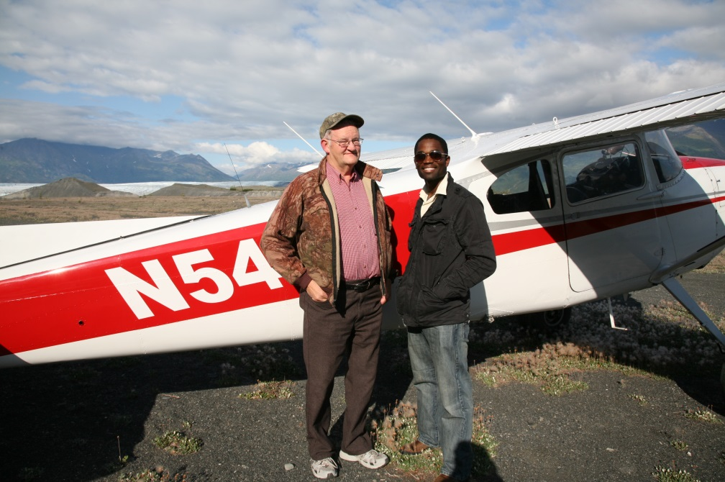
What’s the greatest variable?
The Pilot
Documented Performance
Mission weight and density altitude
Fly with a CFI
I’M SAFE
Notes:
Once again – the greatest variable is the pilot but if you document your baseline performance at mission weight and density altitude and fly regularly with a CFI, you’re well on your way to safer flying and fewer nasty surprises.
(Next Slide)

Slide 14
Limitations : Where do they come from?
Physics
Max Gross Weight
Static load testing
Vne (Never Exceed Speed)
Critical for structural integrity (Wings, Control surfaces, Empennage)
Violations usually result in bent metal – or worse.
Regulation
Based on Physics but usually include a safety factor
Notes:
Before we go let’s have a few words on aircraft limitations and where they come from.
Limitations are derived from Physical Laws. For example Certification testing involves, among other things, loading an airframe to the point of structural failure. Max Gross Weight is determined in part with reference to that testing. Vne is derived in part from flight testing where the onset of control flutter is experienced. Violation of physical limitations often results in structural failure.
Regulatory limitations are based on physics too but they usually include a safety factor.
(Next Slide)

Slide 15
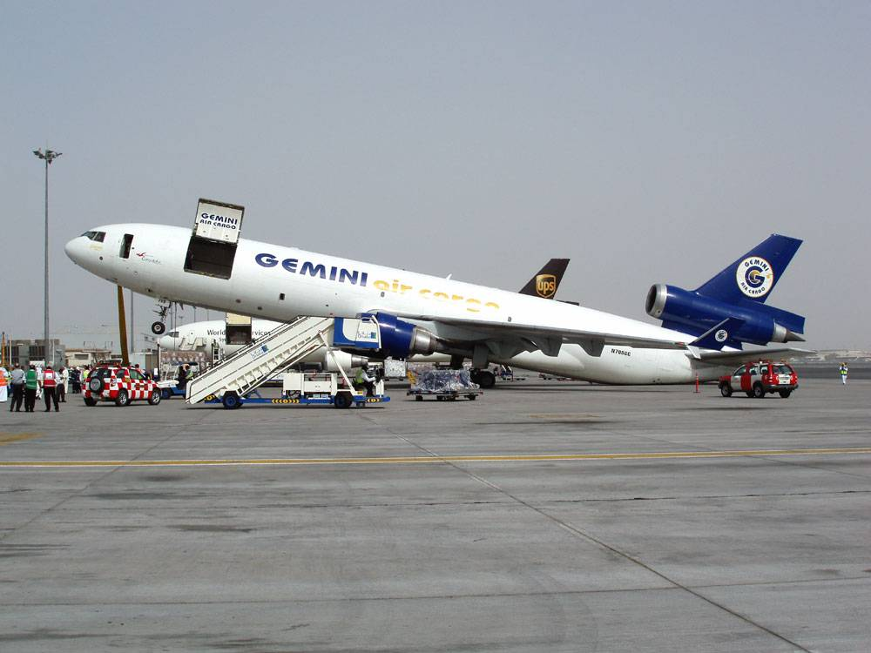
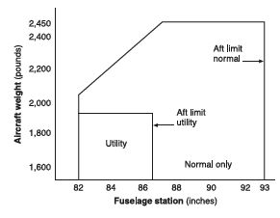
Limitations
Weight & Center of Gravity (balance)
Weight, load composition, and cg position relative to datum
Notes:
Here are some common limitations categories: (Click)
Weight and Center of Gravity. We’re used to seeing maximum gross weight limitations. Some aircraft also have gross weight limitations for takeoff and landing. The composition of the weight is important too. It makes a difference whether the weight is comprised of passengers, cargo, or fuel. Baggage areas often have weight limitations and many aircraft have a zero fuel weight limitation. The calculated center of gravity location must fall within acceptable limits as well.
I know what you’re thinking, “I’ve been a little over on occasion and nothing bad has happened. Here’s the thing. Manufacturers calculate airframe life limits based on operations at max gross weight. Operating above that weight introduces additional stress and fatigue into the airframe and that will cause it to fail sooner than predicted. How much sooner? Hard to tell because you don’t know how often and for how long it was overloaded or whether it was overstressed in flight.
(Next Slide)

Slide 16
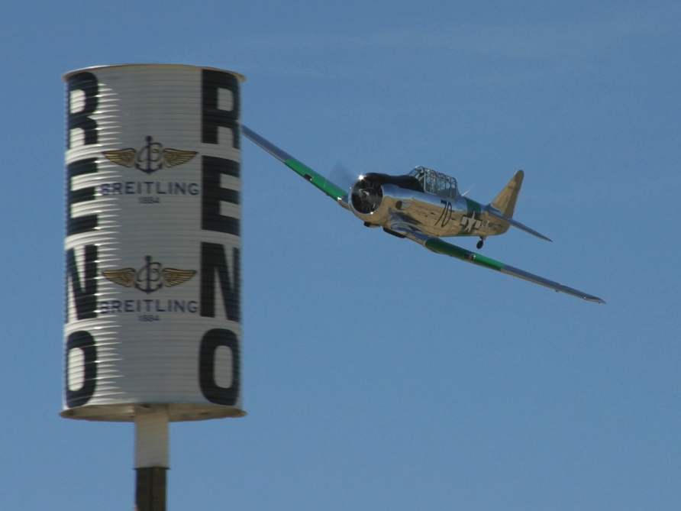
Limitations
Speed
Aircraft design limits, configuration and flight environment
Vne, Vfe, Vle, Va
Notes:
We’re all familiar with speed limitations. They too are based on flight physics and component strength. And they’re dependent on design limits, aircraft configuration, and the flight environment. We’ve already mentioned Vne as an example of an aircraft design limitation.
Vfe and Vle have to do with configuration of flaps and landing gear. We all know that operating in the yellow arc of the airspeed indicator is reserved for smooth air but how turbulent can it be to operate within the arc? The answer is – not very. Certification standards require the airframe to withstand 50 foot per second vertical gusts. But that’s at Va – design maneuvering speed. At higher speeds a 25 foot per second gust is the limit and these are very common in light to moderate turbulence. So the guideline here is, “if the air isn’t perfectly smooth don’t operate in the yellow arc.”
(Next Slide)

Slide 17
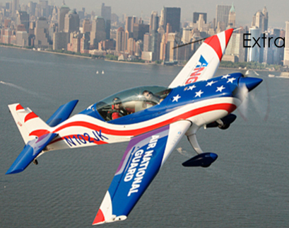
Limitations
Aerodynamic Loading
Gs
Normal Category 3.8 Positive 1.52 Negative
Utility Category 4.4 1.76
Aerobatic Category 6.0 3.00
Notes:
And limitations are established for aerodynamic loading for normal, utility, and aerobatic certification categories. Some general aviation aircraft are certified in more than one category with weight and balance limitations associated with each category.
Finally we leave you with this thought: Many limitations are easy to exceed so pilots must be careful to operate their aircraft within it’s limitations all the time. We owe it to ourselves and those who fly the aircraft after us for years into the future.
(Next Slide)

Slide 18
Questions?
Notes:
Presentation Note: You may wish to provide your contact information and main FSDO phone number here. Modify with
Your information or leave blank.
(Next Slide)

Slide 19
Title
Sub Title
<Audience>
<Presenter>
< >
Notes:
File Number Original Author: Name (Date); POC Kevin Clover, AFS-850 Operations Lead, Office 562-888-2020; revised by Name Date
Presentation Note: This is the title slide for Title
Presentation notes (stage direction and presentation suggestions) will be preceded by a Bold header: the notes themselves will be in Italic fonts.
Program control instructions will be in bold fonts and look like this: (Click) for building information within a slide; or this: (Next Slide) for slide advance.
Some slides may contain background information that supports the concepts presented in the program.
Background information will always appear last and will be preceded by a bold Background: identification.
We have included a script of suggested dialog with each slide. Presenters may read the script or modify it to suit their own presentation style.
The production team hope you and your audience will enjoy the show. Break a leg!
(Next Slide)

