Slide 1
Topic of the Month September Flying After Inactivity
Notes:
2017/6-16-109 (I) PP Original Author: James Mason; POC Kevin Clover, AFS-850 Operations Lead, Office 562-888-2020
Presentation Note: This is the title slide for Flying After Inactivity
Presentation notes (stage direction and presentation suggestions) will be preceded by a Bold header: the notes themselves will be in Italic fonts.
Program control instructions will be in bold fonts and look like this: (Click) for building information within a slide; or this: (Next Slide) for slide advance.
Some slides contain background information that supports the concepts presented in the program.
Background information will always appear last and will be preceded by a bold Background: identification.
We have included a script of suggested dialog with each slide. Presenters may read the script or modify it to suit their own presentation style.
The production team hope you and your audience will enjoy the show. Break a leg!
(Next Slide)

Slide 2
Welcome
Exits
Restrooms
Emergency Evacuation
Breaks
Sponsor Acknowledgment
Other information
Notes:
Presentation Note: Here’s where you can discuss venue logistics, acknowledge sponsors, and deliver other information you want your audience to know in the beginning.
You can add slides after this one to fit your situation.
(Next Slide)

Slide 3
Overview
How Long Has It Been?
Medical Policy Changes & BasicMed
Refresher, or Flight Review, IPC?
Consider using the WINGS program
Planning your return to the cockpit
How Long is This Going to Take?
Notes:
You’ll want to get your audience thinking about “just how long HAS it been since I’ve flown?” Many pilots think about inactivity in terms of months or years before they need to meet with a CFI, when an honest assessment may reveal the need for some dual after a period of just weeks. The goal should be proficiency, NOT simply meeting the FAR requirements to act as PIC.
Does a pilot need a simple refresher, say after a month or two, or have they been away from the cockpit so long that they need a Flight Review? If instrument rated, perhaps they need an IPC.
An excellent way to regain your skills after a layoff: use the WINGs Program. For that matter, its an excellent way to maintain skills during a time of infrequent flying.
It’s helpful to sit down with your CFI and plan how you’re going to get back to being a comfortable, proficient pilot. An efficient plan usually saves time and money.
Pilots both under and over estimate how much instruction, both flight AND ground, they may need after a period of inactivity. It’s much better to think in terms of becoming proficient again, not the time involved.
Presentation Note: If you’ll be discussing additional items, add them to this list (Next Slide)

Slide 4
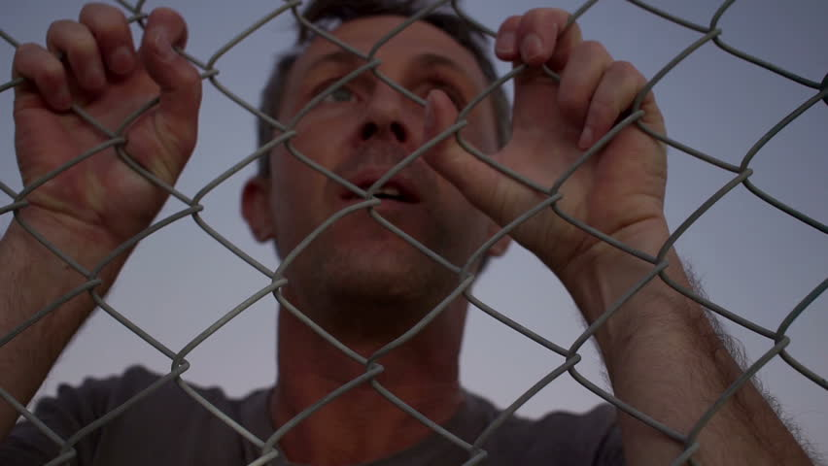
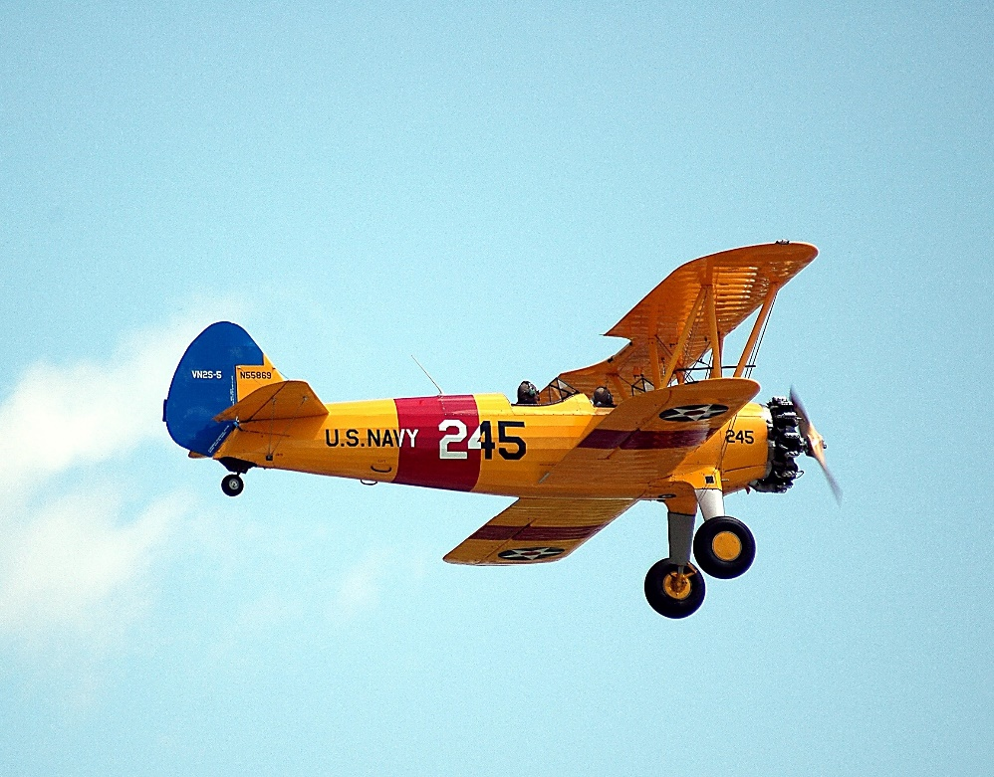
How Long Has It Been?
Notes:
Been awhile since you’ve graced an airplane cockpit? Finding yourself like this guy hanging out at the airport fence watching airplanes a lot? Perhaps at an airshow it hits you: “wait, I’M a pilot-it’s just been (insert number of weeks/months/years) since I’ve flown. I need to get back in the air!!”
Or, perhaps you own an aircraft and realize that the two of you haven’t seen each other for several weeks (okay, months…) and you really need to get out there and go flying.
For whatever reason, you, like many other pilots, have decided it’s time to get airborne again. Great!!
(Next Slide)

Slide 5
You Are NOT Alone!!!
Work
Vacation
Family
Health
Finances
ALL contribute to a temporary or long-term layoff for most pilots at some point
Notes:
Most, if not all, pilots face a period of flying inactivity during their flying careers. All of the above reasons are causes for this:
Work-a trip out of town for several weeks or months; taking on extra duties or responsibilities; a job change; relocating while working for the same company or business
Vacation-cruises; long trips out of the country
Family-new arrivals; caring for ailing loved ones suffering from a long-term or terminal illness;
Health-cold or flu; medication or condition that makes one unable to meet the FAA medical standards; surgery
Finances-loss of income; unanticipated expenses for car, home, family, etc.; airplane maintenance (!!)
Ask attendees to discuss some examples of how they found themselves, short or long-term, unable to fly. This can help others discover that they can get back to flying, just as others have.
(Next Slide)

Slide 6
Returning With BasicMed?
Over 5000 Pilots Have Successfully Certified Using BasicMed
Many Have Not Flown As PIC for an Extended Period
Be Sure To Understand These New Regulations Thoroughly.
Be Sure to Work With a CFI Who Is Familiar With These New Regulations During Your Refresher Training
Notes:
The new BasicMed rules have resulted in a large number of pilots returning to the cockpit. While these rules allow a pilot to act as PIC without visiting an Aviation Medical Examiner (AME) they DO NOT eliminate the need to be free from medical conditions that preclude safe piloting.
Many pilots obtaining, or attempting to obtain, BasicMed certification have not re-applied for a standard medical certificate due to a medical condition that they know would cause denial of their certification, or require extensive tests and reports to the FAA to receive a special-issuance. Remember: you still must self-certify every time you fly, so read the regulations carefully and consult with your physician and/or AME before proceeding.
Since the regulations are so new, be sure to read and understand them thoroughly. You must take a course-just like refreshing your knowledge after a layoff with your CFI for the standard medical certification rules, don’t just do the minimum. Learn what you truly can and cannot do with these new regs. Take the time to find a CFI who truly understands them, or can point you to another one who truly does.
(Next Slide)

Slide 7
Short-Term: Refresher Training
A Few Weeks/Months Without Flying
Are You Legal To Carry Pax?
Does The Thought of Flying Solo Make You Hesitate?
Notes:
Perhaps its been just a few weeks since you’ve flown. Perhaps a month or two.
For some pilots, a short-term layoff may mean simply getting out to the airplane, taking your time, and getting a flight or two done in VFR or easy IFR conditions. A pilot who has flown a lot, consistently, and then took a month off may not need anything more than this. However, one who has flown only a few hours total and taken off for a month or two should consider flying with a CFI to regain confidence and proficiency.
One benchmark: are you current to carry passengers? If not, get with an instructor for a refresher, instead of going out solo and “getting current”. If it’s been more than two months since you’ve flown, even if you are legal (especially at night) it’s still an excellent idea to meet with a CFI.
Another consideration: Does the thought of flying, solo or with passengers, make you hesitate? If its for any reason other than weather or mechanical issues, you need to meet with your CFI, even if it’s been just a couple of weeks.
Discussion: What criteria do you use as a ‘red flag’ indicator that some refresher training is necessary?
(Next Slide)

Slide 8
Haven’t Flown One of THESE for Awhile…
Perhaps YOUR inactivity involves not flying a certain type you’d like to fly again.
Find a CFI familiar with the type.
Most rental aircraft providers will NOT allow you to fly specific types after a period of inactivity in-type.
Notes:
So, you’ve been flying that good ‘ol Cessna 172 around quite a bit-several times a month. Last year, you checked out in the nice Cessna T210 the flying school rents. Next week, you have a trip that the faster, larger Cessna would be PERFECT for!!
CFI’s get calls from pilots all the time, asking “how long do you think it will take me to get a checkout again in the (insert name of high-performance airplane)? I’ve got a trip this coming weekend and would like to take it (!?!?)” Again, if you don’t operate a certain type, or for that matter, a certain combination of avionics IN a type, regularly, you skills erode.
Plan ahead-schedule well in advance of your planned flight with a knowledgeable CFI, familiar with the type (or avionics) and be willing to fly and refresh your knowledge to a point of proficiency, NOT just meeting a minimum time.
The fact that almost all flight schools or aircraft rental facilities or clubs require flight with a CFI after a month or so without flying a specific type tells all you need to know. They, and their insurance carriers, have seen over time that just because you fly in something else doesn’t mean you don’t need a least a short refresher in another type.
(Next Slide)

Slide 9
Do You Need A Flight Review?
More Than 24 calendar months since you’ve flown?
Consider Doing the Equivalent if it’s Been More Than a Few Months
Notes:
Obviously, if it’s been 24 calendar months since you’ve flown, you will need a BFR. What if it’s been, say, 10 years? 20? That’s right-you “just” need a Flight Review. Your pilot’s certificate never expires-only your medical certificate and Flight Review and/or IPC does.
If it’s been this long, don’t expect a quick refresher course. In the last two years, we’ve had changes to medical certification rules; introduction of the Airman Certification Standards (ACS) for Private Pilot and Instrument Rating practical tests, and likely by the time you read this, Commercial Pilot as well; 122.00, Flight Watch, has gone away-and many others. Discussion: what other ‘new’ regs can you name?
If it’s been quite a bit more than two years, it will “take what it takes” to bring you back up to speed. Most pilots get the motor skills of flying back fairly quickly, but learning changes to regulations, procedures, and re-learning those that have not but are forgotten, should be emphasized and can be studied anytime-just like you did when you initially trained!
Even if it’s just been a few months, consider getting a BFR or IPC, regardless. Or, consider completing a WINGS Phase, which will grant the equivalent of a Flight Review.
(Next Slide)

Slide 10
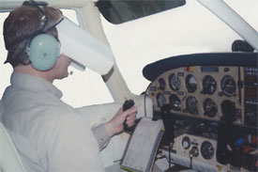
I’m IFR Current…Right?
Being Legal for IFR is NOT the same as
Proficiency!
If It’s Been Even Couple of Months, Get
Some Refresher Training
Consider Flying With a CFI-I Once Each Month, With Emphasis on Flying In
Actual Conditions.
Notes:
If you’re a recent graduate of IFR training, you’ve heard this statement repeatedly. But it’s easy in some parts of the country to convince yourself that those approaches, holds and course tracks 5.5 months ago are ok just to ‘punch through a little cloud deck’. What could happen? Well-what if you lose comm? Or some other issues develops with the airplane? What if your PFD suddenly comes up with the “big red X”? Are you ready?
Instrument pilots find that their skills must be exercised regularly-it’s not like riding a bike, after all!! To that end, as we say here, consider flying once a month with a CFI-I and working on these and other skills that acquire rust if you don’t think about and use them. Also, an IPC every six months is excellent for maintaining your ability to use the rating, safely.
(Next Slide)

Slide 11
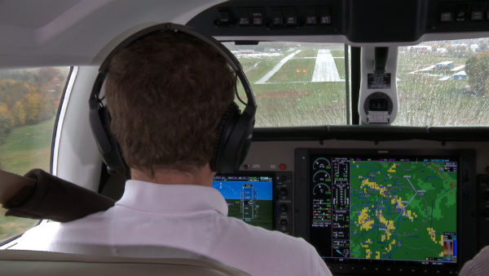
Oh Yeah! The WINGS Program!!
Whether It’s Been A Few Weeks or Many Years,
Consider using the FAA’s WINGS Program To
Regain Proficiency!
Check Out the Many Presentations
Available To Review On the WINGS
Site
Earn a WINGS Phase, Or If It’s Been A Very Long Period, Do More
Than One
Notes:
If you’re viewing this presentation, chances are you’re at least familiar with the FAA WINGS programs, if not a participant. The seminar you’re at right now counts toward a WINGS phase; completing the appropriate content on the WINGS site counts too. You don’t have to be current to view these or attend seminars and meetings.
As mentioned before, a WINGS phase counts as a BFR. You can get an IPC and have that count as part of a phase, as well as aircraft checkouts.
Almost any topic you’d like to learn more about is available on WINGS’ site, or will be presented at a FAASTeam presentation. Subscribe to the email notifications of these events as part of your return to the cockpit!!!
(Next Slide)

Slide 12
WINGS Courses for Refresher Training
Faasafety.gov features Activities & Courses, Many For Free
You Can Browse or Search These Offerings
You Can Attend Seminars Like This One, Or Participate In Webinars
Notes:
An option for today’s pilots return to the cockpit, online resources like faasafety.gov (the WINGS hub) can let you refresh your knowledge at your own pace, at your home, office, airport lounge, etc. Since costs are often a concern and may have led to your inactivity, these courses can save you money and streamline the process.
Example: in your favorite browser, enter “faasafety.gov”. When the page comes up, in the upper left corner you will see a blue header with “Activities, Courses, Seminars & Webinars”. Move your pointer over this, and a drop-down menu appears. Click on “Courses” and then, next to “WINGS COURSES” click on “show WINGS courses” and take a look at just the first page you see. The first one is “A Direct Approach to Class B VFR Operations” !! Perfect for pilots to review after a short layoff, a long period of inactivity, or if you’re current and are nervous about flying in Class B airspace on trip.
Here is the link to this page: https://www.faasafety.gov/gslac/ALC/course_catalog.aspx
You can subscribe to an email notification service on faasafety.gov that will inform you about seminars and webinars. These can not only help you learn and re-learn the material you need to return to flying, but you will also meet other pilots and flight instructors who can help and encourage you.
Here is the link to the seminars page:
https://www.faasafety.gov/SPANS/events/EventList.aspx?statecd=CA
(Next Slide)

Slide 13
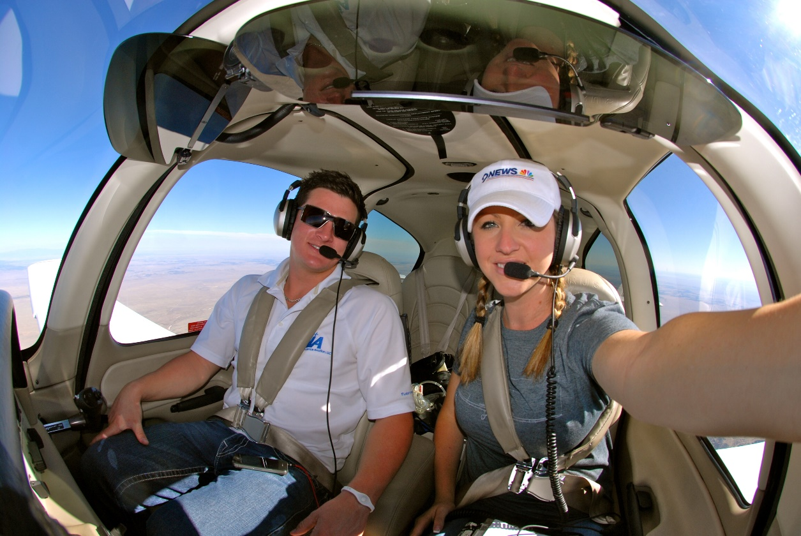
Planning Your Return to the Air
What Skills Do You Really
Want to Refresh?
What Can You Do On Your Own To Prepare?
Meet With A CFI
GO FLYING ASAP!!
Notes:
Great, you’ve decided you’re ready to get flying again!! You need to consider what
Skills have eroded due to your inactivity, and which ones you truly want or need to refresh. For example, ask yourself:
Can I, or do I really want to, fly at night?
Can I, or do I really want to fly IFR?
Am I ready in case of an engine failure? Under what conditions?
Call your CFI, or find one. Ask around if you don’t have a favorite, or want to try someone new. CFI’s are always glad to see a customer walk in after a period of inactivity with a list of questions-it means they’ve started to study and prepare on their own. Any CFI will gladly help you plan out the steps to regain your proficiency and confidence.
Particularly if it’s been a long, long time…GO FLYING!! Don’t delay, get back in the air. Often you’ll be pleased and surprised at what you can still do, and the enjoyment of being back up helps everything else fall into place!!
(Next Slide)

Slide 14
RUST!!! What Skills Are Gone?
Short-Term Layoffs Will
Usually Involve Motor
Skill Erosion
Long-Term Absence Will Require
Both Knowledge and Motor Skill
Refreshment
Notes:
While planning your return to flying, consider what skills, exactly, you really need to apply your ‘rust eraser’ to. If it’s been just a few weeks or months, generally your motor skills (handling crosswinds, being precise with altitude, airspeeds, checklists, etc.) are your concerns. You may just need to go flying with a CFI and polish these skills a bit.
If your layoff involves many months to many years, pilots often find that their motor skills return relatively quickly, BUT their mental skills (often, FYI, the MOST important skills in many situations) need more work and study. These can range from changes in regulations or procedures, to remembering airspace requirements, to….?? In such a case, you need to plan for ground study and instruction in addition to flying instruction.
Discussion: What kinds of flying skills do pilots feel concerned about after lack of use? What kinds of operations require regular use to keep mental skills sharp? What things involve both??
(Next Slide)

Slide 15
If You’re Unsure…
Time to Call Your Favorite CFI!!
Don’t Try This At Home…Or Alone
It’s Best to Erase Your Uncertainty With
Help !!
Notes:
Sometimes, due to the nature of the activity, finances or whatever, we just don’t fly enough. Like so many things, if you’re asking yourself “should I get some dual” the answer is YES. Don’t forget-every time you work with an instructor, you learn something! If you have any hesitation, just go fly with your favorite CFI.
For discussion: perhaps you don’t think you’re all that ‘rusty’. If you go flying today, and the engine quits, are you ready? What do you need to do to BE ready if you think you’re not? If you’re vacuum system quits, or the AHRS stops working correctly (of course those never quit, right?), can you get the airplane safely on the ground if you’re in clouds?
What if ATC radar goes down? What if the beautiful calm day you’re anticipating after a long day of flying cross county turns ugly at your destination? Can you handle it? Do you know how to divert?
Another definition of inactivity could be this: inactive use of certain skills that might be needed. Even if you fly regularly!!
(Next Slide)

Slide 16
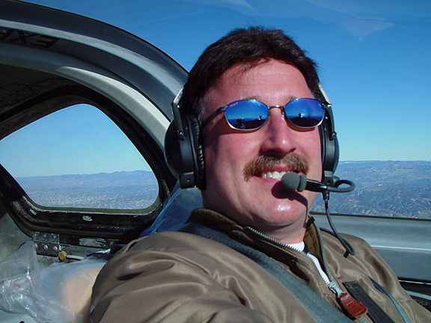
GO FLYING, ASAP!!!!
Notes:
Even if you’re not at the controls, one of the best ways to knock off the rust is to get in the air! Most CFI’s can cite at least one client who called with the statement “well, I went flying with my buddy, and realized how much I miss doing this” or “I took the airlines because I felt unsure if I was up to flying this trip, could we go flying in those conditions?” The point is, standing on the sidelines often creates more inactivity. GO FLYING!! Then you can have that amazing grin on YOUR face that you see here!!
(Next Slide)

Slide 17
How Much Time Will This Take?
Is This Really the Right Question?
Your Goal Should Be Proficiency and Safety
One Size Doesn’t Fit All
Notes:
It might not take as much time as you think. Or, it might take quite a lot more than you think! As with all things related to learning and maintaining a skill, no two people arrive at a standard in the same amount of time. And, some tasks or skills are easy for some, and not others. Again, no two pilots will master a given required skill or area of knowledge with the same ease. EVERYONE has plateaus, remember?
Since flying is a privilege that we earn, after a period of inactivity your goal should be to regain the proficiency you had when you felt sharp. A great yardstick (yes, we know this is difficult!) is to ask yourself, could I pass my check ride TODAY? If the answer is NO, then analyze WHY. Go through the Airman’s Certification Standards (if the practical test for your license is still governed by the Practical Test Standards, give some thought to looking at the ACS that applies to another practical test) and look at the tasks. You’ll no doubt feel that some areas, you’re fine. Others, perhaps not so much. THOSE are the areas you need to practice and regain proficiency with. The result: managing risk when you fly, and increased safety for you and your passengers.
Remember: maybe your friend didn’t struggle with crosswind landings (yeah, right!). If you did, it may take awhile before you’re really up to speed on them again. Don’t rush the process-people are depending on you to be sharp on WHATEVER is required.
(Next Slide)

Slide 18
Train Beyond The Minimum
Don’t Accept “Good Enough”
Accept The Counsel of Your Training Partner
Use Your Return To the Cockpit to Become a Better Airman
Notes:
As we’ve discussed, you’ve been out of the saddle for awhile. Hopefully you’ll go flying ASAP and recall how much you enjoy this activity! Whatever training you plan or need to do, go beyond the minimum standard. You, and your passengers, will enjoy your return to flying even more if you do this. With respect to some areas of skill and knowledge, having this attitude could save your life!
The ACS, PTS, Flight Review and IPC requirements are MINIMUM standards. Accept the counsel of your selected training partner, whether that is an independent CFI or a flight school that assigns you several instructors. Flight Instructors love to hear “can we practice that again?” or better yet “let’s meet one more time so I can get really sharp with these things”. It’s NOT because they want more of your money-it’s because they’ve seen time and again what happens when pilots are in a hurry to get done.
Now that you’re spending the time, energy and money to return to flight status, tell your instructor at least one skill you’d like to improve. It’ll make you a better pilot. Things like: can we go fly in some wind? Can you help me fly an ILS to ATP standards?
What other things can you think of???
(Next Slide)

Slide 19
Make A Plan to Stay Sharp!!
Plan To Fly Regularly, Even if You Don’t NEED to
Take Note of the Skills That Needed The Most Practice
Plan To Fly With an Instructor Routinely
WINGS
Notes:
Congratulations! Hopefully we’ve inspired you to get back in the air after some time off!!! Now that you’re enjoying flying again, make a plan to fly regularly so you don’t need to go through all of this again. The frequency will vary from pilot to pilot. Consult with your CFI about what YOU need. As stated earlier, some clubs and flight training/rental providers require that you fly at least once a month to rent an aircraft solo. Like so many other things mentioned here, this is a MINIMUM. Respect that, and plan to fly at least twice a month.
Discussion: If you can only fly twice a month, what should you do during those flights to stay sharp?
While training to regain your proficiency, you will notice some things either came back quickly, or were never lost. Others, will take a lot of practice, particularly if they involve changes or new material. Those things will require you to practice them more, and more often, than the other skills and knowledge areas.
Fly with an instructor often-even if you ARE an instructor! Getting another set of eyes, ears and brains observing your flying helps keep bad habits and rust from setting in for ALL pilots!!
Consider regularly visiting faasafety.gov and taking a course online. Better yet, come to a seminar once a month on a new topic.
(Next Slide)

Slide 20
References
FAA Flying After Inactivity Safety Briefing:
https://www.faa.gov/news/safety_briefing/2014/media/SE_Topic_04_2014.pdf
Lapsed Pilots: AOPA
https://www.aopa.org/training-and-safety/lapsed-pilots
FAA WINGS Courses, Seminars, Webinars:
https://www.faasafety.gov/content/TabLanding.aspx?tab=courses
Notes:
(Next Slide)

Slide 21
Questions?
Notes:
Presentation Note: You may wish to provide your contact information and main FSDO phone number here. Modify with
Your information or leave blank.
(Next Slide)

Slide 22
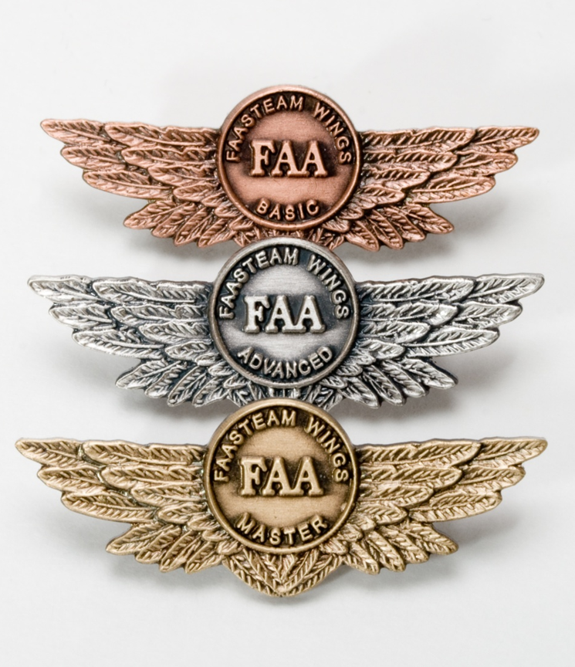
Proficiency and Peace of Mind
Fly regularly with your CFI
Perfect Practice
Document in WINGS
Notes:
There’s nothing like the feeling you get when you know you’re playing your A game and in order to do that you need a good coach (Click)
So fly regularly with a CFI who will challenge you to review what you know, explore new horizons, and to always do your best. Of course you’ll have to dedicate time and money to your proficiency program but it’s well worth it for the peace of mind that comes with confidence. (Click)
Vince Lombardi, the famous football coach said, “Practice does not make perfect. Only perfect practice makes perfect.” For pilots that means flying with precision. On course, on altitude, on speed all the time. (Click)
And be sure to document your achievement in the Wings Proficiency Program. It’s a great way to stay on top of your game and keep your flight review current.
(Next Slide)

Slide 23
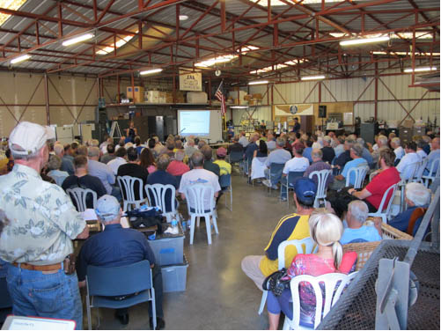
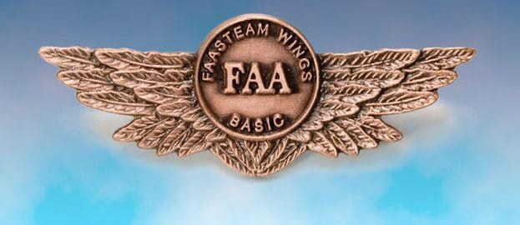
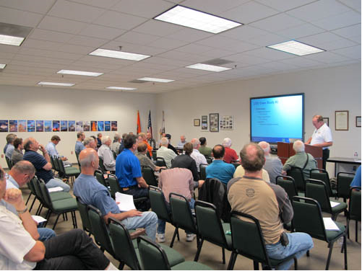
Thank you for attending
You are vital members of our GA safety community
Notes:
Your presence here shows that you are vital members of our General Aviation Safety Community. The high standards you keep and the examples you set are a great credit to you and to GA.
Thank you for attending.
(Next Slide)

Slide 24
Topic of the Month September Flying After Inactivity
Notes:
(The End)

