Slide 1
The National FAA Safety Team Presents
Topic of the Month - October
Avoiding Adverse Drug Interactions
<Audience>
<Presenter>
< >
Notes:
2020/10-04-176(I)PP Original Author: John Steuernagle; POC Kevin Clover, AFS-850 Operations Lead, Office 562-888-2020
Presentation Note: This is the title slide for Avoiding Adverse Drug Interactions
Script - We have included a script of suggested dialog with most slides. The script will always appear in a non-italic font. Presenters may read the script or modify it to suit their own presentation style. See template slides 5 and 6 for examples of a slides with script.
Presentation Instructions - (stage direction and presentation suggestions) will be preceded by a Bold header: the instructions themselves will be in Italic fonts. See slides 2, 3, and 4 for examples of slides with Presentation Instructions only.
Program control instructions - will be in bold fonts and look like this: (Click) for building information within a slide; or this: (Next Slide) for slide advance.
Background information - Some slides may contain background information that supports the concepts presented in the program.
Background information will always appear last and will be preceded by a bold Background: identification.
The production team hope you and your audience will enjoy the show. Break a leg!
(Next Slide)

Slide 2
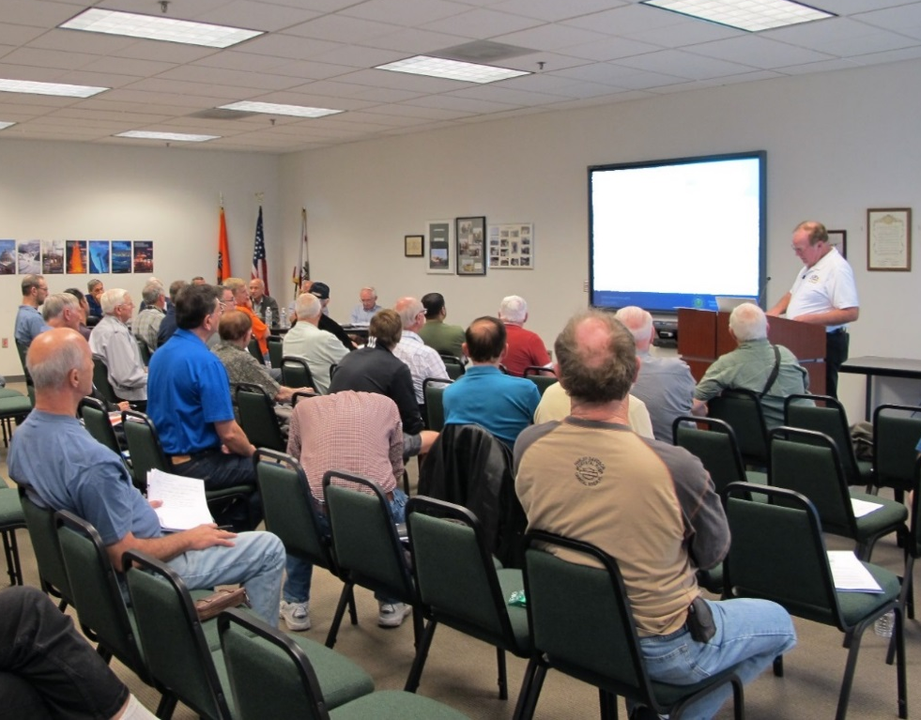

Welcome
Exits
Restrooms
Emergency Evacuation
Breaks
Sponsor Acknowledgment
Set phones and pagers to silent or off
Other information
Notes:
Presentation Note: Here’s where you can discuss venue logistics, acknowledge sponsors, and deliver other information you want your audience to know in the beginning.
You can add slides after this one to fit your situation. (Next Slide)

Slide 3
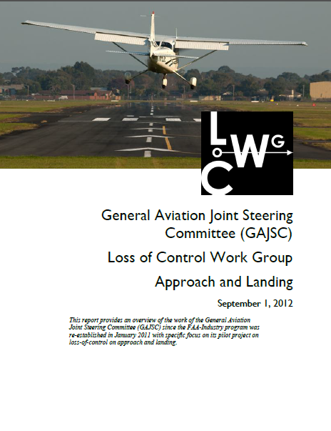
Overview
General Aviation Joint Steering Committee (GAJSC) & FAA Accident Study Findings
Flying and Medications
Drug Interactions
  Drug – Drug
  Drug - Food
Notes:
In this presentation we’ll talk a little bit about a recent GAJSC and FAA studies that feature some interesting findings with respect to pilots and medications
We’ll talk generally about flying while medicating and specifically about drug interaction problems you may encounter when taking more than one drug. Or
when taking a drug with certain foods or alcohol.
Presentation Note: If you’ll be discussing additional items, add them to this list
(Next Slide)

Slide 4
FAA Findings
In a 2011 FAA study involving pilot fatalities….
  570 out of 1,353 pilots tested positive for medications/drugs.
  511 of the 570 (90%), were flying under CFR Part 91.
Extent of Impairment – Undetermined
  But cause for concern
Notes:
In a 2011 study from the FAA’s CAMI Toxicology Lab drugs/medications were found in 570 pilots (42%) from 1,353 total fatal pilots tested. Most of the pilots with positive drug results, 511 (90%), were flying under CFR Part 91.”. (Click)
While there were some instances of recreational drugs, the majority were prescription or over the counter medications. Antihistamines were the most commonly found. (Click)
Left undetermined was the extent of pilot impairment – if any – due to drug use but the issue is cause for concern for several reasons:
(Next Slide)

Slide 5

What’s the Problem
Not easy to determine extent of impairment
  Different medication effects for different people
  Post-mortem redistribution and sample type
Don’t know about pilot’s condition
  Pre-existing medical condition requiring medication
AME not consulted?
Drug interactions
Notes:
So what’s the problem:
First of all – We all know that some medications may compromise a pilot’s ability to control the aircraft and/or adversely affect judgment and decision-making. (Click)
What’s not so obvious is it’s difficult for investigators to say for sure that pilot performance was compromised because the effect of drugs and medications varies widely among individuals. In addition, post-mortem redistribution of a substance creates some confusion as to the actual blood levels prior to the accident. The amount of a substance may vary considerably in different tissues. (Click)
A less obvious problem poses the question; what pre-existing physical condition requires the use of medication in the first place? (Click)
It’s not unusual to find that pilots are evaluated and treated for conditions that are not revealed to their Aviation Medical Examiners. In those cases an AME doesn’t have an opportunity to review the complete medical history of diagnoses and treatments for some of the pilots they examine. (Click)
There’s also the issue of drug interactions and that’s what we’re going to discuss today.
(Next Slide)

Slide 6
What’s the Problem
65% of MD visits result in a prescription
40% of US population has 4 or more prescriptions
Possibly combined with OTC medications
Adverse reactions increase dramatically with 4
or more medications
Notes:
In the United States, roughly 65% of all doctor visits result in a prescription. (Click)
and 40% of the United States population has 4 or more prescriptions. - (Click)
that may be combined with OTC medications. (Click)
The odds of an adverse reaction increase dramatically with 4 or more prescribed medications.
So how can pilots know which drugs in combination are likely to compromise safe flight?
(Next Slide)

Slide 7

Consult your AME
List all conditions
List all medications
  Prescription
  OTC
  Dietary supplements
Notes:
Well before we go any further let’s just say that when it comes to potential drug interactions; we need to consult our AMEs
Aviation medical examiners are trained to look for potential drug interaction problems but they can’t help if they don’t have the complete picture.
So list all your medical conditions and the medications prescribed to treat them. And list any over-the-counter drugs you’re taking – even aspirin. (Click)
And finally, because dietary supplements can react adversely with some medications, tell your AME about them as well.
Armed with this information AMEs can advise their patients effectively.
(Next Slide)

Slide 8
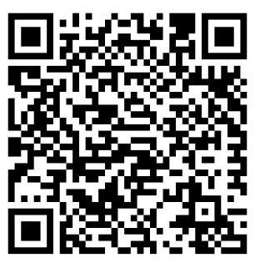
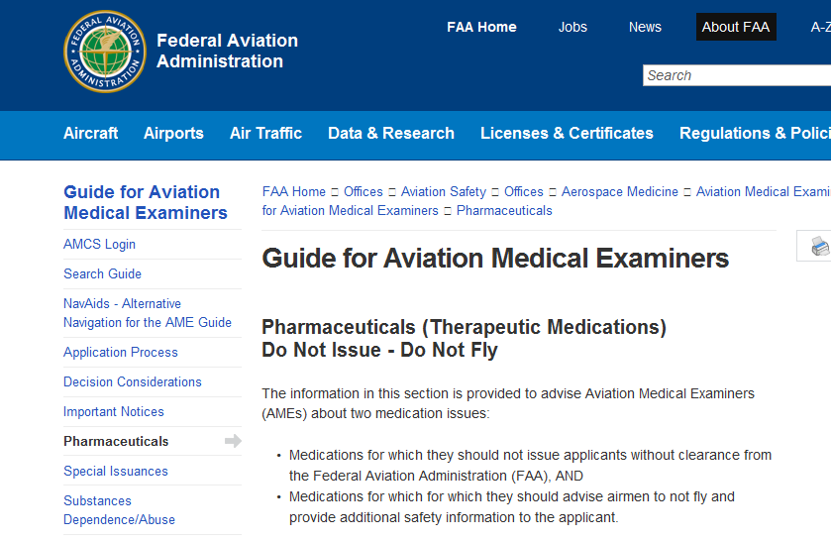
Do not issue – Do not fly
https://tinyurl.com/l43gpcu
Notes:
You and your Aviation Medical Examiner can access lists of medications that preclude medical certificate issuance (Do not Issue) or medications that are not
compatible with safe flight operations (Do not Fly). Those lists are available at the website shown on the screen.
That’s the easy and obvious part. What’s not so easy or obvious is how drugs interact with other drugs and with food or alcohol. For that information we’ll have to dig a little deeper.
Presentation Note: You can access the Do not Issue – Do not Fly lists at this URL: https://www.faa.gov/about/office_org/headquarters_offices/avs/offices/aam/ame/guide/pharm/dni_dnf/
(Next Slide)

Slide 9
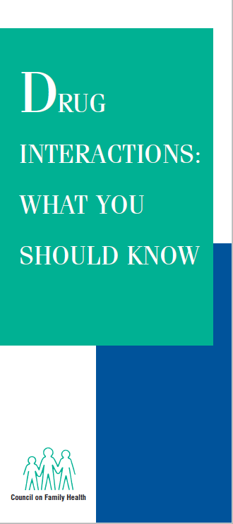
Drug Interactions
Consult your AME!
https://www.fda.gov/media/76562/download
Notes:
When we speak of drug interactions, we’re talking about how prescription and OTC drugs interact with (Click)
What we eat and drink (Click)
Including products we use to supplement our diet (Click)
And how the drugs we’re taking react with each other.
The resource links on screen will take you to a handy pamphlet that will get you started on the topic.
But the pamphlet doesn’t address all the possible adverse interactions. For that evaluation you’ll need to……
Presentation note: Ask for input from the audience. You’re looking for, “Consult your AME”! When audience input has been received (Click)
That’s right – consult your AME!
There’s another thing you need to do. Any ideas as to what it is? It has to do with each prescribed and OTC medication you intend to use.
Presentation note: Ask for input from the audience. You’re looking for, “Read the label and product information for each medication” When audience input has been received advance to:
(Next Slide)

Slide 10
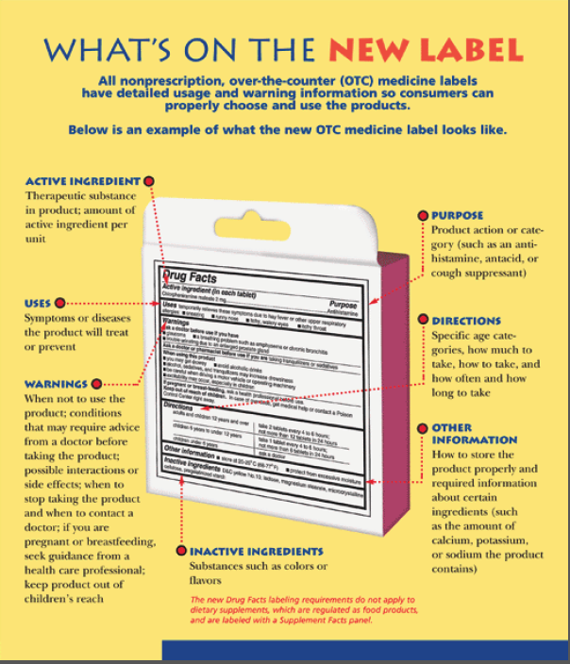
Read the label
OTC Medication Labeling
Labeling Standards
  Directed to medication users
  In non-technical language
Notes:
Food and Drug Administration (FDA) OTC labeling requirements are directed to users so be sure to read the label before you medicate and fly.
(Next Slide)

Slide 11
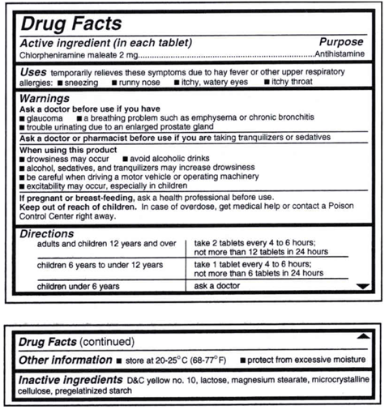
OTC Medication Labeling
Read the label
  Active Ingredient(s)
  Purpose
  Uses
  Warnings
  Directions
Notes:
The standard OTC Label will tell you the active ingredients, purpose, and uses for the drug as well as warnings and directions for use.
Note in this example we’re looking at an antihistamine that we might take to address cold symptoms.
Note the warnings of drowsiness and those associated with driving a motor vehicle or operating machinery. Do you think it would be safe to fly while using this drug? How long will it reside in your system? How soon would you be safe to fly after stopping the drug?
You won’t find the answers to any of those questions on the label. This might be a good time to consult your AME.
(Next Slide)

Slide 12
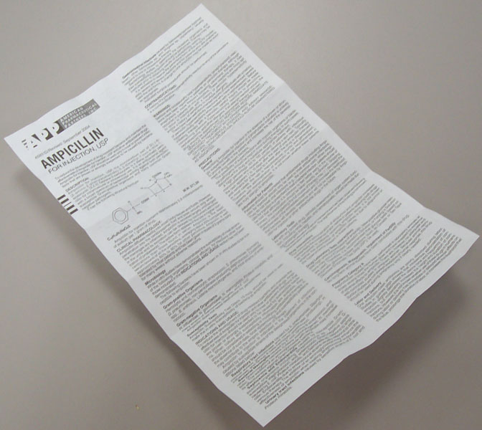
Prescription Drug Labeling
Known by several names including prescribing information or package insert
Intended for Healthcare providers, but available to anyone.
  May be several pages long in very small print
  Very technical language
Notes:
Per Food and Drug Administration (FDA) the acceptable names are: prescribing information, package insert, professional labeling, direction circular, package circular
This information is intended for health professionals and is rarely given to the patient although it is readily available on line. Currently it consists of a document included in the medication box or attached to a container, but FDA is trying to change this to electronic format. Prescription drug labeling features highly detailed information in technical language; presented in a standard format.
(Next Slide)

Slide 13

Drug-drug interactions
Antihistamines with hypertension drugs
Drugs, food, or beverages that contain caffeine
Pain relievers
  Acetaminohpen, aspirin, ibuprofen, etc.
Antacids
Notes:
Antihistamines can be prescribed and they are readily available over the counter. They are not recommended for flying and they can adversely react with some prescription drugs used to treat high blood pressure.
Drugs, food, or beverages that contain caffeine can react adversely with other drugs. The same is true for some pain relievers and antacids.
(Next Slide)

Slide 14

Drug-food interactions
Empty or full stomach
Alcohol intake
Certain foods
  Grapefruit and grapefruit juice
    Can interact with some cholesterol
    and hypertension drugs.
Pain relievers
  Acetaminohpen, aspirin, ibuprofen, etc.
Antacids
Notes:
Whether to take on an empty or full stomach has to do with drug absorption characteristics and possible adverse side effects such as nausea.
Alcohol intake may interfere with drug absorption or promote adverse reactions to the drug/alcohol combination. Many drugs are incompatible with alcohol.
Certain foods can increase or decrease concentration of some drugs. For instance, grapefruit and grapefruit juice can affect how well some medicines work and it may cause dangerous side effects.
Prescription and OTC pain relievers and Antacids may also react adversely with food.
(Next Slide)

Slide 15
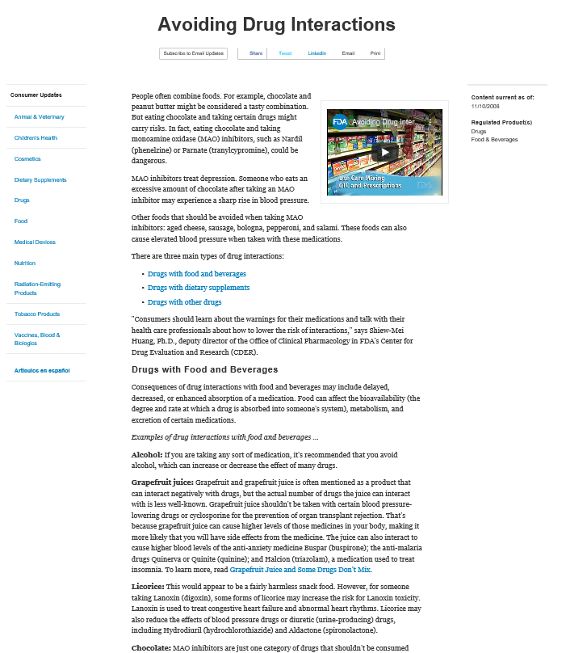
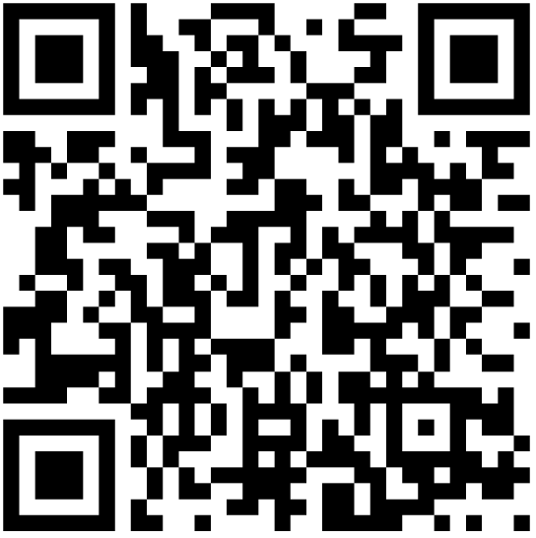
Drugs & Food
https://tinyurl.com/vr4axa4
Notes:
Here’s a resource you can use to learn more about adverse food and drug reactions.
It describes some but by no means all, adverse drug and food interactions.
(Next Slide)
Presentation note: The tiny URL on the slide should work. In case it does not - here is the complete link to the Drug Interactions web page:
https://www.fda.gov/consumers/consumer-updates/avoiding-drug-interactions

Slide 16
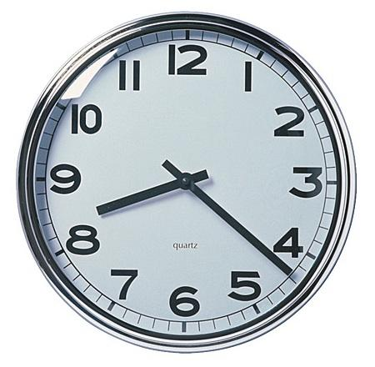
How long must I wait?
FAA recommends waiting five times the dosage interval.
  Particularly true for any medication causing drowsiness.
Four times per day = 6-hour intervals
  5 x 6 = 30 hours
Notes:
If you’ve been taking a medication that precludes flying, how long must you wait after ceasing the medication before you return to the air? (Click)
This is a good question for your AME to answer but the general rule is to wait until 5 times the dosage interval has passed. (Click)
For example; if you take a medication 4 times a day (6-hour intervals) you should wait at least 30 hours before resuming pilot duties.
(Next Slide)

Slide 17
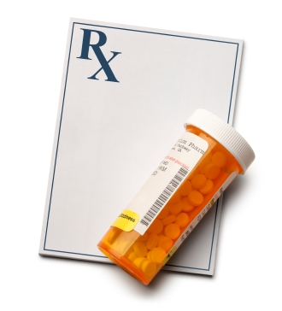
Tips
Consult your AME and read the labels before flying while using prescription and/or OTC Drugs.
Make sure your AME knows about all the drugs you take and the medical conditions requiring their use.
Let your prescribing doctor know that you are a pilot.
Ask about adverse effects associated with drug combinations and with foods and dietary supplements..
In between doctor visits you’re self assessing your condition before each flight. Ground yourself when you’re not fit to fly.
Notes:
Finally – here are some tips for safe flying while taking prescribed or OTC medications.
Consult your AME and read the labels before flying while using prescription and/or OTC Drugs.
Make sure your AME knows about all the drugs you take and the medical conditions requiring their use.
Let your prescribing doctor know that you are a pilot.
Ask about adverse effects associated with drug combinations and with foods and dietary supplements.
In between doctor visits you’re self assessing your condition before each flight. Ground yourself when you’re not fit to fly.
(Next Slide)

Slide 18
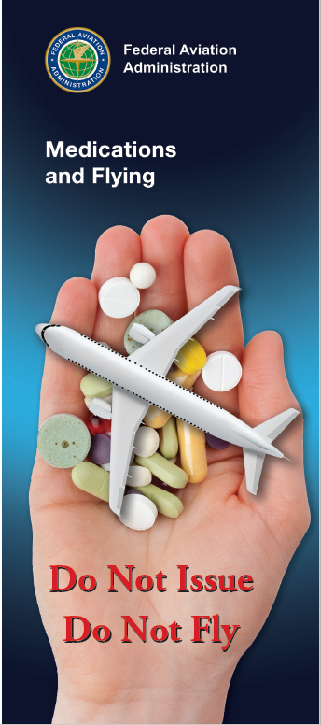
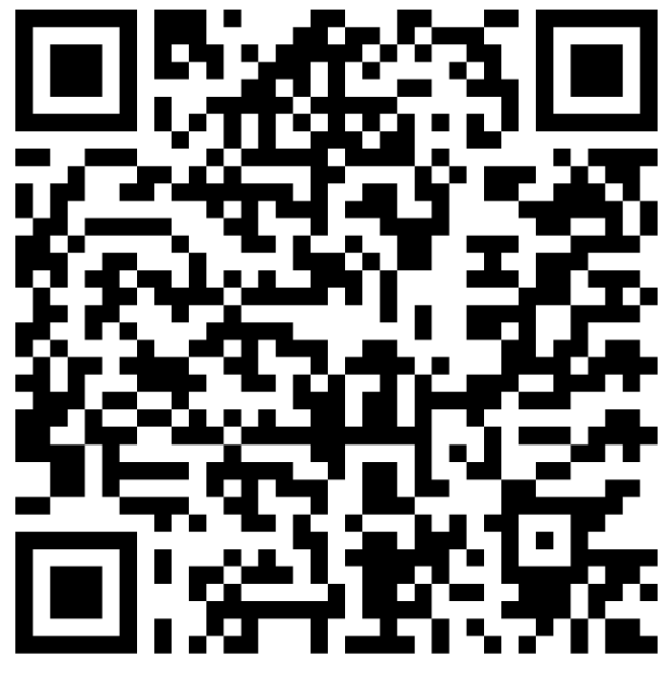
For more information
https://tinyurl.com/y94lokh8
Notes:
Much of the information in this presentation was taken from FAA’s Medications and Flying Brochure. You can download a copy at the URL or QR code on the screen.
(Next Slide)

Slide 19

Questions?
Special Thanks to:
  Jon M. Grazer, MD
  William J. Tsai, MD
  G. J. Salazar, MD, MPH
Notes:
Presentation Note: You may wish to provide your contact information and main FSDO phone number here. Modify with
your information or leave blank.
(Next Slide)

Slide 20
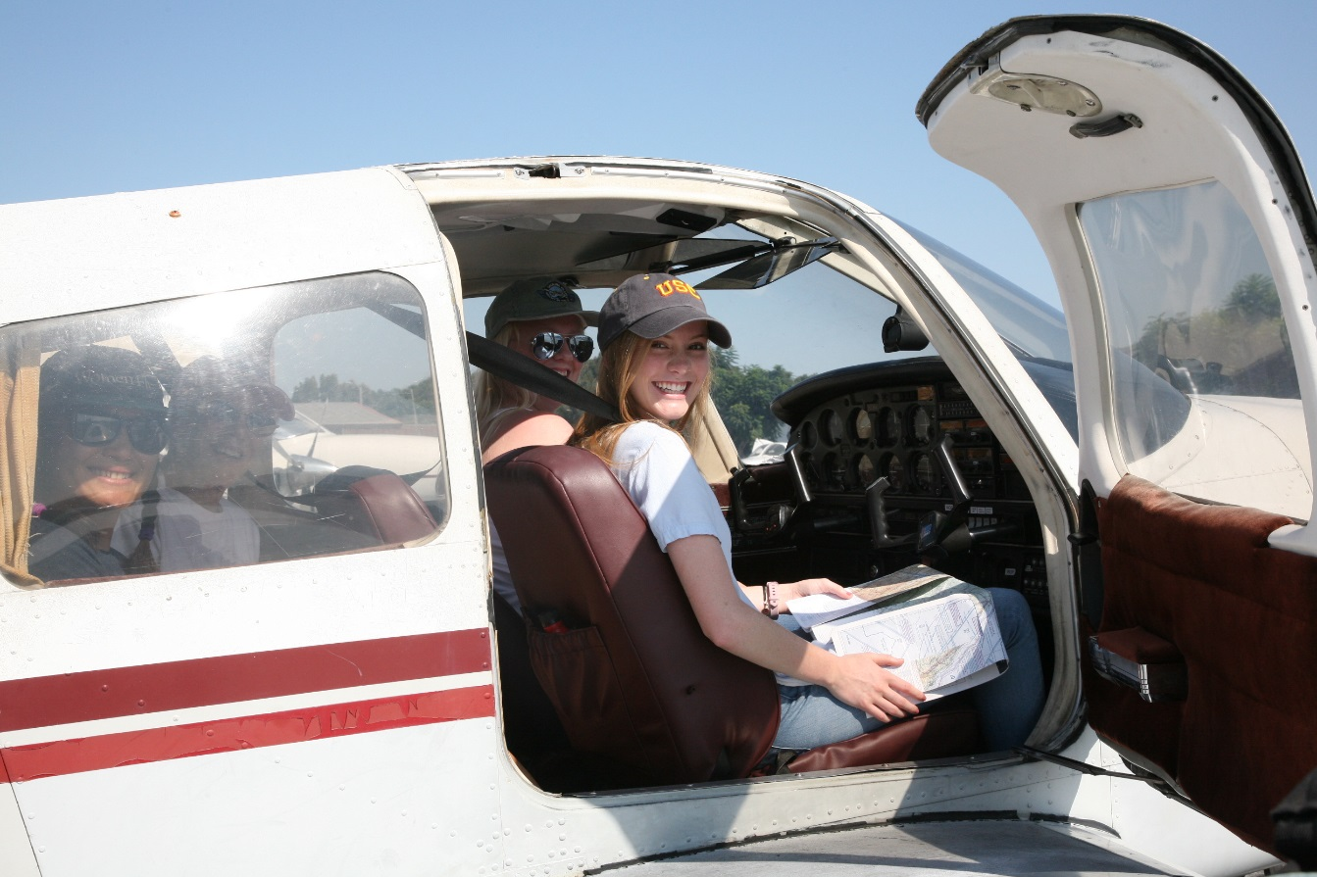
Have you earned your WINGS?
Proficient Pilots are:
  Confident
  Capable
  Safe
WINGS will keep you
on top of your game
Notes:
Have you earned your WINGS? Proficiency is key to success in almost every thing worth doing – especially flying. Proficient pilots are confident, capable, and safe.
WINGS is a proficiency training system specifically designed for general aviation pilots and, regular participation will keep you on top of your flying game.
(Next Slide)

Slide 21
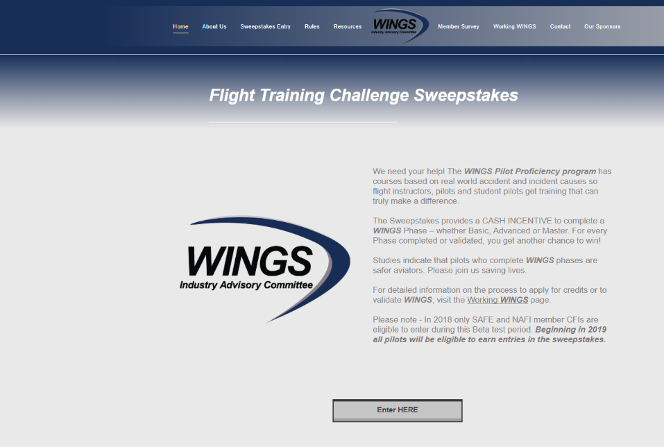
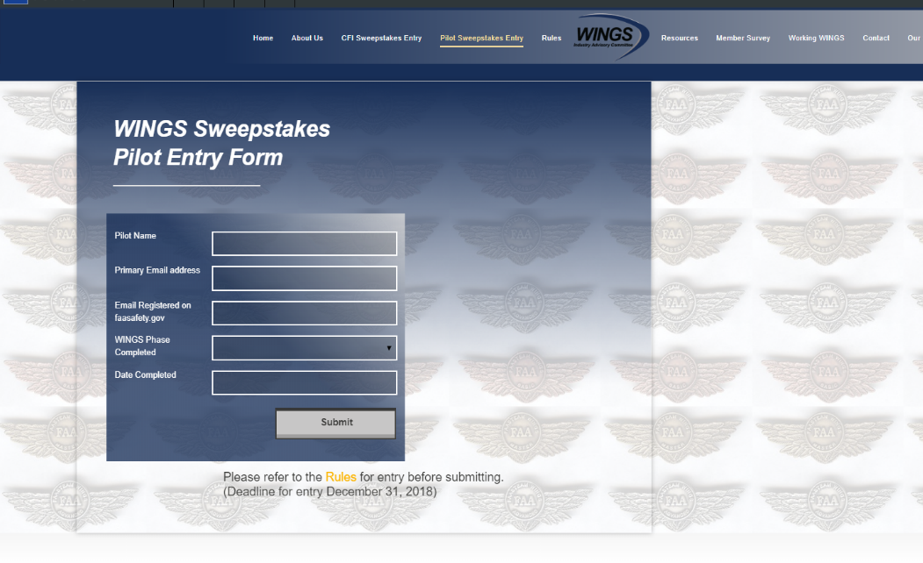
The Paul & Fran Burger 2019
WINGS $10,000 Sweepstakes
Complete WINGS Phases and WIN Cash Awards!
http://www.mywingsinitiative.org/
Notes:
Now there’s even more reasons to participate in WINGS. Every time you complete a WINGS Phase you’re eligible to win cash the WINGS Sweepstakes.
The sweepstakes is generously funded by Paul Burger, a long time advocate for general aviation safety and a retired aviator who believes participation in this program saves lives. VISIT WWW.MYWINGSINITATIVE.ORG to learn more and enter the sweepstakes.
(Next Slide)
c

Slide 22

How To Win – It’s Easy
Whenever you complete a WINGS phase, select WINGS Sweepstakes on the Team Member Award section of your My WINGS page
Or Visit www.mywingsinitiative.org & click on “Sweepstakes Entry”
Complete the form, get chances to win one of 10 cash prizes!
Four $1,500, Four $750,Two $500 Winners
Notes:
After you’ve completed a phase of WINGS you can enter the sweepstakes by clicking on “Claim Rewards” in the “WINGS – at a glance” section of your My WINGS page and select WINGS Sweepstakes. Or you can go directly to the mywingsinitiative.org website.
(Next Slide)

Slide 23
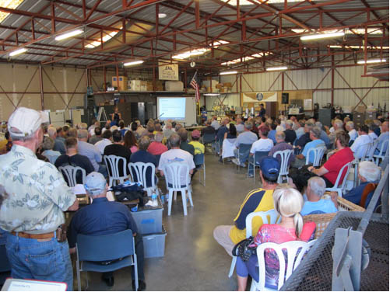
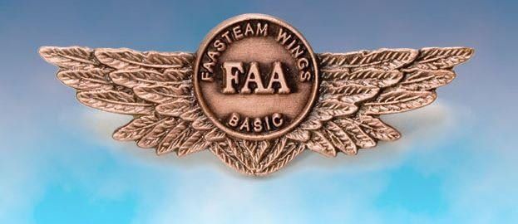
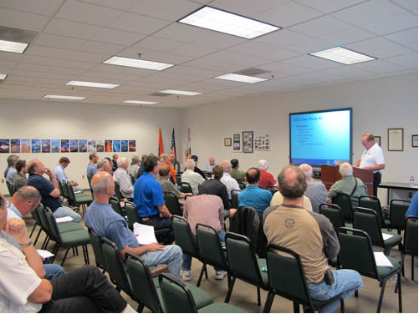
Thank you for attending
You are vital members of our GA safety community
Notes:
Your presence here shows that you are vital members of our General Aviation Safety Community. The high standards you keep and the examples you set are a great credit to you and to GA.
Thank you for attending.
(Next Slide)

Slide 24
The National FAA Safety Team Presents
Topic of the Month - October
Avoiding Drug Interactions
<Audience>
<Presenter>
< >
Notes:
(The End)

