Slide 1
The National FAA Safety Team Presents
Topic of the Month – November
Normalization of Deviation Bias
<Audience>
<Presenter>
< >
Notes:
2022/11/14-266(I)PP Original Author: John Steuernagle; POC Kevin Clover, National FAASTeam Program Mgr. Ops., Office 562-888-2020
Presentation Note: This is the title slide for CFIT and Normalization of Deviation Bias
Script - We have included a script of suggested dialog with most slides. The script will always appear in a non-italic font. Presenters may read the script or modify it to suit their own presentation style. See template slides 5 and 6 for examples of a slides with script.
Presentation Instructions - (stage direction and presentation suggestions) will be preceded by a Bold header: the instructions themselves will be in Italic fonts. See slides 2, 3, and 4 for examples of slides with Presentation Instructions only.
Program control instructions - will be in bold fonts and look like this: (Click) for building information within a slide; or this: (Next Slide) for slide advance.
Background information - Some slides may contain background information that supports the concepts presented in the program.
Background information will always appear last and will be preceded by a bold Background: identification.
The production team hope you and your audience will enjoy the show. Break a leg!
(Next Slide)

Slide 2
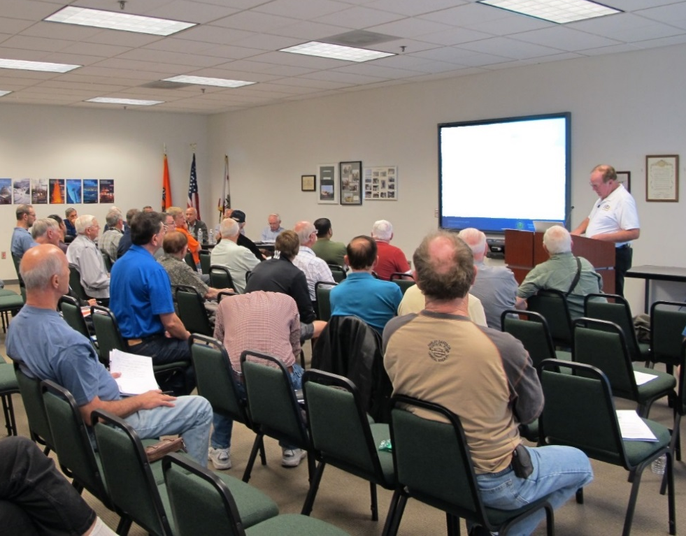

Welcome
Exits
Restrooms
Emergency Evacuation
Breaks
Sponsor Acknowledgment
Set phones and pagers to silent or off
Other information
Notes:
Presentation Note: Here’s where you can discuss venue logistics, acknowledge sponsors, and deliver other information you want your audience to know in the beginning.
You can add slides after this one to fit your situation.
(Next Slide)

Slide 3
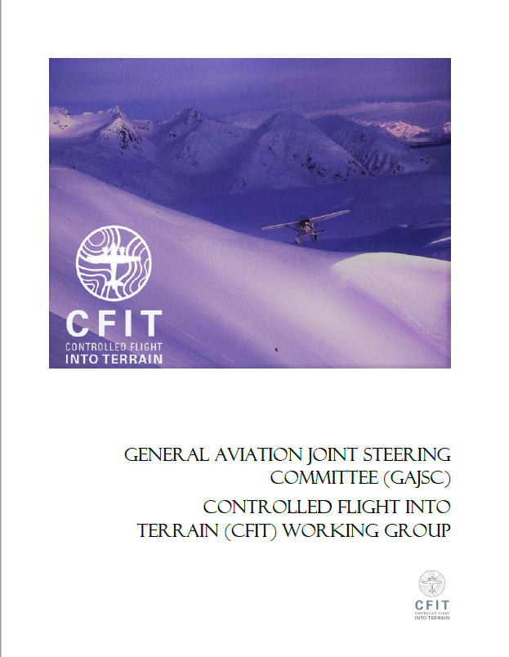
Overview
Normalization of Deviance
CFIT Case Studies
Maintaining Proficiency
*GAJSC – General Aviation Joint Steering Committee
Notes:
The General Aviation Joint Steering Committee (GAJSC) Controlled Flight Into Terrain (CFIT) work group report suggests that certain human biases may be significant factors in CFIT accidents. In this presentation we’ll talk a little bit about CFIT and human biases that may negatively influence pilot decision making. We’ll review some CFIT case studies and we’ll offer some thoughts on how to effectively manage things that we can control and plan for dealing with things that are beyond our control. Finally we’ll offer a few suggestions for maintaining pilot proficiency.
Presentation Note: If you’ll be discussing additional items, add them to this list
(Next Slide)

Slide 4
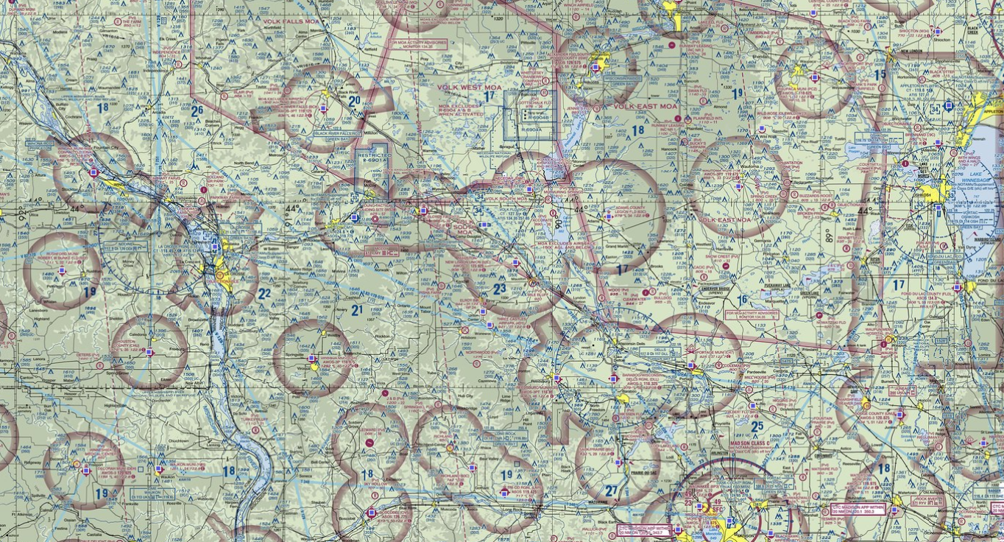

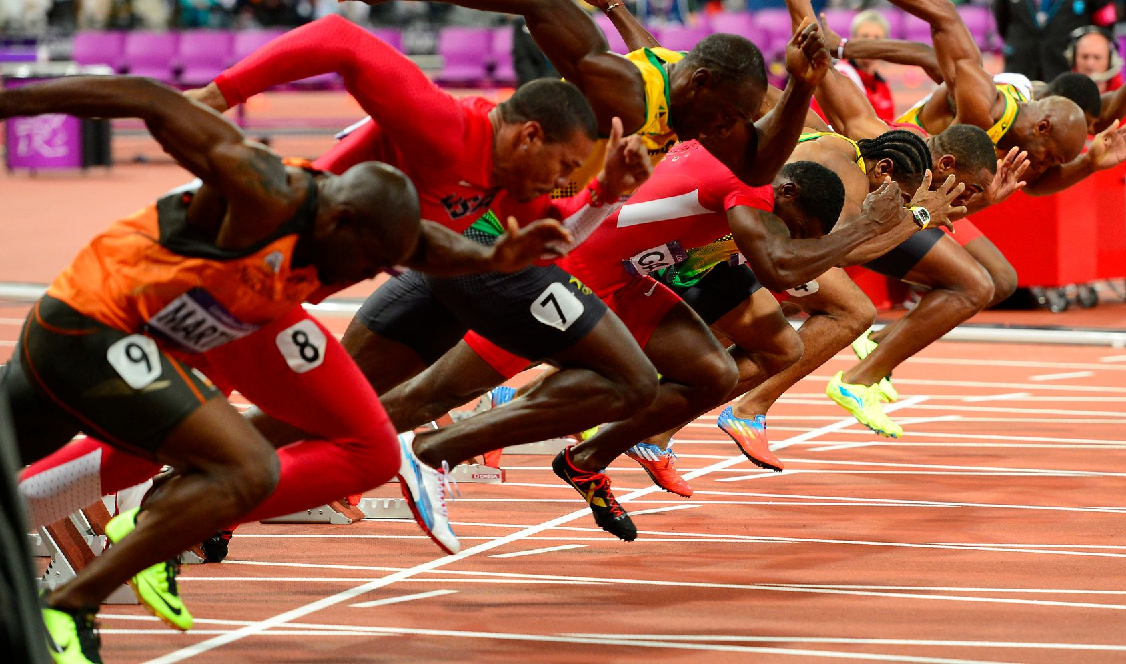
Pushing the limits is human nature
A recipe for success
Continuous improvement
  Safety & Quality control
Shortcuts
  Save time & money
Notes:
Make no mistake – human beings are programmed to push their limits. It’s a recipe for success. Athletic training and coaching are designed to improve performance over time.
We’ve all heard that, “records are made to be broken” and that’s certainly been the case in nearly every field of human endeavor. The first person to run a mile in less than four minutes achieved that milestone in 1954. Since then runners have shaved more than 16 seconds from that record! (Click)
Every corporate management systems calls for continuous improvement of output and production efficiency. If we can produce more product in less time with fewer employees then that’s a good thing provided safety is maintained and product quality doesn’t suffer. (Click)
And people are always looking to take advantage of shortcuts. (Click)
Why take the long way around when you can save time and money by going direct?
(Next Slide)

Slide 5

Complications
Bias – a prejudice in favor of or
against one thing, person or group
compared with another, often in
a way considered to be unfair
Normalization of Deviance
  Operational Drift
  Dunning-Krueger Effect
Notes:
In watchmaking, the term, “complication” refers to added features that complicate the challenge of designing elegant machines that provide a wealth of information in a small package. Here we’re using the word to describe human biases that complicate the process of making sound decisions. (Click)
Bias is defined as a prejudice in favor of or against one thing, person, or group compared with another, often in a way considered to be unfair. (Click)
Normalization of Deviance describes the human tendency, often well intended, to deviate from established procedures and norms over time and the acceptance of those deviations as new norms. These deviations are sometimes referred to as Operational Drift. (Click)
Deviation can be influenced by The Dunning-Krueger Effect that has to do with self-assessment of one’s capabilities. Dunning and Krueger discovered two interesting
Things about humans that we’ll get to in a couple of slides but first let’s look at some examples of normalization of deviance.
(Next Slide)

Slide 6



What’s the limit?
Posted vs Practical
  I’m not speeding – just keeping up with traffic
Notes:
To facilitate our discussion we’ll talk about limits. Let’s take for example, Interstate highway 405 in California. The posted speed limit where the highway transits Los Angeles is 65 miles per hour. But if traffic congestion isn’t heavy, speed averages closer to 75 miles per hour. We might think that average speeds are higher because resources are not available to enforce the limit but in fact the highway is patrolled. (Click)
You’ve probably noticed this phenomenon of posted vs practical speed limits on some of the highways you use. In many areas, traffic flows at higher than posted speed limits. After a while this speed becomes the new normal and drivers will not consider they’re speeding unless they go faster than the flow. You wouldn’t say you were speeding if you’re just keeping up with the traffic. But you might well think ill of the occasional maniac who’s chewing up the highway at well over the average traffic speed. When that happens you may be influenced by another unhelpful human bias. We’ll get to that in a couple of minutes but first.
(Next Slide)

Slide 7
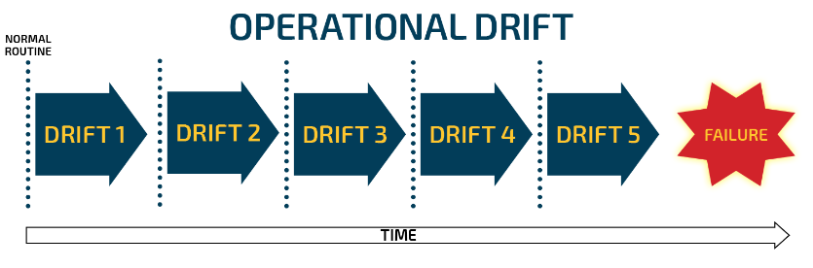
Operational Drift
Acceptable process limits tend to drift over time
Notes:
In any process, limits are established to define and ensure acceptable performance. Limits are often safety driven and, if they are well designed, there is a cushion of safety to compensate for human, machine, and operational environment variations. Thus we are comfortable with the notion that exceeding a limitation, by just a bit or for a brief moment is not likely to result in catastrophe. But because we are human, this comfort with brief excursions from limits can cause big problems over time. Here’s how that works.
Because we want to conserve energy and operate efficiently, we tend to push performance limits. Exceeding aircraft speed or weight limitations by “just a bit” will allow us to be more efficient and after all, we have a safety cushion to rely on. Over time we come to accept deviations and they become our new norms. So what’s the problem?
You guessed it, once we’re comfortable with the new norm we’ll be tempted to push that limit. This tendency to progressively exceed limits is known as Operational Drift. Each deviation is so slight that it seems inconsequential until one day. (Click)
We have a failure.
(Next Slide)

Slide 8
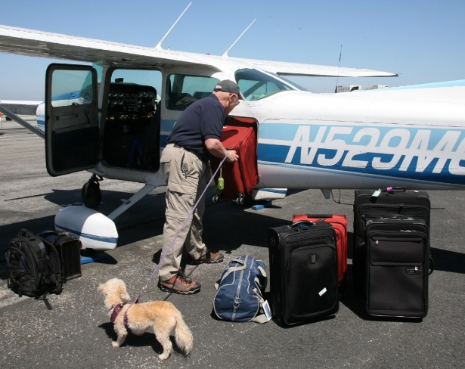
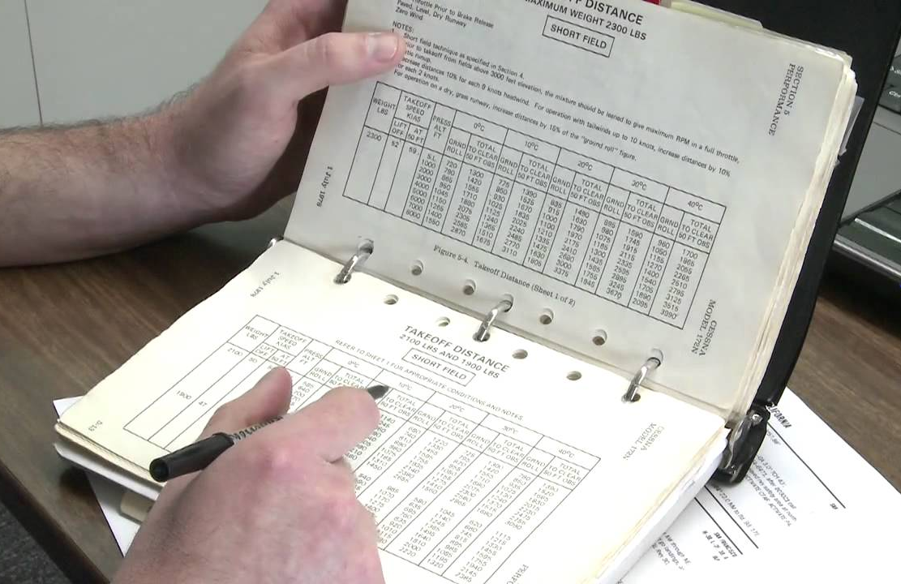
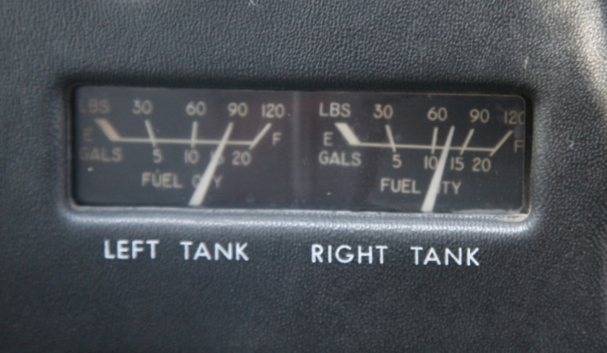
How often have you heard….
She’ll haul anything you can fit in the door
Relax - It flew in here – it’ll fly out
We’ve got plenty of fuel
Notes:
How often have you heard these statements. You may even have said them yourself. Each of these statements relates to aircraft and pilot performance expectations.
Occasionally, in the course of accident investigation, we discover that those expectations were unreasonable. And occasionally we find that pilots have progressively deviated from established limitations until there is no safety factor and an accident occurs.
(Next Slide)

Slide 9

We’ve got plenty of fuel
Regular round-trip flight from Virginia to New England
  675 nm
    Fuel – 48Gal @ 7GPH
      6 hrs. 48 min. – no reserve
    Speed – 110 Knots
      6 hrs. 5 min. – no wind
      Average Trip – 6 hrs. 15 min.
    No refuel if outbound leg is < 3 hours
Notes:
A pilot based in Virginia made regular 675 mile round trip flights to visit relatives in New England.
The fuel capacity of his aircraft was 48 gallons. At 65% power the aircraft burned 7 gallons per hour – enough for
6 hours and 48 minutes of flight with no reserve. (Click)
65% power yielded 110 Knots true airspeed. That equated to 6 hours and 5 minutes for the round
trip assuming no wind. Over several trips the average total trip time was 6 hours and 10 minutes. That yielded
a 38-minute fuel reserve for the return trip. (Click)
Initially the pilot would purchase fuel in New England – even though he had sufficient fuel on board for the return trip.
But fuel was much more expensive than at his home field so the pilot became accustomed to returning without refueling,
“if the outward trip had taken less than 3 hours”.
On one occasion the pilot experienced symptoms of carburetor ice in the initial climb out on the return leg. Carburetor
heat solved the problem and the return leg was uneventful. Until the fuel was exhausted 20 miles north of his destination in
night VMC conditions.
Presentation Note: Lead a discussion on what the audience thinks was the cause of the accident. Factors include the use of carburetor heat
and the resultant richer fuel mixture on the return leg, the less than legal fuel reserve for night operations, and the complacency from having
Been successful on many previous trips. Over time and banking on a 30-minute fuel reserve, the pilot became comfortable with making the trip
without refueling even though winter operations often resulted in landing after dark.
(Next Slide)

Slide 10


The Dunning - Kruger Effect
Less experienced practitioners tend to overrate their ability
  and their decision making
More experienced aviators appear to be more cautious
  Taking more factors into consideration
  Considering their previous experience
Notes:
The Dunning-Kruger effect has to do with the tendency of people who are relatively inexperienced in a task to overestimate their ability with respect to it.
This may explain some of the overly confident behavior of some low-time pilots.
Conversely, more experienced practitioners tend to underestimate their abilities. They may well be taking their previous experience into account when making conservative estimates of future performance.
Even so – pilots who are new to the game and old pros are equally susceptible to Normalization of Deviation Bias.
(Next Slide)

Slide 11
She’ll haul anything that will fit in the door
Airplane owned for more than 10 years
  Max T.O. Wt. 2550
  Empty Weight 1680
  Fuel 53 Gal 318 Lb.
  Useful Load 552 Lb.
Notes:
When the pilot bought this aircraft it was ideal for a couple and a small dog. Ten years later the dog is still small but the people and their essential traveling gear have grown larger and heavier.
(Next Slide)

Slide 12
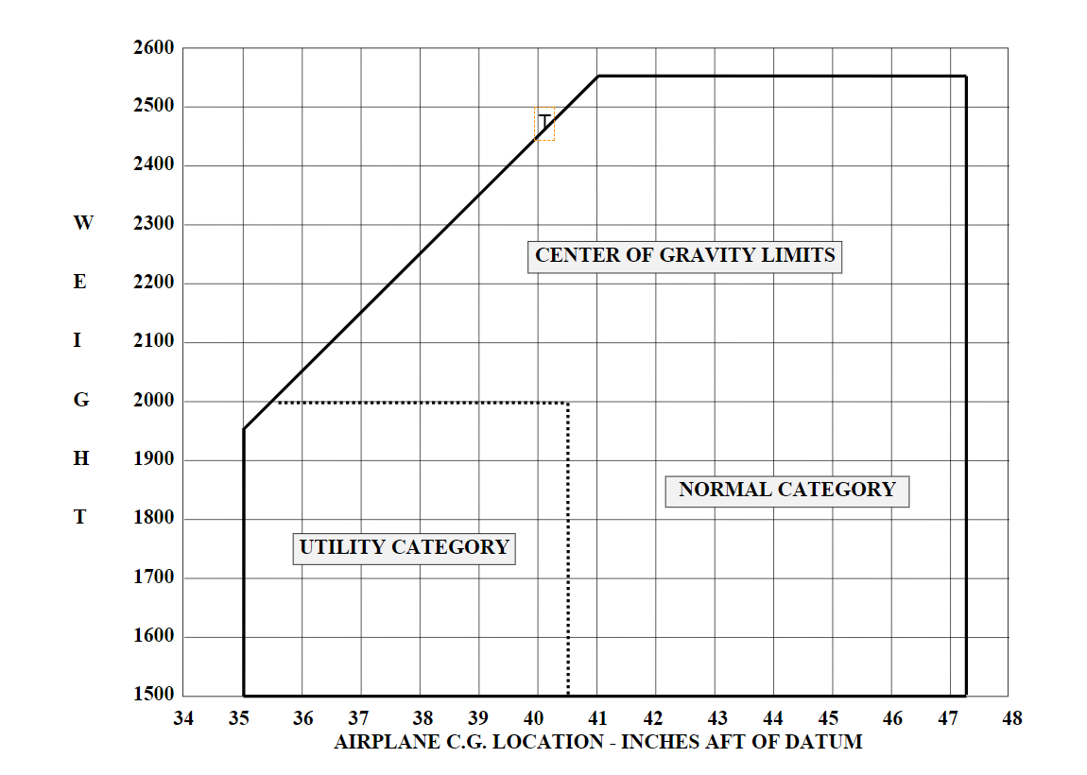
Ten years of operational drift
Notes:
Ten years ago the aircraft was comfortably within the allowable weight and center of gravity envelope.
But as the list of travel essentials grew the CG moved progressively aft and the weight increased until now he’s regularly flying overweight. (Click)
Because the weight increased gradually, aircraft performance reduced gradually too. Sure it takes a little more runway to takeoff and a little more time to climb but each slight degradation of performance has, over time, become the new normal.
To see why this can be problematic, let’s take a couple of minutes to discuss aircraft design and limitations.
(Next Slide)

Slide 13
Examples of Weight and Balance Limits
  Typically based on climb performance, & airframe strength
  Nose Gear limits, ability to flare, trim
(weight)
  Tail gear structural limit, stick forces going to zero, spin resistance, longitudinal stability, can’t push forward on balked landing
Horizontal Tail Strength, Ability to flare, Nose Gear
(Center of Gravity)
Notes:
You’ve all seen weight and balance limits graphed like this red box. Each part of the box is an expression of a design or performance limitation. (Click)
At lower weights you can stay within nose gear stress limits, and you can flare & trim with a forward center of gravity. As weight increases though the CG must move aft to avoid exceeding design and control limits. That’s why this line slants aft. (Click)
This upper weight limit is typically based on climb performance criteria and airframe strength. Maximum gross weight is established early in the design process and each structural component is designed to support that figure.. (Click)
The aft limit is predicated on tail wheel strength, pitch control forces approaching zero, spin resistance, longitudinal stability – see control forces approaching zero – and the ability to control pitch with full power application as in a go around from a balked landing. (Click)
Finally – the forward limit is determined by the empennage strength, the ability to flare, and nose gear design limits.
(Next Slide)

Slide 14
Weight Limits – True or False
1. Maximum gross weight is selected early in the design of most airplanes and the rest of the airplane is designed around that number.
Yes – that’s true.
2. Exceeding maximum gross weight routinely can result in fatigue problems.
You bet – exceeding max gross weight – even by a little bit will result in fatigue problems. As the fleet ages we’re seeing more of this.
3. Exceeding maximum gross weight results in lower climb rates and can result in structural failure.
Well duh – of course we’re going to climb slower but the insidious thing is the possibility of structural failure.
4. When exceeding Max Gross Wt. Stall speed goes up, controllability can be reduced, ability to maneuver without entering an accelerated stall can be reduced.
Yes this is all true when you exceed weight limits.
Notes:
With that in mind, let’s look at a few true false questions. These all have to do with the maximum gross weight limit.
What do you think about this statement? (Click)
Well we just talked about that so yes – that’s true. (Click)
You bet – exceeding max gross weight – even by a little bit will result in fatigue problems. As the fleet ages we’re seeing more of this. (Click)
Well duh – of course we’re going to climb slower but the insidious thing is the possibility of structural failure. It’s important to note that, unlike humans who can successfully recover from stress injuries, aircraft can’t. For aircraft, stress is cumulative and operating beyond design limitations will, at some point, result in failure. (Click)
4. Yes this is all true when you exceed weight limits.
(Next Slide)

Slide 15

Operational drift and CFIT
Reduced margins of safety
CFIT – a possibility
Notes:
Environmental familiarity can encourage operational drift. Pilots new to an area are likely to insist on excellent ceiling and visibility conditions before attempting flight. But as they become familiar with the environment, they may accept less than ideal weather conditions. This practice can reduce margins of safety to the point where VFR flight is no longer possible and controlled flight into terrain becomes more likely.
(Next Slide)

Slide 16

Coping with Normalization of
Deviation
Recognition
  Everyone is susceptible
  Awareness is the first step
Document and operate within limitations
  POH
  Regulations
  Personal
Notes:
Let’s have a little discussion on what to do next.
First of all – everyone is susceptible to human biases so awareness of that fact is the logical first step to take. So what do we do about it? (Click)
It’s tough to know if we’re exceeding limitations if we don’t know what they are so it’s a good idea to document them. That way we have a ready reference to consult.
So what would that documentation look like?
Presentation note: Lead a discussion of the question. Hopefully the audience will cite the Pilot’s Operating Handbook, Weight & Balance, and performance calculations. Be sure to make the point that aviation regulations also document limitations, equipment, and operational requirements for aircraft and for the people who fly and maintain them. Finally, introduce the topic of personal limitations or minimums. (Click)
Well that was an interesting discussion. Obviously we have to do more than document limitations. We must commit to operating within them – all of the time.
Now let’s turn our attention to documenting personal capabilities and limitations with a simple safety risk management mnemonic found in the Risk Management Handbook.
(Next Slide)

Slide 17
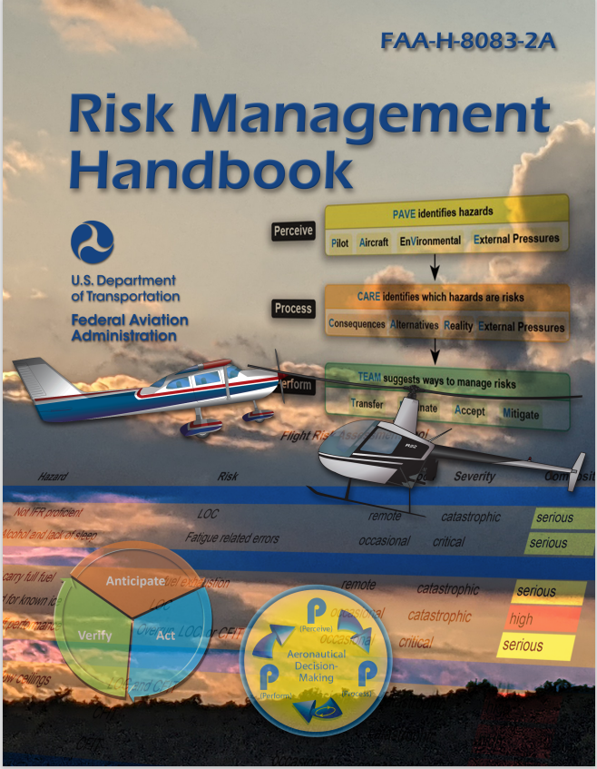
Personal Minimums
Pilot
Aircraft
enVironment
External Pressures
Notes:
“A man’s got to know his limitations”. Clint Eastwood as Dirty Harry said it 40 years ago and it’s still true today. But how do we know what our personal limitations are? Our Pilot Capabilities are not fixed in stone. Our ability to cope with wind and weather changes from year to year, day to day, and even hour to hour. That’s why many successful pilots develop personal minimums for all their flying activities. (Click)
Chapter 2 in FAA’s Risk Management Handbook shows us how to set Personal Minimums. Parameters to consider are associated with the acronym PAVE. (Click)
We’ll discuss the meaning of the letters and the curious case of the misaligned V in the following slides,.
P represents the pilot. (Click)
A stands for Aircraft (Click)
V represents the environment within which we’ll be operating (Click)
And E has to do with external pressures and distractions. We’ll take a more in depth look at each of these areas in following slides.
(Next Slide)

Slide 18
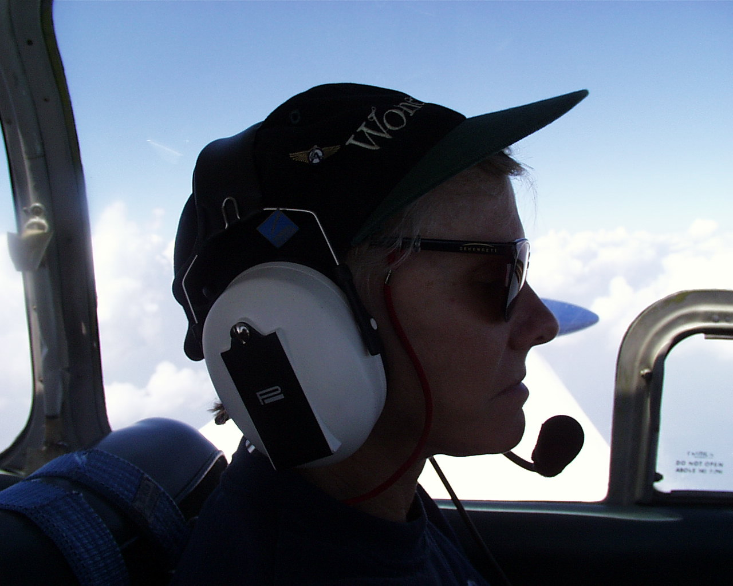
Pilot
Certification Level
Total Experience
Recent Experience
Health
Fatigue
Stress
Notes:
To assess pilot capabilities we want to look at (Click)
Certification Level (Click)
Total experience including time in make and model and (Click)
Recent Experience – overall and in make and model (Click)
Pilot health is obviously important and should be a no brainer but we include it here because a recent study found over the counter or prescriptions in post mortem toxicology screens of 80% of pilots in fatal accidents.
We’re not saying that those drugs were the cause of the accidents but the surprising high percentage does make us wonder about what medical conditions those pilots were treating and how those conditions may have affected pilot performance. (Click)
Fatigue is another big issue these days. Accident investigation data show that fatigue is often a pilot performance degrading factor. (Click)
Finally we have stress. We’ll also address this under external pressures but internal – self imposed – stress is something most pilots live with and, if it’s excessive, it can contribute to reduced pilot performance.
(Next Slide)

Slide 19
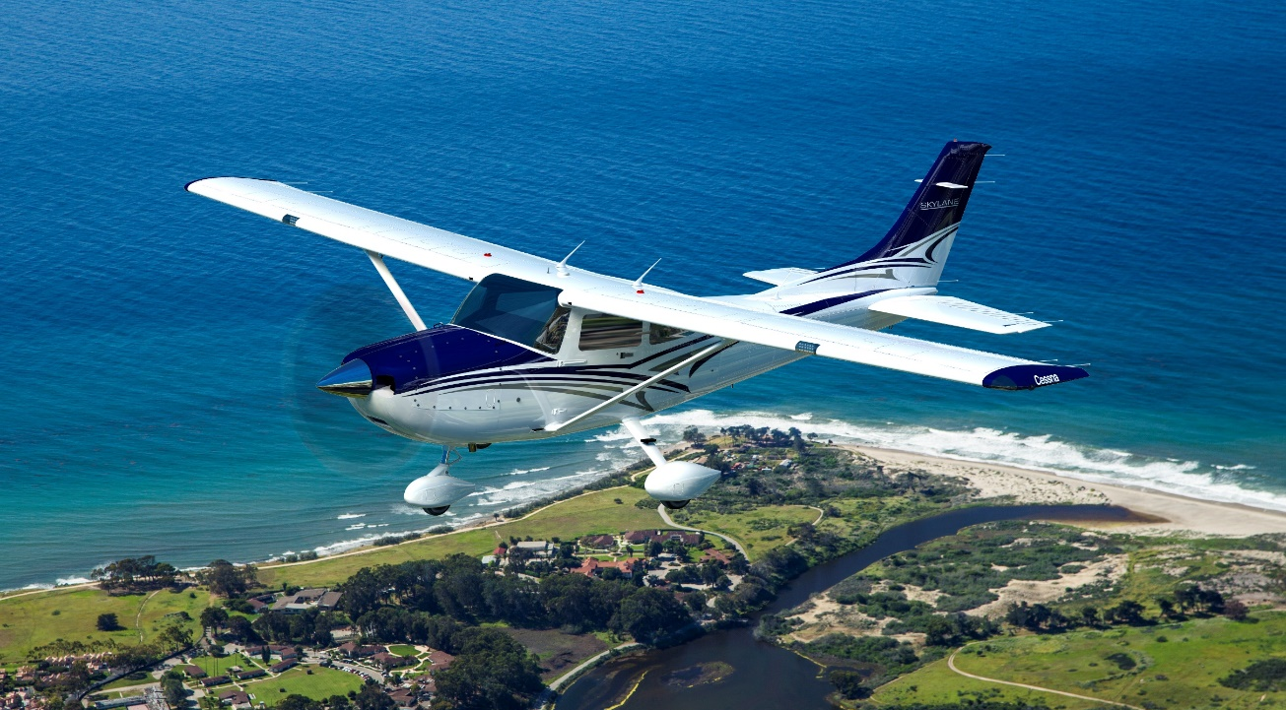
Aircraft
Performance
Range
Instrumentation
Navigation Equipment
Wx Avoidance Equipment
Notes:
Naturally, we want to consider aircraft performance parameters with respect to the mission. (Click)
Range, instrumentation, navigation and weather avoidance equipment must also match the mission.
(Next Slide)

Slide 20

enVironment
Topography
Runway & approach aids
Wind and Weather
Lighting Conditions
Notes:
And of course pilots must carefully consider the environments they fly in. Topography, lighting conditions, wind, weather, runways and approach aids. All of these taken together provide environmental challenges on every flight.
(Next Slide)

Slide 21

External Pressures
Employers & Passengers
Schedules & Deadlines
Expenses
Notes:
Employers and Passengers can exert enormous pressure on pilots to complete their missions on time regardless of changing conditions (Click)
And we’ve seen accidents that could have been prevented if the pilot had only purchased 10 gallons more of that unexpectedly expensive fuel at the destination airport. We’ve also seen accidents where the pilot should have gone to the expense of remaining overnight but took off into darkness and marginal weather instead.
(Next Slide)

Slide 22
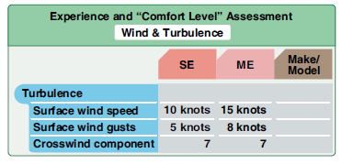
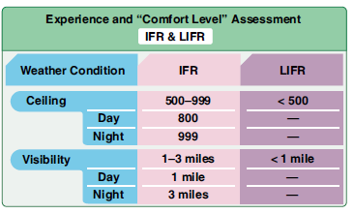
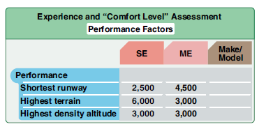
Assess Experience and Comfort Level
Notes:
Developing a personal minimums document is a matter of assessing your pilot experience and comfort level with respect to various mission and environmental conditions. You’ll complete several tables like the these and together they’ll comprise your personal minimums.
(Next Slide)

Slide 23
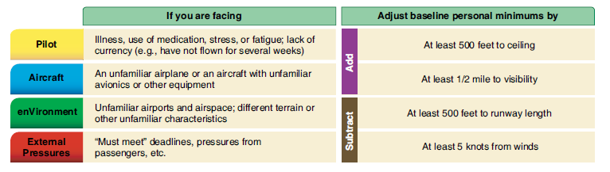
Adjust for Specific Conditions
Add
Subtract
Never adjust to a less conservative level
Notes:
Once you have established your personal minimums, you can adjust them for specific conditions as we can see here. One caveat and it’s very important. (Click)
If you’re going to adjust a previously determined minimum always do so in a more conservative direction. In other words if you want less conservative minimums you must acquire pilot and aircraft capability to ensure safety. An example would be a flight operation that wants to operate to Category II approach minimums must have specially trained crew and navigation equipment as well as recent experience, to fly the Cat II approach.
(Next Slide)

Slide 24
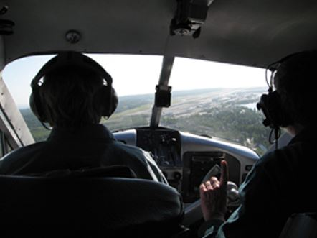


Develop & adjust with your CFI
CFIs provide:
  Perspective
  Consistency
  Coaching
Regular Reassessment
  Required for professionals
  Highly recommended for all pilots
Gold Seal
Notes:
We strongly encourage you to develop and periodically reassess your personal minimums in consultation with your CFI. Flight Instructors are trained to assess pilot performance. They can provide perspective and consistency and they can coach pilots in improvement. Professional pilots are required to undergo periodic evaluations and, although not required, re-assessing pilot performance and personal minimums regularly is a gold seal best practice for general aviation pilots at all certificate levels.
(Next Slide)

Slide 25
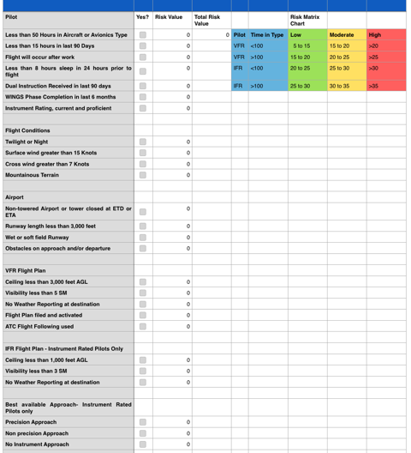

Preflight with a FRAT (Flight Risk Assessment Tool)
20 Statements - VFR
22 Statements - IFR
FAAST FRAT
https://bit.ly/3g7GJOf
Notes:
A Flight Risk Assessment Tool – or FRAT – is one means of consistently evaluating hazards that may be associated with any flight.
The FAAST FRAT is a simple automated spread sheet that contains 20 condition statements for VFR pilots; 22 for IFR pilots.
The statements describe common general aviation flight liabilities and assets. Pilots simply click the “yes” box next to each statement that applies to their flight.
Each yes statement generates a risk value and those values are totaled on the sheet.
The total risk value is related to the risk matrix chart to determine whether the flight risk is likely to be low, moderate, or high.
The FAAST FRAT is available in the FAASafety.gov library. Scan the QR code or navigate to the URL on screen to download your copy.
(Next Slide)

Slide 26
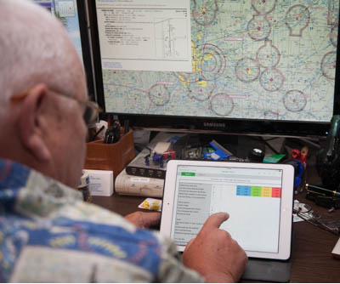
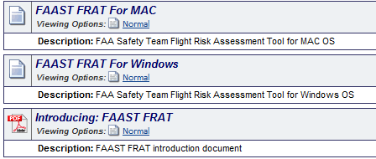
FAAST FRAT
FAAST FRAT
Click on Flight Risk Assessment Tool
Download appropriate FRAT for your computer.
Notes:
Click on Flight Risk Assessment Tool (FRAT)
Download the appropriate FRAT for your computer.
(Next Slide)

Slide 27
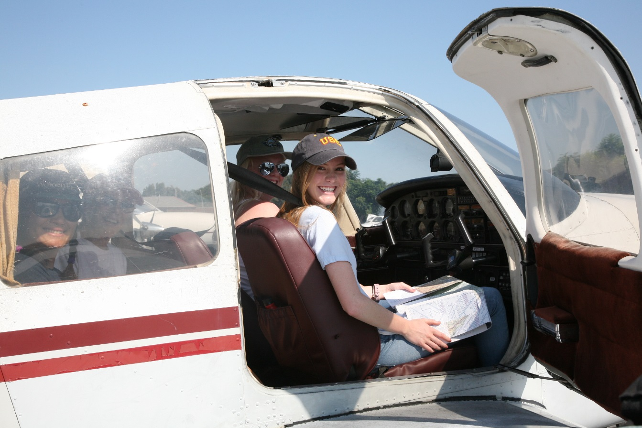
Have you earned your WINGS?
Proficient Pilots are:
  Confident
  Capable
  Safe
WINGS will keep you
on top of your game
Notes:
Have you earned your WINGS? Proficiency is key to success in almost every thing worth doing – especially flying. Proficient pilots are confident, capable, and safe.
WINGS is a proficiency training system specifically designed for general aviation pilots and, regular participation will keep you on top of your flying game. You can earn WINGS credit while developing your personal minimums with your CFI.
(Next Slide)

Slide 28
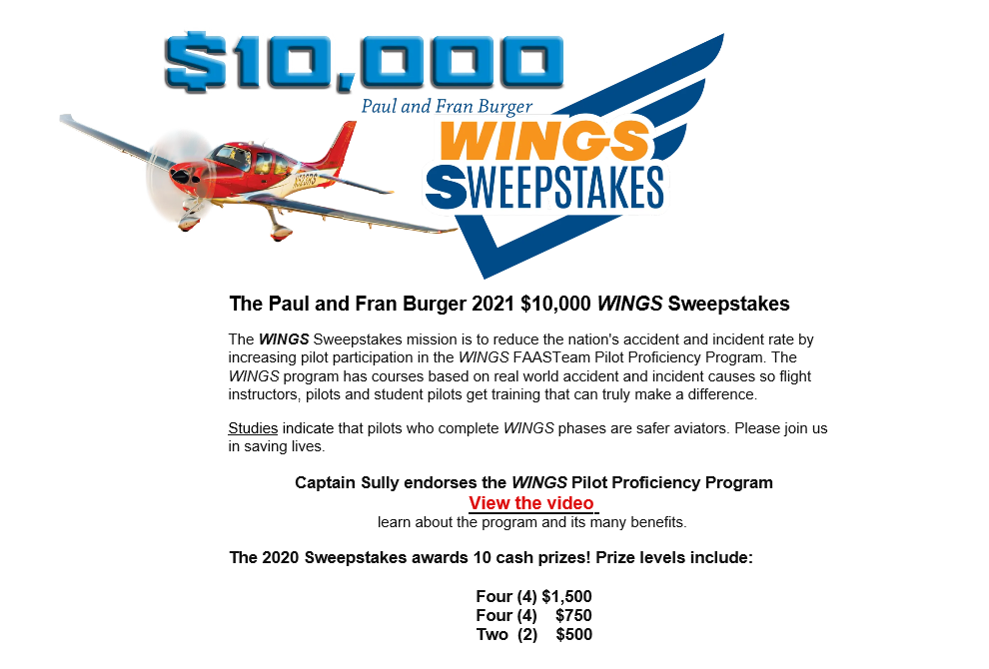


http://www.mywingsinitiative.org/
Notes:
Every time you complete a WINGS Phase you’re eligible to win cash in the WINGS Sweepstakes.
The sweepstakes is generously funded by Paul Burger, a long time advocate for general aviation safety and a retired aviator who believes participation in this program saves lives. VISIT WWW.MYWINGSINITATIVE.ORG to learn more and enter the sweepstakes.
Just navigate to http://www.mywingsinitiative.org or scan the QR code for details. By the way, Instructors can also enter the sweepstakes. But there are even better reasons to participate in WINGS.
(Next Slide)

Slide 29

Questions?
Notes:
Presentation Note: You may wish to provide your contact information and main FSDO phone number here. Modify with your information or leave blank.
(Next Slide)

Slide 30
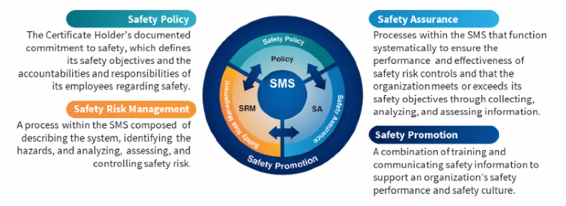

Safety Management Systems (SMS)
Coming to General Aviation
https://www.faa.gov/about/initiatives/gasafetyoutreach
Notes:
Safety Management Systems are a set of policies and processes that can increase the safety and efficiency of any flight operation. And FAA is bringing SMS to General Aviation. You may have heard of SMS but thought it was only for large organizations but actually SMS can be scaled to fit any operation large or small.
There are 4 major components to a Safety Management System (Click)
Safety Policy – a documented commitment to safety that runs from the head of an organization to its newest member. (Click)
Safety Risk Management – a process that identifies hazards within an operation, determines to what extent an identified hazard may impact flight safety, and controls the risk of occurrence to an acceptable level. (Click)
Safety Assurance – By collecting and analyzing information derived from safety performance data Safety Assurance ensures the performance and effectiveness of Safety Risk Controls. (Click)
Safety Promotion communicates safety information and commitment throughout the organization. (Click)
You can find more information about Safety Management Systems at the URL on the Screen.
(End)

Slide 31
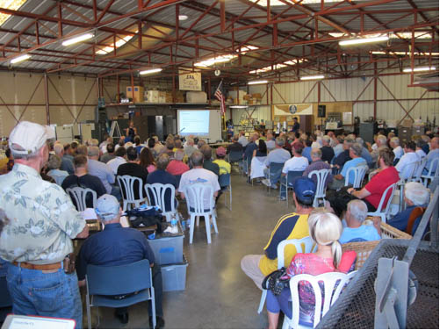
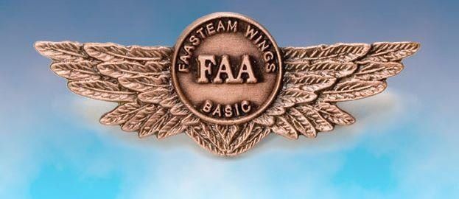
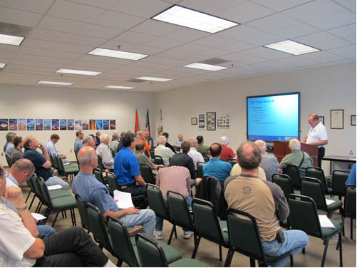
Thank you for attending
You are vital members of our GA safety community
Notes:
Your presence here shows that you are vital members of our General Aviation Safety Community. The high standards you keep and the examples you set are a great credit to you and to GA.
Thank you for attending.
(Next Slide)

Slide 32
The National FAA Safety Team Presents
Topic of the Month – November
CFIT & Plan Continuation Bias
<Audience>
<Presenter>
< >
Notes:
(The End)

