Slide 1
The National FAA Safety Team Presents
Topic of the Month - January
Safety Risk Management
For GA Pilots
Notes:
2024/09-10-317(I)PP Original Author: John Steuernagle; POC FAASTeam (Operations), Office 701-226-6283.
Presentation note: This is the title slide for FY2026 Topic of the Month – January – Risk Management for GA Pilots
Script - We have included a script of suggested dialog with most slides. The script will always appear in a non-italic font. Presenters may read the script or modify it to suit their own presentation style. See template slides 3 and 4 for examples of a slides with script.
Presentation Instructions - (stage direction and presentation suggestions) will be preceded by a Bold header: the instructions themselves will be in Italic fonts. See slides 2 for an example of slides with Presentation Instructions only.
Program control instructions - will be in bold fonts and look like this: (Click) for building information within a slide; or this: (Next Slide) for slide advance.
Background information - Some slides may contain background information that supports the concepts presented in the program.
Background information will always appear last and will be preceded by a bold Background: identification.
The production team hope you and your audience will enjoy the show. Break a leg!
(Next Slide)

Slide 2
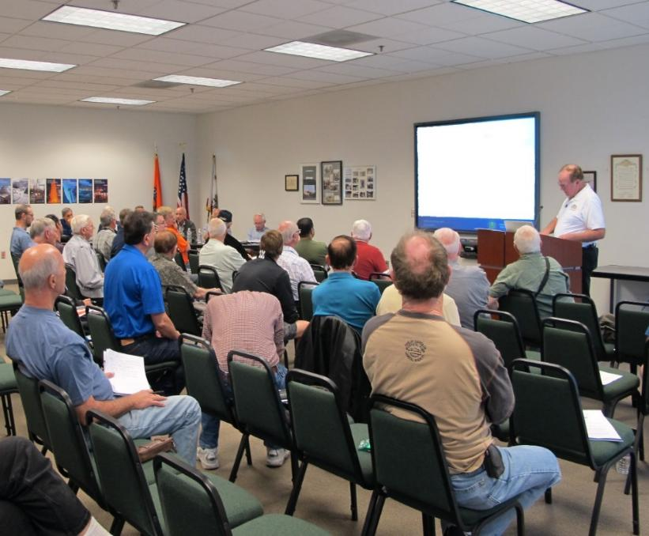
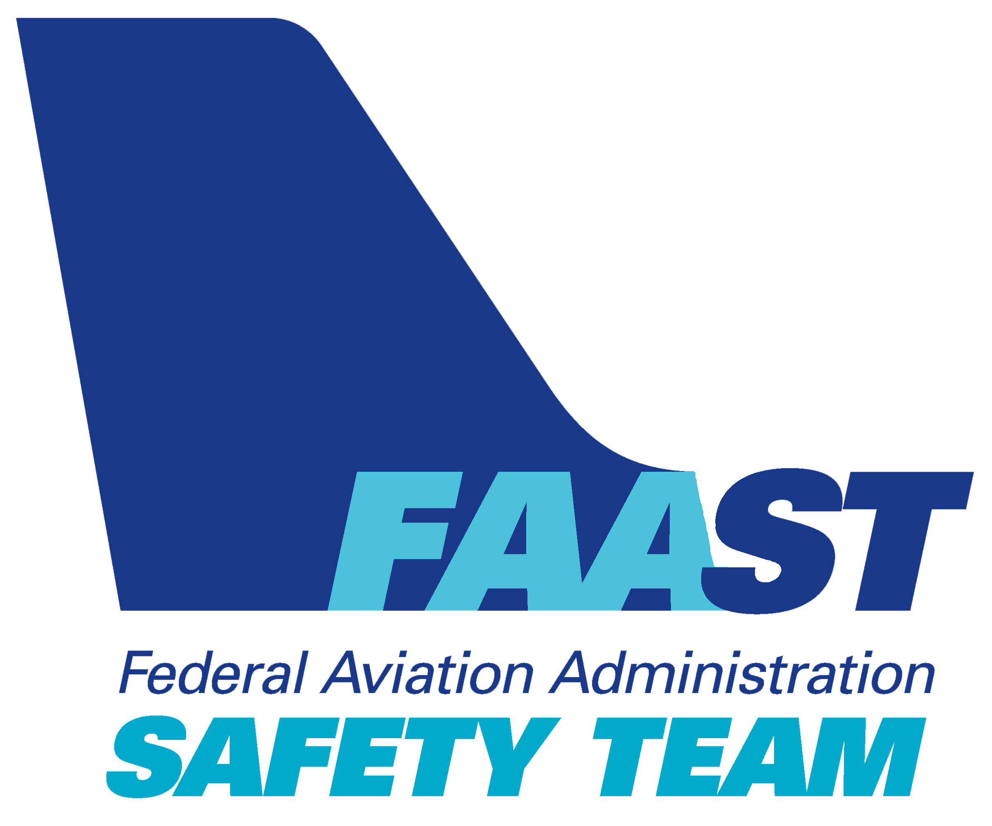
Welcome
Exits
Restrooms
Emergency Evacuation
Breaks
Silence Phones & Devices
Sponsor Acknowledgment
Other
Notes:
Presentation Note: Here’s where you can discuss venue logistics, acknowledge sponsors, and deliver other information you want your audience to know in the beginning.
You can add slides after this one to fit your situation.
(Next Slide)

Slide 3
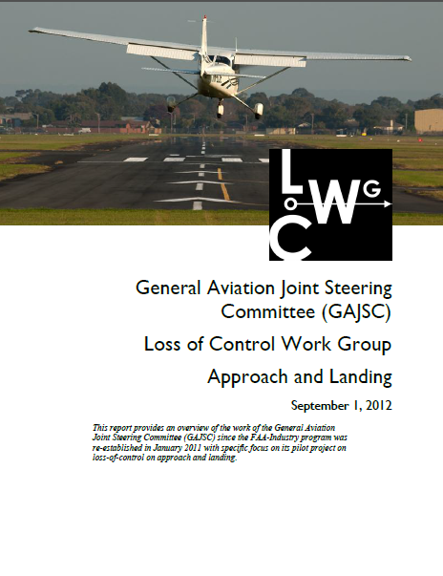
Overview
General Aviation Joint Safety Committee (GAJSC) & FAA
Accident Study Findings
Aeronautical Decision Making
Single-pilot Crew Resource Management
Safety Culture
Notes:
In this presentation we’ll talk a little bit about recent GAJSC and FAA studies that deal with deficiencies identified in a selection of general aviation accident investigations. We’ll take a high-level view of a process that has increased safety and effectiveness of aviation organizations world-wide. And we’ll describe how that process can help smaller organizations – even individual pilots to improve Aeronautical Decision Making, Crew Resource Management, and Safety Culture.
Presentation Note: If you’ll be discussing additional items, add them to this list.
(Next Slide)

Slide 4
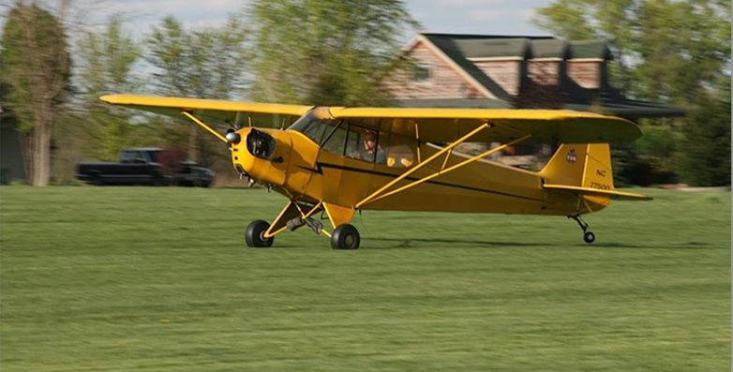

1936 – 2026
Celebrating nearly a century of progress!
Notes:
For more than a century, we've been producing and flying powered aircraft. The Taylor Cub first flew in 1936 and cruised at 70 miles per hour. 90 years later, the Piper M 700 cruises at 346 mph. Each new design flies more payload farther, faster, and more efficiently than those that have gone before. And cockpit automation has ironically reduced pilot workload but eroded aircraft handling skills.
But that progress isn’t limited to aircraft.
(Next Slide)

Slide 5
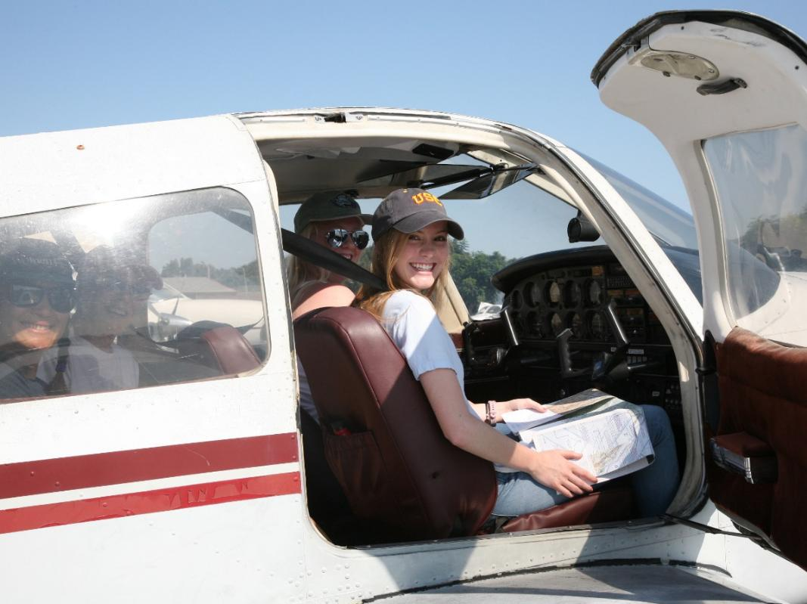
We’ve been busy with pilots too.
Human Factors and Best Practices studies
Safety Management Systems (SMS)
Notes:
We've been busy with pilots too. Human Factors and Best Practices Studies have shown us that taking a system approach to safety management is the best way to ensure operational success.
Airlines and industries world-wide have adopted Safety Management Systems with great success. Although not required of individual pilots, SMS knowledge and practice can improve General Aviation safety and efficiency. Let’s take a look at the basic SMS components and how they work together.
(Next Slide)

Slide 6

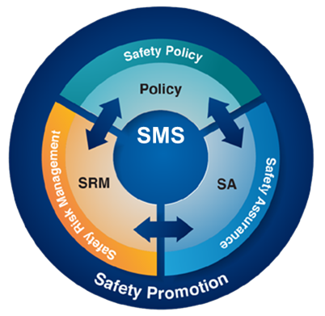
Notes:
Safety Policy, whether for organizations or individuals, defines our commitment to safety and describes the things we do to ensure safe flight operations. (Click) Safety Policy is one of four components of a Safety Management System.
(Click) Safety Risk Management is a well informed, structured methodology for identifying hazards, assessing the risk they pose to safe operations, and eliminating, or mitigating risks to acceptable levels,
(Click) Safety Assurance assesses our performance and documents our successes, shortcomings, and best practices. And Safety Assurance feeds back to Safety Risk Management to improve SRM process and procedure.
(Click) All SMS components benefit from unrestricted 2-way communication.
And Safety Promotion ensures that Safety Management remains a top priority.
That’s a high-level view of all Safety Management Systems work. Most GA pilots don’t have the resources to employ and document a full-blown SMS, but they can use SMS elements to support competence, confidence and safety in their flight operations.
Let’s first take a look at Safety Policy.
(Next Slide)

Slide 7
Safety Policy
Safety is my highest priority.
I will maintain or increase my pilot knowledge and skill.
I will conduct all flight operations in compliance with applicable rules and regulations.
I will define & document my pilot performance capabilities.
I will identify hazards and assess risks for all flight operations.
I will eliminate identified risks or mitigate them to acceptable levels of safety.
I will assess my pilot performance after each flight.
I will adjust expected performance values according to post-flight assessments.
I will promote safety policy to the general aviation safety community.
Notes:
Here are some statements that describe Safety Policy. They reflect a commitment to safe general aviation operations.
Presentation note: Allow your audience to read through the list. Then ask if any of the statements are unreasonable or unachievable by GA Pilots. Then:
I think we all agree that the safety policy statements on screen are reasonable and achievable by General Aviation Pilots. So, let’s consider this to be our safety policy and move on to the next SMS element – Safety Risk Management.
(Next Slide)

Slide 8

Safety Risk Management – A matter of balance
Knowledge, Skill, & Technology
Flight Challenges
Safety Risk Management
Notes:
Safety Risk Management is a matter of balance. Our knowledge, skills, and technologies must be equal to or exceed the challenges we face in flight. But how do we know in advance that we’ll be up to the task? (Click)
That’s where safety risk management comes in. We use the SRM process to understand flight challenges before we accept them. But before we see how that works, let’s define some terms.
(Next Slide)

Slide 9
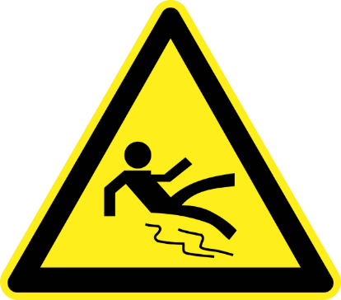
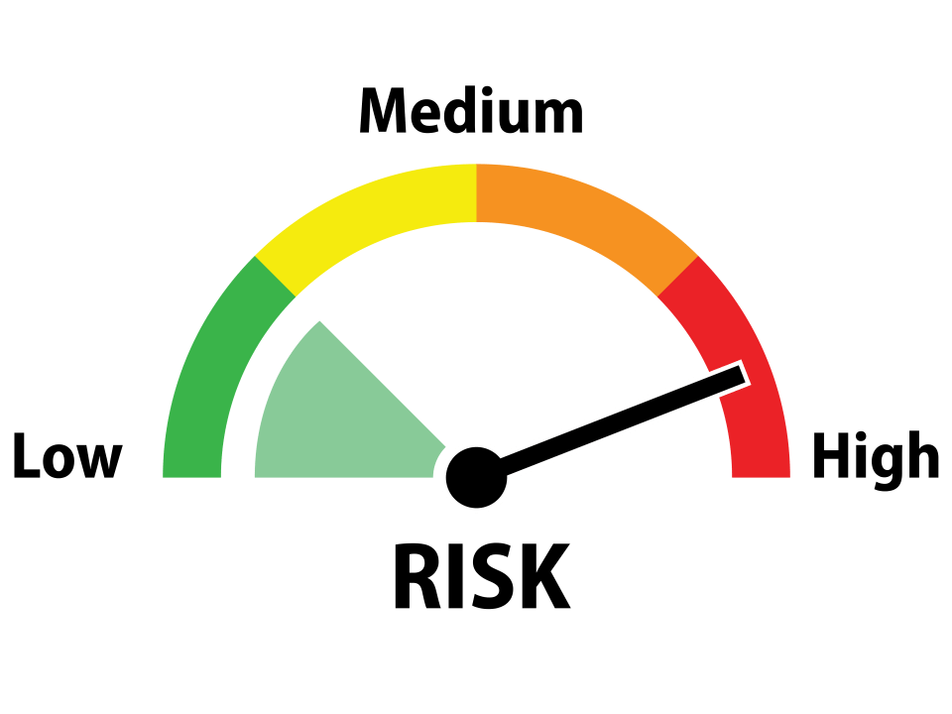
Hazards and Risks
Hazard
  A condition, event, object or circumstance
  that could cause or contribute to an
  unwanted event
Risk
  The future influence of hazards on safe
  operations
Notes:
A hazard is a condition, event, object or circumstance that could cause or contribute to an unwanted event. If we walk on an icy driveway on our way to the mailbox we might slip and fall. (Click)
Risk is the future influence of hazards on safe operations. In other words, risk is an educated estimate of the chances that a given hazard might negatively affect our operations.
(Next Slide)

Slide 10
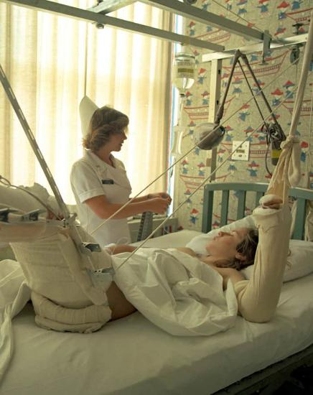

Severity of consequences
Marginal
Catastrophic
Notes:
The severity of consequences can run from minor inconvenience (Click)
To a catastrophe.
(Next Slide)

Slide 11
Risk Assessment & Disposition
Accept
Eliminate
Mitigate
Notes:
Let’s say we’ve identified a hazard and we’re pretty sure it will cause us some trouble. We now have three choices: (Click)
We can accept the risk – rarely a good idea but you never know until you try. You might just make it. (Click)
We can eliminate the risk – that way we don’t have to deal with it at all. (Click)
Or we can mitigate the risk to an acceptable level. Make it less likely that we’ll have a negative experience. There’s just one more thing we need to consider.
(Next Slide)

Slide 12
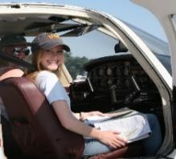
The SRM Process
Perceive –
  Assess plan effectiveness
Process –
  Develop adjustments to the plan
Perform
  Implement plan adjustments
Perceive –
  Identify the hazard
Process –
  Assess the likelihood of occurrence
  Assess the severity of consequences
  Develop plan to eliminate or mitigate risk
Perform
  Implement risk elimination or mitigation plan
Notes:
Here’s an easy to remember the process steps for hazard identification, risk assessment, and risk mitigation. (Click)
Perceive – Identify the hazard. (Click)
Process – Assess the chances of the hazard impacting your flight operation. Assess the severity of consequences if it does, and develop a plan to either eliminate the risk or reduce it to an acceptable level. (Click)
Perform by executing your risk elimination plan. Simple? Yes, it is. But are we done here? Not quite. (Click)
Now it’s time to perceive the effectiveness of your risk mitigation plan. Are you getting the results you expected, or do you need to adjust the plan? If so, Process and Perform the plan adjustments and – you guessed it – Perceive the results.
So, you see that the SRM process is far from a one and done job but rather a continuous management of safety risks.
That’s enough of theory – let’s see how it works in practice.
(Next Slide)

Slide 13
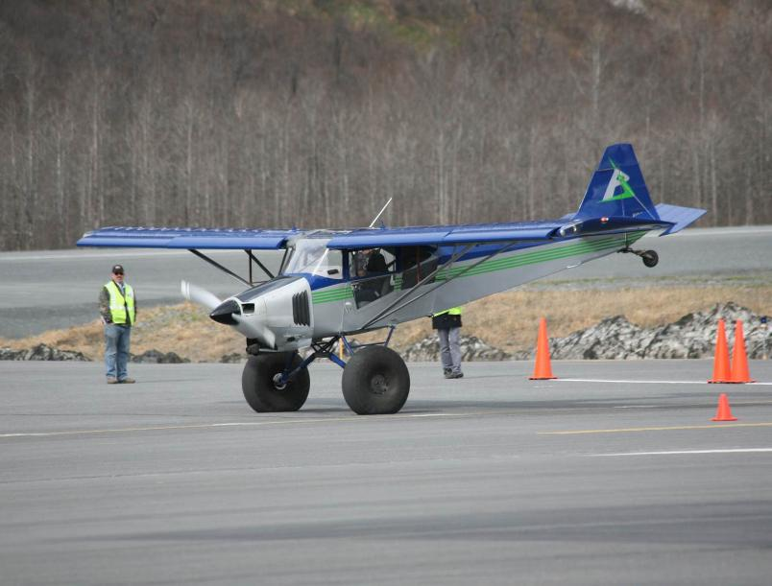
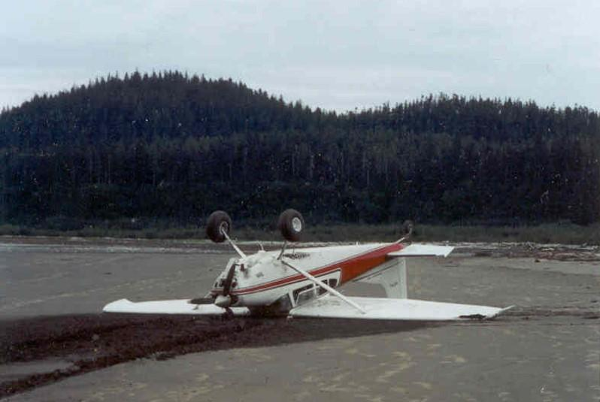
Risk Assessment
How bad is the wreck going to look?
Notes:
A famous Alaskan bush pilot was asked how he assessed the risks of landing at unfamiliar back country strips. His answer: “well the first thing you want to ask yourself is, how bad is the wreck going to look?” (Click)
Here’s a picture of a well executed short field landing at an annual Alaskan contest in Valdez. No airplanes were harmed in the filming of this event and the landing was success. No wreck. (Click)
But here’s a photo of another Alaskan landing on a beach. The combination of aircraft, pilot, and environment didn’t work out optimally in this case and, if the pilot had assessed this result as likely, he might not have attempted the landing.
(Next Slide)

Slide 14
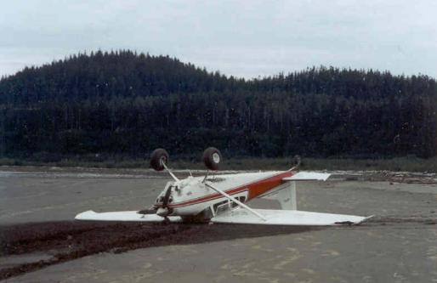

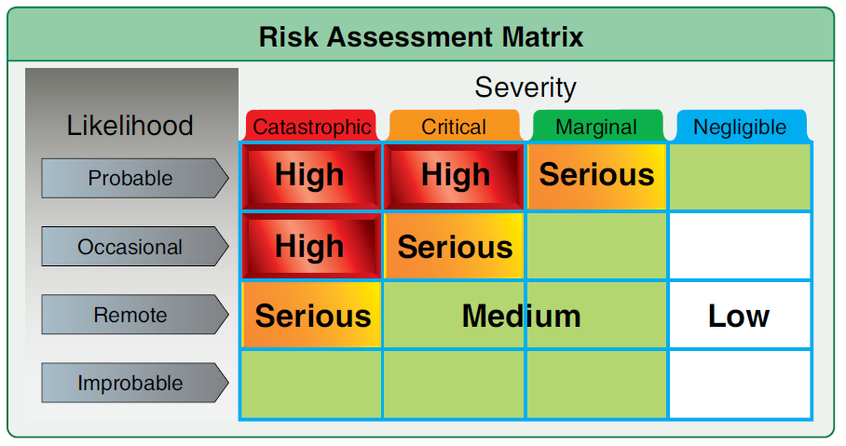
Risk Assessment
  Likelihood
    Probable
    Occasional
    Remote
    Improbable
  Severity
    Catastrophic
    Critical
    Marginal
    Negligible
Notes:
Under given environmental conditions - in this case a soft sandy beach. And considering pilot, and aircraft capabilities, how bad is the wreck going to look if we attempt a landing? Think in terms of likelihood and severity. (Click)
Likelihood first – If we attempt this landing, how likely are we to end up on our back? If we have no experience in this type of operation it’s probable that we’ll get a non-optimal result. But, if this is something that we do almost every day and we’ve been in and out of this landing area before, the likelihood would be remote. (Click)
Next, we’ll consider severity. Unless there’s a fire, it’s unlikely that we or our passengers will experience catastrophic injuries, but, depending on our restraint systems and personal protective gear, they could be critical. We must also consider whether there are people and transportation available at this location or will we be in a survival situation until rescued.
Presentation note: Ask the audience for their thoughts as to likelihood and severity. then: (Click)
Here’s a risk matrix from FAA’s Risk Management Handbook. Obviously, these accidents happen occasionally and when they do, the severity of injury can be critical (Click)
You can see that the combination of Occasional and Critical equals Serious risk and we must do something to reduce that risk to an acceptable level.
(Next Slide)

Slide 15
Residual Risk
Notes:
One more thing. There are few activities that are risk free. Whether driving a car or flying a plane or even walking around the block, safety does not mean “risk free” If we don’t eliminate risks, whatever’s left over after mitigation is risk that we agree to live with. (Click) That’s called residual risk.
The whole point of Safety Risk Management is to intelligently assess our capabilities with respect to our objectives and stack the odds as much in our favor as possible. Let’s take a look at a few things that will help us to do that.
(Next Slide)

Slide 16

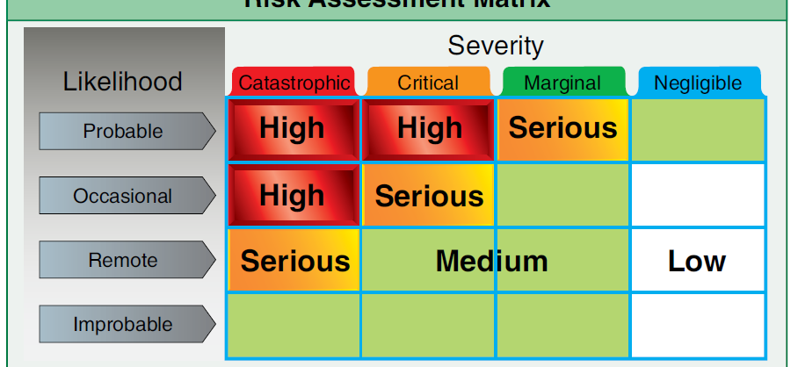
Safety Risk Management
Personal minimums
Baseline pilot performance assessments
Flight Risk Assessment Tools (FRATs)
Notes:
Here are three Safety Risk Management aids that can improve your SRM effectiveness:
Personal minimums, Baseline pilot performance assessments, and Flight Risk Assessment Tools or FRATS.
We’ll take a brief look at each of these.
(Next Slide)

Slide 17
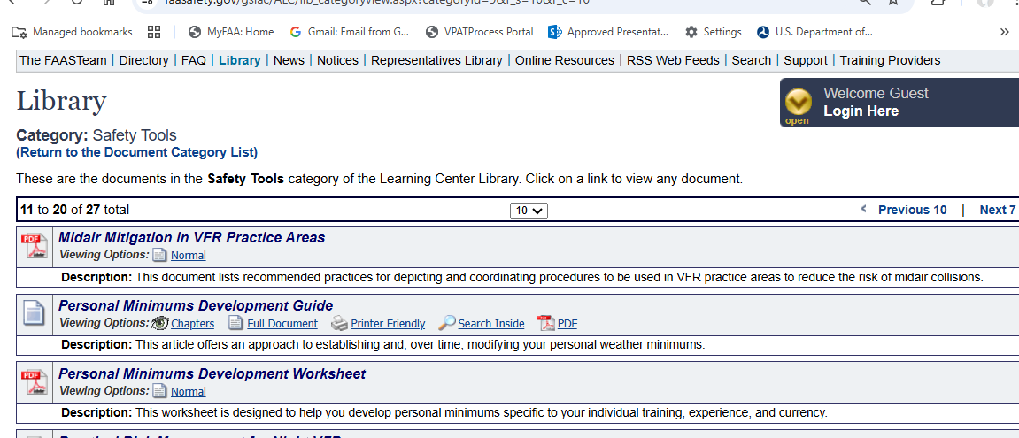
Personal Minimums Checklists
Notes:
As the name implies, Personal Minimums Checklists document the minimum safe personal and flight environment conditions for individual pilots. Based on actual pilot performance assessments, your personal minimums clearly define what you’re capable of tackling…………. and, just as importantly, what you’re not.
Personal minimums checklists should always be developed in consultation with a Flight Instructor. Check the FAASafety.gov library category “Safety Tools” for a personal minimums development Guide and worksheet.
(Next Slide)

Slide 18
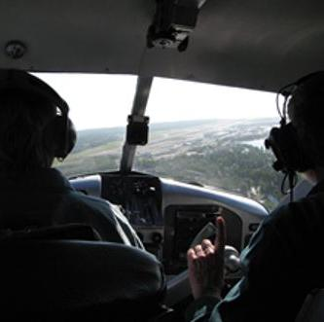
Baseline Performance Assessments
Aircraft
  Mission weight
  Maximum wind experienced
    In aircraft type
Airfield
  Typical for mission
  Seek local knowledge
Notes:
In order to establish personal minimums, you need to have a baseline – think of it as your personal, documented, demonstration of performance. We suggest you document your performance at least once a year with a WINGS CFI. Try to pick a day when you can experience actual cross-wind conditions in the airplane you usually fly and loaded to your typical mission weight. Select an airfield that’s typical for the missions you fly. If you’re planning trips to a short, obstructed runway; try to find something similar to train on. Gather information about the destination airfield from pilots who’ve flown there and share that information with your instructor. That will help your CFI to construct realistic scenarios for you to fly.
(Next Slide)

Slide 19
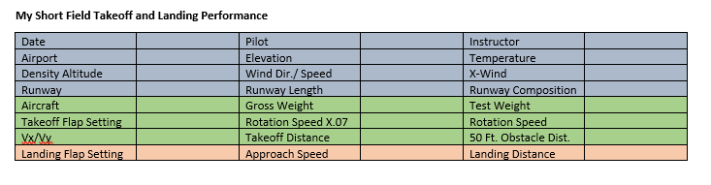


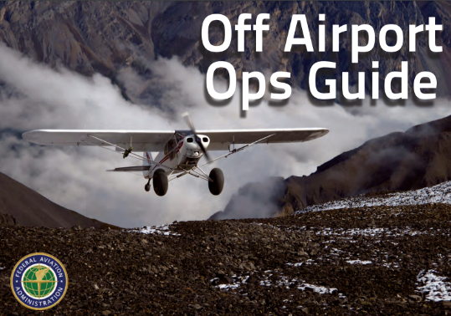
Baseline Performance
Gold Seal
Notes:
Here’s a chart from the Alaskan Off-airport Ops Guide that some pilots use to document their takeoff and landing performance. We’ll tell you where you can find this and other useful documents at the end of this program.
Once you’ve completed the chart, you’ll have a performance baseline to work with. You can adjust your baseline as you gain experience and skill. If you want to adjust your baseline we strongly suggest that you do it with a CFI. That way you’ll have an objective assessment of your capabilities, and a flight instructor may offer suggestions and instruction for improving your baseline performance.
(Next Slide)
Background: You can access the Off-airport Ops Guide at FAASafety.gov\Resources\Library\Alaskan Operations. https://www.faasafety.gov/files/gslac/library/documents/2017/Sep/135893/Alaska%20Off%20Airport%20Operations%20Guide.pdf

Slide 20
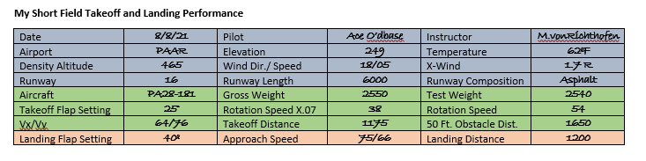

Baseline Performance
FAASafety.gov\Resources\Library\Alaskan Operations
Gold Seal
Notes:
Here’s the completed chart. (Click)
Notice that it includes a rotation speed. (Click)
But it also documents a figure that’s 70% of the rotation speed. Does anyone know what that’s about?
Presentation note: Pause for audience input then:
Some of you know about the 50/70 rule that’s used to establish a go/no-go decision point for every takeoff. It’s especially useful for short runways and here’s how it works.
(Next Slide)

Slide 21





Is my aircraft performing as expected?
No Obstruction Take-off - 50/70:
50% of the way down the runway
70% of your calculated 60 kts.
rotation speed:
  60 x .7 = 42kts. at 50% of the Calculated Take-Off Distance (CTD)
  Obstructions on Take-off - 30/70:
  60 x .7 = 42kts. at 30% of CTD
Notes:
When planning takeoff from short unobstructed runways, establish a landmark at 50% of your calculated takeoff distance. (Click)
When on the take off roll you should have 70% of your rotation speed at that point. If you don’t – the safest thing is to abort the takeoff and reduce weight or wait for more favorable wind and temperature conditions. In this example we’re assuming a rotation speed of 60 knots. 70% of 60kts. is 42kts, the airspeed you’ll want to see at the halfway point (Click)
For obstructions off the departure end of the runway, you’ll need to have 70% of your rotation speed by the time you’ve travelled 30% of your available takeoff distance. (Click)
Performance monitoring is a must. Practice 50/70 or 30/70 procedures every time you fly.
(Next Slide)

Slide 22


Notes:
Here’s a QR code for the Alaskan Off-airport Operations Guide.
(Next Slide)

Slide 23
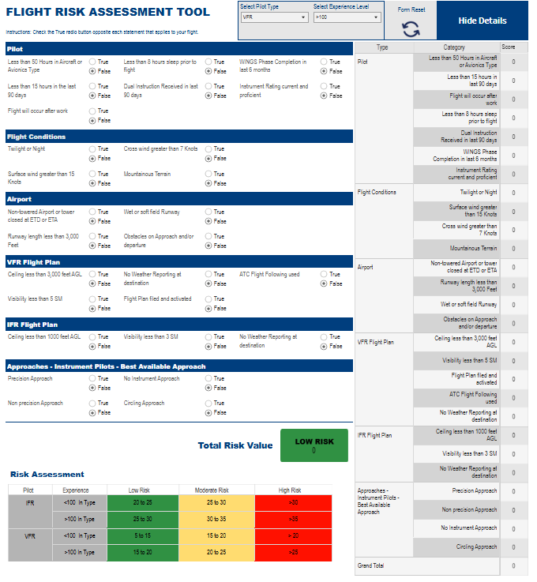

FAAST FRAT
Notes:
The FAASTeam Flight Risk Assessment Tool or FAAST FRAT is a simple, automated spreadsheet that considers 28 user- controlled data points to assign a risk value to any GA flight. No FRAT can anticipate all the hazards that could affect a flight, but the FAAST FRAT does help to organize your Safety Risk Management thinking.
You can access the FAAST FRAT through the QR code on screen or in the FAASafety.gov Library in the Flight Risk Assessment Tools category.
Next, well take a quick look at Safety Assurance.
(Next Slide)

Slide 24
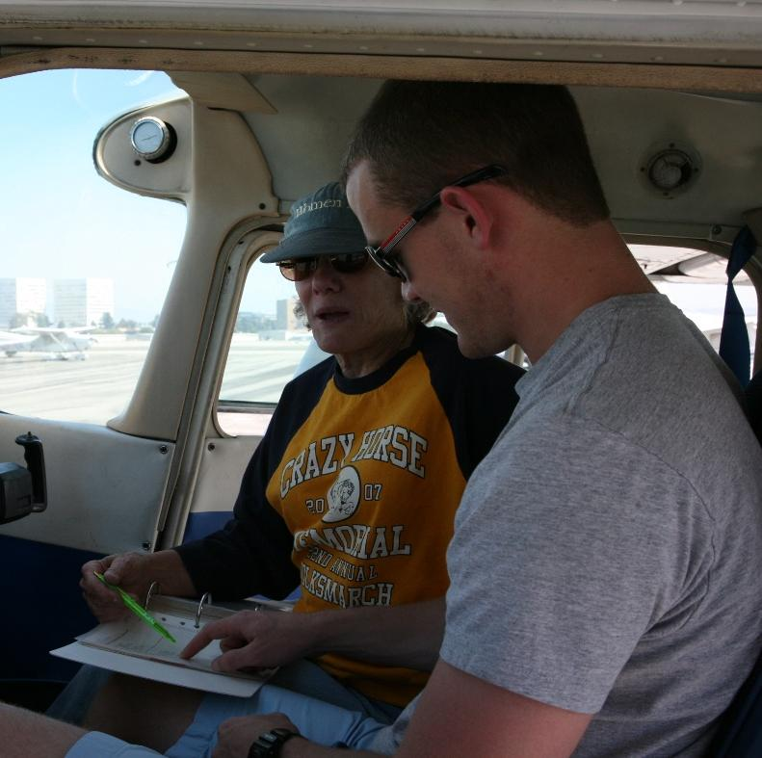
Safety Assurance
Post-flight debrief.
Pilot performance assessment
Feedback to Safety Risk Management
Notes:
The Safety Assurance component of SMS documents safety performance in operations and feeds back lessons learned and best practices to the Safety Risk Management component. For individual aviators, comprehensive post-flight briefings and performance assessments can refine our SRM and may indicate areas where additional training would be beneficial.
Obviously, it would be best to brief with a flight instructor after a dual flight, but objective self-briefings are valuable too.
(Next Slide)

Slide 25

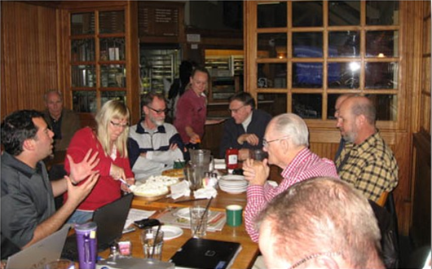
Safety Promotion
Notes:
Safety promotion is simply walking the talk, setting the example of safe flight operations, and exploiting opportunities to promote safety with fellow aviators and with the public.
(Next Slide)

Slide 26
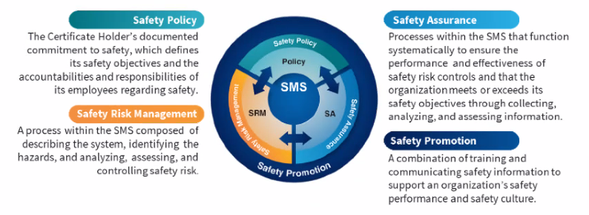

Safety Management Systems (SMS)- Review
Safety Management System (SMS) | Federal Aviation Administration (faa.gov)
Notes:
Here’s a quick review:
Safety Management Systems are a set of policies and processes that can increase the safety and efficiency of any flight operation. And FAA is bringing SMS to General Aviation. You may have heard of SMS but thought it was only for large organizations but actually, SMS can be scaled to fit any operation large or small.
There are 4 major components to a Safety Management System (Click)
Safety Policy – a documented commitment to safety that runs from the head of an organization to its newest member. (Click)
Safety Risk Management – a process that identifies hazards within an operation, determines to what extent an identified hazard may impact flight safety, and controls the risk of occurrence to an acceptable level. (Click)
Safety Assurance – By collecting and analyzing information derived from safety performance data Safety Assurance ensures the performance and effectiveness of Safety Risk Controls. (Click)
Safety Promotion communicates safety information and commitment throughout the organization. (Click)
You can find more information about Safety Management Systems at the URL on the Screen.
(Next Slide)

Slide 27
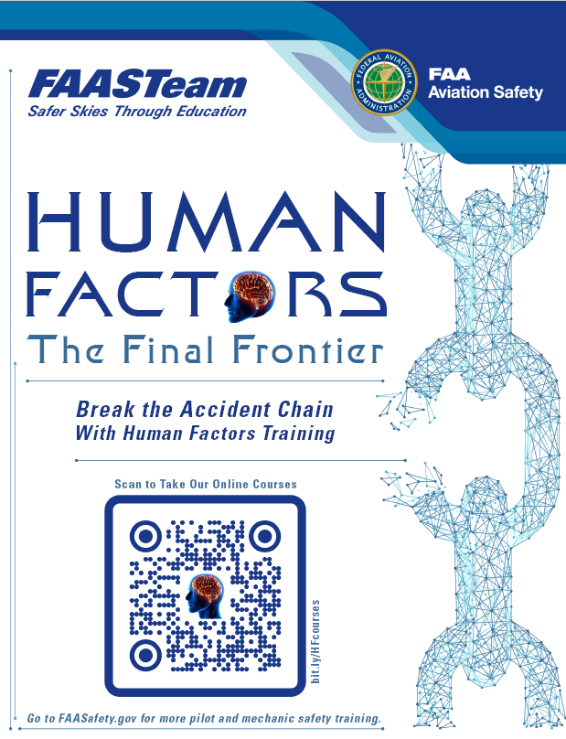
Begin (or continue)
your Human Factors journey here
http://bit.ly/HFcourses
Notes:
FAASTeam Human Factors for Pilots online courses can help you to fly with competence, confidence, and safety. We encourage you to explore the series. Navigate to the URL or scan the QR code on screen for a FAASTeam Human Factors course catalog that features direct links to each of the courses.
(Next Slide)

Slide 28

Thank you!
Aviate - Fly the aircraft first and maintain control.
Navigate - Manage your flight path to ensure you are clear of terrain, obstacles, and air traffic.
Communicate - With your aircraft under control in safe airspace; communicate and act on your intentions.
Notes:
Well, that concludes this presentation. Thanks very much for your participation. We applaud your dedication to excellence in aviation safety and we invite you to continue your journeys to excellence in the FAA WINGS Pilot Proficiency Program.
Please accept our best wishes for safe flying and remember to always, (Click)
Aviate - Maintain aircraft control and reduce levels of automation to a point where you are comfortable in managing your flight path. (Click)
Navigate - Manage your flight path to ensure you are clear of terrain, obstacles, and air traffic. (Click)
Communicate - With your aircraft under control in safe airspace; communicate and act on your intentions.
(Next Slide)

Slide 29

Questions?
Notes:
Presentation Note: You may wish to provide your contact information and main FSDO phone number here. You can also add WINGSPro contact information.
Modify with your information or leave blank.
(Next Slide)

Slide 30
The National FAA Safety Team Presents
Topic of the Month - January
Safety Risk Management
for GA Pilots
Notes:
(The End)

