Slide 1
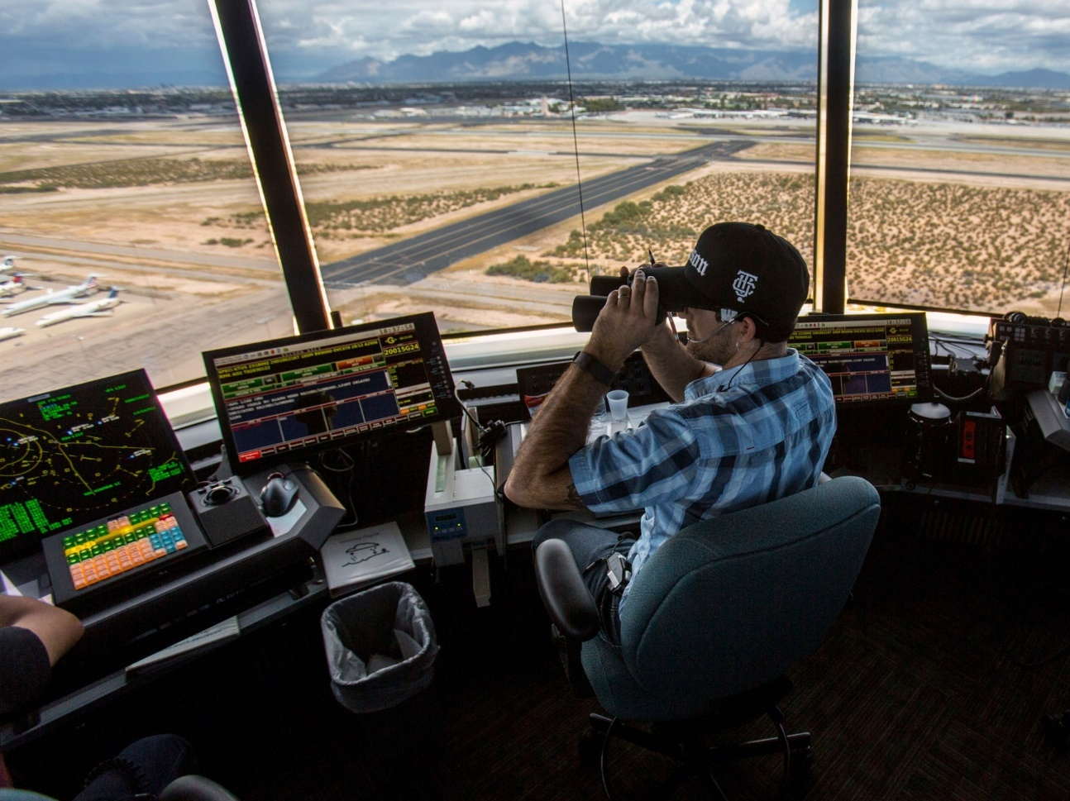
The National FAA Safety Team Presents
Topic of the Month – February
Visual Traffic Separation and Collision Avoidance
Notes:
2024/09-10-318(I)PP Original Author: John Steuernagle December 2025; POC John Steuernagle National Operations FPM, Office (562-888-2020 revised by (Name) (MM/DD/YYYY)
Presentation Note: This is the title slide for Visual Traffic Separation and Collision Avoidance
Script - We have included a script of suggested dialog with most slides. The script will always appear in a non-italic font. Presenters may read the script or modify it to suit their own presentation style. See template slides 5 and 6 for examples of slides with script.
Presentation Instructions - (stage direction and presentation suggestions) will be preceded by a Bold header: the instructions themselves will be in Italic fonts. See slide 2 for an example of slides with Presentation Instructions only.
Program control instructions - will be in bold fonts and look like this: (Click) for building information within a slide; or this: (Next Slide) for slide advance.
Background information - Some slides may contain background information that supports the concepts presented in the program.
Background information will always appear last and will be preceded by a bold Background: identification.
The production team hope you and your audience will enjoy the show. Break a leg!
(Next Slide)

Slide 2
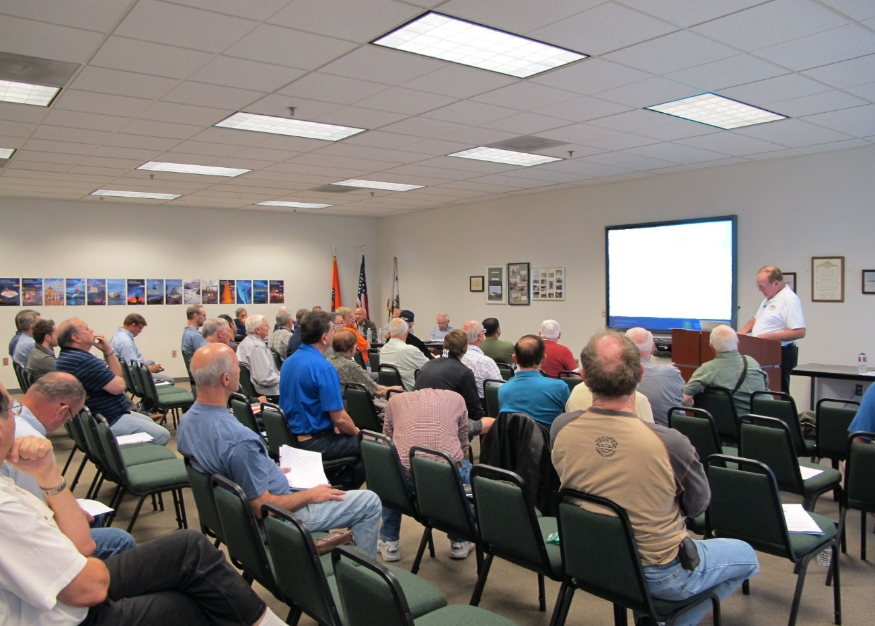

Welcome
Exits
Restrooms
Emergency Evacuation
Breaks
Phones & devices to silent or off
Sponsor Acknowledgment
Other information
Notes:
Presentation Note: Here’s where you can discuss venue logistics, acknowledge sponsors, and deliver other information you want your audience to know in the beginning.
You can add slides after this one to fit your situation.
(Next Slide)

Slide 3

Overview
Pilot Responsibilities for collision avoidance
Guidance & references
Techniques & Technologies
Notes:
Today we’ll be discussing pilot responsibilities for collision avoidance as stated in guidance and reference documents. We’ll also touch on some techniques and technologies that will help to avoid collisions.
Presentation Note: If you’ll be discussing additional items, add them to this list.
(Next Slide)

Slide 4
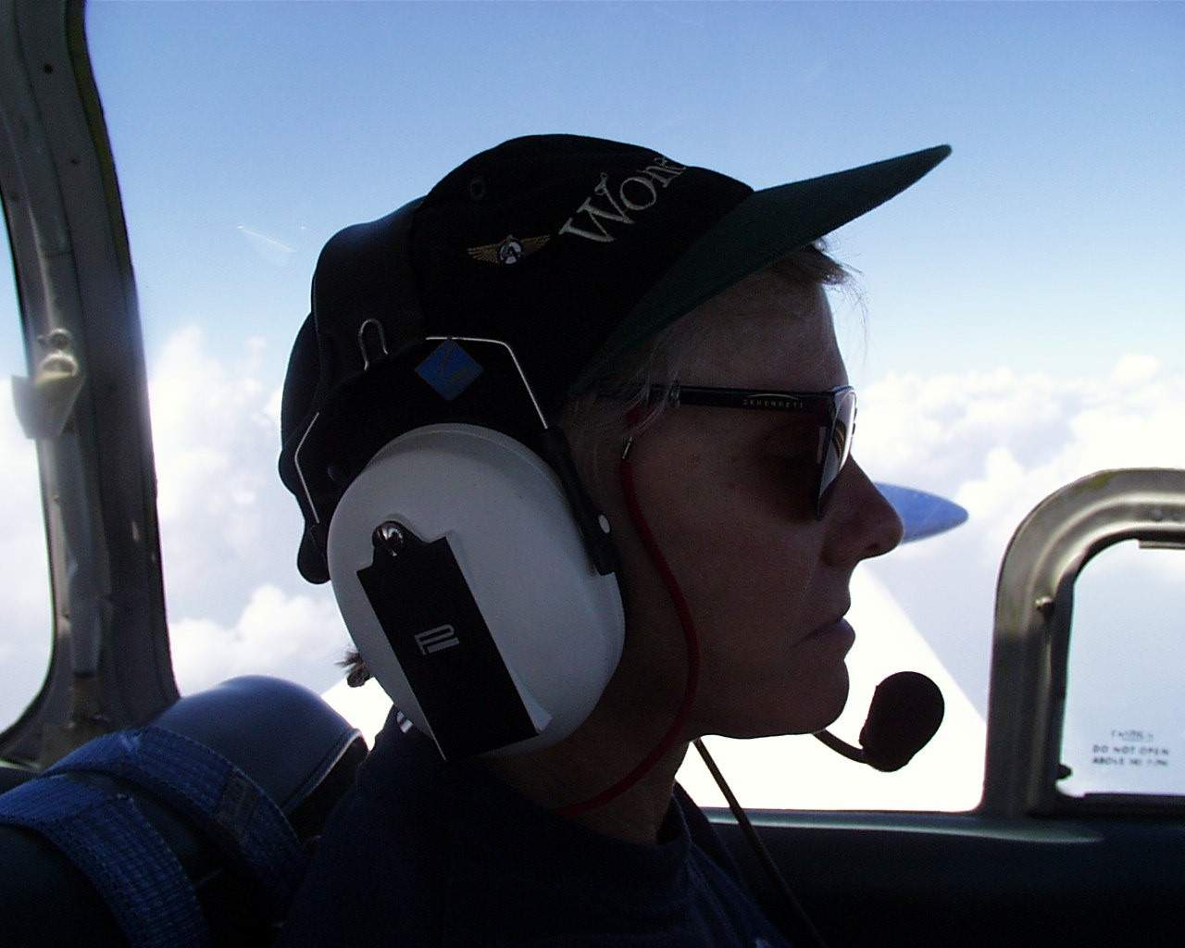
Collision Avoidance
See and Avoid
Marbles in the box
ATC Services
Notes:
Pilots understand that they’re primarily responsible for collision avoidance. We know we must keep a constant watch for traffic and, if necessary, maneuver to avoid it.
We also understand that the more objects you put in a given area i.e., marbles in a box - the more likely it is that collisions will occur. Understandably, aircraft tend to cluster at busy airports necessitating Air Traffic Control services to effect orderly traffic flow. It’s nice to have extra eyes on the traffic but, even if we’re complying with an ATC clearance, we pilots are still responsible for collision avoidance.
That’s made abundantly clear in two important publications.
(Next Slide)

Slide 5
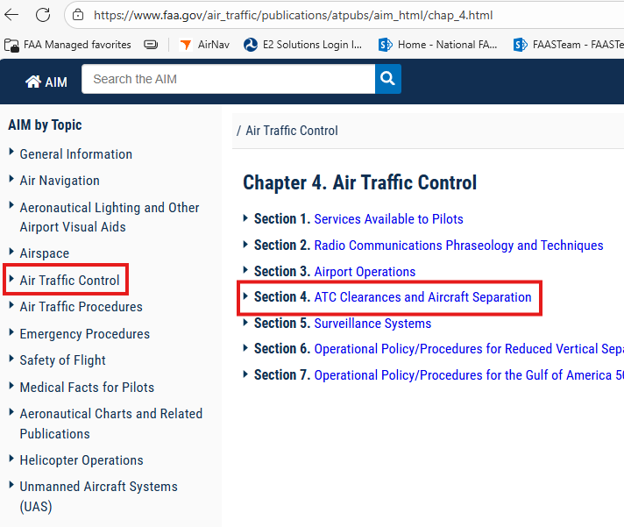
Aeronautical Information Manual
Authorization to proceed
  Specified conditions
  Controlled Airspace
    Known traffic
14 CFR 91.3a
  Rule, regulation, altitude deviation
  Unsafe aircraft operation
  Aircraft in jeopardy
Notes:
The first of these is the Aeronautical Information Manual Chapter 4 Section 4. (Click)
The AIM defines Air Traffic Control Clearances as authorizations to proceed under specified conditions in controlled Airspace. Clearances are based on known traffic and physical conditions and pilots are expected to comply but…. (Click)
14CFR 91.3 – Responsibility and authority of the pilot in command, makes us the final authority as to the operation of our aircraft. That means we’re expected to reject any clearance that would, in our opinion, result in a rule, regulation, or minimum altitude deviation or that would require unsafe operation of our aircraft.
Likewise, if at any time we can’t safely comply with a clearance, we must inform ATC and request an amended clearance. Of course, if we’d prefer a different altitude or routing, we can always ask. It could happen.
It sounds simple enough. Let’s see what it looks like in practice.
(Next Slide)
Background: URL for AC AIM: https://www.faa.gov/air_traffic/publications/atpubs/aim_html/

Slide 6
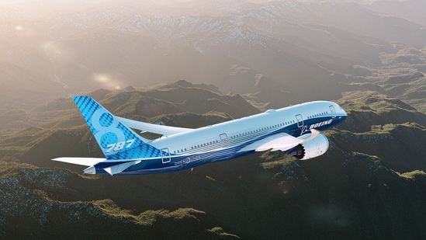
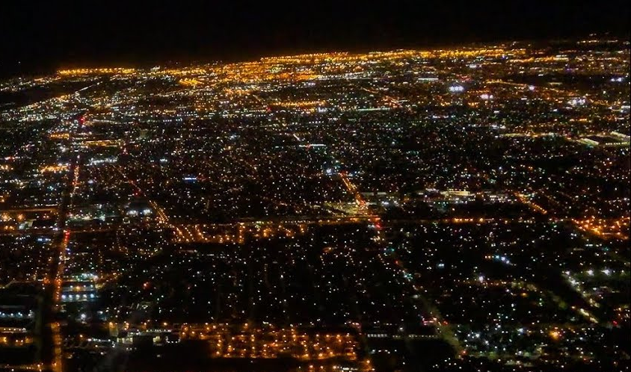
Visual Separation
Authorization to proceed
  Specified conditions
  Controlled Airspace
    Known traffic
Notes:
We’re all used to scanning for traffic and if, for instance, ATC points out the 787 ahead and, after we confirm the traffic is in sight, clears us to pass behind we’ll be responsible for safe separation. Mindful of wake turbulence potential, we’ll keep the aircraft in sight and navigate safely behind it. (Click)
But what if we’re faced with the same situation in a high traffic density area? Identifying our traffic and maintaining separation just got a whole lot harder.
Day or night – identifying and maintaining separation in high-density airspace is a challenge that, if accepted, we must be able to meet.
(Next Slide)

Slide 7
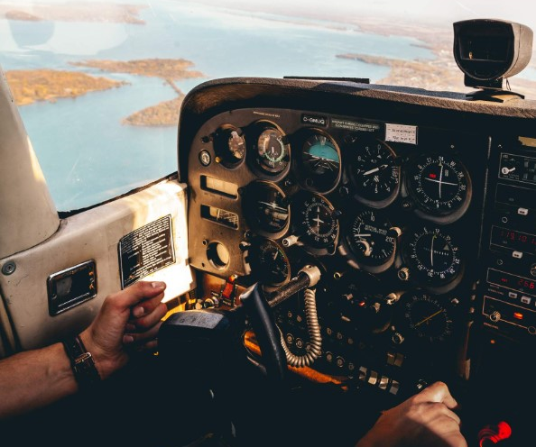
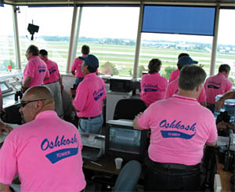
Visual Separation
Notes:
It’s definitely easier in times of good weather with few airplanes to keep track of. By the way, (Click)
operating in and out of Oshkosh, WI during the annual EAA Air Venture pilgrimage is not one of the easy times.
Let’s now turn to a publication that offers a wealth of useful information on Collision Avoidance.
(Next Slide)

Slide 8
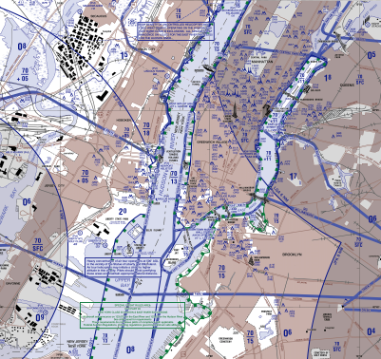
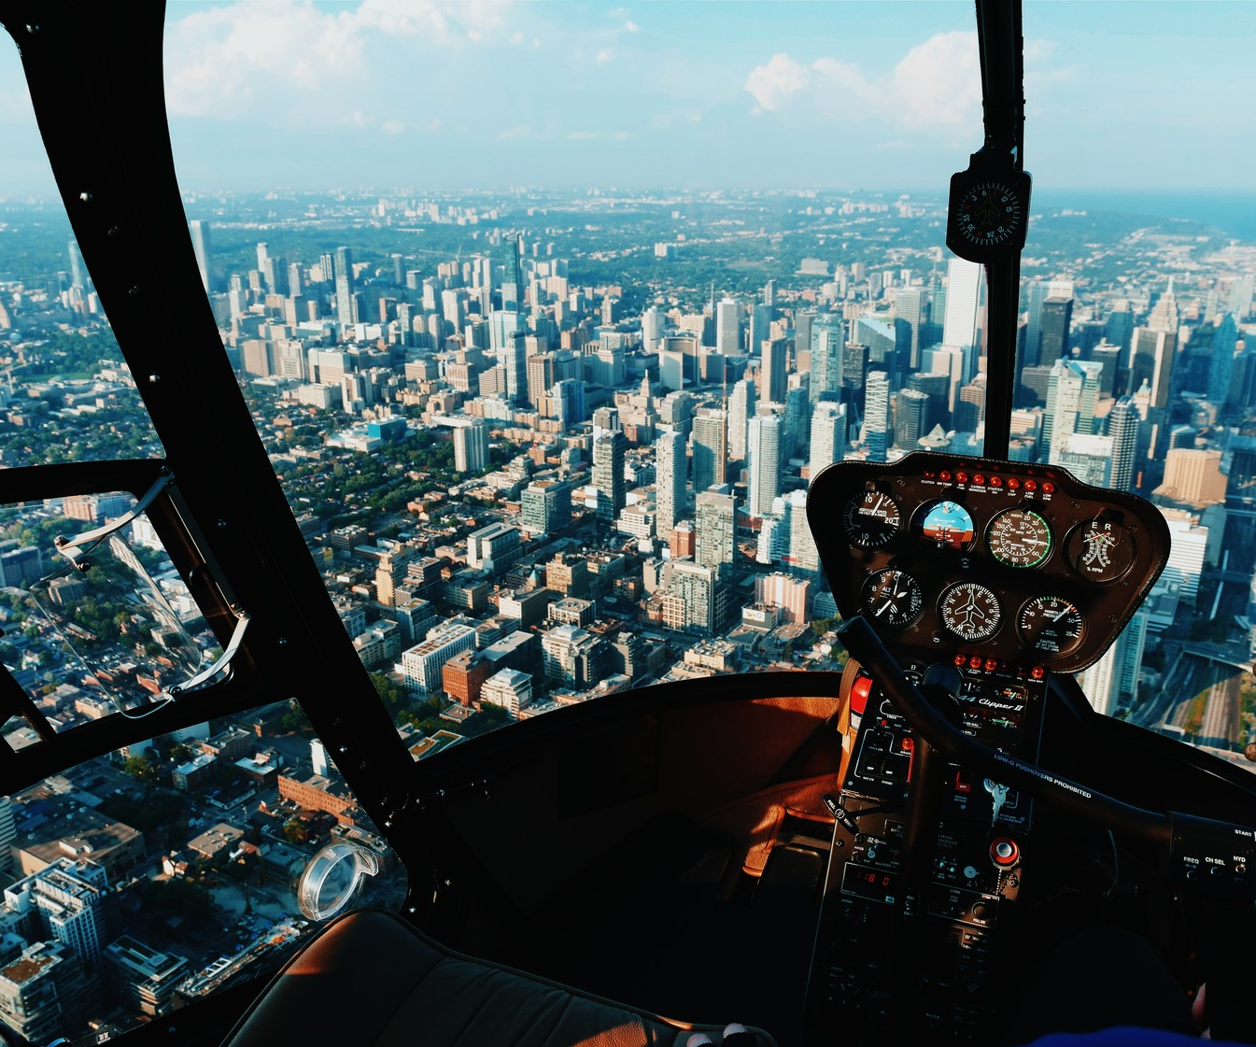
Helicopter Routes and special procedures
Notes:
Helicopter routes established in high-traffic areas concentrate rotary-wing traffic in predictable paths that provide separation from fixed-wing aircraft and expedite traffic flow. All pilots should be especially vigilant when operating in proximity to these routes and helicopter pilots must ensure that they can maintain separation if they are operating on visual clearances. They must adhere to the assigned routes including altitude assignments as published or as modified by ATC. As always, the final authority for safety is the pilot.
Airport operators routinely establish local procedures for the operation of gliders, parachutists, lighter-than-air- aircraft, helicopters, and ultralight vehicles. All pilots must be especially vigilant when mixed-traffic operations are in progress.
(Next Slide)

Slide 9
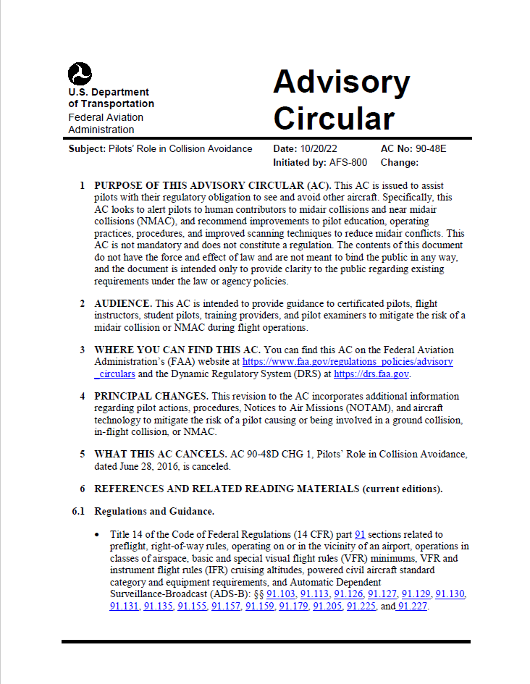

AC 90-48E
Human Vision capabilities and limitations
Airport ground and flight operations
Common Collision scenarios
Effective scanning techniques
Collision avoidance technologies
Notes:
AC 90-48 E Pilots’ Role in Collision Avoidance is a must-read resource for all pilots. The publication covers human vision capabilities and limitations, ground and flight operations on and in the vicinity of airports, common collision scenarios, effective scanning techniques, and collision avoidance technologies.
(Next Slide)
Background: URL for AC 90-48: https://drs.faa.gov/browse/excelExternalWindow/DRSDOCID101287214720221026144324.0001

Slide 10
Scanning for traffic
Manage inside time
Scanning Technique
Notes:
We’ve made great progress in digital flight instrumentation but attractive as full panel glass displays may be, our main job in VMC weather is still looking out the window. Secondary to admiring the landscape is, of course, scanning for traffic. Pilots must manage their inside time in order to have plenty of time for scanning. Don’t fixate on the instruments. A few seconds to monitor the situation is all it takes, then back to scanning for traffic. Programming a navigator, switching fuel tanks, or even changing radio frequencies may take a little longer but keep inside time to a minimum. (Click)
Effective scanning is accomplished with a series of short, regularly spaced eye movements that bring successive areas of the sky into the central visual field. Each movement should not exceed 10 degrees, and each area should be observed for at least 1 second to enable detection. Although most pilots seem to prefer horizontal back-and-forth eye movements, each pilot should develop a scanning pattern that is most comfortable and then adhere to it to ensure optimum scanning.
(Next Slide)

Slide 11
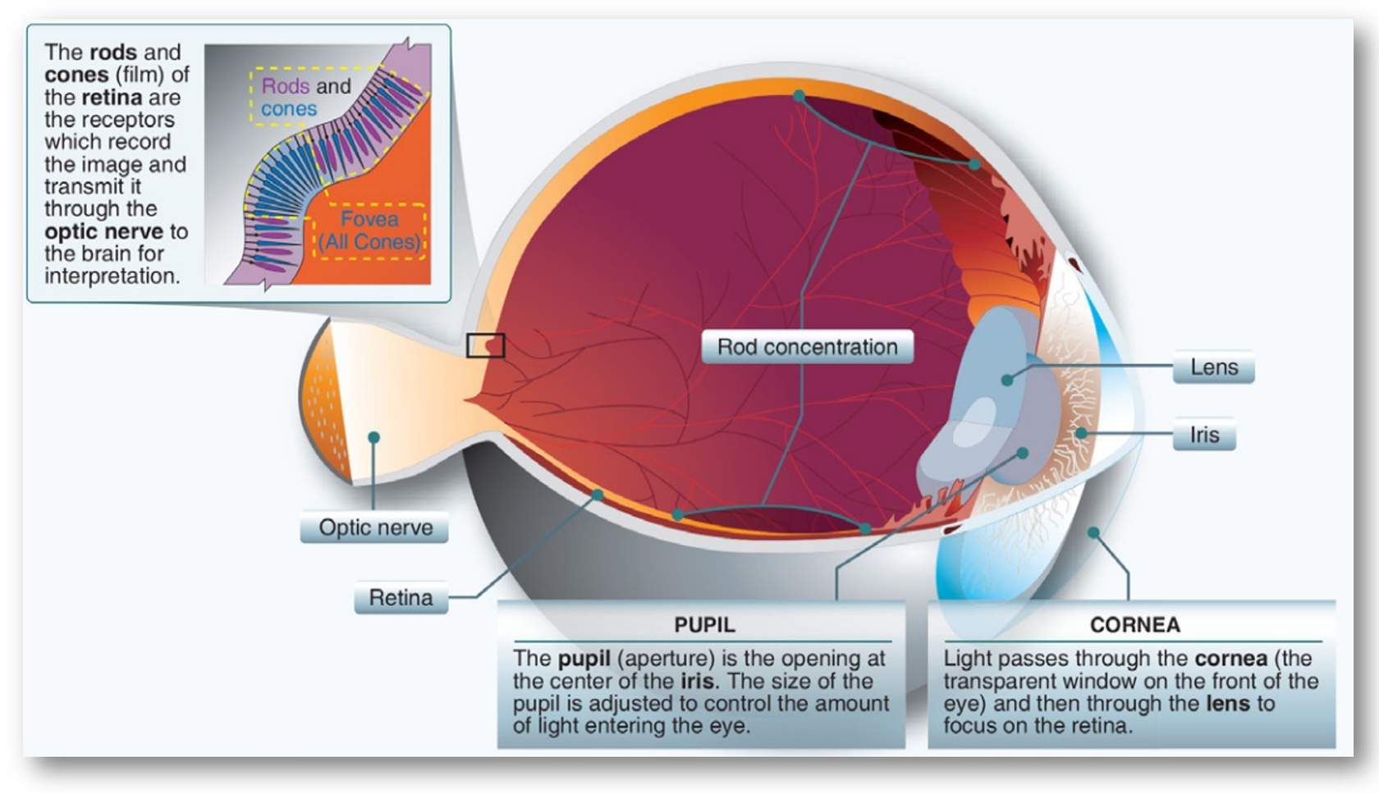
Vision
Day vs night performance
  Peripheral scan at night
Optical illusions
Aircraft Attitude
  Climbs & descents
  Adjust pitch & bank for improved
  coverage
Notes:
Low light photoreceptors in the eye are concentrated on the retina periphery making it difficult or impossible to see objects when looking directly at them. Night scan techniques use peripheral vision to identify and track targets.
There are also several common in-flight optical and vestibular illusions that pilots must cope with.
Presentation note: For more information see FY2025 Operations Topic of the Month – Vestibular Illusions
Altering aircraft pitch and bank attitude from time to time – particularly when climbing and descending can enable pilots to scan areas that are blocked by aircraft structure.
(Next Slide)

Slide 12
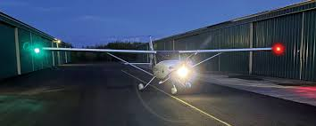
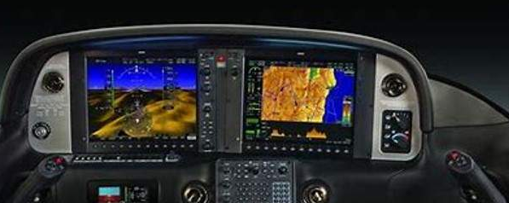
Collision avoidance technologies
Strobe and pulse lights
Landing lights
ADS-B
  TIS
TCAS
Notes:
One of the most effective collision avoidance technologies improves your ability to be seen. Strobe and pulse lights operating day and night enhance your visual presence. Many pilots also show landing lights – especially in high-density traffic and pattern operations.
ADS-B-in Traffic Information Service will help you spot ADS-B-out equipped aircraft, but it won’t help you to see unequipped aircraft. Of course, many commercial aircraft are equipped with TCAS that not only spots traffic but also offers conflict resolution solutions.
(Next Slide)

Slide 13
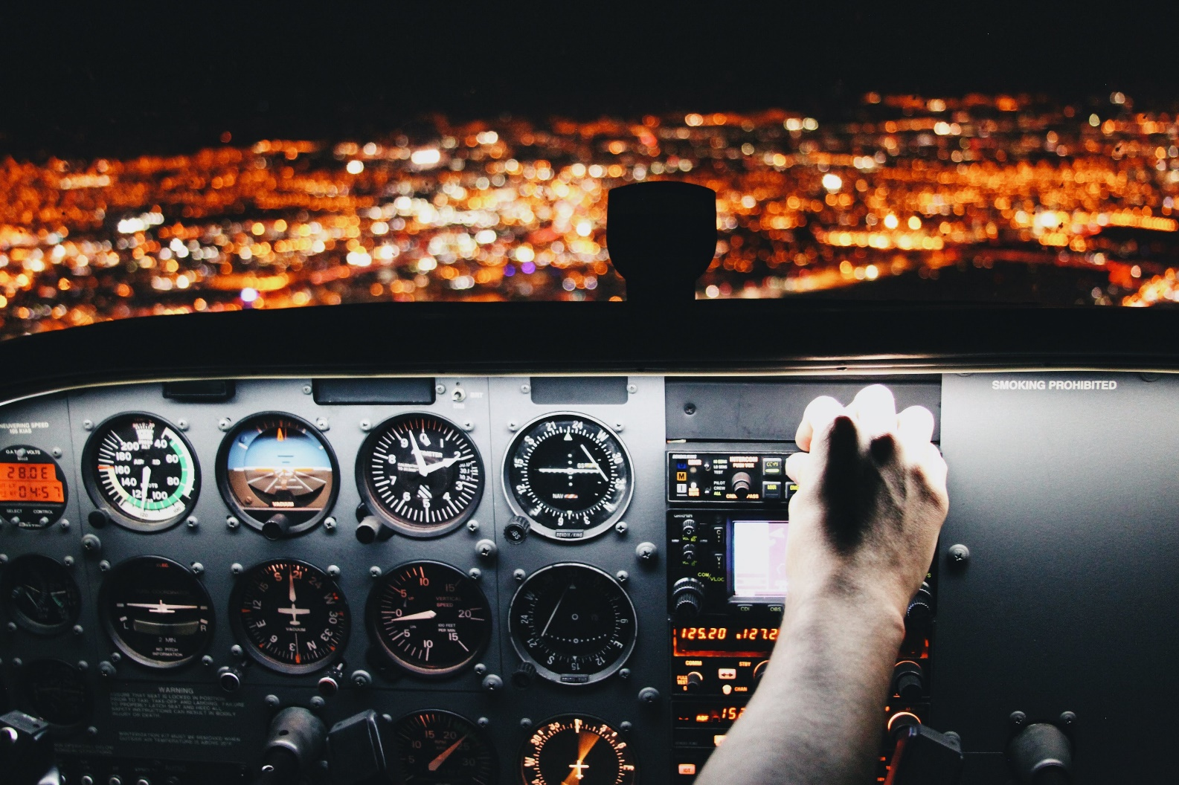
Vigilance
Boredom
Distractions
Notes:
The key to collision avoidance is vigilance. Most humans are not good at monitoring stable activities. Spending hours of scanning – especially when nothing is detected – makes the mind wander and any distraction, no matter how insignificant, is welcome relief from boredom. Collision avoidance depends upon our constant attention to the collision avoidance task, and the reward is flights that are, “uneventful”.
(Next Slide)

Slide 14
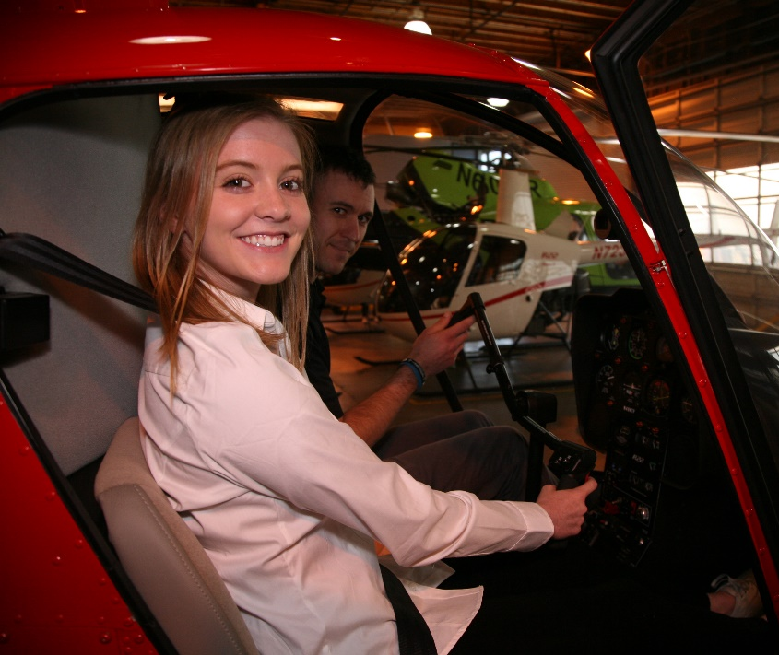
Have you earned your WINGS?
WINGS Proficient Pilots are:
  Confident
  Capable
  Safe
WINGS will keep you
on top of your game
Notes:
Have you earned your WINGS?
Proficiency is key to success in almost everything worth doing – especially flying. Proficient pilots are confident, capable, and safe.
WINGS is a proficiency training system specifically designed for general aviation pilots and, regular participation will keep you on top of your flying game. If you’re already a WINGS pilot – you know the value of proficiency pilot. If you’re not, ask your local FAASTeam Program Manager or FAASTeam Representatives for more information on how to get started in WINGS.
Presentation note: You may wish to ask how many members of the audience are active in WINGS and ask if they would be willing to talk with the non-WINGS pilots after the show.
(Next Slide)

Slide 15
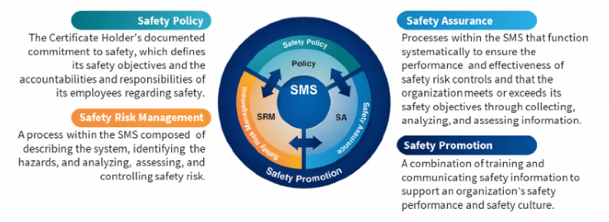
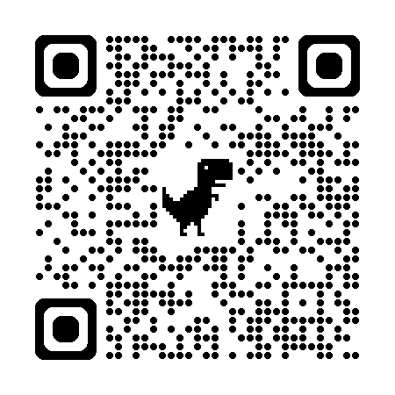

Safety Management Systems (SMS)
Coming to General Aviation
https://www.faa.gov/about/initiatives/sms
Notes:
Safety Management Systems are a set of policies and processes that can increase the safety and efficiency of any flight operation. And FAA is bringing SMS to General Aviation. You may have heard of SMS but thought it was only for large organizations but actually SMS can be scaled to fit any operation large or small.
There are 4 major components to a Safety Management System (Click)
Safety Policy – a documented commitment to safety that runs from the head of an organization to its newest member. (Click)
Safety Risk Management – a process that identifies hazards within an operation, determines to what extent an identified hazard may impact flight safety, and controls the risk of occurrence to an acceptable level. (Click)
Safety Assurance – By collecting and analyzing information derived from safety performance data Safety Assurance ensures the performance and effectiveness of Safety Risk Controls. (Click)
Safety Promotion communicates safety information and commitment throughout the organization. (Click)
You can find more information about Safety Management Systems at the URL on the Screen.
(End)

Slide 16
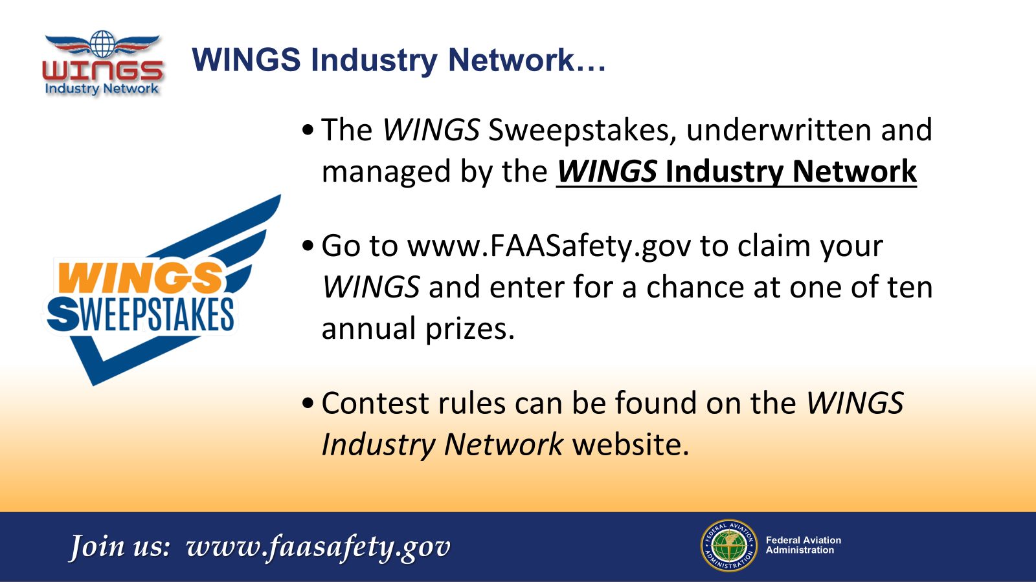
Notes:
Every time you complete a WINGS Phase, you’re eligible to win cash in the WINGS Sweepstakes.
The sweepstakes is generously funded by the WINGS Industry Network. https://wingsindustry.com to learn more and enter the sweepstakes.
Just navigate to http://www.mywingsinitiative.org or scan the QR code for details. By the way, Instructors can also enter the sweepstakes.
(Next Slide)

Slide 17

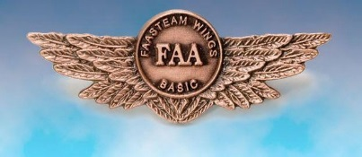
Questions?
Notes:
Presentation Note: You may wish to provide your contact information and main FSDO phone number here. You can also add WINGSPro contact information.
Modify with your information or leave blank.
(Next Slide)

Slide 18
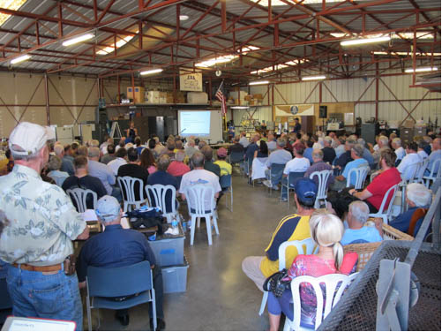

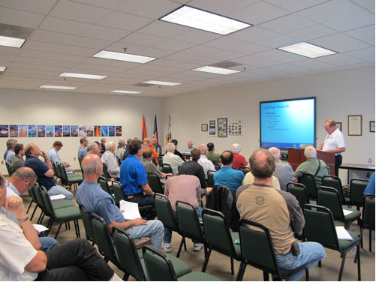
Thank you for attending
You are vital members of our GA safety community
Notes:
Your presence here shows that you are vital members of our General Aviation Safety Community. The high standards you keep and the examples you set are a great credit to you and to GA.
Thank you for attending.
(Next Slide)

Slide 19
The National FAA Safety Team Presents
Topic of the Month – February
Visual Traffic Separation
Notes:
2025/10-29-338(I)PP Original Author: John Steuernagle December 2025; POC John Steuernagle National Operations FPM, Office (562-888-2020 revised by (Name) (MM/DD/YYYY)
Presentation Note: This is the title slide for CFIT Avoidance Technology
Script - We have included a script of suggested dialog with most slides. The script will always appear in a non-italic font. Presenters may read the script or modify it to suit their own presentation style. See template slides 5 and 6 for examples of slides with script.
Presentation Instructions - (stage direction and presentation suggestions) will be preceded by a Bold header: the instructions themselves will be in Italic fonts. See slide 2 for an example of slides with Presentation Instructions only.
Program control instructions - will be in bold fonts and look like this: (Click) for building information within a slide; or this: (Next Slide) for slide advance.
Background information - Some slides may contain background information that supports the concepts presented in the program.
Background information will always appear last and will be preceded by a bold Background: identification.
The production team hope you and your audience will enjoy the show. Break a leg!
(Next Slide)

