Slide 1

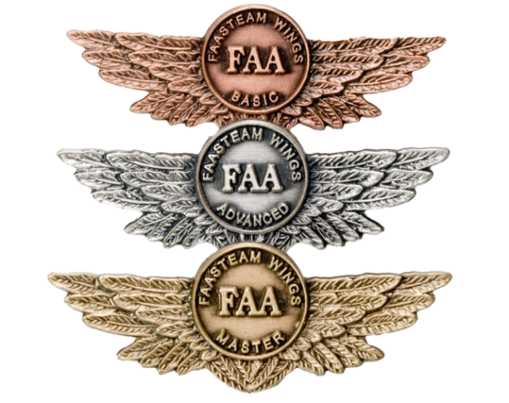
The National FAA Safety Team Presents
Topic of the Month – March
Human Factors and WINGS
Notes:
2024/09-10-319(I)PP Original Authors: AU CASA & John Steuernagle; March 2025; POC John Steuernagle National FAASTeam Operations Program Manager, Office 562-264-5484
Presentation Note: This is the title slide for Human Factors and Wings.
Script - We have included a script of suggested dialog with most slides. The script will always appear in a non-italic font. Presenters may read the script or modify it to suit their own presentation style. See template slides 5 and 6 for examples of a slides with script.
Presentation Instructions - (stage direction and presentation suggestions) will be preceded by a Bold header: the instructions themselves will be in Italic fonts. See slides 2, 3, and 4 for examples of slides with Presentation Instructions only.
Program control instructions - will be in bold fonts and look like this: (Click) for building information within a slide; or this: (Next Slide) for slide advance.
Background information - Some slides may contain background information that supports the concepts presented in the program.
Background information will always appear last and will be preceded by a bold Background: identification.
The production team hope you and your audience will enjoy the show. Break a leg!
(Next Slide)

Slide 2
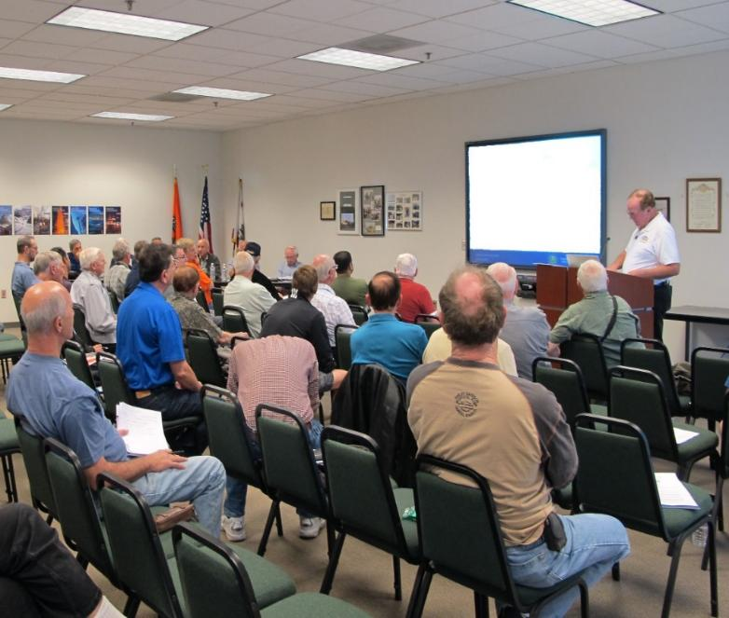

Welcome
Exits
Restrooms
Emergency Evacuation
Breaks
Phones & pagers to silent or off
Sponsor Acknowledgment
Other information
Notes:
Presentation Note: Here’s where you can discuss venue logistics, acknowledge sponsors, and deliver other information you want your audience to know in the beginning.
You can add slides after this one to fit your situation.
(Next Slide)

Slide 3
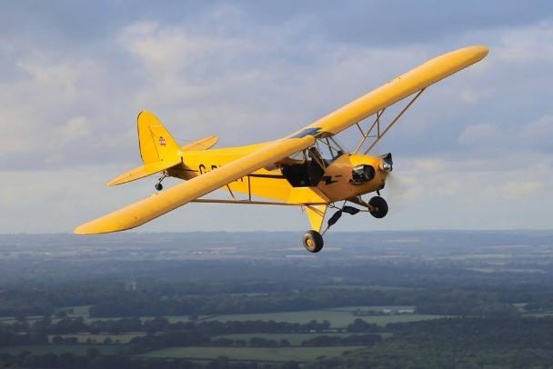
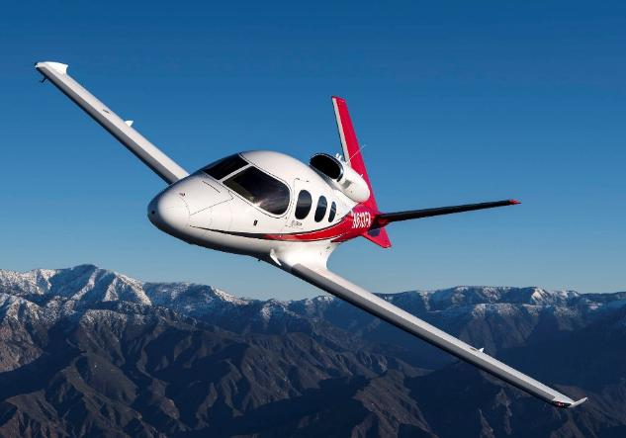
We’ve come a long way….
Notes:
We’ve come a long way in GA Safety, and we should celebrate our part in attaining and maintaining the lowest GA accident rates ever. But, as we said before, we’ll have to explore some new ground if we’re going to drive the GA Accident Rate lower.
(Next Slide)

Slide 4

Human Factors
The Final Frontier
Notes:
Human Factors study and human factors-informed product and process design are producing better informed pilots and more capable aircraft; a combination that yields solid safety results.
(Next Slide)

Slide 5

Human Factors
Human Factors study applies knowledge of the human body and mind in order to understand human capabilities and limitations.
HF knowledge informs human task specifications and complementary system and technology design.
Notes:
The term “human factors” refers to the wide range of issues affecting how people perform tasks in their work and leisure environments. Human factors study applies knowledge of the human body and mind to better understand human capabilities and limitations. This allows us to better design tasks, systems, and technology in order to optimize the relationship between human operators and the environments within which they work.
(Next Slide)

Slide 6
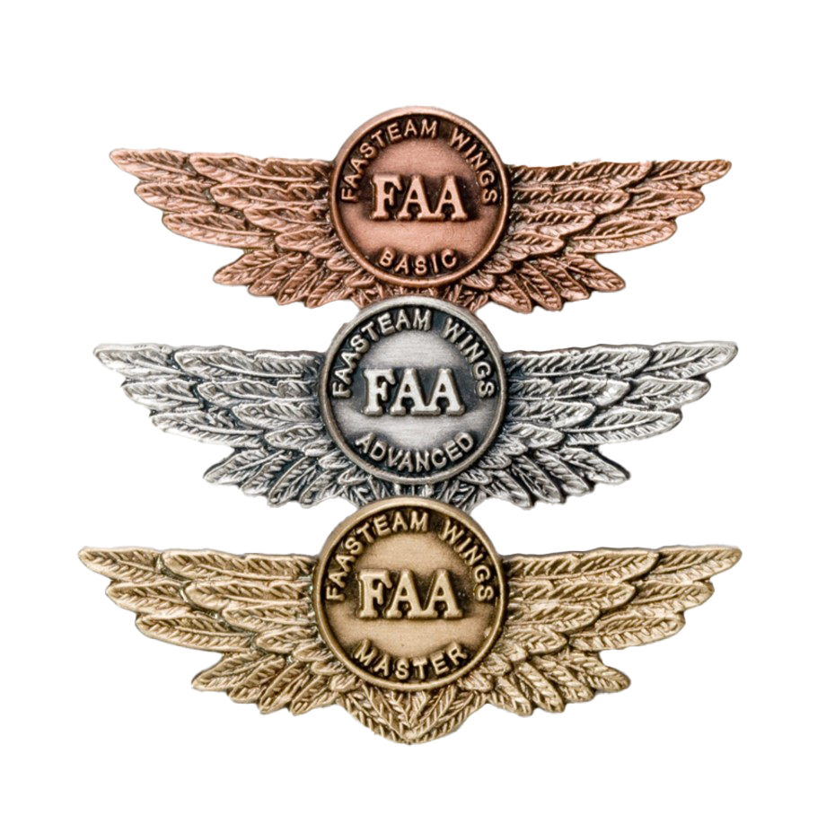
What does that have to do with WINGS?
Safety Culture
Human Performance
Communication
Teamwork
Situational Awareness
Decision Making
Threat & Error Management
Human Information Processing
Design and Automation
Notes:
You may be wondering, what has Human Factors have to do with WINGS? Plenty. Leveraging our understanding of human factors improves our performance, communication, teamwork, situational awareness, and decision making. Threat and error management recognizes and accommodates human factors strengths and weaknesses. And, understanding how humans process information informs aircraft and systems design and automation. (Click)
A robust safety culture supports human endeavors in all of these areas which, some folks will recognize as the modules in our Human Factors for Pilots online course series.
(Next Slide)

Slide 7

Culture
a set of shared attitudes, values, goals, and practices that Characterizes an institution or organization
the set of values, conventions or social practices associated with a particular field, activity, or societal characteristic
shared beliefs, attitudes, norms and values
“the way we do things around here.”
Notes:
The beliefs, attitudes, norms and values that people within an organization share are described as Organizational Culture. (Click)
You might describe culture as, “the way we do things around here.
Safety culture is an essential part of organizational culture. It affects the way the organization manages safety and therefore, the ultimate effectiveness of its safety management system.
Culture has a profound influence on individual pilots too but sometimes they don’t see it that way.
(Next Slide)

Slide 8
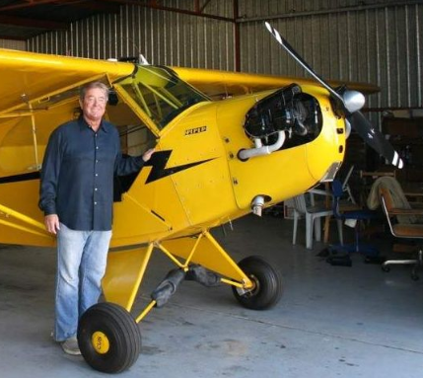
But I’m just one pilot…
I don’t fly for an airline or belong to a club.
I don’t have a culture that influences my decisions.
Notes:
While we might not think we’re part of an aviation organization the fact is, we are all subject to cultural influences. We share values and beliefs with our Flight Instructors, fellow pilots, and aviation mentors. Likewise, we’re influenced by the values and beliefs of our family, work colleagues, and friends. All of these influence “the way we do things around here”. Hopefully, those influences argue for a positive and robust safety culture.
(Next Slide)

Slide 9
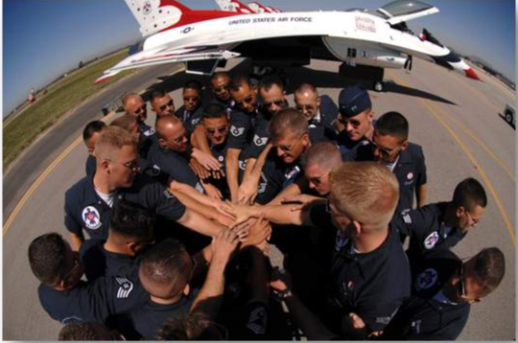
“A great safety culture is when people continue to work safely and do the right things… even when no one is watching.”
Anonymous
Notes:
Simply put: “A great safety culture is when people continue to work (and fly) safely and do the right things – even when no one is watching.”
(Next Slide)

Slide 10

WINGS Safety Culture
Train to Proficiency
Safety Risk Management
Best Operational Practices
Lessons Learned
Safety Promotion
Notes:
A positive safety culture is the foundation on which The FAA WINGS Pilot Proficiency Program is built. (Click)
WINGS pilots train to proficiency. (Click)
They practice Safety Risk Management, (Click)
and adhere to Best Operational Practices. (Click)
They improve their operational safety and efficiency through study of Lessons Learned, (Click)
and they “walk the talk” promoting safety through their words and actions.
Let’s consider a year’s worth of WINGS Proficiency Training.
(Next Slide)

Slide 11
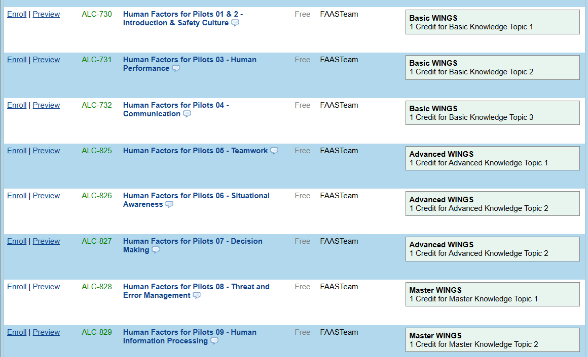
WINGS Knowledge Activities
Notes:
FAASafety.gov hosts more than 1300 online courses more than 600 of which qualify for WINGS credit. More than 150,000 online WINGS Courses are completed each year.*
* FY 2024 Data
(Next Slide)

Slide 12
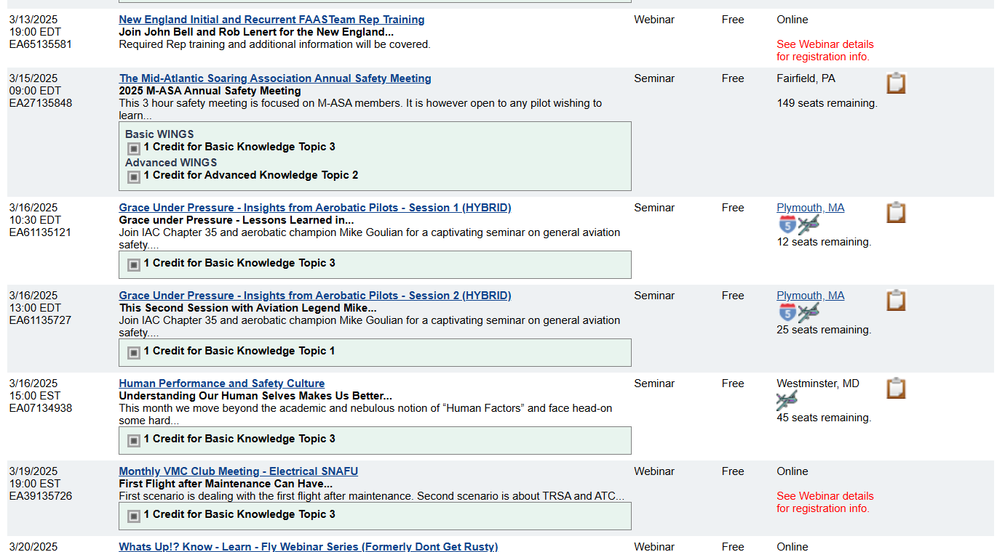
WINGS Knowledge Activities
Notes:
In one year, the FAASTeam sponsored 3183 Seminars and 813 Webinars where critical safety information was presented to 439,000 Attendees.*
* FY 2024 Data
(Next Slide)

Slide 13
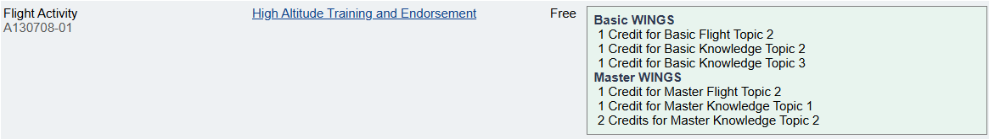
WINGS Flight Activities
Notes:
More than 27,000 Standard Flight Activities are completed each year.* Each WINGS activity supports our collective safety culture and leverages our human factors strengths while compensating for our weaknesses. Here’s how that’s done.
* FY 2024 Data
(Next Slide)

Slide 14


Human Performance
Capabilities & limitations
Health & well being
Stress management
Hydration & nutrition
Exercise
Rest & recuperation
Notes:
WINGS Proficiency instruction recognizes human performance capabilities and limitations. WINGS Pilots and Flight instructors know that their health and well being have a direct impact on pilot proficiency. The strive for optimum stress levels. Not so much as to feel overwhelmed or so little as to invite complacency and distraction. They also attend to hydration and nutrition. They acknowledge the benefits of exercise and the necessity of adequate rest and recuperation.
(Next Slide)

Slide 15
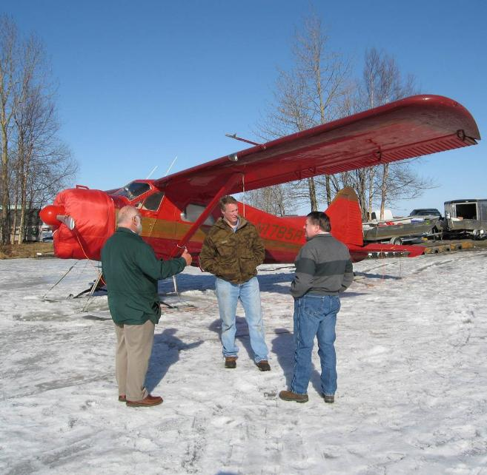

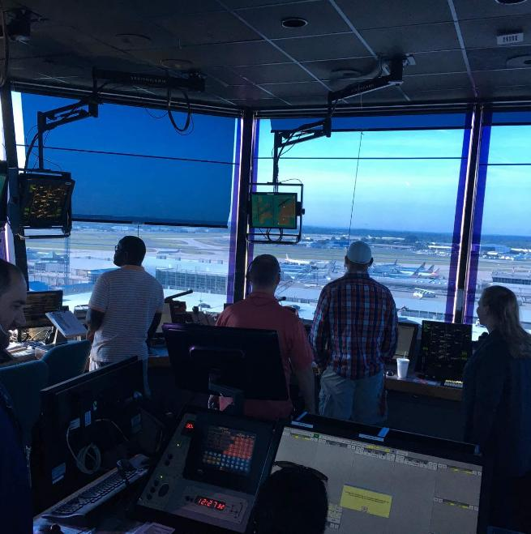
✓ Active listening
✓ Readback/hear back
Clarification
Questioning
✓ Procedures
✓ Checklists
Communication
Notes:
Effective communication is essential to safe, efficient operations. WINGS instruction provides ample opportunity for pilots to practice critical communication skills.
(Next Slide)

Slide 16
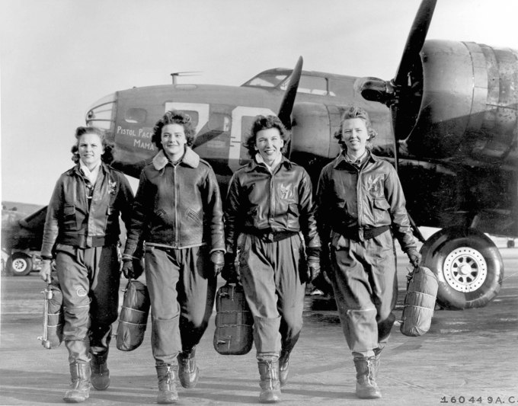
Teamwork
Single-pilot resource management
Crew resource management
Pilot / Controller communication
Pilot / Passenger, Maintenance, Ramp, Wx, flight planning & CFI coordination.
This Photo by Unknown Author is licensed under CC BY-SA
Notes:
WINGS instructors stress single-pilot and crew resource management. They show pilots how to leverage all the considerable resources available to ensure safe flight operations. WINGS pilots learn how to be effective team members and how to captain a team.
(Next Slide)

Slide 17
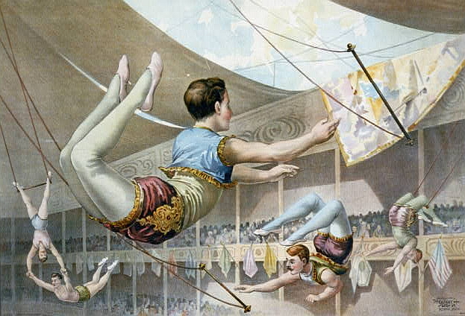
Situational Awareness
Scenario-based instruction
  Weather and terrain
  Aircraft and systems
  Fuel
This Photo by Unknown Author is licensed under CC BY-SA
Notes:
Each WINGS flight provides situational awareness challenges and opportunities for improvement. WINGS instructional scenarios require pilots to be well informed and oriented with respect to weather and terrain, aircraft and aircraft systems, and fuel state.
(Next Slide)

Slide 18

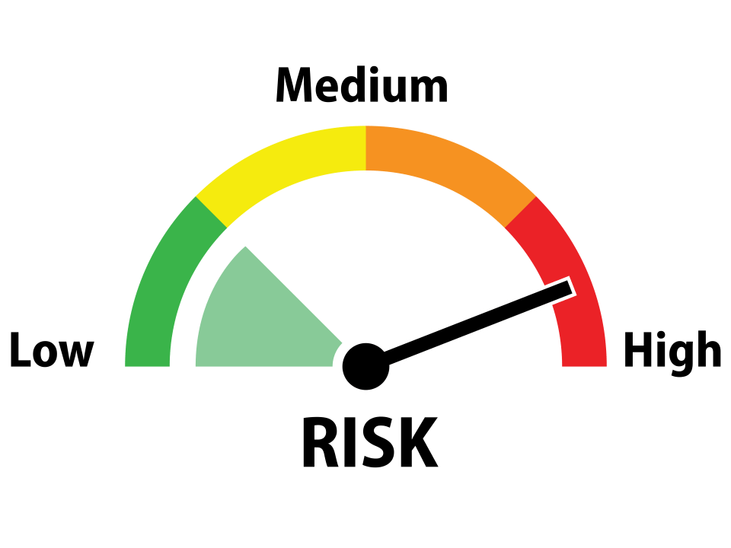
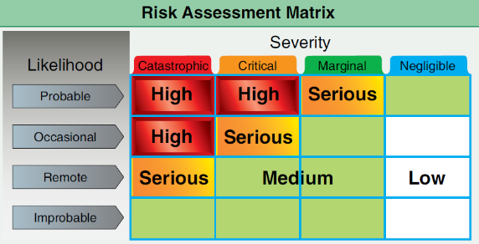
Safety Risk Management
Hazard – a condition, object or circumstance that could cause or contribute to an unwanted event
✓ Risk – the future influence
of hazards on safe operations
Risk Assessment – how likely are identified hazards to impact flight operations and how severe will the consequences be if they do?
Errors
Error Management
Notes:
WINGS Instructors and Pilots practice safety risk management by (Click)
Identifying Hazards – conditions, objects, or circumstances that could cause or contribute to an unwanted event, (Click)
Determining the risk that hazards will negatively impact flight operations, (Click)
And assessing the severity of consequences if they do. We also employ a dynamic risk management process known as Threat and Error Management.
(Next Slide)

Slide 19
Threat & Error Management
Threats
A Safety Management Approach
  ✓ Threats
  Errors
If not properly managed, threats and errors can lead to Undesired Aircraft States
Threat Management
Errors
Error Management
Undesired States
Undesired State
Management
End State
Notes:
All WINGS training is subject to risk analysis and Threat & Error Management is one Risk Management methodology that is taught.
Threat and error management is a safety management approach to flying that detects, recognizes, and manages threats (Click)
– such as adverse weather, terrain or aircraft equipment malfunctions. (Click)
and Errors – such as unclear communications between pilots and crew or pilots and controllers or improper aircraft configuration. (Click)
If not properly managed, threats and errors can lead to Undesired Aircraft States such as loss of control. TEM teaches pilots how to recognize threats, such as adverse weather conditions, and errors – think miscommunication or aircraft misconfiguration. Once threats and errors are recognized they can be managed, thus preventing their progression to Undesired Aircraft States. Threat & Error Management teaches pilots how to recognize and deal with small problems before they become big ones.
(Next Slide)

Slide 20
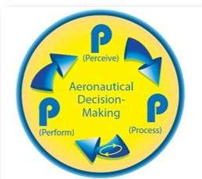
Decision Making
You can’t improvise good decisions
  Process and practice
Use decision-making aids
  Mnemonics, FRATS
Maintain reserve mental capacity
  Delegate or shed load when time is critical
Keep the “Big Picture” in mind
  Maintain Situational Awareness
Notes:
If Decision Making is defined as “the act of choosing between alternatives under conditions of uncertainty.” then Aeronautical Decision Making can be defined as “the act of choosing between alternatives under conditions of uncertainty while maintaining control in a dynamic and often hostile environment. Here are some takeaways from WINGS Decision-making training: (Click)
You can’t improvise good decisions. Practice in structured decision-making is essential to positive results. (Click)
Use decision making aids such as mnemonics and Flight Risk Assessment Tools to structure your decision-making process. (Click)
Maintain reserve mental capacity. We perform at our best when we are moderately stressed and challenged. But if too many things are happening too quickly it’s time to shed some load. In some cases, this could lead to landing short of the destination. (Click)
Successful pilots are always aware of their physical and mental state, aircraft and systems disposition, flight progress, and fuel state. That situational awareness or “Big Picture”, is the foundation upon which good decisions are made.
WINGS training scenarios provide ample opportunity for pilots to exercise their decision-making skills.

Slide 21
Human Information Processing
Memory
Bias
Errors
Illusions
Startle Response
Notes:
As you might expect, (Click)
WINGS instruction leverages what we know about human memory and information processing to compensate for biases and errors. (Click)
We have extensive experience with deadly aviation illusions that, with proper awareness and training, can be effectively dealt with in flight. (Click)
And scientific studies of the Human Startle Response have informed WINGS training curricula that teach us how to cope with or avoid unsafe responses to startle and surprise.
(Next Slide)

Slide 22
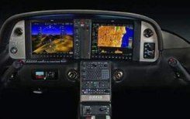
Design and Automation
Pilot/Aircraft interfaces
Ergonomic design
✓ Overreliance on automation
Hand-flying skill erosion
Automation surprise
Notes:
And finally, WINGS training recognizes that pilots can become overly reliant on modern aircraft automated systems, thus diminishing their hand flying skill.
We also know that effective management of automated systems is reducing the time available to visually scan for traffic and other threats to safety. Human factors knowledge and research informs WINGS training curricula that balance automation with hand flying and failure mode operation to maintain high levels of pilot skill and to avoid confusion when automation directs the aircraft to do something that was not expected.
(Next Slide)

Slide 23
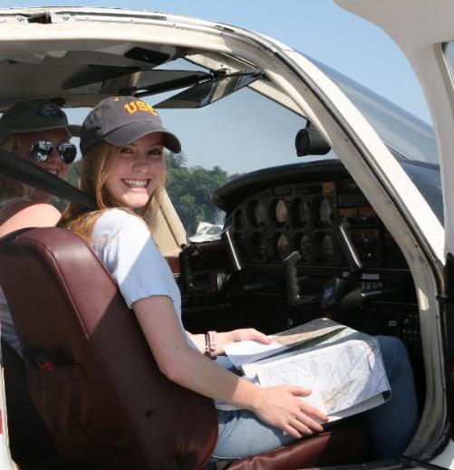
Foundational Elements of Safety
✓ Safety Risk Management
  Hazard identification & risk mitigation
✓ Pilot Proficiency
  The skills to do the job
✓ Technology
  Supporting safe decision making
  and aircraft operations
Notes:
Our collective and individual safety programs are based on these foundational elements: (Click)
Safety Risk Management – hazard identification and risk mitigation,
We defined hazards, risks, and risk assessment (Click)
Pilot Proficiency – the skills to do the job,
We discussed the necessity of continuing proficiency education for pilots in the context of FAA’s WINGS Pilot Proficiency Program (Click)
and we discussed the benefits and challenges presented by emerging Aviation Technologies.
(Next Slide)

Slide 24

Understanding Human Factors
Better communicators
Better decision makers
Better crisis managers
Better teachers
Better students
Safer Operations!
Notes:
Understanding human factors facilitates communication. We are better able to craft messages and better able to understand them.
Decision making is much improved when human factors are considered.
Understanding how we function under stress and managing our responses to stressful situations makes it much more likely we’ll survive a crisis.
Human Factors-aware Flight Instructors can craft more effective instructional experiences for students.
And students who are versed in HF are better able to absorb and retain information. (Click)
That all adds up to safer, more efficient flight operations.
(Next Slide)

Slide 25
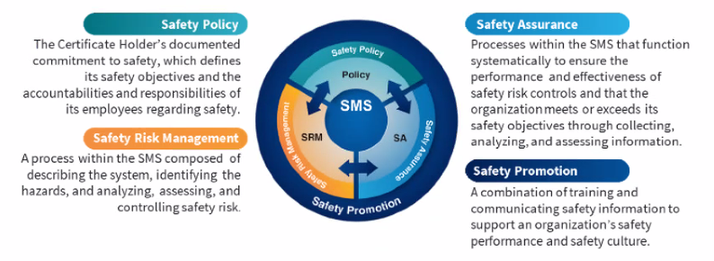
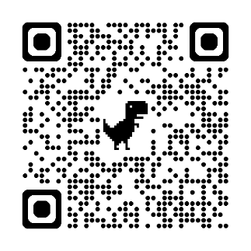

Safety Management Systems (SMS)
Coming to General Aviation
https://www.faa.gov/about/initiatives/sms
Notes:
Safety Management Systems are a set of policies and processes that can increase the safety and efficiency of any flight operation. And FAA is bringing SMS to General Aviation. You may have heard of SMS but thought it was only for large organizations but actually SMS can be scaled to fit any operation large or small.
There are 4 major components to a Safety Management System (Click)
Safety Policy – a documented commitment to safety that runs from the head of an organization to its newest member. (Click)
Safety Risk Management – a process that identifies hazards within an operation, determines to what extent an identified hazard may impact flight safety, and controls the risk of occurrence to an acceptable level. (Click)
Safety Assurance – By collecting and analyzing information derived from safety performance data Safety Assurance ensures the performance and effectiveness of Safety Risk Controls. (Click)
Safety Promotion communicates safety information and commitment throughout the organization. (Click)
You can find more information about Safety Management Systems at the URL on the Screen.
(End)

Slide 26

Questions?
Notes:
Presentation Note: You may wish to provide your contact information and main FSDO phone number here. You can also add WINGSPro contact information.
Modify with your information or leave blank.
(Next Slide)

Slide 27
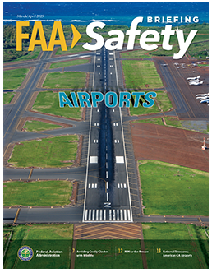


FAA Safety Briefing
Dedicated to GA Safety
6 – issues per year
Print or online
Social media & Face book presence
https://www.faa.gov/newsroom/faa-safety-briefing-magazine
Notes:
FAA Safety Briefing magazine, available in print or online, publishes 6 times each year. It’s another important safety information conduit another The magazine is available in print or online versions. The magazine also has a robust social media safety presence. Navigate to the URL or scan the QR code on the screen to read the latest issue.
(Next Slide)

Slide 28
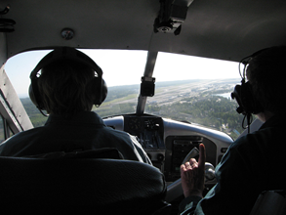
Proficiency and Peace of Mind
  Fly regularly with your CFI
  Perfect Practice
  Document in WINGS
Perfect Practice
Document in WINGS
Notes:
There’s nothing like the feeling you get when you know you’re playing your A game and in order to do that you need a good coach (Click)
Proficient Pilots fly regularly with CFIs who will challenge them to review what they know, explore new horizons, and to always do their best. Of course, they must dedicate time and money to their proficiency program but it’s well worth it for the peace of mind that comes with confidence. (Click)
Vince Lombardi, the famous football coach said, “Practice does not make perfect. Only perfect practice makes perfect.” For pilots that means
flying with precision. On course, on altitude, on speed all the time. (Click)
Encourage your flight training clients to document their achievements in the Wings Proficiency Program. It’s a great way to stay on top of their game and keep their flight review current.
(Next Slide)

Slide 29
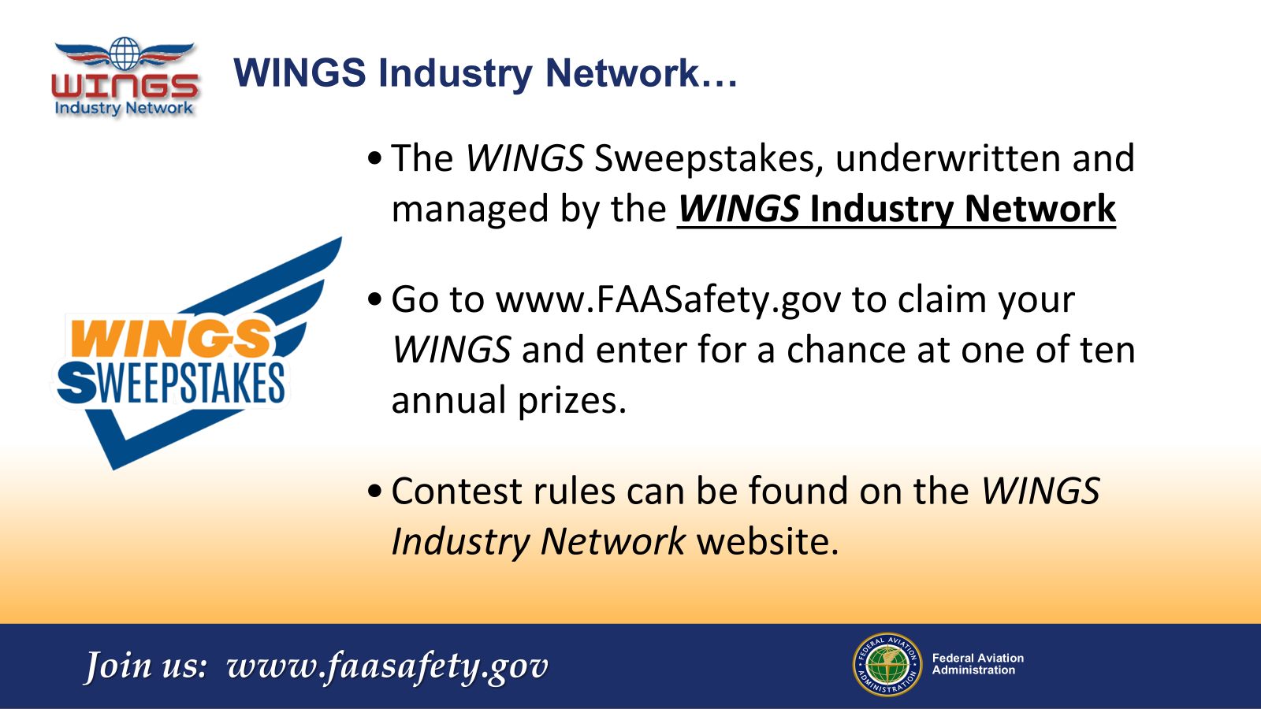
Notes:
Every time you complete a WINGS Phase, you’re eligible to win cash in the WINGS Sweepstakes.
The sweepstakes is generously funded by the WINGS Industry Network. https://wingsindustry.com to learn more and enter the sweepstakes.
Just navigate to http://www.mywingsinitiative.org or scan the QR code for details. By the way, Instructors can also enter the sweepstakes.
(Next Slide)

Slide 30
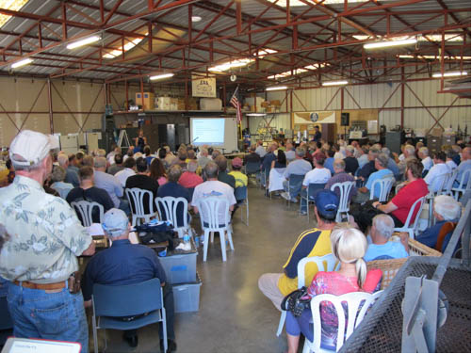
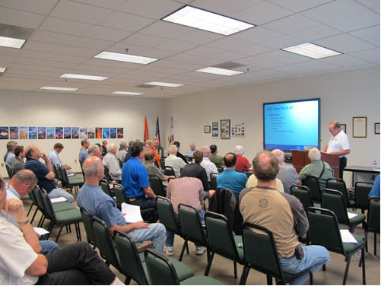
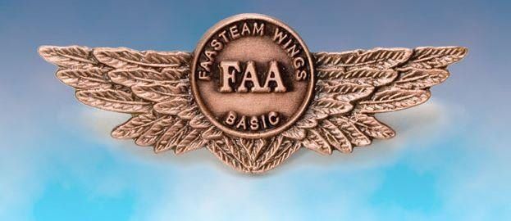
Thank you for attending
You are vital members of our GA safety community
Notes:
Your presence here shows that you are vital members of our General Aviation Safety Community. The high standards you keep and the examples you set are a great credit to you and to GA.
Thank you for attending.
(Next Slide)

Slide 31
The National FAA Safety Team Presents
Topic of the Month – March
Human Factors and WINGS
Notes:
(The End)

