Slide 1
The FAA Safety Team Presents:
Topic of the Month – April Angle of Attack Awareness
Notes:
2024/09-10-320(I)PP Original Author: Jay M. Flowers, AGF 930 FAASTeam; Graphics provided by Boldmethod.com; POC John Steuernagle, National FAASTeam Program Manager - Operations, Office AFG 930;
Presentation Note: This is the title slide for (Angle of Attack Awareness)
Script - We have included a script of suggested dialog with most slides. The script will always appear in a non-italic font. Presenters may read the script or modify it to suit their own presentation style. See template slides 5 and 6 for examples of slides with script.
Presentation Instructions - (stage direction and presentation suggestions) will be preceded by a Bold header: the instructions themselves will be in Italic fonts. See slides 2, 3, and 4 for examples of slides with Presentation Instructions only.
Program control instructions - will be in bold fonts and look like this: (Click) for building information within a slide; or this: (Next Slide) for slide advance.
Background information - Some slides may contain background information that supports the concepts presented in the program. Background information will always appear last and will be preceded by a bold Background: identification.
The production team hope you and your audience will enjoy the show. Break a leg!
(Next Slide)

Slide 2

Welcome
Exits
Restrooms
Emergency Evacuation
Breaks
Sponsor Acknowledgment
Other information
Notes:
Presentation Note: Here’s where you can discuss venue logistics, acknowledge sponsors, and deliver other information you want your audience to know in the beginning.
You can add slides after this one to fit your situation.
(Next Slide)

Slide 3
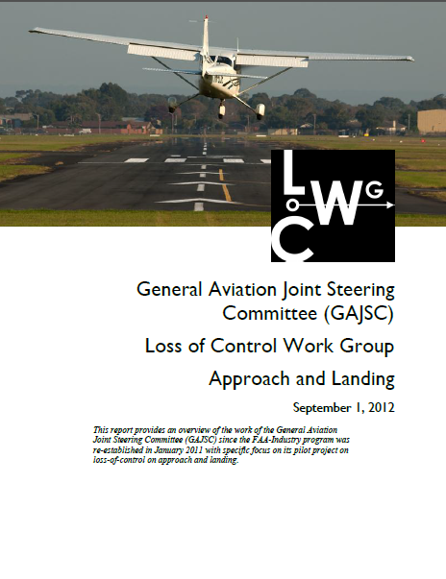
Overview
GAJSC Loss of Control Accident Study
Current Accident Statistics
Stall aerodynamics
AOA Indicators
*GAJSC – General Aviation Joint Safety Committee
Notes:
In this program, we’ll share some General Aviation Joint Safety Committee accident study findings with respect to Loss of Control. We’ll add some current accident statistics and a quick review of Stall aerodynamics and the benefits of angle of attack indicators.
Presentation note: If you’ll be discussing additional items, add them to this list.
(Next Slide)

Slide 4
10 Year Look Back at GA Accidents
Accident Total – 15,928
Total number of accidents involving
Angle of Attack as a causal factor – 5.1% or 819
Of those 5.1%, nearly half (401) were fatal.
Of the Angle of Attack related accidents:
Roughly half were pilot induced
Roughly the other half, Pilot Capability was cited as airspeed was not attained or maintained
Notes:
10 Year Look Back at GA Accidents
Accident Total – 15,928 (Reported from the NTSB and the CAROL)
Total number of accidents involving
Angle of Attack as a causal factor – 5.1% or 812
Of those 5.1%, half were fatal.
Of the Angle of Attack related accidents:
Roughly half were pilot induced
Roughly the other half, Pilot Capability was cited as airspeed was not attained or maintained
Presentation note: Data as collected from the NTSB and the FATDAT FAASTeam Data Analysis tool.
Let’s define Loss of Control - A Loss of Control (LOC) accident involves an unintended departure of an aircraft from controlled flight. LOC can happen when the aircraft enters a flight regime that is outside its normal flight envelope and quickly develops into a stall or spin.
Training is the ONLY skill-based thing you can do as an airman to reduce or mitigate the risk.
Adding an Angle of Attack or AOA indicator supports that training and should be considered as your next avionics upgrade.
(Next Slide)

Slide 5
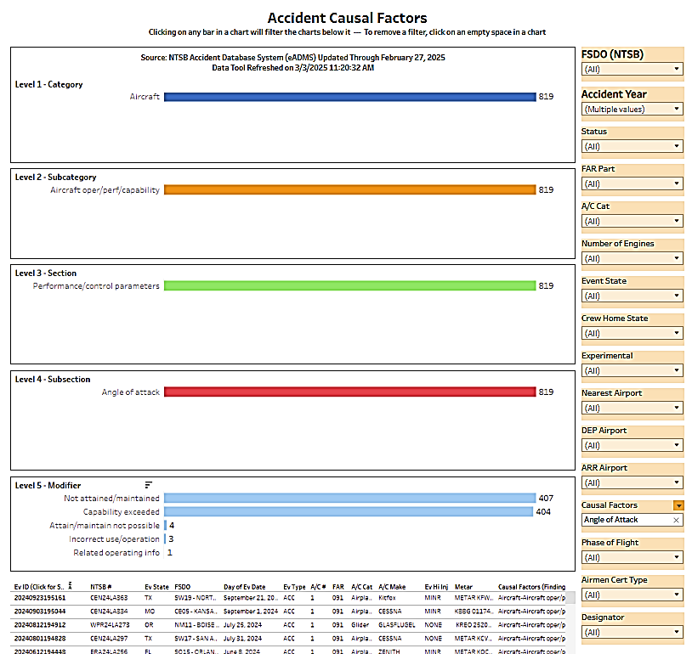
Data collection Source: NTSB CAROL
Aircraft
Aircraft oper/perf/capability
Performance/control/parameters
819
Angle of Attack
Notes:
The data source for our topic was provided by the NTSB through the CAROL – Case Analysis and Reporting Online - Tool. The Causal Factor for angle of attack was found through analysis of the comments reported to by NTSB. This slide gives you a different look at the data.
(Click) ( 4 items will be revealed through animation timing )
Aircraft
Aircraft operator/performance/capability
Performance/control/parameters
Angle of attack – Under subsection 4. note that the total numbers attributed to AOA is the same for all previous categories,, subcategories, and sections, with 819 total, the same number as the Category at the top.
(Click) and the modifier for Angle of Attack:
Not Attained/maintained - 407
Capability exceeded – 404
With these data in mind let’s consider aerodynamic stalls and how they relate to angle of attack.
(Next Slide)

Slide 6
Aerodynamic Stalls
Which of these statements are true with respect to stalls?
Can occur in any phase of flight
Are a factor in many fatal accidents
Usually involve low time pilots
Can occur at any airspeed
All of the above.
Notes:
Let’s begin with this question: Which of these statements are true with respect to stalls?
Presentation Note: Ask the audience to consider these statements with respect to stalls. When they have answered; click to reveal the correct answer.
(Click)
That’s right. Stalls can occur at any airspeed in any phase of flight. They are a factor in many fatal accidents and often – but not always – involve low time pilots.
(Next Slide)

Slide 7
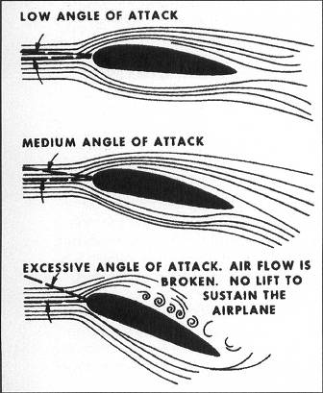
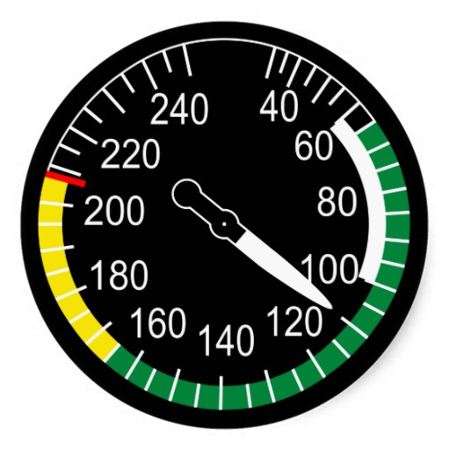
The Airspeed Problem
Notes:
We often discuss stalls with respect to airspeed and that can be a problem.
Wings stall when their critical angle of attack is exceeded. Airspeed is a secondary indication of how close we are to the critical angle of attack.
(Next Slide)

Slide 8
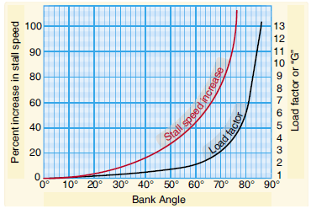
The Airspeed Problem
Aircraft configuration
Vs Cruise configuration
Vso Landing configuration
Load
Notes:
There are problems with using airspeed indications for stall avoidance. (Click)
One being that Stall speed changes with aircraft configuration. (Click)
Another has to do with aircraft load. As load or weight increase stall speed will also increase.
So, if a wing can stall at any airspeed in any configuration pilots must manage angle of attack and that argues for an AOA display and/warning system in the aircraft.
(Next Slide)

Slide 9
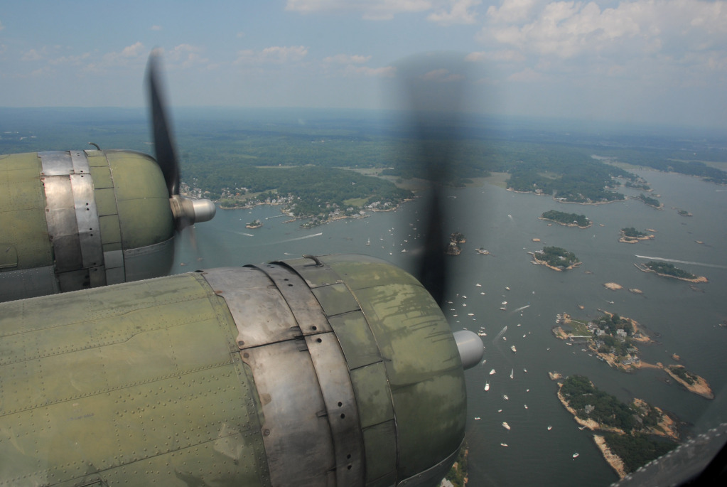
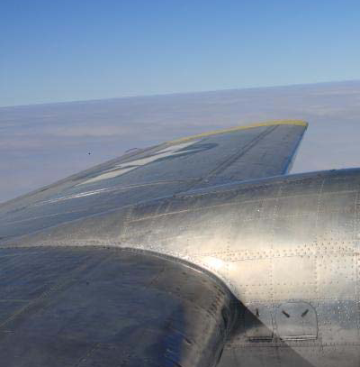
Angle of Attack - Visual
Notes:
The key to stall awareness is the pilot’s ability to visualize the wing’s angle of attack in any circumstance and thereby be able to estimate his/her margin of safety above stall.
This is a learned skill that must be acquired early in-flight training and carried through the pilot’s entire flying career.
(Next Slide)

Slide 10
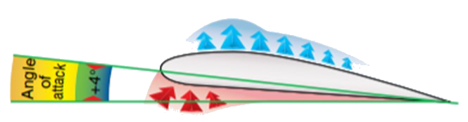
What is Angle of Attack (AOA)
There are two reference lines that define AOA:
The chord line
The line of the relative wind
The number of degrees between these lines is the Angle of Attack.
Notes:
Angle of attack is defined by two references: (Click)
One is the chord line of the wing shown here in Blue – an imaginary line drawn from the leading edge to the trailing edge of the air foil. (Click)
The other reference is the relative wind shown here by the red line. The relative wind is parallel to and in the opposite direction of the direction of flight. (Click)
The angle represented by these lines is the Angle of Attack or AOA.
(Next Slide)
Background: Angle of Attack (Airplane Flying Handbook Chapter 4 p. 4-2)
The angle of attack (AOA) is the angle at which the chord of the wing meets the relative wind. The chord is a straight line from the leading edge to the trailing edge. At low angles of attack, the airflow over the top of the wing flows smoothly and produces lift with a relatively small amount of drag. As the AOA increases, lift as well as drag increases; however, above a wing’s critical AOA, the flow of air separates from the upper surface and backfills, burbles and eddies, which reduces lift and increases drag. This condition is a stall, which can lead to loss of control if the AOA is not reduced. It is important for the pilot to understand that a stall is the result of exceeding the critical AOA, not of insufficient airspeed. The term “stalling speed” can be misleading, as this speed is often discussed when assuming 1G flight at a particular weight and configuration. Increased load factor directly affects stall speed (as well as do other factors such as gross weight, center of gravity, and flap setting). Therefore, it is possible to stall the wing at any airspeed, at any flight attitude, and at any power setting. For example, if a pilot maintains airspeed and rolls into a coordinated, level 60° banked turn, the load factor is 2Gs, and the airplane will stall at a speed that is 40 percent higher than the straight-and-level stall speed. In that 2G level turn, the pilot has to increase AOA to increase the lift required to maintain altitude. At this condition, the pilot is closer to the critical AOA than during level flight and therefore closer to the higher speed that the airplane will stall at. Because “stalling speed” is not a constant number, pilots must understand the underlying factors that affect it in order to maintain aircraft control in all circumstances.
(Next Slide)

Slide 11
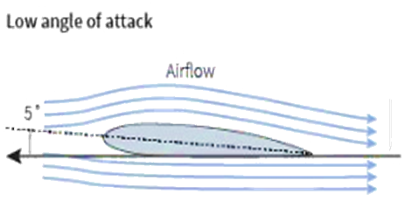
Low Angle of Attack
Typical for Cruise Phase of Flight
Relative wind impacts leading edge just below center
Higher speed of relative wind on top of wing produces the needed lift
Smooth airflow over the airfoil
Stable flight characteristics
Notes:
Low Angle of Attack:
Typical for a Cruise Phase of Flight
Relative wind impacts leading edge just below center
Higher speed of relative wind produces the needed lift
Smooth airflow over the airfoil
Stable flight characteristics
Responsive to control input
This AoA is typical of an airplane in cruise flight. The air separates cleanly just below the center of the leading edge of the airfoil, so it is not as disturbed as it flows over the top surface of the wings as it is with a higher AoA. The airflow is smooth over the airfoil and the high velocity of the air over the airfoil produces the lift needed for level flight. In these conditions the wing is stable and responsive to control input.
(Next Slide)

Slide 12
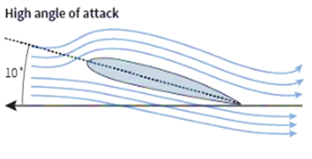
High Angle of Attack
Typical of Approach and Departure phases of Flight
Relative wind impacts airfoil lower on the leading edge
Lift is produced by accelerated airflow over the top of the airfoil
Feels less stable due to less responsive controls
Still a safe condition because the aircraft is still maneuverable and completely controllable
Notes:
High Angle of Attack
Typical of Approach and Departure phases of Flight
Relative wind impacts airfoil lower on the leading edge
Lift is produced by accelerated airflow over the top of the airfoil
Feels less stable due to less responsive controls
Still a safe condition because the aircraft is still maneuverable and completely controllable
This is typical of lower airspeed operations such as approach or departure phase of flight. The relative wind impacts the leading edge further down from the center, so the flow of air becomes more accelerated (Bernoulli’s Principle) as it flows over the upper surface of the wing. The pressure difference is greater between the underside and the top of the wing generating the lift needed for level flight. The airplane feels less stable because the flight controls are not as responsive and require greater amounts of input for a given reaction. This condition is still safe because the airplane is completely controllable and maneuverable.
(Next Slide)

Slide 13
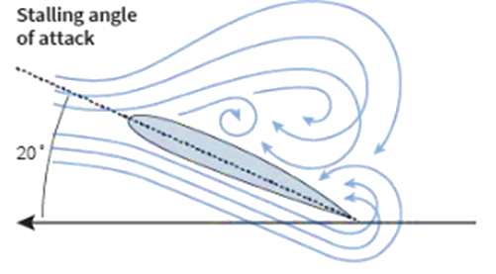
Critical Angle of Attack or Stalling AoA
Not a Normal Phase of Flight
Impact of Relative Wind moves low on the leading edge
The air cannot smoothly flow from the leading edge to the trailing edge across the top of the airfoil
The separation of the airflow results in the loss of lift otherwise known as a stall
Notes:
Critical Angle of Attack or Stalling AoA
Not a Normal Phase of Flight
Impact of Relative Wind moves lower on the leading edge
The air cannot smoothly flow from the leading edge to the trailing edge across the top of the airfoil
The separation of the airflow results in the loss of lift otherwise known as a stall
No matter how you reach this AoA (intended or unintended) this is NOT a normal phase of flight. While the reaction of the airplane is predictable, the pilot is not in control of the airplane in terms of being able to maneuver using control surface input, until the AoA is reduced, and the surface of the wing begins producing lift. Once the Critical AoA is reached there is always a cost in terms of loss of altitude that can only be mitigated by timely addition of thrust and smooth accurate control inputs during recovery.
The relative wind impacts the leading edge significantly below the center such that the airflow separates shortly after reaching the upper surface of the wing. The low pressure above the wing becomes a burbling air mass that is no longer attached to the surface and cannot produce lift.
(Next Slide)

Slide 14
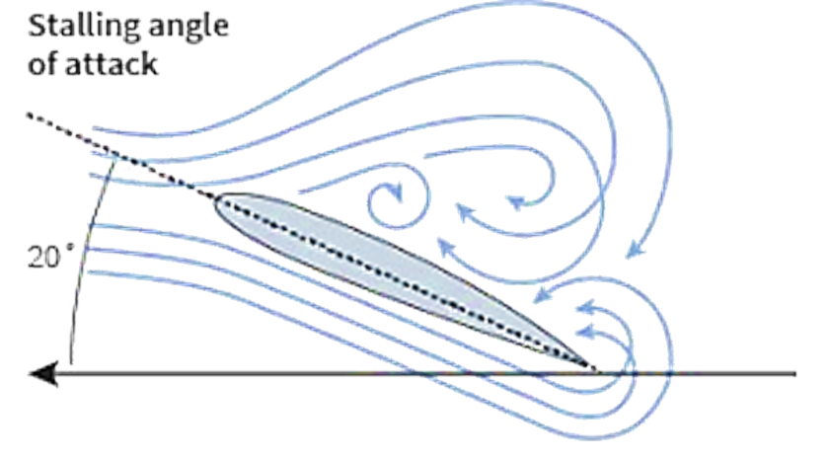
Critical Angle of Attack or Stalling AoA
Notes:
The critical AoA is an aerodynamic constant at which the airfoil will always stall
It does not matter if the relative wind is flowing at 60 knots or 200 knots, when the wing reaches the critical AoA – IT WILL STALL!
It is important to understand that the Critical AoA is an aerodynamic constant for a given airfoil in a given configuration. The velocity of the relative wind does not matter; the airfoil will ALWAYS stall when the Critical AoA is reached.
(Next Slide)

Slide 15
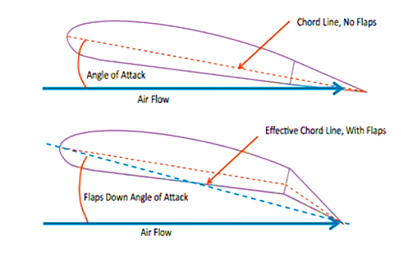
How do Flaps Effect AoA?
Flaps extended - the chord line of the wing is shifted
Trailing edge of the wing is lowered into the relative wind increasing the AoA
If No other control input, the airplane will initially begin to climb.
Notes:
The practical description of the effect that is felt by the pilot of an airplane.
As flaps are extended the effective chord line of the wing is shifted
The trailing edge of the wing is lowered into the relative wind increasing the AoA
If there is no other control input the airplane will initially begin to climb.
We are all trained from the very beginning on what to expect and how to respond when we lower flaps. Viewed from the perspective of an aeronautical engineer lowering the flaps creates a completely different airfoil. All of the components have changed including the actual Critical AoA. We do not need to make a science project out of describing all the changes that just occurred for the purposes of this discussion as long a we remain aware of how to maintain safe flight in the new configuration.
(Next Slide)

Slide 16
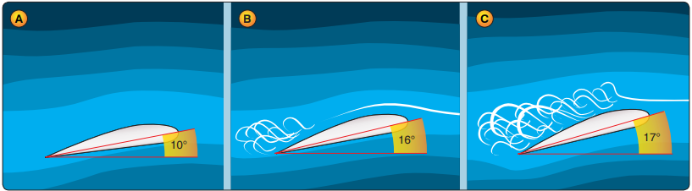
Critical AoA (Stalls) in Steep turns
(Example) In level flight to maintain altitude and Maneuvering Speed may require 8 to 10 degrees AoA leaving 6 to 8 degrees AoA before the air separates from the wing and the stall sequence begins.
Notes:
Presentation Note: Slides 16 and 17 are used in combination to show the difference in AoA being established in level flight versus steep turns (block A).
In level flight to maintain altitude and Maneuvering Speed may require 8 to 10 degrees AoA leaving 6 to 8 degrees AoA before the air separates from the wing and the stall sequence begins.
(Next Slide)

Slide 17
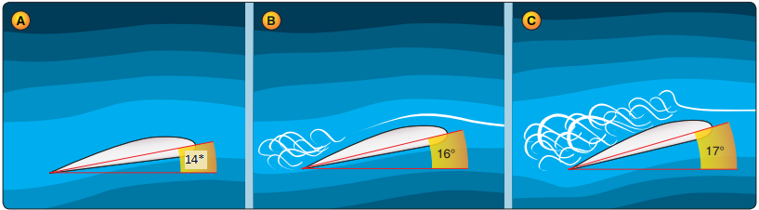
Critical AoA (Stalls) in Steep Turns
(Example) In a steep turn maintaining Maneuvering Speed and a constant altitude may require 14 degrees AoA leaving only 2 degrees AoA before the stall sequence begins.
Notes:
Presentation Note: Slides 16 and 17 are used in combination to show the difference in AoA being established in level flight versus steep turns (block A).
In a steep turn maintaining Maneuvering Speed and a constant altitude may require 14 degrees AoA leaving only 2 degrees AoA before the stall sequence begins.
(Next Slide)

Slide 18
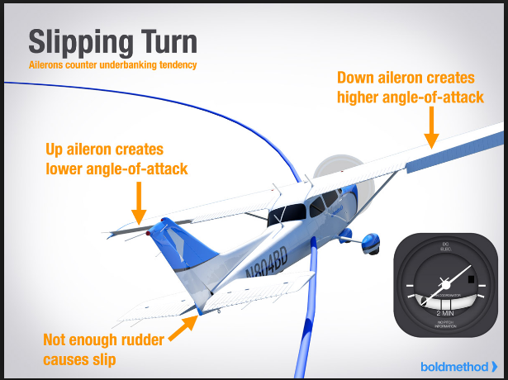
Uncoordinated Flight – Slips
Slips are not as inherently dangerous as skids because the upper wing reaches Critical AoA before the lower wing causing the airplane to roll towards wings level.
Thanks to www.boldmethod.com for the graphic illustration.
Notes:
Slips are not as inherently dangerous because the upper wing reaches Critical AoA before the lower wing causing the airplane to roll towards wings level.
Presentation note: Some resources for review on Slips and Skids:
Pilot Handbook of Aeronautical knowledge Chapter 5
http://www.boldmethod.com/learn-to-fly/aerodynamics/slip-skid-stall/
http://flighttrainingcenters.com/training-aids/private-pilot/pre-solo/slips-forward-and-side/
(Next Slide)

Slide 19
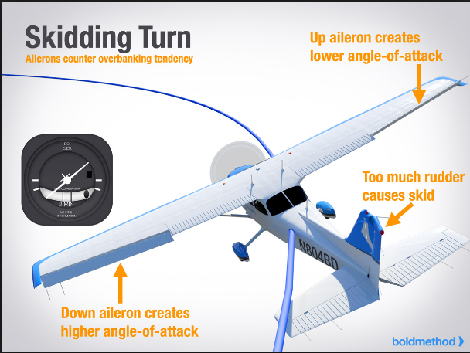
Uncoordinated Flight – Skids
Skids on the other hand are highly dangerous because the low wing reaches Critical AoA first, and the airplane rolls aggressively in the direction of the bank.
Thanks to www.boldmethod.com for the graphic illustration.
Notes:
Skids on the other hand are highly dangerous because the low wing reaches Critical AoA first, and the airplane rolls aggressively in the direction of the bank.
The airplane can rapidly roll inverted or enter a spin.
This is typical of the accidents resulting from a turn from base to final with a tailwind.
The pilot should never try to “push” the airplane through the turn with excess rudder pressure.
IF YOU ARE OVER-SHOOTING FINAL IT IS TIME TO GO-AROUND
Presentation Note: All unintended stalls are dangerous. The statements above indicate a comparison between Slips and Skids.
Some resources for review on Slips and Skids:
Pilot Handbook of Aeronautical knowledge Chapter 5
http://www.boldmethod.com/learn-to-fly/aerodynamics/slip-skid-stall/
http://flighttrainingcenters.com/training-aids/private-pilot/pre-solo/slips-forward-and-side/
(Next Slide)

Slide 20
Uncoordinated Flight - Skids
All unintended stalls are dangerous.
Accident statistics show that overshooting final is particularly fatal.
Pilots get focused on making it work.
If you are turning from base to final with a tailwind and you are overshooting final, GO-AROUND.
As soon as the airplane enters a skidding turn close to the ground you are in a dangerous situation.
Notes:
All unintended stalls are dangerous.
Overshooting final is particularly fatal if a pilot uses excess rudder, forcing the plane into a skid at low altitude.
Pilots seem to get focused on making the approach work out. Be aware of this and DO NOT let your desire to land overcome your awareness of what is happening to the aerodynamic forces out on the wing!
If you are turning from base to final with a tailwind and you are overshooting final, GO-AROUND.
If an airplane enters a skidding turn close to the ground, you’re in a very dangerous situation.
Presentation Note: To most certificated pilots the aerodynamic condition of a skid is merely a theoretical condition. You may have demonstrated a skid at some point long ago and most of us have a sense that they are not a normal flight condition and to avoid them. What we do not know is just how fast and at what point the skidding airplane moves past the boundary of safe flight into an uncontrolled state, because this was never demonstrated, and it is arguable as to whether it should be demonstrated. The unfortunate part for many is that with a little extra pressure on the rudder the boundary was exceeded. The human warning system here needs to be paid attention too in that, ANY time we are trying to “make something work” there is ALWAYS more going wrong than what we can immediately see. We need to fly smoothly out of the situation and come back and try it again applying what we just learned about the conditions we are in. It is interesting how we break out into a cold sweat when we realize the dangerous position we put ourselves in yesterday. Wouldn't it be great if we broke out into a cold sweat just PRIOR to putting ourselves in a compromised position instead? This is called good aeronautical decision making.
(Next Slide)

Slide 21
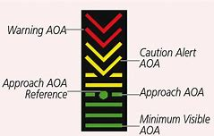
Angle of attack Indicators
The General Aviation Joint Safety Committee has recommended the use of AoA indicators as a means of reducing accidents in GA Aircraft.
Notes:
AOA indicators are appearing on many new aircraft and there are many affordable options for retrofit as well. Angle of attack sensing & display go a long way toward reducing the number of stall/spin accidents. AOA indicators graphically display the angle of attack in all configurations. They not only warn pilots when they are approaching the critical AOA but also indicate optimal AOA for climbs and approaches.
Presentation note: Discuss GAJSC recommendations, then:
(Next Slide)

Slide 22
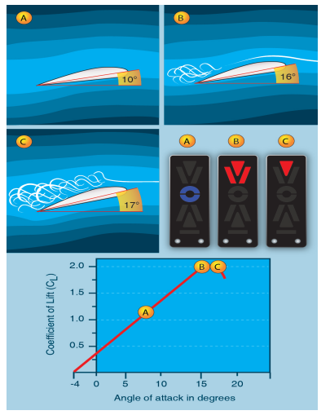
AoA Indicators
It is not enough to know what an AoA Indicator is. Training is what allows you to use it properly.
Knowledge is Power!
Notes:
It is not enough to know what an AoA Indicator is. Training is what allows you to use it properly.
AoA Indicators pretty much all work the same way. Pilots are encouraged to conduct in-flight training to see the indications throughout various maneuvers, such as slow flight, stalls, takeoffs, and landings, and to practice the appropriate responses to those indications. It is also important to note that some items may limit the effectiveness of an AOA indicator (e.g., calibration techniques, wing contamination, unheated probes/vanes). Pilots flying an airplane equipped with an AOA indicator should refer to the pilot handbook information or contact the manufacturer for specific limitations applicable to that indicator type.
(Next Slide)

Slide 23
Resources
Airplane Flying Handbook
Pilot’s Handbook of Aeronautical Knowledge
https://www.youtube.com/watch?v=8JcjWnAJGKQ
There are many good training sources on the internet including www.FAASafety.gov
Special thanks to www.boldmethod.com for sharing graphical aeronautical materials.
Notes:
Here are some resources for further study and training on AOA and AOA indicator technology.
Presentation Note: If you’ll be discussing additional items, add them to this list
(Next Slide)

Slide 24

Questions?
Notes:
Presentation Note: You may wish to provide your contact information and main FSDO phone number here. Modify with
Your information or leave blank.
(Next Slide)

Slide 25
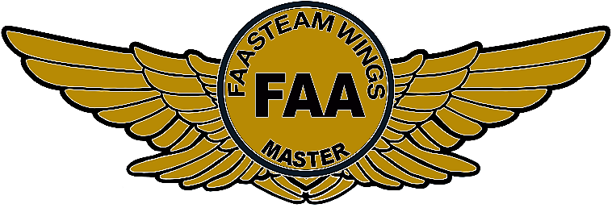
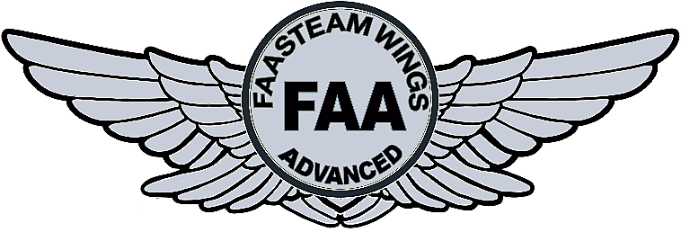
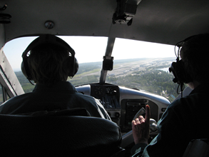
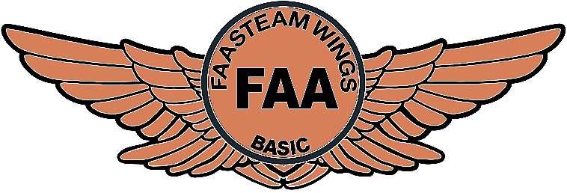
Proficiency and Peace of Mind
Fly regularly with your CFI
Perfect Practice
Document in WINGS
Notes:
There’s nothing like the feeling you get when you know you’re playing your A game and in order to do that you need a good coach (Click)
So, fly regularly with a CFI who will challenge you to review what you know, explore new horizons, and to always do your best. Of course you’ll have to dedicate time and money to your proficiency program but it’s well worth it for the peace of mind that comes with confidence. (Click)
Vince Lombardi, the famous football coach said, “Practice does not make perfect. Only perfect practice makes perfect.” For pilots that means flying with precision. On course, on altitude, on speed all the time. (Click)
And be sure to document your achievement in the Wings Proficiency Program. It’s a great way to stay on top of your game and keep you flight review current.
(Next Slide)

Slide 26



WINGS Industry Network…
The WINGS Sweepstakes, underwritten and managed by the WINGS Industry Network.
Go to the FAASTeam, Team Member Rewards page to learn more about how to enter a chance to win one of ten annual prizes.
Contest rules can be found on the WINGS Industry Network Website: wingsindustry.com
Notes:
The WINGS Sweepstakes, underwritten and managed by the WINGS Industry Network (WIN). WIN is an industry group that supports and promotes the FAA’s WINGS pilot proficiency program.
Go to the FAASTeam, Team Member Rewards page to learn more about how to enter a chance to win one of ten annual prizes. The QR code at bottom right will take you to the Team Rewards page on FAASafety.gov. Pilots and Instructors can enter the sweepstakes whenever they earn or validate a WINGS phase.
For additional information and contest rules, go to the WINGS Industry Network Website at wingsindustry.com.
(Next Slide)

Slide 27
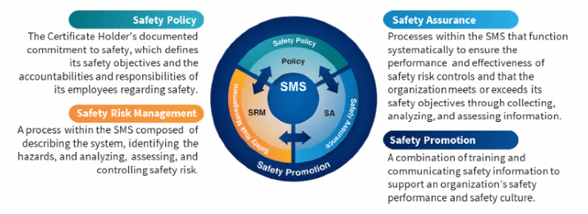

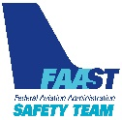
Safety Management Systems (SMS) Coming to General Aviation
https://www.faa.gov/about/initiatives/sms
Notes:
Safety Management Systems are a set of policies and processes that can increase the safety and efficiency of any flight operation. And FAA is bringing SMS to General Aviation. You may have heard of SMS but thought it was only for large organizations but actually SMS can be scaled to fit any operation large or small.
There are 4 major components to a Safety Management System (Click)
Safety Policy – a documented commitment to safety that runs from the head of an organization to its newest member. (Click)
Safety Risk Management – a process that identifies hazards within an operation, determines to what extent an identified hazard may impact flight safety, and controls the risk of occurrence to an acceptable level. (Click)
Safety Assurance – By collecting and analyzing information derived from safety performance data Safety Assurance ensures the performance and effectiveness of Safety Risk Controls. (Click)
Safety Promotion communicates safety information and commitment throughout the organization. (Click)
You can find more information about Safety Management Systems at the URL on the Screen.
(Next Slide)

Slide 28
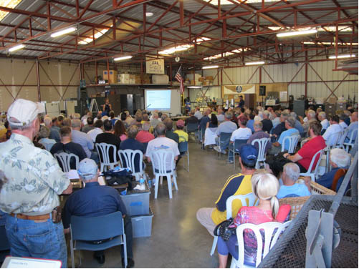
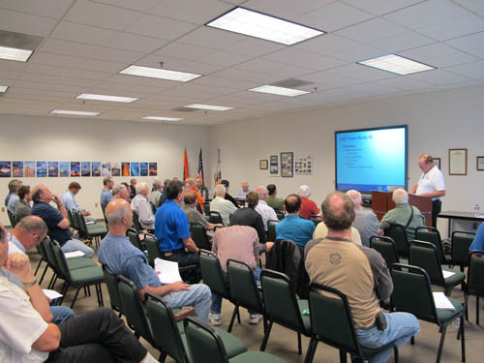
Thank you for attending!
You are vital members of our GA safety community
Notes:
Your presence here shows that you are vital members of our General Aviation Safety Community. The high standards you keep and the examples you set are a great credit to you and to GA.
Thank you for attending.
(Next Slide)

Slide 29
The FAA Safety Team Presents:
Topic of the Month – April Angle of Attack Awareness
Notes:
(The End)

